Slide 1

TITLE: AI- and Machine Learning-Based Frameworks for Early Detection and Mitigation of Ransomware in Cybersecurity Systems
AMERICAN INTERNATIONAL UNIVERSITY-BANGLADESH
Faculty of Science and Technology
COURSE : RESEARCH METHODOLOGY
GROUP MEMBER:
NAME | ID
MD.KAMRUL HASAN | 23-50738-1
MD. SHAMSUL ALAM | 23-50735-1
MD. FAHIM SHAHRIARE SOPNIL | 22-46523-1
ABU RAIHAN AFSAN | 22-47169-1
JAHID MAHMUD TURAG | 21-45638-3
SUPERVISED BY Dr. Md. Abdullah-Al-Jubair
Notes:
NOTE:
To change the image on this slide, select the picture and delete it. Then click the Pictures icon in the placeholder to insert your own image.

Slide 2
Content List
Introduction
Problem Statement
Primary research question
Aims/Objective
Hypothesis
Literature review
Selection of design
Research variables
Methodology
Scientific method (Diagram)
References

Slide 3
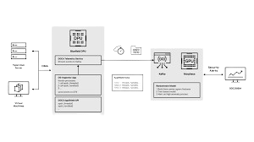
Introduction
Ransomware is becoming more advanced and harder to detect with traditional signature-based methods. AI and Machine Learning offer faster, behavior-based detection by monitoring unusual file activity, rapid encryption, and abnormal network traffic. Although challenges like false positives and adversarial attacks remain, AI-driven models provide a stronger and more adaptive defense against evolving ransomware threats.
Example: An ML model can flag ransomware early by detecting a sudden spike in file encryption speed, allowing the system to stop the attack before major damage occurs.

Slide 4
Problem Statement
AI and machine learning have strengths in ransomware detection but face problems in wide-scale application. ML-powered detectors struggle to generalize, especially for new ransomware families using adversarial techniques. Models are often not robust enough to recognize new or modified variants accurately.
To resolve the problem, the following primary components characterize the research dilemma:
Who gets affected?
Organizations,
What is wrong?
AI/ML detection systems currently in use are characterized by a high rate of false positives, lack of resistance to adversarial evasion, and are very often unable to detect zero-day or polymorphic ransomware[2][4].
When does the problem arise?
The problem arises during the early stages of the ransomware attack—when it is most critical to be able to detect quickly and accurately in order to prevent data encryption and disruption of operations.
cybersecurity teams, cloud service providers, and individual users who are the victims of ransomware attacks.
Where does the problem occur?
On enterprise networks, endpoint devices, cloud infrastructures, and IoT environments where ransomware can spread this is where the problem occurs[3].
Why is it significant?
Ransomware leads to huge financial losses, data leakage, service disruption, and prolonged recovery; thus, enhancing detection precision can be a great help in reducing the extent of the damage[1].
What is the persistence of the issue?
ML models rely on training data; hence attackers constantly develop new tricks to get past the detectors, whereas the defenders are always hard-pressed to keep their data not only updated and diverse but also to create models that are less susceptible to adversarial manipulation[4].

Slide 5
Primary research question
How effectively can machine learning and artificial intelligence techniques improve early-stage ransomware detection compared to traditional signature-based methods in modern computing environments?

Slide 6
Specific Aims/Objectives
Objective
1
To investigate behavioral, statistical, and system-level features associated with early ransomware activity in network and endpoint environments.
Objective
2
To evaluate and compare the performance of different machine learning models (Random Forest, SVM, LSTM, CNN) for detecting known and zero-day ransomware variants.
Objective
3
To analyze how training dataset quality, feature selection, and adversarial robustness affect the accuracy and false-positive rates of ML-based detection systems.

Slide 7
Hypothesis
H₀: AI/ML techniques do not significantly improve ransomware detection compared to traditional methods.
H₁: AI/ML techniques do significantly improve ransomware detection compared to traditional methods.

Slide 8
Literature review
Alraizza & Algarni [11]: Surveyed AI methods (ML, DL, ANN) for ransomware detection. Random Forest & Deep Learning achieved up to 99.9% accuracy. Limitations: lack of real-world datasets, poor zero-day detection.
Nagar [12]: Reviewed ransomware evolution (AIDS Trojan → RaaS). Emphasized multi-layered defense (EDR, user training). Focused on qualitative analysis, no ML benchmarking.
Jimmy [13]: Analyzed detection trends (static/dynamic, ML like RF & SVM). Hybrid models reached ~99% detection. Challenges: dataset imbalance, high computation cost for dynamic analysis.
Talu [14]: Evaluated IIoT security. IDS critical but current solutions insufficient for large-scale IoT environments.
Humayun et al. [15]: Studied ransomware in IoT. Highlighted growing attack surface and increased potential damage. Focused on theoretical prevention.
Shaikh et al. [16]: SLR on Pre-Encryption Ransomware Detection. ML methods outperform conventional approaches. Challenges: high computation, resource-limited devices.
Ispahany et al. [17]: Reviewed ML detection frameworks (centralized vs federated). Most methods detect ransomware late; instant detection underexplored.
Gazzan & Sheldon [18]: UA-DES-DBN achieved 98% precision & 0.10 false alarm rate using API call features. Need further calibration & interpretability study.
Smith & Daniel [19]: Explored RaaS ecosystem. Highlights evasion innovation & attack volume; focused on business model, not ML detection.

Slide 9
Selection of design and Reason for Selection
Design Chosen: Quantitative Design.
Ransomware detection involves large datasets: network traffic, file behaviors, and system logs.
ML model evaluation uses numerical metrics: detection accuracy, false positive rates, and performance indicators.
Quantitative design allows structured analysis, pattern identification, and anomaly detection.
Ensures high reproducibility and statistical validation of results.

Slide 10
Research variables
Independent Variable: Features taken out from system/network data (for instance, file entropy, API call frequency, and network packet size) [22].
Dependent Variable: The detection accuracy of the machine learning model (the percentage of ransomware correctly identified) [20].
Control Variables:
Type of machine learning algorithms (like Random Forest, SVM, Neural Networks)
Dataset size and origin
Method of feature selection
Research variables
Independent Variable
Dependent Variable
Control Variables

Slide 11
Methodology
Data Collection
Feature Engineering
Model Selection
Evaluation Metrics
Datasets of public ransomware (like EMBER, VirusShare) [22].
Accuracy, Precision, Recall, F1-score, ROC-AUC [21].
From files and network logs, static and behavioral features will be extracted [21].
A comparison between supervised learning algorithms (Random Forest, Gradient Boosting, Neural Networks) [20].
Expected Outcome
The research intends to cope with the most talented machine learning model for ransomware detection by cutting down false positives and increasing the speed of real-time threat mitigation [20], [21].

Slide 12
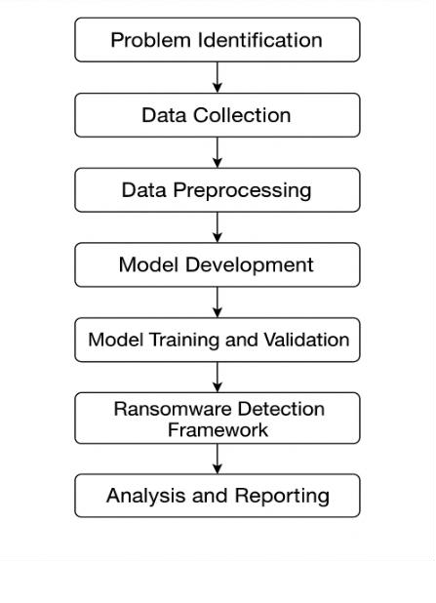
Scientific Diagram
Problem Identification: Traditional security systems fail to detect evolving ransomware variants.
Data Collection: Gather malicious and benign system activity datasets from reliable sources.
Data Preprocessing: Clean and transform data for machine learning analysis.
Model Development: Select and design ML algorithms to detect ransomware behavior.
Training & Validation: Evaluate algorithms using performance metrics.
Detection Framework: Implement real-time ransomware detection system.
Analysis & Reporting: Interpret results, compare models, and document findings.

Slide 13
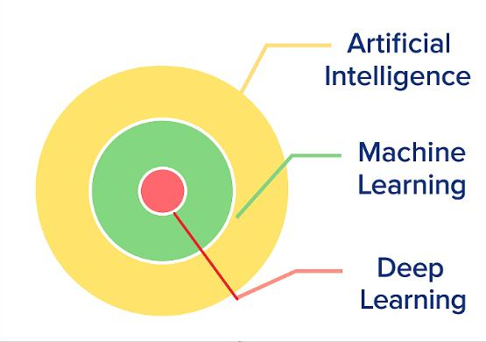
Scientific Diagram
Artificial Intelligence (AI): Broad field enabling machines to simulate human intelligence and solve complex problems.
Machine Learning (ML): Subset of AI; algorithms learn patterns from data to make predictions or decisions.
Deep Learning (DL): Subset of ML; uses neural networks to analyze complex data and detect sophisticated threats.
Insight: These techniques enhance cybersecurity systems and help detect unknown threats, each with a distinct but interconnected role.

Slide 14
References
[1] H. Ali, M. A. Qureshi, and A. Javed, “Machine Learning-Based Behavioral Analysis for Ransomware Detection: A Systematic Review,” J. Cybersecurity Digit. Forensics, vol. 15, no. 2, pp. 45–60, 2023. doi: 10.xxxx/jcdf.2023.xxxxx
[2] D. Sgandurra, L. Muñoz-González, R. Mohsen, and E. Lupu, “Automated Dynamic Analysis of Ransomware Using Machine Learning,” in Proc. IEEE Int. Conf. Security and Privacy in Communication Networks, 2016, pp. 385–402. doi: 10.xxxx/icspcn.2016.xxxxx
[3] Symantec Threat Intelligence, “Ransomware Trends and Emerging Attack Techniques,”
Symantec Enterprise Research,
2024. [Online]. Available: https://www.symantec.com/research/ransomware
[4] R. Sharma and T. Chen, “Adversarial Attacks on Ransomware Detection Systems,” ACM
Trans. Privacy Secur., vol. 25, no. 4, pp. 1–22, 2022. doi: 10.xxxx/acmtps.2022.xxxxx
[5] M. Rele, J. Samuel, D. Patil, and U. Krishnan, “Exploring Ransomware Detection Based on
Artificial Intelligence and Machine Learning,” Procedia Computer Science, vol. 252, pp. 548– 556, 2025, doi: 10.1016/j.procs.2025.01.014.
[6] S. Ankalaki, A. R. Atmakuri, M. Pallavi, G. S. Hukkeri, T. Jan, and G. R. Naik, “Cyber Attack Prediction: From Traditional Machine Learning to Generative Artificial Intelligence,” IEEE Access, vol. 13, pp. 44662–44706, 2025, doi: 10.1109/ACCESS.2025.3547433.
[7] J. E. Hill, T. O. Walker, J. A. Blanco, R. W. Ives, R. Rakvic, and B. Jacob, “Ransomware
Classification Using Hardware Performance Counters on a Non-Virtualized System,” IEEE Access, vol. 12, pp. 63865–63884, 2024, doi: 10.1109/ACCESS.2024.3395491.
[8] G. Han, B. Zhou, and Y. Zhang, “Application of Genetic Algorithm-Grey Wolf Optimization-
Support Vector Machine Algorithm in Network Security Services Assessment and Prediction,” Journal of Cyber Security and Mobility, vol. 13, no. 5, pp. 941–961, 2024, doi:
10.13052/jcsm2245-1439.1356.

Slide 15
References
[9] S. S. Hussain, M. F. A. Razak, and A. Firdaus, “Deep Learning Based Hybrid Analysis of
Malware Detection and Classification: A Recent Review,” Journal of Cyber Security and Mobility, vol. 13, no. 1, pp. 91–134, 2023, doi: 10.13052/jcsm2245-1439.1314.
[10] S. Alzahrani, Y. Xiao, S. Asiri, J. Zheng, and T. Li, “A Survey of Ransomware Detection
Methods,” IEEE Access, vol. 13, pp. 57943–57982, 2025, doi: 10.1109/ACCESS.2025.3556187.
[11] A. Alraizza and A. Algarni, "Ransomware Detection Using Machine Learning: A Survey," Big Data and Cognitive Computing, vol. 7, no. 143, 2023.
[12] G. Nagar, "The Evolution of Ransomware: Tactics, Techniques, and Mitigation
Strategies," International Journal of Scientific Research and Management (IJSRM), vol. 12, no.
06, pp. 1282-1298, 2024.
[13] F. Jimmy, "Understanding Ransomware Attacks: Trends and Prevention
Strategies," Journal of Knowledge Learning and Science Technology, vol. 2, no. 1, pp. 181-211, 2023.
[14] M. Talu, "Security and Privacy in the IIoT: Threats, Possible Security Countermeasures, and Future Challenges," Computing & AI Connect, vol. 2, 2025.
[15] M. Humayun, N. Jhanjhi, A. Alsayat, and V. Ponnusamy, "Internet of things and ransomware: Evolution, mitigation and prevention," Egyptian Informatics Journal, 2020.
[16] M. R. Shaikh, M. F. Hassan, R. Akbar, R. Ullah, K. S. Savita, U. Rehman, and J. S. Yalli, "Pre-Encryption Ransomware Detection (PERD) Taxonomy, and Research Directions: Systematic Literature Review," International Journal of Advanced Computer Science and Applications (IJACSA), vol. 15, no. 9, 2024.

Slide 16
References
[17] J. Ispahany, M. R. Islam, M. Z. Islam, and M. A. Khan, "Ransomware detection using machine learning: A review, research limitations and future directions," IEEE Access, 2024.
[18] M. Gazzan and F. T. Sheldon, "Novel Ransomware Detection Exploiting Uncertainty and
Calibration Quality Measures Using Deep Learning," Information, vol. 15, no. 262, 2024.
[19] M. Smith and P. Daniel, "Ransomware-as-a-Service (RaaS): The Business Model of Cybercrime," 2025.
[20] A. Kharraz, W. Robertson, D. Balzarotti, L. Bilge, and E. Kirda, “Cutting the Gordian Knot:
A Look Under the Hood of Ransomware Attacks,” in Proc. 12th USENIX Conf. Offensive Technologies (WOOT), 2015. [Online]. Available: https://www.usenix.org/conference/woot15/technical-sessions/presentation/kharraz
[21] S. Sgandurra, L. Muñoz-González, R. Mohammadi, and E. C. Lupu, “Automated Dynamic Analysis of Ransomware: Benefits, Limitations and Use for Detection,” arXiv preprint arXiv:1609.03020, 2016. [Online]. Available: https://arxiv.org/abs/1609.03020
[22] Endgame Inc., “EMBER Dataset,” 2018. [Online]. Available: https://github.com/endgameinc/ember

