Slide 1
BASICS OF ELECTRICAL AND ELECTRONICS ENGINEERING
M.RAJA,
ASSISTANT PROFESSOR(Senior Grade),
DEPARTMENT OF EIE,
KONGU ENGINEERING COLLEGE,
PERUNDURAI-638060.

Slide 2
UNIT – IV AC Machines and Transformers
Construction and Working Principle of Single Phase Transformer, AC Generator, Single Phase Induction Motor (Split Phase and Capacitor Start Induction Motor), Three Phase Induction Motor - DOL and Star-Delta starter- Applications.

Slide 3
TRANSFORMERS
Principle:
The transformer works on the principle of electromagnetic induction. In this case, the conductors are stationary and the magnetic flux is varying with respect to time.Thus, the induced emf comes under the classification of statically induced emf.
The transformer is a static piece of apparatus used to transfer electrical energy from one circuit to another. The two circuits are magnetically coupled. One of the circuits is energised by connecting it to a supply at specific voltage magnitude, frequency and waveform.
Then, we have a mutually induced voltage available across the second circuit at the same frequency and waveform but with a change in voltage magnitude if desired.

Slide 4
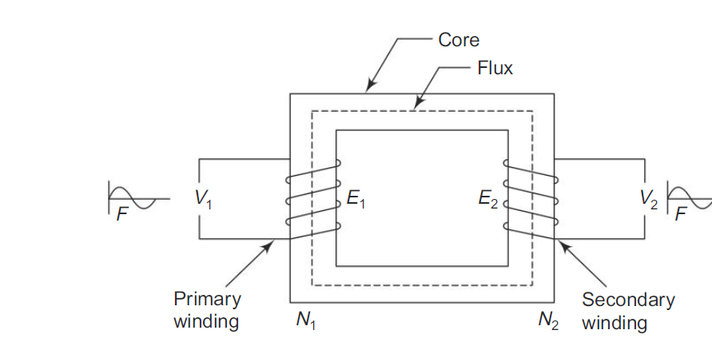

Slide 6
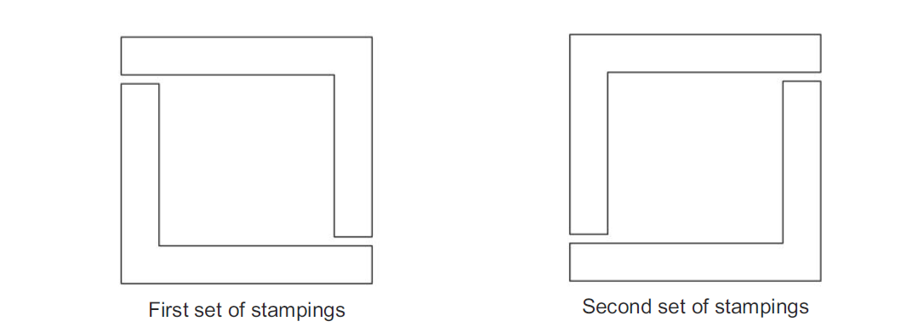

Slide 7
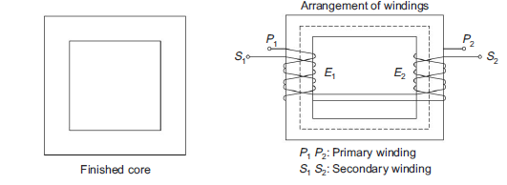

Slide 8
The following are the essential requirements of a transformer:
(a) A good magnetic core
(b) Two windings
(c) A time varying magnetic flux
The transformer core is generally laminated and is made out of a good magnetic material such as transformer steel or silicon steel. Such a material has high relative permeability and low hysteresis loss.
One type of transformer, called the core type is constructed using L-shaped laminations or stampings.

Slide 9
Working
Let us say that a transformer has N1 turns in its primary winding and N2 turns in its secondary winding. The primary winding is connected to a sinusoidal voltage of magnitude V1 at a frequency ‘f’ hertz. A working flux of f webers is set up in the magnetic core.
This working flux is alternating and sinusoidal as the applied voltage is alternating and sinusoidal.
When this flux link the primary and the secondary winding, emfs are induced in them. The emf induced in the primary is the self induced emf and that induced in the secondary is the mutually induced emf. Let the induced voltages in the primary and the secondary be E1 and E2 volts respectively.
These voltages will have sinusoidal waveform and the same frequency as that of the applied voltage. The currents which flow in the closed primary and the secondary circuits are respectively I1 and I2.

Slide 10
In any transformer,
K =N2/N1
defines the transformation ratio.
Three categories of transformer action are possible:
E2 < E1 (i.e. V2 < V1) … step down transformer
E2 = E1 (i.e. V2 = V1) … 1:1 or equal ratio transformer
E2 > E1 (i.e. V2 > V1) … Step up transformer
The induced emfs are proportional to the number of turns. In any transformer, the primary ampere turns equals the secondary ampere turns.
i.e. N1I1 = N2I2

Slide 11
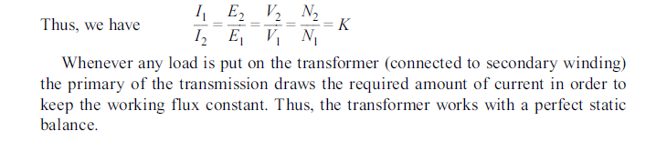

Slide 12
AC GENERATOR OR ALTERNATOR
An alternator works on the principle of electromagnetic induction. If a conductor is placed in a moving magnetic field an emf is induced in the stationery conductor as per Faraday’s first law of electromagnetic induction.
Construction:
The two important parts of AC generators are stator and rotor. The construction of ac generator showing all main parts is given in Fig.
Stator The stator consists of a cast iron or mild steel frame, which supports the armature core. This frame acts as an enclosure and provides a closed path for the magnetic flux. The armature core is made of laminated sheets. The material for armature core may be special magnetic iron or steel alloys. The inner periphery of the armature core is slotted, in order to accommodate the armature winding.
The armature winding may be single layer or double layer. The 3-phase armature winding should be a balanced one. The number of turns and size of wire should be same for all the 3-phase winding and the 3-phase winding are displaced in space by 120° (electrical) between them. The three ends of three phase winding are connected together to make the star print, and the other three terminals of the three phase windings are brought out of the generator.

Slide 13
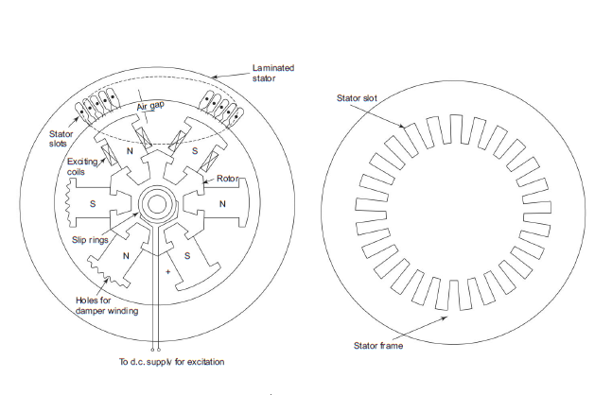

Slide 14
Rotor:
The rotor is like a flywheel having alternate N and S poles on its outer periphery.
These electromagnets are magnetised by means of low dc voltage of 125 or 250 V.
As rotor and hence the field magnets are rotating, this dc excitation voltage is given through slip rings which are fixed on the frame.

Slide 15
There are two types of rotors used in ac generators.
(i) Salient or projecting pole type: It is used for engine driven generators, which are run at low and medium speed. The rotor has even number of projecting poles,whose cores are boiled to a heavy magnetic wheel of cast iron. The axial length of rotor is short and the diameter is large.
(ii) Smooth cylindrical type: It is used for steam turbine driven generators or turbo alternators which are run at high speed. The rotor is made up of cast iron and cylindrical in shape. The outer periphery of the rotor is slotted to receive the field windings. The field windings are wound, such that N and S poles occur alternately.
The number of field poles may be two or four. The axial length of rotor is large and its diameter is less.

Slide 16
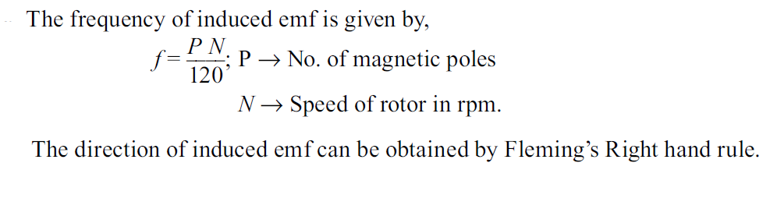
Working of Alternator
The field magnets are magnetised by applying 125 volts or 250 volts through slip rings. The field windings are connected such that, alternate N and S poles are provided.
The rotor and hence the field magnets are driven by the prime movers (steam driven turbine or engine driven).
As the rotor rotates, the armature conductors are cut by the magnetic flux. Hence emf is induced in the armature conductors. As the magnetic poles are alternately N and S pole, the emf acts in one direction and then in the other direction. Hence an alternating emf induced in the stator conductors.
The frequency of induced emf is depends on the number of N and S poles moving past an
armature conductor in one second.

Slide 17
SINGLE PHASE INDUCTION MOTORS
Single phase induction motors are widely used in domestic, industrial and machine tool applications. The capacity of this motor varies from fractional horse power to 5 HP. Fractional horse power motors are used in variety of applications.
Construction and Non-Self Starting of 1-phase Induction Motor:
The construction of 1-phase is similar to 3-phase induction motors. The starter has a single winding.
The rotor is squirrel cage type as in 3-phase induction motor. When starter winding is energised with single phase supply an alternating flux is set up,but it is not a revolving field as in 3-phase induction motor.
This alternating flux when acting on stationery motor cannot produce rotation. Only a revolving starting.However if the rotor is given an initial start by hand or by other means, then motor may start and run.

Slide 18
To make the single phase induction motors self starting, the following type of
1-phase induction motors were developed.
(a) Split-phase induction motors
(i) Resistance-start motor
(ii) Capacitor-start motor
(iii) Permanent split-capacitor motor
(iv) Two-value capacitor motor
(b) Shaded-pole induction motor
(c) Reluctance-start induction motor
(d) Repulsion-start induction motors

Slide 19
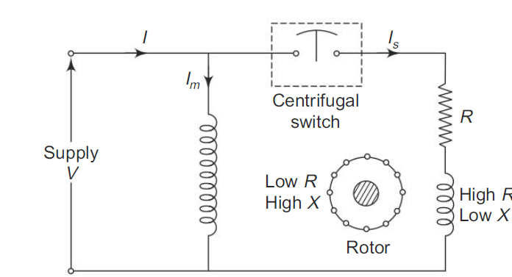
Split Phase Resistance Start 1-Phase Induction Motor
In addition to the main winding of the motor, an auxillary winding is also placed in the starter. Both these windings are uniformly distributed in the stator slots. The two windings are displaced by 90° (electrical) in space.
The main winding is called running winding and the auxillary winding is called the starting winding. The arrangement of these two windings in stator is shown in Fig.

Slide 20
The main winding is highly inductive and the auxillary winding should be highly resistive. For this purpose, the auxiliary winding is provided with less number of turns. To make it highly resistive external resistance can be used in the auxiliary winding circuit.
A centrifugal switch placed in the auxiliary winding circuit. The switch is in closed condition when the motor is at rest.
The 1-phase supply is given to the two windings, which are I parallel across the supply. The currents through the main winding and starting winding are displaced by an angle α as shown in Fig.
This angle α should be kept nearer to 90° by proper design of starting winding. The starting torque developed is proportional to sin α.
When the motor attain 75% of rated speed, the centrifugal switch is opened and hence starting winding is disconnected from the supply. The starting torque developed is 150 to 200% full load torque of the motor.

Slide 21
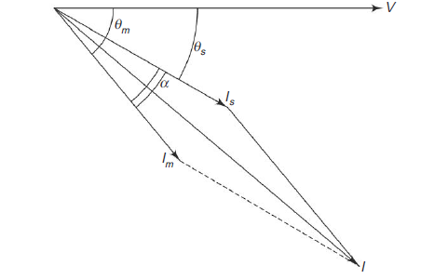
This type of motor is used in oil burns, machine tools, grinders, dish washes,washing machines, airblowers and air compressors.

Slide 22
Split Phase Capacitor Start Induction Run Single Phase Induction Motor
The single phase supply given to the stator winding, can be split into two phases by connecting a suitable capacitor in series with the starting winding, as shown in Fig.
The value of capacitance should be such that the phase angle α between Is and Im should be nearer to 90°. Then the fluxes due to this current is also displaced by the same angle α. This causes revolving field.
The starting torque developed depends on sin α. The starting torque developed is about 300 to 450% of full load torque. This is more as compared to the previous type motor as a is more here.
The value of α in the previous type motor is around 40° only. When the motor attains 75% of rated speed, the centrifugal switch opens and the starting winding is isolated from the circuit.
This motor is used where high starting torque is needed under loaded condition.
They are used for pumps, refrigerations units, air-conditioners, large size washing machines, etc.

Slide 23
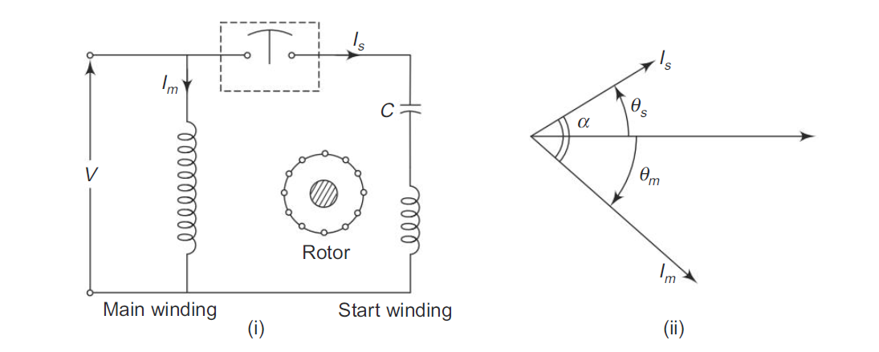
Split Phase Capacitor Start Induction Run Single Phase Induction Motor

Slide 24
THREE PHASE INDUCTION MOTOR
Principle:
When a three phase balanced voltage is applied to a three phase balanced winding, a rotating magnetic field is produced. This field has a constant magnitude and rotates in space with a constant speed. If a stationary conductor is placed in this field, an emf will be induced in it. By creating a closed path for the induced current to flow,an electromagnetic torque can be exerted on the conductor. Thus, the conductor is put in rotation.

Slide 25
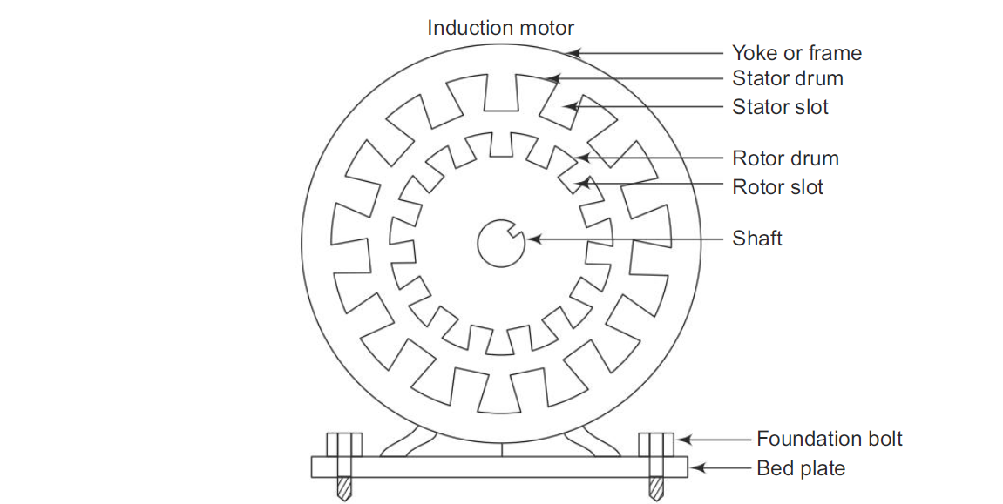
CONSTRUCTION OF THREE PHASE INDUCTION MOTOR

Slide 26
Stator: This is the stationary part of the motor. It consists of an outer solid circular metal part called the yoke or frame and a laminated cylindrical drum called the stator drum. This drum ash number of slots provided over the entire periphery of it.
Required numbers of stator conductors are embedded in the slots. These conductors are electrically connected in series and are arranged to form a balanced three phase winding. The stator is wound to give a specific number of poles.
The stator winding may be star or delta connected.
Rotor :This is the rotating part of the induction motor. It is also in the form so slotted cylindrical structure.
The air gap between stator and rotor is as minimum as mechanically possible. There are two types of rotors—squirrel cage rotor and slipring or wound rotor.

Slide 27
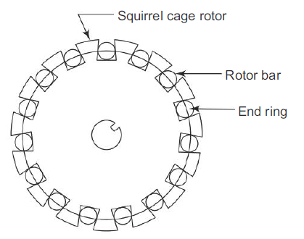
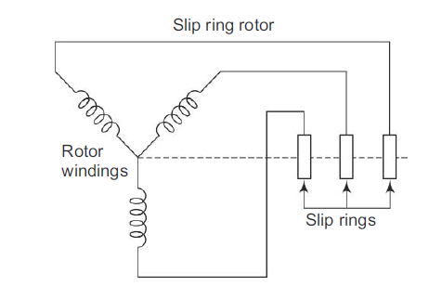
Figure 1. shows the construction of a squirrel cage rotor. in this type, each rotor slot accommodates a rod or bar made of a good conducting material.
These rotor rods are short circuited at both ends by means of end rings made of the same metal as that of the rotor conductors. Thus, the rotor circuit forms a closed path for any current to flow through.
Figure-2. shows the rotor winding of a slip ring or wound rotor. In this case, large number of conductors are embedded in the rotor slots.
These conductors are electrically connected to form a balanced three phase winding.
Again, the rotor is wound to give the same number of poles as the stator.
Three similar ends of the rotor winding are joined together thus making a common point.
The other three ends are connected to three slip rings which are mounted to the shaft.
These slip rings are used to create a short circuit among the three phase windings of the rotor.
Fig.1 Construction of squirrel cage rotor
Fig.2 -The rotor winding of a slip ring or wound rotor.

Slide 28
Working
A three phase balanced voltage is applied across the three phase balanced stator winding. A rotating magnetic field is produced. This magnetic field completes its path through the stator, the air gap and the rotor.
In this process, the rotor conductors, which are still stationary, are linked by the time varying stator magnetic field.
Therefore, an emf is induced in the rotor conductors. When the rotor circuit forms a closed path, a rotor current is circulated. Thus, the current carrying rotor conductors are placed in the rotating magnetic field.
Hence, as per the law of interaction,an electromagnetic force is exerted on the rotor conductors. Thus, the rotor starts revolving.

Slide 29
According to Lenz’s law, the nature of the rotor induced current is to oppose the cause producing it. Here the cause is the rotating magnetic field. Hence, the rotor rotates in the same direction as that of the rotating magnetic field.
In practice, the rotor speed never equals the speed of the rotating magnetic field (called the synchronous speed). The difference in the two speeds is called slip. The current drawn by the stator is automatically adjusted whenever the motor is loaded.

Slide 30
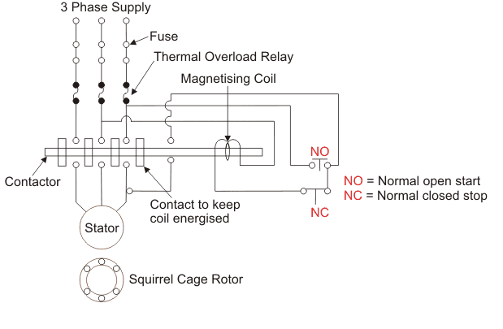
DOL Starter (Direct On Line Starter) Diagram And Working Principle
What is DOL Starter?
A DOL starter (also known as a direct on line starter or across the line starter) is a method of starting a 3 phase induction motor. In a DOL Starter, an induction motor is connected directly across its 3-phase supply, and the DOL starter applies the full line voltage to the motor terminals.

