Slide 1
BASICS OF ELECTRICAL AND ELECTRONICS ENGINEERING
M.RAJA,
ASSISTANT PROFESSOR(Senior Grade),
DEPARTMENT OF EIE,
KONGU ENGINEERING COLLEGE,
PERUNDURAI-638060.

Slide 2
UNIT – V Basic Electronics
Theory of PN Junction Diode - Operation of Rectifiers (Half wave, Full wave) and Filters - Zener Diodes - Zener Diode as Voltage Regulator - Transistors: Types - Operation of NPN Transistor - Transistor as an Amplifier - Operation and Characteristics of Thyristor: Silicon Controlled Rectifier - UPS and SMPS (Block Diagram approach).

Slide 3
SEMICONDUCTOR THEORY
Depending on their conductivity, materials can be classified into three types as conductors,semiconductors and insulators. Conductor is a good conductor of electricity.
Insulator is a poor conductor of electricity. Semiconductor has its conductivity lying between these two extremes.
Materials can be classified into these three types depending on the number of valence electrons in the atom. Electrons in the outermost orbit of an atom are valence electrons. In a good conductor, the number of valence electrons will be 1 or 2, (e.g.copper).
In an insulator, the outermost orbit will be completely filled (e.g. xenon).
In a semiconductor, the outermost orbit will be partially filled. For example, the number of valence electrons is 4 in Germanium (Ge) and Silicon (Si).

Slide 4
Energy Band Structure
The range of energies that an electrons may possess in an atom is known as the energy band. The three important energy bands are explained below.
(i) Valence Band The range of energy possessed by valence electrons is known as valence band.
(ii) Conduction Band In good conductors, the valence electrons are loosely attached to the nucleus, so that even on applications of small electric field, some of the valence electrons may get detached from the nucleus to become free electrons.
These free electrons which are responsible for the conduction of current in good conductors are called conduction electrons and the range of energies possessed by these electrons is known as conduction band.
(iii) Forbidden Band The energy band in between the conduction band and the valence band is called forbidden band.

Slide 5
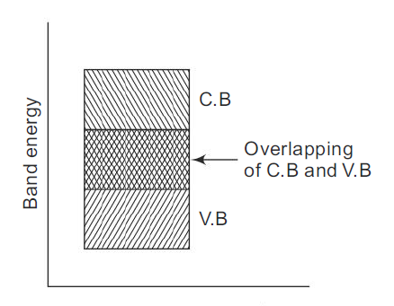
Classifications of Materials According to Energy Bands Conductor In good conductors, as shown in Fig. 1, the valence and conduction bands overlap each other.
Due to this overlapping, even the application of small electric field causes the free electrons to constitute electric current.

Slide 6
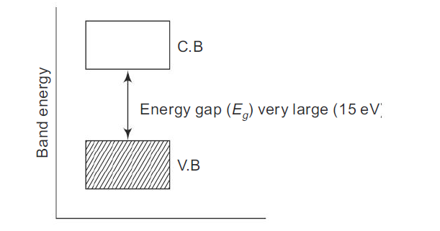
Insulator:
In insulator, as shown in Fig. , the forbidden energy gap Eg is very large and hence almost all the electrons are in the valence band and the conduction band is almost empty. Hence, no electrons are available for conduction.

Slide 7
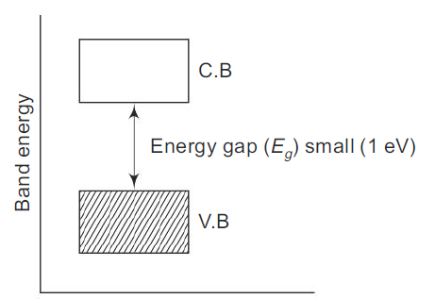
Semiconductor:
Semiconductors are those substances whose electrical conductivity lies in between conductors and insulators. In terms of energy band shown in Fig. , the valence band is almost filled (partially filled) and conduction band is almost empty.

Slide 8
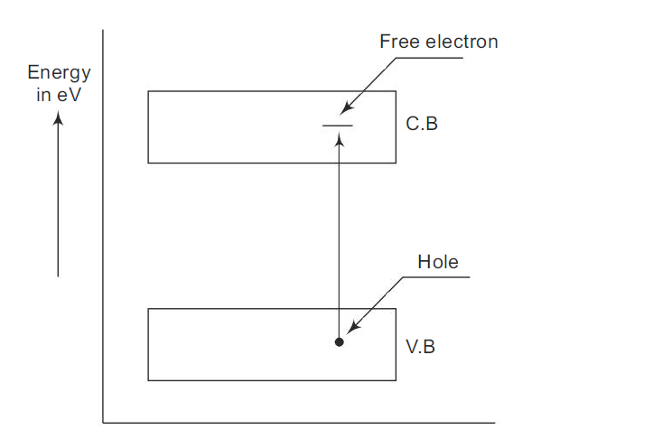

Classifications of Semiconductors
Intrinsic Semiconductor:
A pure semiconductor is called intrinsic semiconductor.
As already explained in the first chapter, even at the room temperature, some of the valence electrons may acquire sufficient energy to enter the conduction band to form free electrons.
Under the influence of electric field, these electrons constitute electric current. A missing electron in the valence band leaves a vacant space there,which is known as a hole, as shown in Fig. Holes also contribute to electric current.

Slide 9
In an intrinsic semiconductor, even at room temperature, electron-hole pairs are created. When electric field is applied across an intrinsic semiconductor, the current conduction takes place by two processes, namely, free electrons and holes.
Under the influence of electric field, total current through the semiconductor is the sum of currents due to free electrons and holes.
Though the total current inside the semiconductor is due to free electrons and holes, the current in the external wire is fully by electrons. In Fig., holes being positively charged move towards the negative terminal of the battery.
As the holes reach the negative terminal of the battery, electrons enter the semiconductor near the terminal (X ) and combine with the holes.
At the same time the loosely held electrons near the positive terminal (Y ) are attracted away from their atoms into the positive terminal. This creates new holes near the positive terminal which again drift towards the negative terminal.

Slide 10
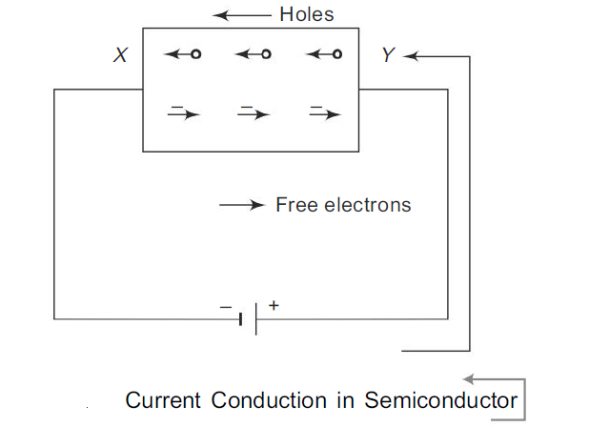

Slide 11
Extrinsic Semiconductor Due to the poor conduction at room temperature, the intrinsic semiconductor, as such, is not useful in the electronic devices. Hence the current conduction capability of the intrinsic semiconductor should be increased.
This can be achieved by adding a small amount of impurity to the intrinsic semiconductor, so that it becomes impurity semiconductor or extrinsic semiconductor. This process of adding impurity is known as doping.
The amount of impurity added is extremely small, say 1 to 2 atoms of impurity for10^6 intrinsic atoms.
N-type Semiconductor :A small amount of pentavalent impurities such as arsenic, antimony or phosphorus is added to the pure semiconductor (germanium or silicon crystal) to get N-type semiconductor.
Germanium atom has four valence electrons and antimony has five valence electrons.
As shown in Fig., each antimony atom forms a covalent bond with surrounding four germanium atoms. Thus four valence electrons of antimony atom form covalent bond with four valence electrons of individual germanium atom and fifth valence electron is left free which is loosely bound to the antimony atom.

Slide 12
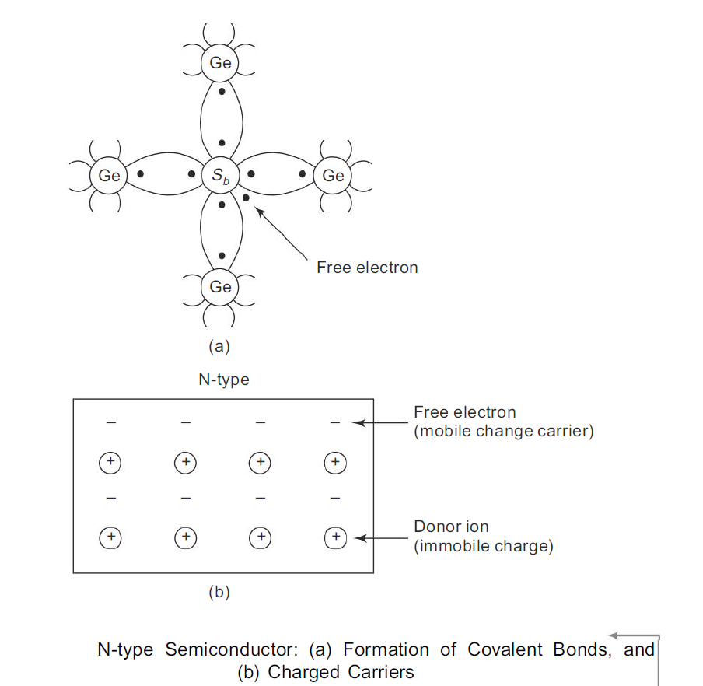

Slide 13
This loosely bound electron can be easily excited from the valence band to the conduction band by the application of electric field or increasing the thermal energy.
Thus every antimony atom contributes one conduction electron without creating a hole.
Such pentavalent impurities are called donor impurities because it donates one electron for conduction.
On giving an electron for conduction, the donor atom becomes positively charged ion because it loses one electron. But it cannot take part in conduction because it is firmly fixed in the crystal lattice.
Thus, the addition of pentavalent impurity (antimony) increases the number of electrons in the conduction band thereby increasing the conductivity of N-type semiconductor.
As a result of doping, the number of free electrons far exceeds the number of holes in an N-type semiconductor. So electrons are called majority carriers and holes are called minority carriers.

Slide 14
P-type Semiconductor A small amount of trivalent impurities such as aluminium or boron is added to the pure semiconductor to get the P-type semiconductor.
Germanium (Ge) atom has four valence electrons and boron has three valence electrons as shown in Fig.
Three valence electrons in boron form covalent bond with four surrounding atoms of Ge leaving one bond incomplete which gives rise to a hole. Thus trivalent impurity (boron) when added to the intrinsic semiconductor (germanium) introduces a large number of holes in the valence band.
These positively charged holes increase the conductivity of P-type semiconductor.
Trivalent impurities such as boron is called acceptor impurity because it accepts free electrons in the place of holes.
As each boron atom donates a hole for conduction, it becomes a negatively charged ion. As the number of holes is very much greater than the number of free electrons in a P-type material, holes are termed as majority carriers and electrons as minority carriers.

Slide 15
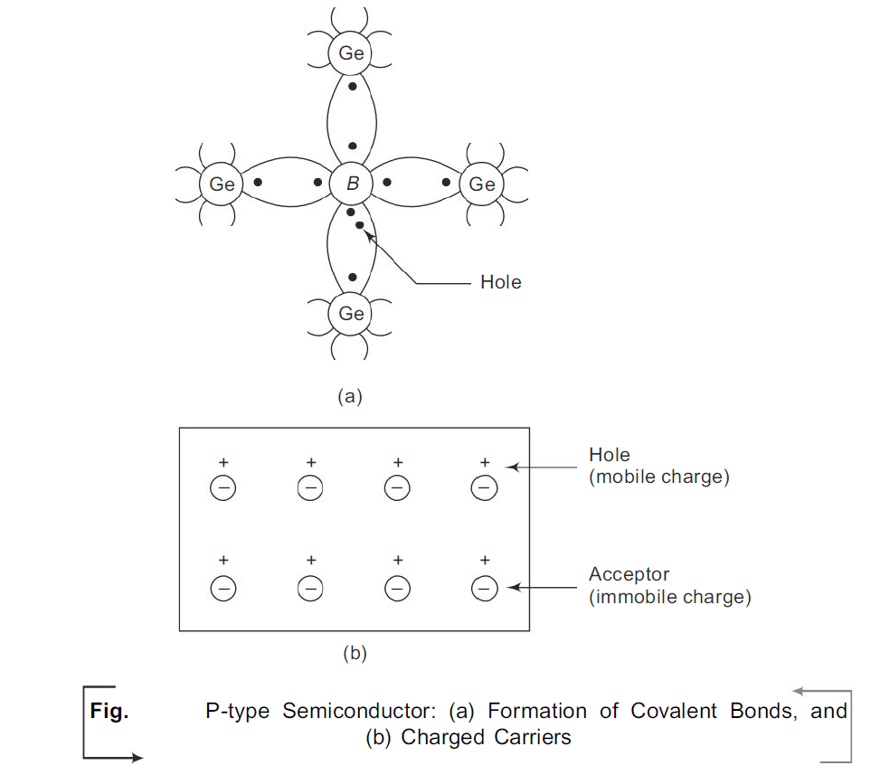

Slide 16
PN JUNCTION DIODE
In a piece of semiconductor material, if one half is doped by P-type impurity and the other half is doped by N-type impurity, a PN junction is formed. The plane dividing the two halves or zones is called PN junction.
As shown in Fig., the N-type material has high concentration of free electrons while P-type material has high concentration of holes. Therefore at the junction there is a tendency for the free electrons to diffuse over to the P-side and holes to the N-side. This process is called diffusion.
As the free electrons move across the junction from N-type to P-type, the donor ions become positively charged. Hence a positive charge is built on the N-side of the junction.
The free electrons that cross the junction uncover the negative acceptor ions by filling in the holes. Therefore a net negative charge is established on the P-side of the junction.

Slide 17
This net negative charge on the P-side prevents further diffusion of electrons into the P-side. Similarly, the net positive charge on the N-side repels the holes crossing from P-side to N-side.
Thus a barrier is set up near the junction which prevents further movement of charge carriers, i.e. electrons and holes. This is called potential barrier or junction barrier V0. V0 is 0.3 V for germanium and 0.72 V for silicon.
The electrostatic field across the junction caused by the positively charged N-type region tends to drive the holes away from the junction and negatively charged P-type region tends to drive the electrons away from the junction. Thus the junction region is depleted to mobile charge carriers. Hence it is called depletion layer.

Slide 18
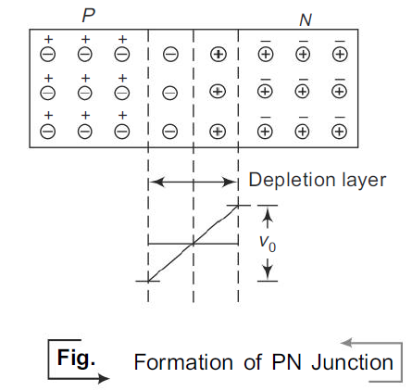

Slide 19
Under Forward Bias Condition
When positive terminal of the battery is connected to the P-type and negative terminal to the N-type of the PN junction diode, the bias applied is known as forward bias.
Operation As shown in Fig., the applied potential with external battery acts in opposition to the internal potential barrier.
Under the forward bias condition, the applied positive potential repels the holes in P-type region so that the holes move towards the junction and the applied negative potential repels the electrons in the N-type region and the electrons move towards the junction.
Eventually when the applied potential is more than the internal barrier potential, the depletion region and internal potential barrier disappear.

Slide 20
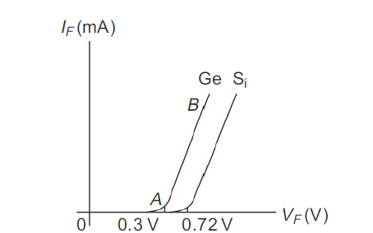
V–I Characteristics of a Diode Under Forward Bias
Under forward bias condition, the V–I characteristics of a PN junction diode are shown in Fig. As the forward voltage (VF) is increased, for VF < V0, the forward current IF is almost zero (region OA), because the potential barrier prevents the holes from P-region and electrons from N-region to flow across the depletion region in the opposite direction.
For VF > V0, the potential barrier at the junction completely disappears and hence, the holes cross the junction from P-type to N-type and the electrons cross the junction in the opposite direction, resulting in relatively large current flow in the external circuit.

Slide 21
A feature worth noting in the forward characteristics shown in Fig. is the cut in or threshold voltage (Vr) below which the current is very small. It is 0.3 V and 0.72 V for germanium and silicon respectively.
At the cut in voltage, the potential barrier is overcome and the current through the junction starts to increase rapidly.

Slide 22
Under Reverse Bias Condition
When the negative terminal of the battery is connected to the P-type and positive terminal of the battery is connected to the N-type of the PN junction, the bias applied is known as reverse bias.
Operation Under applied reverse bias as shown in Fig., holes which form the majority carriers of the P-side move towards the negative terminal of the battery and electrons which form the majority carrier of the N-side are attracted towards the positive terminal of the battery.
Hence the width of the depletion region which is depleted of mobile charge carriers increases. Thus the electric field produced by applied reverse bias, is in the same direction as the electric field of the potential barrier.
Hence, the resultant potential barrier is increased, which prevents the flow of majority carriers in both directions. Therefore, theoretically no current should flow in the external circuit. But in practice, a very small current of the order of a few microamperes flows under reverse bias as shown in Fig.

Slide 23
Electrons forming covalent bonds of the semiconductor atoms in the P- and N-type regions may absorb sufficient energy from heat and light to cause breaking of some covalent bonds.
Hence electron–hole pairs are continually produced in both the regions. Under the reverse bias condition, the thermally generated holes in the P-region are attracted towards the negative terminal of the battery and the electrons in the N-region are attracted towards the positive terminal of the battery.
Consequently, the minority carriers, electrons in the P-region and holes in the N-region, wander over to the junction and flow towards their majority carrier side giving rise to a small reverse current.
This current is known as reverse saturation current. The magnitude of reverse saturation current mainly depends upon junction temperature because the major source of minority carriers is thermally broken covalent bonds.

Slide 24
For large applied reverse bias, the free electrons from the N-type moving towards the positive terminal of the battery acquire sufficient energy to move with high velocity to dislodge valence electrons from semiconductor atoms in the crystal.
These newly liberated electrons, in turn, acquire sufficient energy to dislodge other parent electrons. Thus, a large number of free electrons are formed which is commonly called as an avalanche of free electrons.
This leads to the breakdown of the junction leading to very large reverse current. The reverse voltage at which the junction breakdown occurs is known as breakdown voltage.

Slide 25
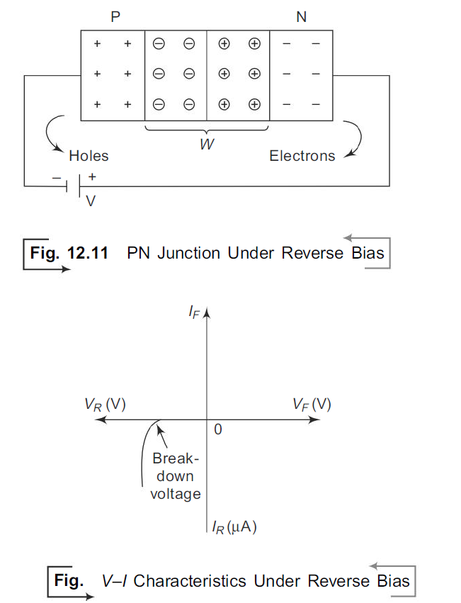

Slide 26
The PN junction diode will perform satisfactorily only if it is operated within certain limiting values. They are:
(i) Maximum forward current It is the highest instantaneous current under forward bias condition that can flow through the junction.
(ii) Peak inverse voltage It is the maximum reverse voltage that can be applied to the PN junction. If the voltage across the junction exceeds PIV, under reverse bias condition, the junction gets damaged.
(iii) Maximum power rating It is the maximum power that can be dissipated at the junction without damaging the junction. Power dissipation is the product of voltage across the junction and current through the junction.

Slide 27
PN DIODE APPLICATIONS
An ideal PN junction diode is a two terminal polarity sensitive device that has zero resistance (diode conducts) when it is forward biased and infinite resistance (diode does not conduct) when reverse biased.
Due to this characteristic the diode finds a,number of applications as follows.
(i) rectifiers in dc power supplies
(ii) switch in digital logic circuits used in computers
(iii) clamping network used as dc restorer in TV receivers and voltage multipliers
(iv) clipping circuits used as wave shaping circuits used in computers, radars,radio and TV receivers
(v) demodulation (detector) circuits.
The same PN junction with different doping concentration finds special applications as follows:
(i) detectors (APD, PIN photo diode) in optical communication circuits
(ii) Zener diodes in voltage regulators
(iii) varactor diodes in tuning sections of radio and TV receivers
(iv) light emitting diodes in digital displays
(v) LASER diodes in optical communications
(vi) Tunnel diodes as a relaxation oscillator at microwave frequencies.

Slide 28
ZENER DIODE
When the reverse voltage reaches breakdown voltage in normal PN junction diode, the current through the junction and the power dissipated at the junction will be high.
Such an operation is destructive and the diode gets damaged. Whereas diodes can be
designed with adequate power dissipation capabilities to operate in the breakdown region. One such a diode is known as Zener diode. Zener diode is heavily doped than
the ordinary diode.
From the V–I characteristics of the Zener diode, shown in Fig., it is found that the operation of Zener diode is same as that of ordinary PN diode under forward biased condition. Whereas under reverse-baised condition, breakdown of the junction occurs. The
breakdown voltage depends upon the amount of doping. If the diode is heavily doped, depletion layer will be thin and, consequently, breakdown occurs at lower reverse voltage and further, the breakdown voltage is sharp. Whereas a lightly doped diode has a higher breakdown voltage.
Thus breakdown voltage can be selected with the amount of doping.

Slide 29
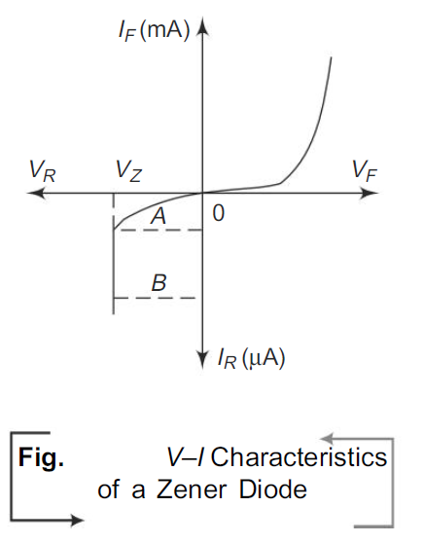
The sharp increasing current under breakdown conditions are due to the following two
mechanisms.
(1) Avalanche breakdown
(2) Zener breakdown.

Slide 30
Avalanche Breakdown
As the applied reverse bias increases, the field across the junction increases correspondingly.
Thermally generated carriers while traversing the junction acquire a large amount of kinetic energy from this field. As a result the velocity of these carriers increases. These electrons disrupt covalent bonds by colliding with immobile ions and create new electron-hole pairs.
These new carriers again acquire sufficient energy from the field and collide with other immobile ions thereby generating further electron–hole pairs.
This process is cumulative in nature and results in generation of avalanche of charge carriers within a short time. This mechanism of carrier generation is known as Avalanche multiplication. This process results in flow of large amount of current at the same value of reverse bias.

Slide 31
Zener Breakdown
When the P and N regions are heavily doped, direct rupture of covalent bonds takes place because of the strong electric fields, at the junction of PN diode.
The new electron-hole pairs so created increase the reverse current in a reverse biased PN diode.
The increase in current takes place at a constant value of reverse bias typically below 6 V for heavily doped diodes. As a result of heavy doping of P and N regions, the depletion region width becomes very small and for an applied voltage of 6 V or less, the field across the depletion region becomes very high, of the order of 10^7 V/m, making conditions suitable for Zener breakdown.
For lightly doped diodes, Zener breakdown voltage becomes high and breakdown is then predominantly by Avalanche multiplication.
Though Zener breakdown occurs for lower breakdown voltage and Avalanche breakdown occurs for higher breakdown voltage, such diodes are normally called Zener diodes.

Slide 32
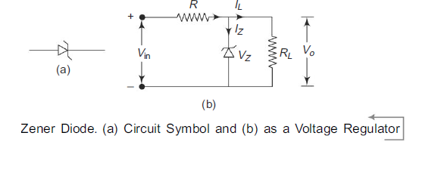
Applications
From the Zener characteristics shown in Fig., under the reverse bias condition, the voltage across the diode remains almost constant although the current through the diode increases as shown in region AB. Thus, the voltage across the Zener diode serves as a reference voltage. Hence, the diode can be used as a voltage regulator.
In Fig. it is required to provide constant voltage across load resistance RL, whereas the input voltage may be varying over a range. As shown, Zener diode is reverse biased and as long as the input voltage does not fall below VZ (Zener breakdown voltage), the voltage across the diode will be constant and hence the load voltage will also be constant.

Slide 33
RECTIFIERS
Rectifier is defined as an electronic device used for converting ac voltage into unidirectional
voltage. A rectifier utilizes unidirectional conduction device like a vacuum diode or PN junction diode. Rectifiers are classified depending upon the period of conduction as Half-wave rectifier and Full-wave rectifier.
Half-wave Rectifier:
It converts an ac voltage into a pulsating dc voltage using only one half of the applied ac voltage. The rectifying diode conducts during one half of the ac cycle only. Figure shows the basic circuit and waveforms of a half wave rectifier.

Slide 34
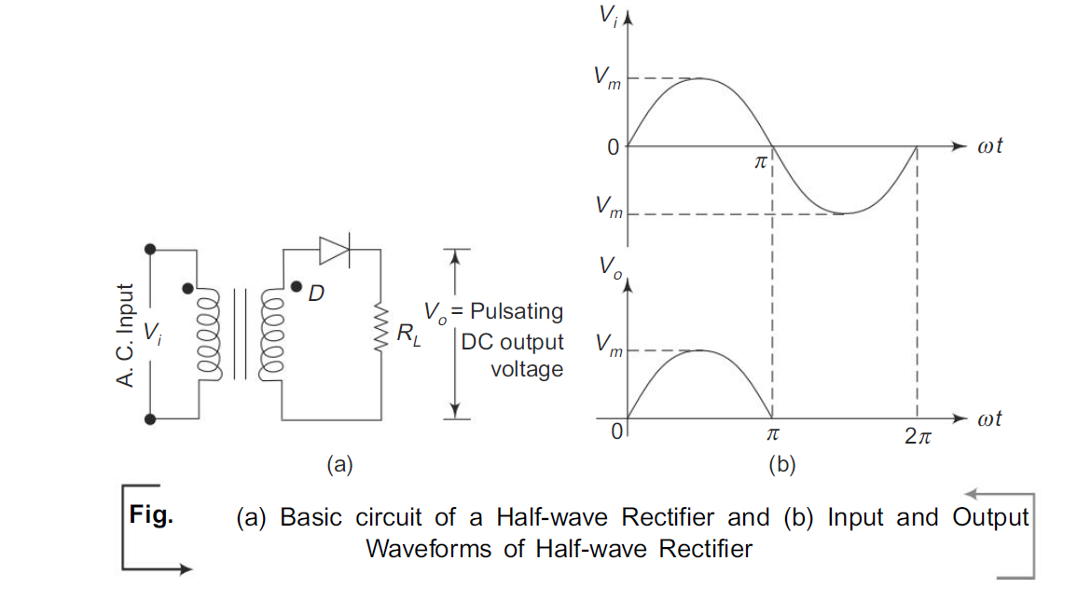

Slide 35
Let Vi be the voltage to the primary of the transformer and given by the equation
Vi = Vm sin ω t; Vm >> Vr
where Vr is the cut-in voltage of the diode. During the positive half-cycle of the input signal, the anode of the diode becomes more positive with respect to the cathode and hence, diode D conducts.
For an ideal diode, the forward voltage drop is zero. So the whole input voltage will appear across the load resistance, RL.
During negative half-cycle of the input signal, the anode of the diode becomes negative with respect to the cathode and hence, diode D does not conduct. For an ideal diode, the impedance offered by the diode is infinity. So the whole input voltage appears across diode D. Hence, the voltage drop across RL is zero.

Slide 36
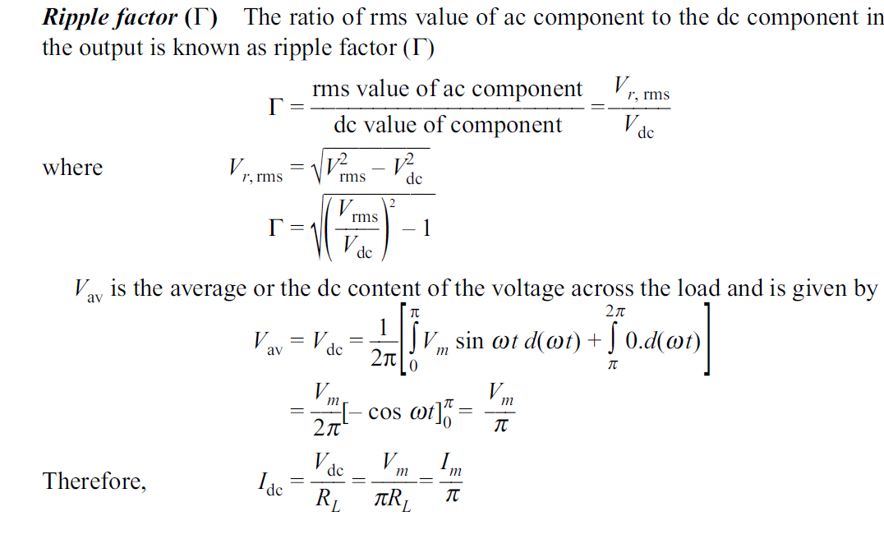

Slide 37
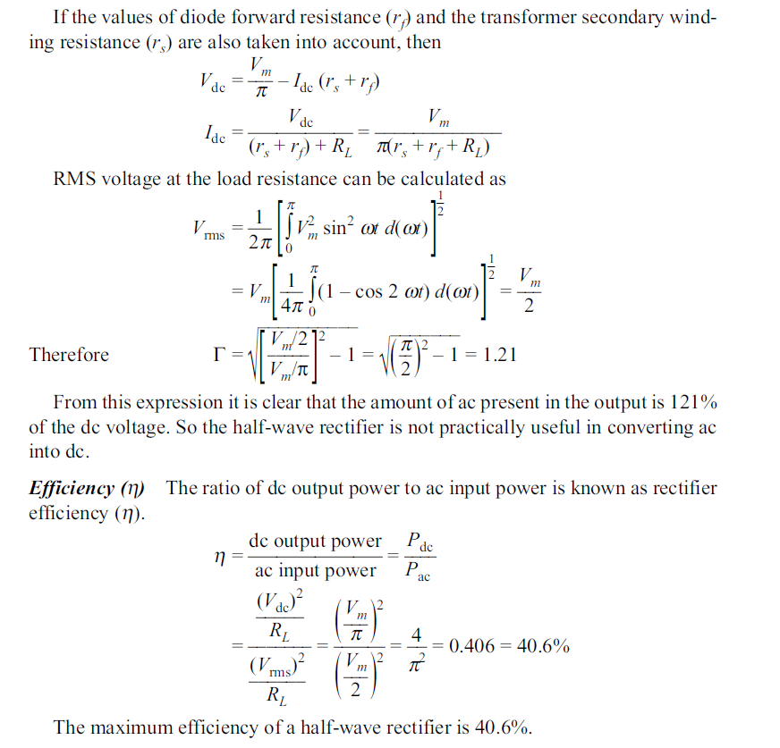

Slide 38
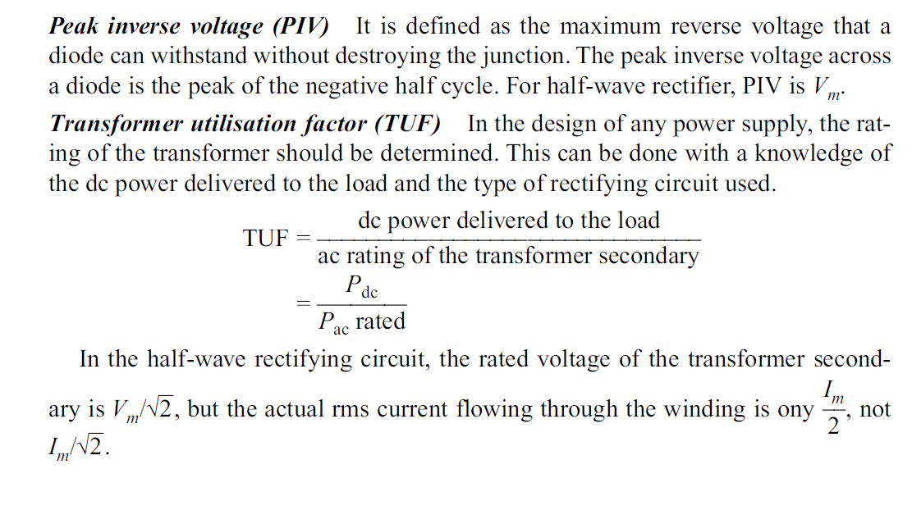

Slide 39
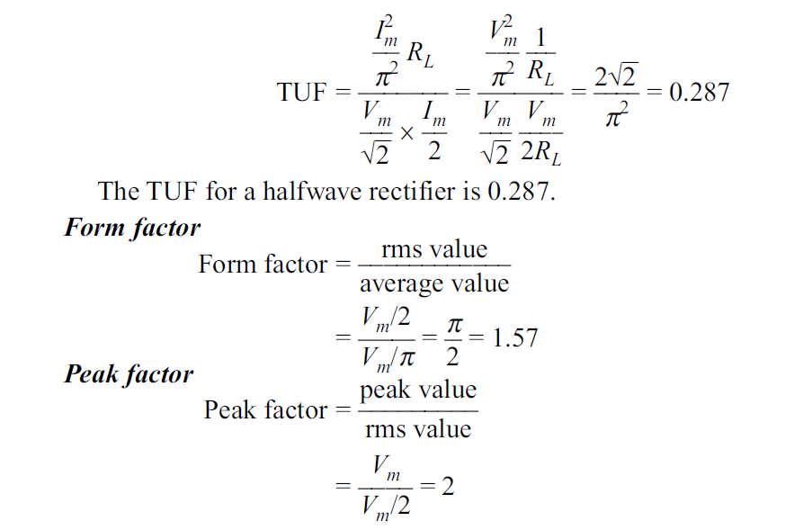

Slide 40
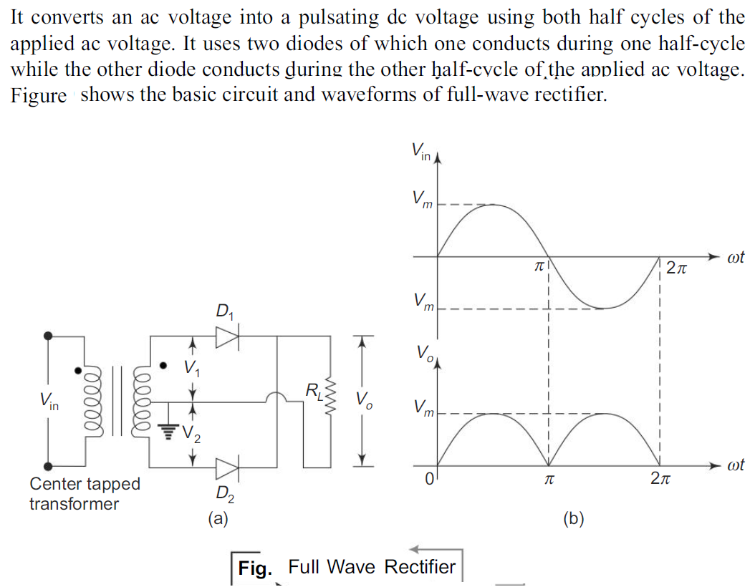
Full-wave Rectifier

Slide 41
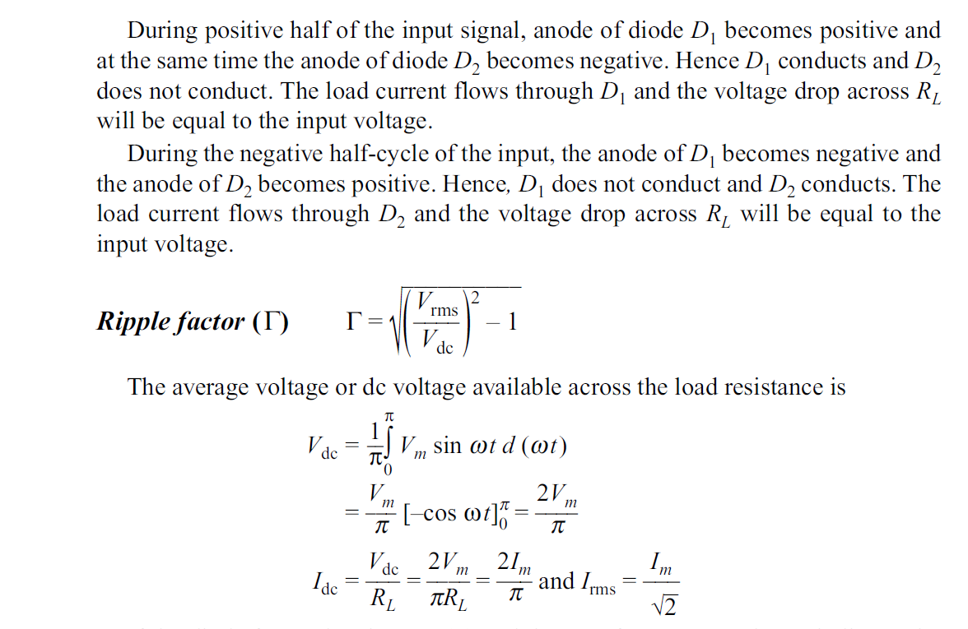

Slide 42
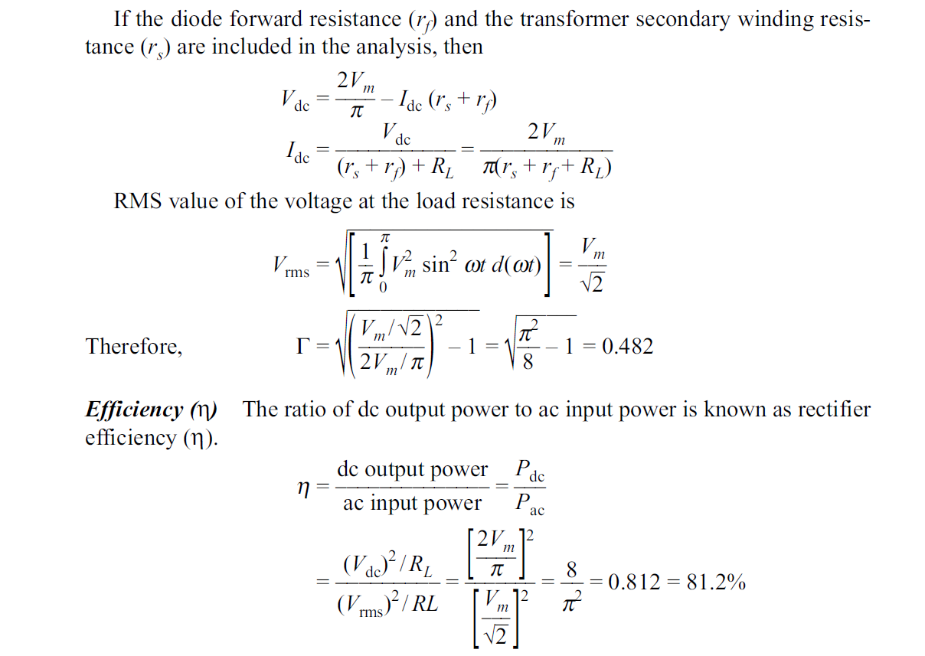

Slide 43
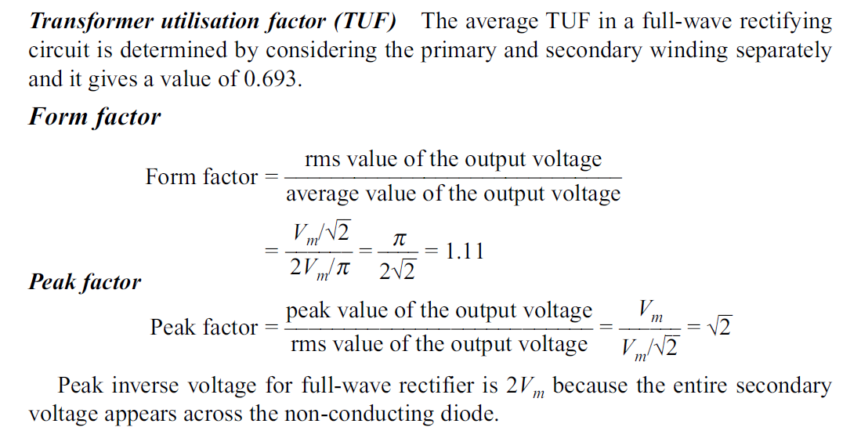

Slide 44
FILTERS
The output of a rectifier contains dc component as well as ac component. Filters are
used to minimise the undesirable ac, i.e. ripple leaving only the dc component to appear at the output.
The ripple in the rectified wave being very high, the factor being 48% in the fullwave rectifier; majority of the applications which cannot tolerate this, will need an output which has been further processed.
Figure shows the concept of a filter, where the full wave rectified output voltage is applied at its input. The output of a filter is not exactly a constant dc level.
But it also contains a small amount of ac component. Some important filters are:
(i) Inductor filter (ii) Capacitor filter
(iii) LC or L-section filter, and (iv) CLC or p-type filter

Slide 45
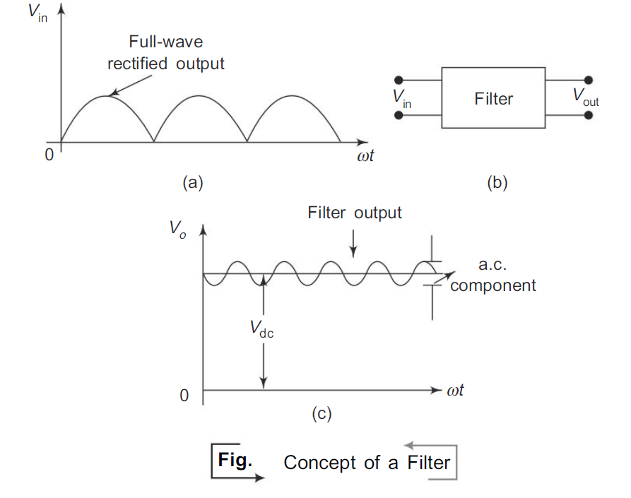
Inductor Filter
When the output of the rectifier passes through an inductor, it blocks the ac component and allows only the dc component to reach the load.

Slide 46
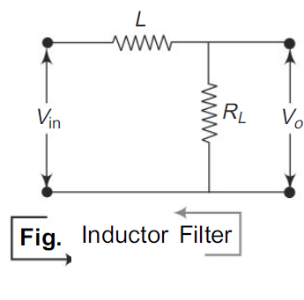

Slide 47
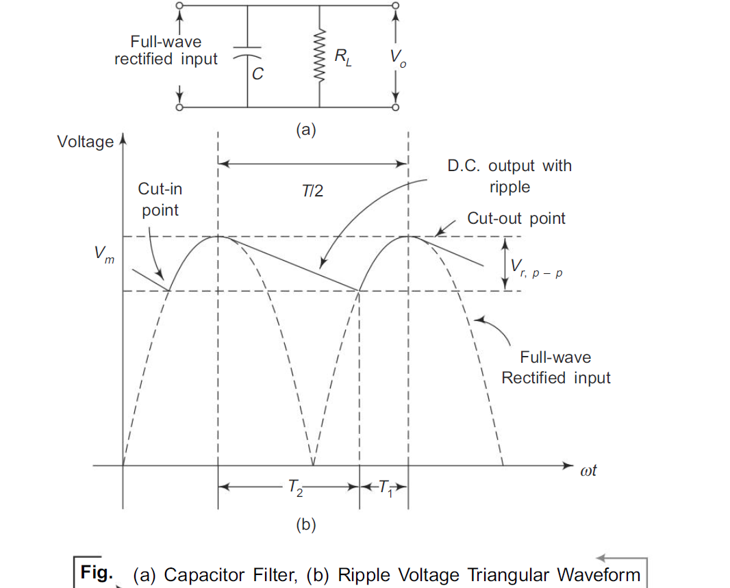
Capacitor Filter
An inexpensive filter for light loads is found in the capacitor filter which is connected
directly across the load, as shown in Fig.. The property of a capacitor is that it allows ac component and blocks the dc component. The operation of a capacitor filter is to short the ripple to ground but leave the dc to appear at the output when it is connected across a pulsating dc voltage.

Slide 48
During the positive half-cycle, the capacitor charges up to the peak value of the transformer secondary voltage, Vm, and will try to maintain this value as the fullwave input drops to zero.
The capacitor will discharge through RL slowly until the transformer secondary voltage again increases to a value greater than the capacitor voltage. The diode conducts for a period which depends on the capacitor voltage (equal to the load voltage).
The diode will conduct when the trans former secondary voltage becomes more than the ‘cut-in’ voltage of the diode. The diode stops conducting when the transformer voltage becomes less than the diode voltage. This is called cut-out voltage.

Slide 49
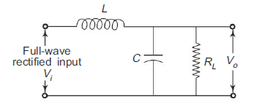
LC Filter
We know that the ripple factor is directly proportional to the load resistance RL in the inductor filter and inversely proportional to RL in the capacitor filter. There fore, if these two filters are combined as LC filter or L-section filter as shown in Fig. the ripple factor will be independent of RL.
If the value of the inductance is increased, it will increase the time of conduction.
At some critical value of inductance, one diode, either D1 or D2 in full-wave rectifier, will always be conducting.

Slide 50
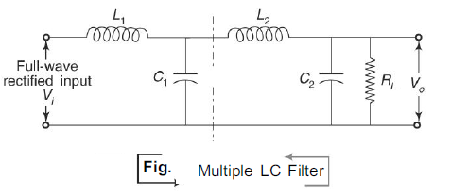

Slide 51
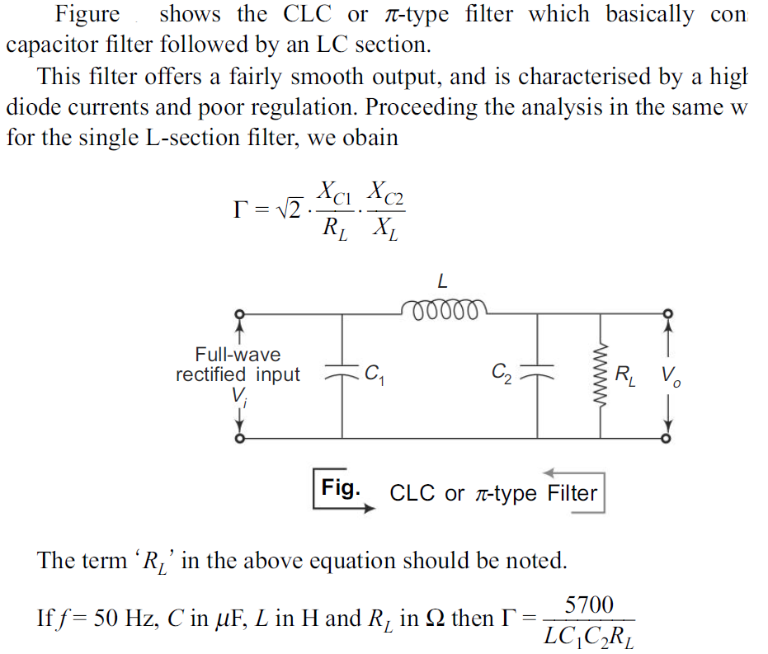
CLC or π-section Filter

Slide 52
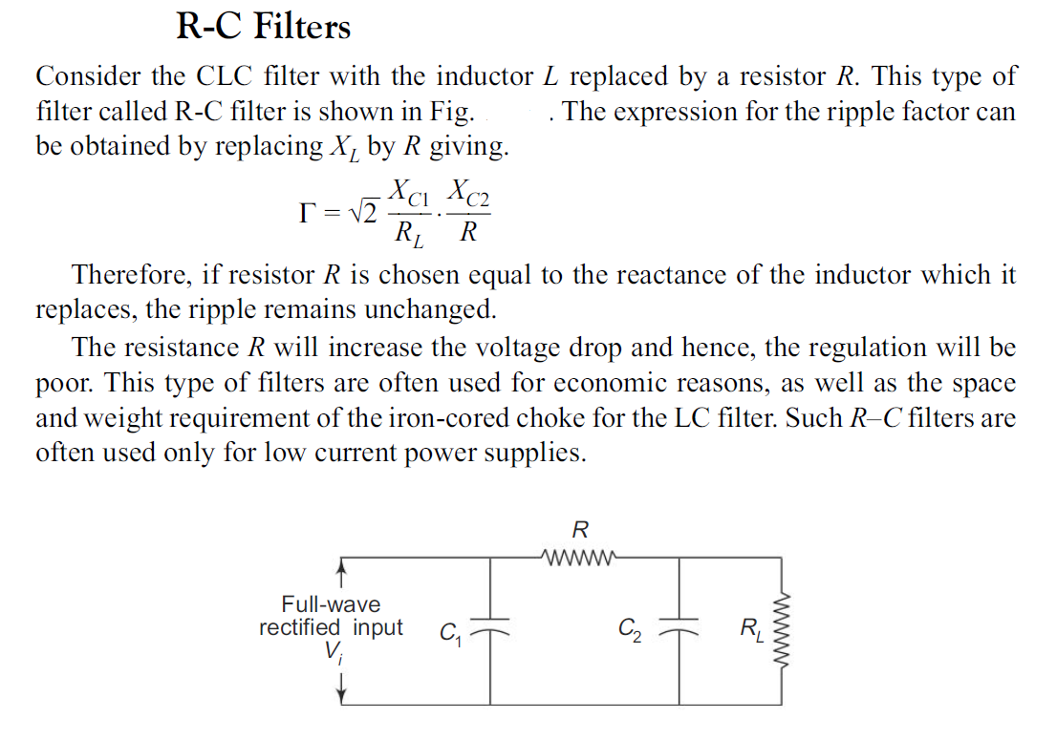

Slide 53
INTRODUCTION OF BIPOLARJUNCTION TRANSISTOR
A Bipolar Junction Transistor (BJT) is a three terminal semiconductor device in which the operation depends on the interaction of both majority and minority carriers and hence the name Bipolar.
The BJT is analogous to a vacuum triode and is comparatively smaller in size. It is used in amplifier and oscillator circuits, and as a switch in digital circuits. It has wide applications in computers, satellites and other modern communication systems.

Slide 54
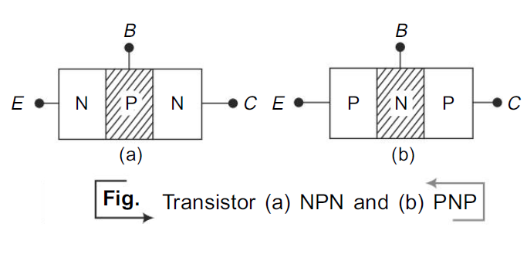
CONSTRUCTION OF BJT
The BJT consists of a silicon (or germanium) crystal in which a thin layer of N-type
Silicon is sandwiched between two layers of P-type silicon. This transistor is referred
to as PNP. Alternatively, in a NPN transistor, a layer of P-type material is sandwiched
between two layers of N-type material. The two types of the BJT are represented in
Fig.

Slide 55
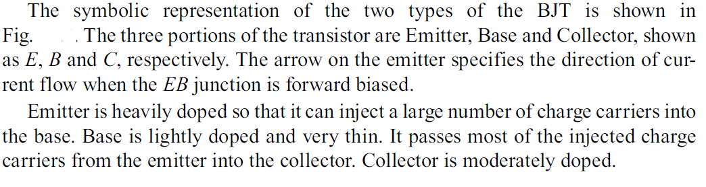

Slide 56
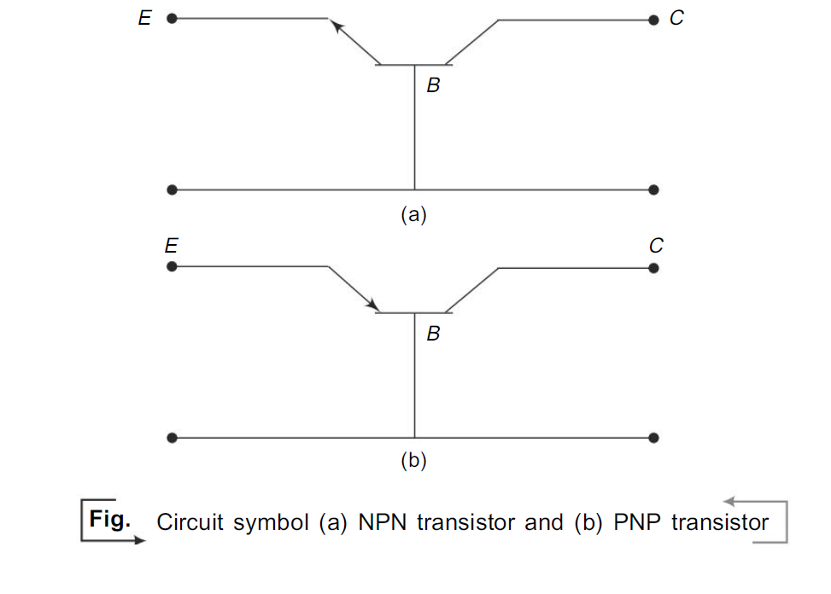
TRANSISTOR BIASING
As shown in Fig. , usually the emitter-base junction is forward biased and collector- base junction is reverse biased. Due to the forward bias on the emitter-base junction an emitter current flows through the base into the collector. Though, the collector-base junction is reverse biased, almost the entire emitter current flows through the collector circuit.

Slide 57
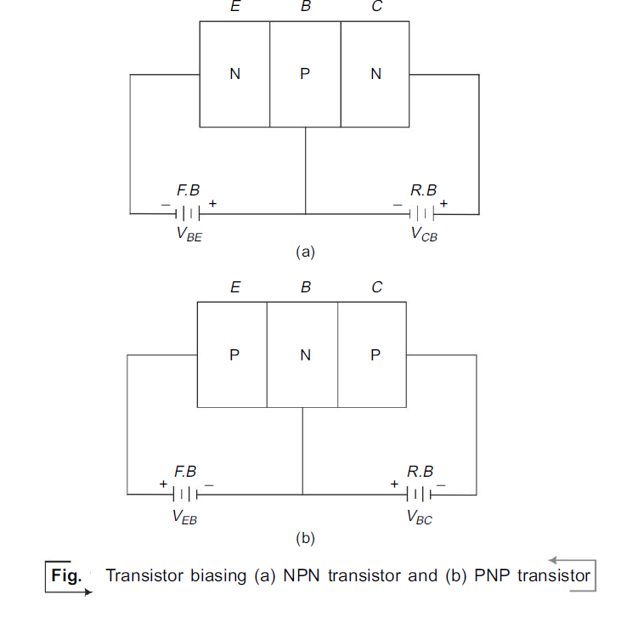

Slide 58
OPERATION OF NPN TRANSISTOR
As shown in Fig., the forward bias applied to the emitter base junction of an NPN transistor causes a lot of electrons from the emitter region to crossover to the base region.
As the base is lightly doped with P-type impurity, the number of holes in the base region is very small and hence the number of electrons that combine with holes in the P-type base region is also very small.
Hence a few electrons combine with holes to constitute a base current IB. The remaining electrons (more than 95%) crossover into the collector region to constitute a collector current IC. Thus the base and collector current summed up gives the emitter current, i.e.
IE = – (IC + IB).
In the external circuit of the NPN bipolar junction transistor, the magnitudes of the emitter current IE, the base current IB and the collector current IC are related by IE = IC + IB.

Slide 59
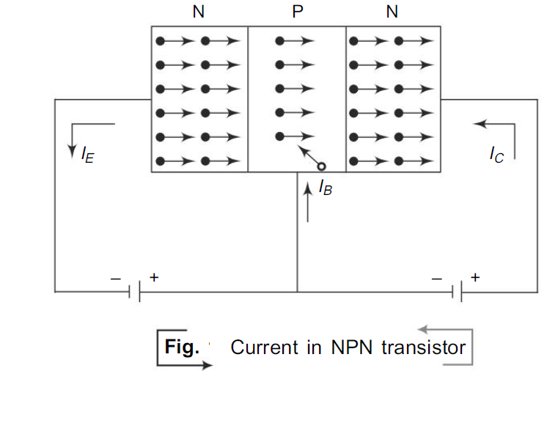

Slide 60
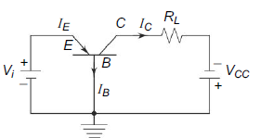
TRANSISTOR AS AN AMPLIFIER
A load resistor RL is connected in series with the collector supply voltage VCC of CB
transistor configuration as shown in Fig.
A small change in the input voltage between emitter and base, say ∆Vi, causes a relatively larger change in emitter current, say ∆IE.
A fraction of this change in current is collected and passed through RL and is denoted by symbol α’.
Therefore the corresponding change in voltage across the load resistor RL due to this current is ∆V0 = α’ RL ∆IE.
Here, the voltage amplification
Av = ∆V0
∆V1
Is greater than unity and thus the transistor acts as an amplifier.

Slide 61
THYRISTOR
Thyristor, in general, is a semiconductor device having three or more junctions.
Such a device acts as a switch without any bias and can be fabricated to have voltage ratings of several hundred volts and current ratings from a few amperes to almost thous and amperes.
The family of thyristors consists of PNPN diode (Shockley diode),SCR, TRIAC, DIAC, UJT etc.

Slide 62
SCR (Silicon Controlled Rectifier)
The basic structure and circuit symbol of SCR is shown in Fig. It is a fourlayer, three-terminal device in which the end P-layer acts as anode, the end N-layer acts as cathode and P-layer nearer to cathode acts as gate.
Characteristics of SCR:
SCR acts as a switch when it is forward biased. When the gate current IG = 0, operation of SCR is similar to PNPN diode. When IG < 0, the amount of reverse bias applied to J2 is increased. So the break over voltage VBO is increased.
When IG > 0,the amount of reverse bias applied to J2 is decreased thereby decreasing the break over voltage.

Slide 63
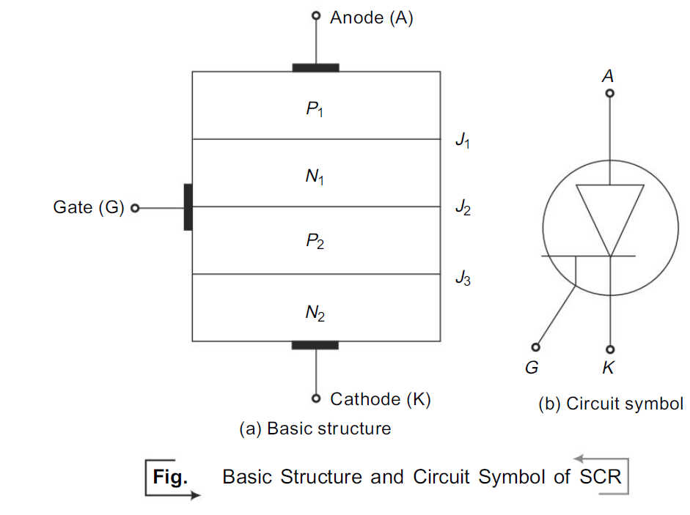
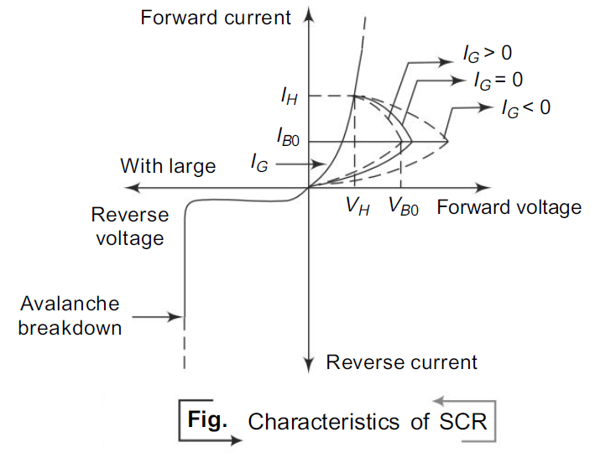

Slide 64
With very large positive gate current, break over may occur at a very low voltage such that the characteristic of SCR is similar to that of ordinary PN diode.
As the voltage at which SCR is switched ‘ON’ can be controlled by varying the gate current IG, it is commonly called as controlled switch.
Once SCR is turned ON, the gate loses control, i.e. the gate cannot be used to switch the device OFF.
One way to turn the device OFF is that the anode current is lowered below IH by reducing the supply voltage below VH, keeping the gate open.
APPLICATIONS OF SCR:
SCR is used in relay control, motor control, phase control, heater control, battery chargers, inverters, regulated power supplies and as static switches.

Slide 65
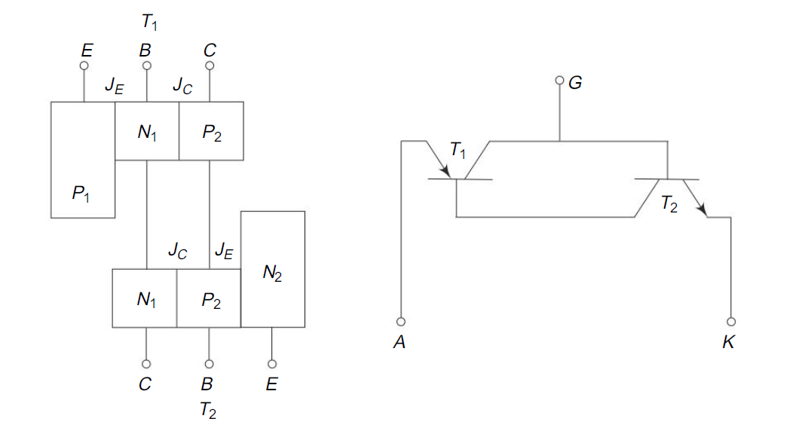
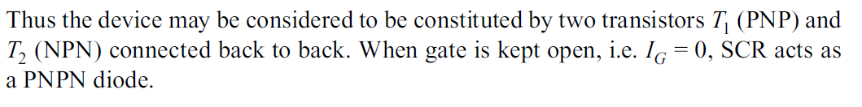
Two Transistor Version of SCR
Two Transistor Version of SCR As shown in Fig., SCR can be split into two parts and displaced mechanically from one another but connected electrically.

Slide 66
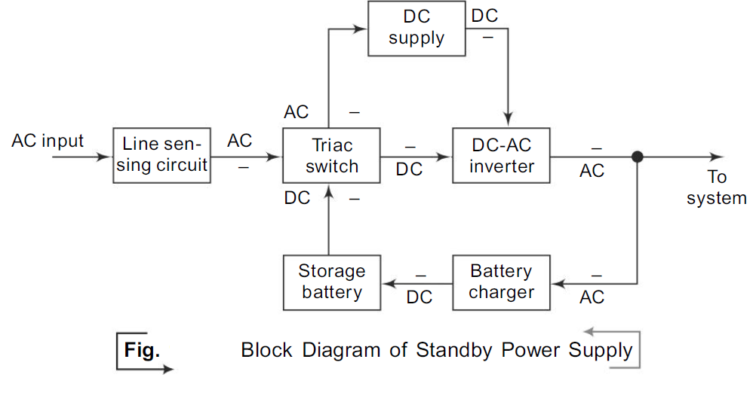
D.C. to A.C. Inverter/Uninterrupted Power Supply(UPS)
The block diagram of Standby Power Supply (SPS), otherwise called as off-line UPS
is shown in Fig. It is a system that uses a special circuit that senses the a.c. line current.
If the sensor detects a loss of power on the line, the system quickly switches over to a standby power system.

Slide 67
The SPS transfers the load to the inverter which draws its power from the attached batteries. The switching process requires a small but measurable amount of time.First, the failure of the electrical supply must be sensed.
Even the fastest electronic voltage sensors take a finite time to detect a power failure. Even after a power failure is detected, there is another slight pause before the computer receives its fresh supply of electricity.
If the switch is not fast enough, the system shuts down and reboots which defeats the purpose of the use of the backup power supply.
The name Uninterrupted Power Supply is self-explanatory. Its output is never interrupted because it does not need to switch its output from line power to battery.
Rather, its battery is constantly and continuously connected to the output of the system through its inverter. It is always supplying power from the battery to the computer.
While a.c. power is available to the UPS, it keeps the UPS battery charged through the rectifier circuits. When the power fails, the charging of the battery is stopped, but the system gets continuous supply from the battery.

Slide 68
It is independent of all the variations of the electrical lines. It is the computer’s own generating station keeping it safe from the polluting effects of lightning and load transients.
Dips and surges can never reach the computer. The computer gets a smooth, constant electrical supply. The duration for which the UPS powers a system depends not on the rating of the UPS in volt-amperes, but that of the rating of the batteries powering it in ampere-hours.
Normally, the UPS comes with a bypass switch. It helps to directly connect the system to the incoming a.c. supply if there is any problem with the UPS.

Slide 69
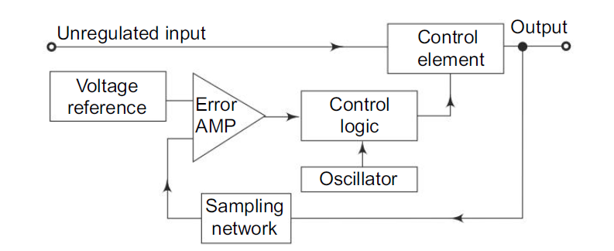
SWITCHED MODE POWER SUPPLY(SMPS)

Slide 70
D.C. to d.c. converters and d.c. to a.c. converters belong to the category of Switched Mode Power Supplies (SMPS). The SMPS operating from mains, without using an input transformer at line frequency 50 Hz is called “off-line switching supply”.
In off-line switching supply, the a.c. mains is directly rectified and filtered and the d.c. voltage so obtained is then used as an input to a switching type d.c. to d.c. converter.
The various types of a voltage regulators used in LPS, fall in the category of dissipative regulator, as it has a voltage control element (transistor or zener diode) which dissipates the power equal to the voltage difference between an unregulated input voltage and a fixed output voltage multiplied by the current flowing through it.
The switching regulators solve the above problem. The switching regulator acts as a continuously variable power converter and hence, its efficiency is negligibly affected by the voltage difference. Therefore, the switching regulator is also known as ‘nondissipative regulator’.

Slide 71
In a switching power supply, the active device that provides regulation is always operated in a switched mode, i.e. it is operated either in cut-off or in saturation.
The input d.c. is chopped at a high frequency (15 to 50 kHz) using an active device (bipolar transistor, power MOSFET or SCR) and the converter transformer.
Here, the size of the ferrite core reduces inversely with frequency. The lower limit is defined at about 15 kHz by the requirement for silent operation and the upper limit of 50 kHz is to limit losses in the choke and in the active switching elements.
The transformed chopped waveform is rectified and filtered. A sample of the output voltage is used as the feedback signal for the drive circuit for the switching transistor to achieve regulation.

Slide 72
The added elements are control logic and oscillator. The oscillator allows the control element
to be switched ON and OFF. The control element usually consists of a transistor switch, an inductor and a diode.
For each switch ON, energy is pumped into the magnetic field associated with the inductor which is a transformer winding in practice.This energy is then released to the load at the desired voltage level.
By varying the duty cycle or frequency of switching, one can vary the stored energy in each cycle and thus control the output voltage.
As a switch can only be ON or OFF, it either allows energy to pass or stop, but does not dissipate energy itself. Since only the energy required to maintain the output voltage at a load current is drawn, there is no dissipation and hence, a higher efficiency is obtained.
Energy is pumped in discrete lumps, but the output voltage is kept steady by capacitor storage.
The major feature of SMPS is the elimination of physically massive power transformers and other power line magnetic. The net result is a smaller, lighter package and reduced manufacturing cost, resulting primarily from the elimination of the 50 Hz components.

Slide 73
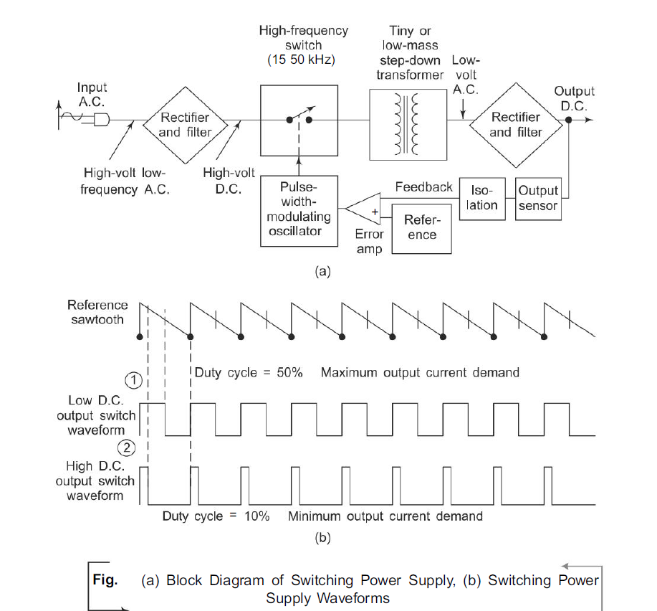

Slide 74
Here, the primary power received from a.c. main is rectified and filtered as high voltage d.c.
It is then switched at a high rate of speed approximately 15 kHz to 50 kHz and fed to the primary side of a step-down transformer.
The step-down transformer is only a fraction of the size of a comparable 50 Hz unit thus relieving the size and weight problems. The output at the secondary side of the transformer is rectified and filtered.
Then it is sent to the output of the power supply.
A sample of this output is sent back to the switch to control the output voltage.
As the load increases, output voltage tends to fall. Most switching power supplies regulate their output using a method called Pulse-Width Modulation (PWM).
The power switch which feeds are primary side of the step-down transformer is driven by a pulse-width modulated oscillator.
When the duty cycle is at 50%, then the maximum amount of energy will be passed through the step-down transformer. As the duty cycle is decreased, less energy will be passed through the transformer.

Slide 75
The width or ON time of the oscillator is controlled by the voltage feedback from the secondary rectifier output, and forms a closed loop regulator.
As shown in Fig. (b), the pulse width given to the power switch is inversely proportional to the output voltage.
When the output voltage drops, the switch is ON for longer time, resulting in more energy delivered to the transformer and a higher output voltage. As the output voltage raises, the ON time becomes shorter until the loop stabilises.

Slide 76
Advantages of SMPS
1.Efficiency is high because of less heat dissipation.
2. As the transformer size is very small, it will have a compact unit.
3. Protection against excessive output voltage by quick acting guard circuits.
4. Reduced harmonic feedback into the supply main.
5. Isolation from main supply without the need of large mains transformer.
6. Generation of law and medium voltage supplies are easy.
7. Switching supplies can change and unregulated input of 24 V into a regulated
output of 1000 V d.c.
8. Though RF interference can be a problem in SMPS unless properly shielded,SMPS in TV sets is in synchronisation with the line frequency (15.625 kHz) and thus switching effects are not visible on the screen.
9. SMPS are also used in personal computers, video projectors and measuring
instruments.

