Slide 1

PRIVACYGATE
On device privacy protection
for safer image sharing
Hackathon project overview
Native Android prototype
iQOO 15 with Snapdragon 8 Elite
100% local analysis
Notes:
PrivacyGate project overview. Visual generated for this presentation. Product facts come from the PrivacyGate repository and supplied project context.

Slide 2
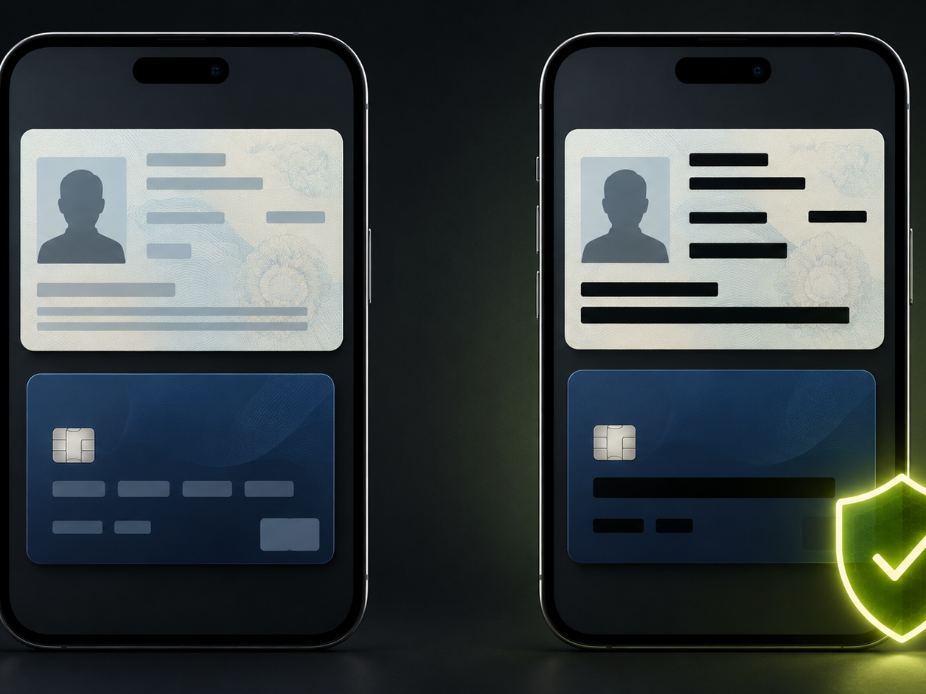
02
Sensitive details travel with necessary documents
People must share IDs, payment evidence, invoices and prescriptions. The recipient needs the document, while many visible fields remain unnecessary.
Late discovery
Users often notice exposed details only after a message has been sent or forwarded.
Warnings without a next step
A generic stop message creates friction when the user still has to complete the share.
Cloud analysis adds another exposure point
Sending the same sensitive image to a server for inspection creates an avoidable second exposure point.
Notes:
The examples contain placeholder fields and no real personal data. Visual generated for this presentation.

Slide 3
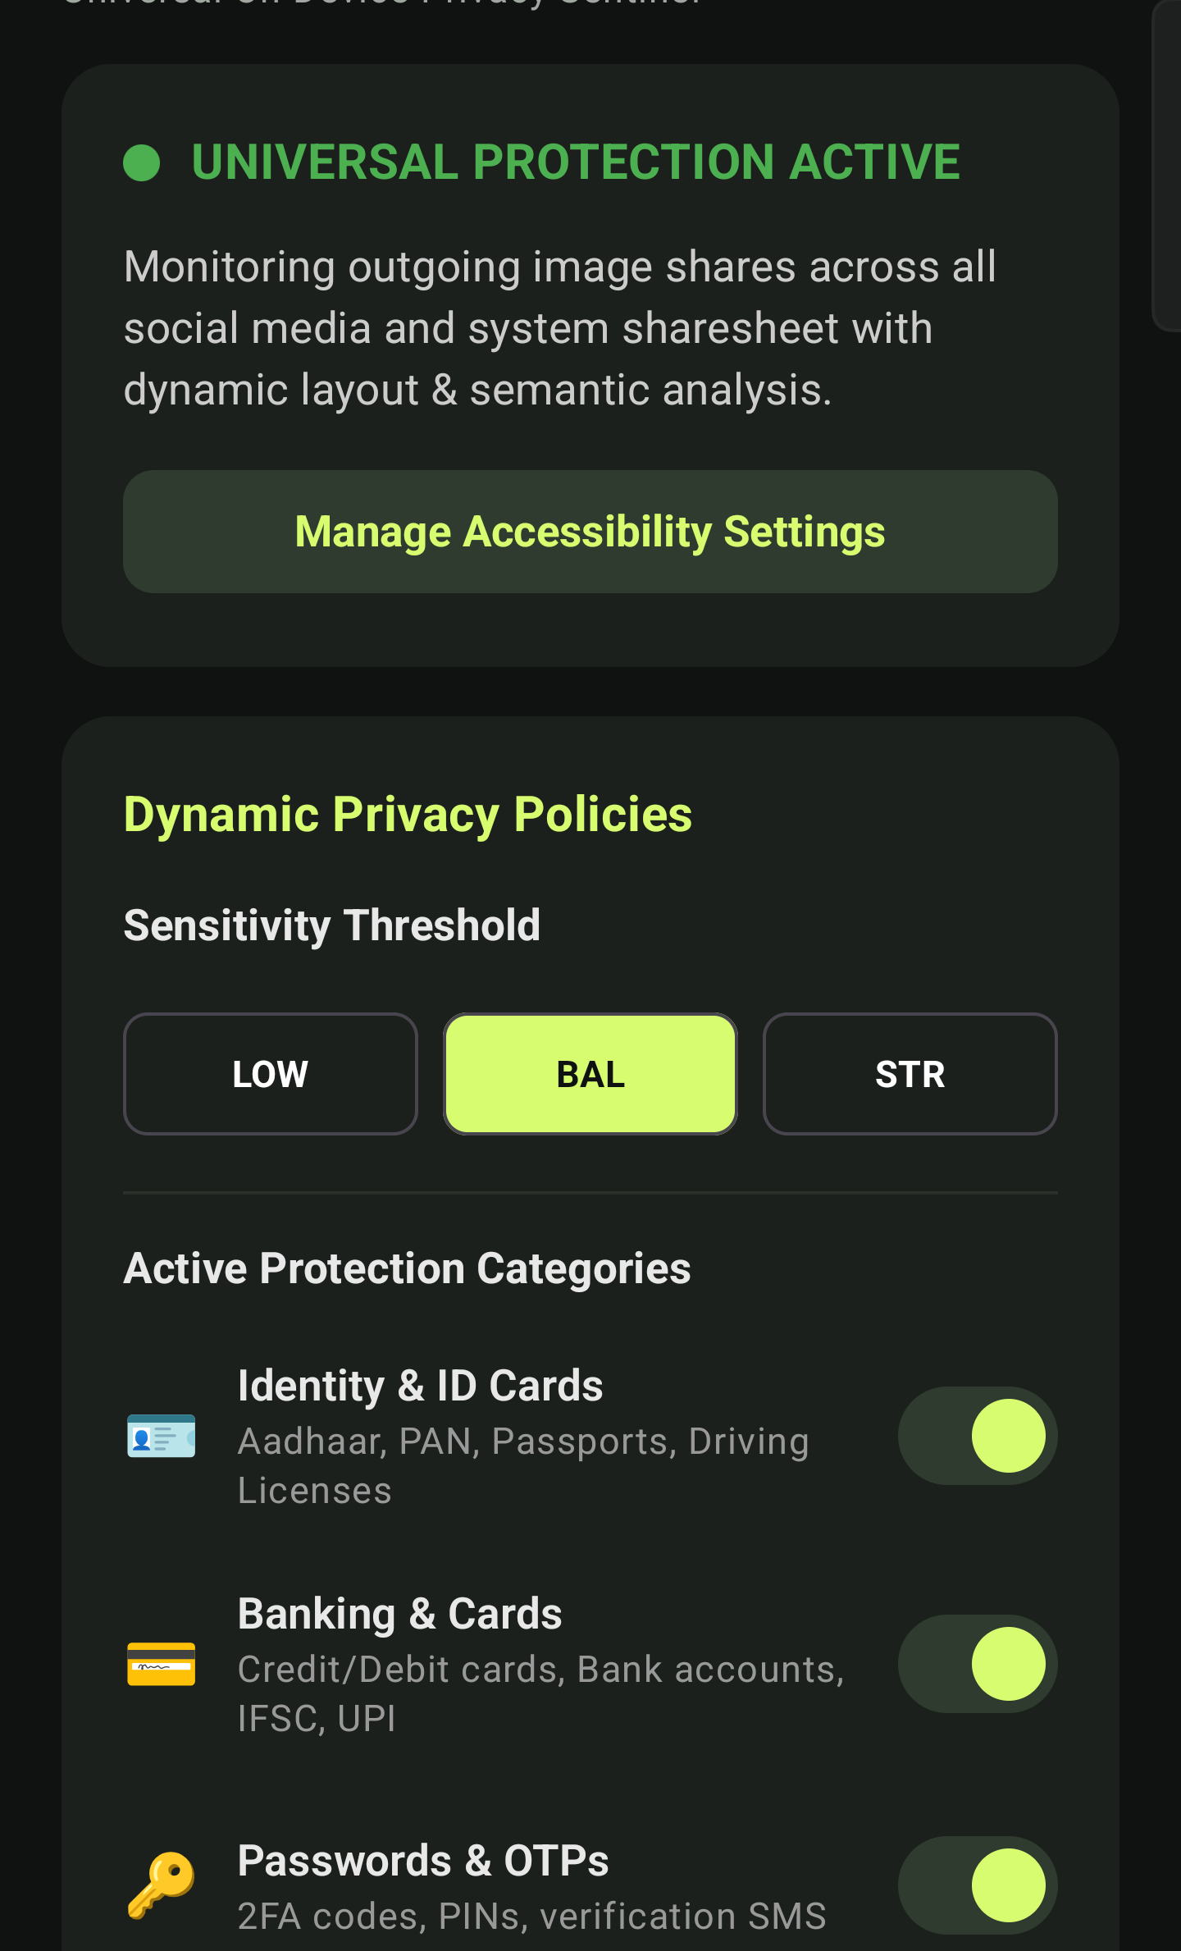
03
A useful checkpoint before the image leaves the phone
01
Observe
Recognize the outgoing preview or direct share action.
Sensitivity and category controls make the warning policy personal.
02
Inspect locally
Read visual and text signals on the device.
03
Explain the risk
Show the category and affected region.
04
Mask or continue
Create a protected copy or honor a deliberate second action.
The first tap creates awareness. The user remains in control of the final share.
Notes:
Dashboard image captured from the current PrivacyGate prototype. It contains settings only and no personal gallery media.

Slide 4

04
High level on device architecture
1
Image source
MediaStore, accessibility screenshot or Android share target
2
Local perception
ML Kit image labels, face detection, segmentation and OCR
3
Privacy decision
User policy, semantic rules and checksum validators
4
Protected output
Redacted bitmap through FileProvider and the native sharesheet
The Android manifest removes internet access. Analysis, policy and masking stay within the device boundary.
Notes:
Architecture reflects the current ML Kit based first layer. The slide intentionally omits low-level class and process details. Visual generated for this presentation.

Slide 5
05
Detection coverage
Current privacy signals
Gallery discovery
How the first layer works
Identity and ID cards
Banking and payment cards
Passwords, PINs and OTPs
Medical and prescription records
Bills, receipts and invoices
Phone numbers and email addresses
Faces and people
People
Documents
Vehicles
Food
Nature
Screenshots
Image labeling identifies broad scenes and objects. Face models detect people. OCR and local validators identify sensitive text.
Next detector milestone
Reliable vehicle number plate localization and precise masking, followed by a specialized sensitive-media classifier.
Each warning category has an independent toggle, so users can match protection to their sharing habits.
Notes:
Coverage derived from the current PrivacyGate settings and ML Kit pipeline. Vehicle number plate localization and specialized sensitive-media classification remain planned work.

Slide 6
06
Product value and delivery plan
Where it helps
Execution path
Hotel check in and KYC
NOW
Prove the core interaction
Hide fields the recipient does not need.
First send warning, clear reason, full-region masking and an airplane-mode demo.
Payment disputes
Protect card and account details while preserving evidence.
Improve masking utility
NEXT
Partial masks for Aadhaar and cards, a cleaner Privacy Island and plate localization.
Medical coordination
Keep prescription context while hiding patient contact information.
WhatsApp Business
HARDEN
Prepare for daily use
Reduce exposure in invoices, receipts and screenshots.
Background indexing controls, batch safe share, thermal safeguards and long-run tests.
Recommendation: continue. The problem is easy to demonstrate, and local processing gives the prototype a clear reason to exist.
Notes:
The roadmap distinguishes current prototype behavior from planned work. No performance, accuracy or adoption metrics are claimed without measurement.

Slide 7
07
Future scope: a privacy layer for every share
The current prototype protects still-image sharing. Its local detection, policy and masking pattern can expand across personal communication and work apps.
01
CONTENT TYPES
02
APP ECOSYSTEM
03
PRODUCT POTENTIAL
Protect more media
Work across channels
Grow the platform
Photos and scanned documents
WhatsApp and WhatsApp Business
Real-time face and plate masking
PDFs and attachments
Instagram, Messenger and Facebook
Multilingual and Indic-language OCR
Messages and screenshots
Telegram and Signal
Personal, family and business policies
Video and screen recordings
Gmail and Outlook
Privacy SDK for other Android apps
Voice notes and transcripts
Teams, Slack, Drive and Files
Enterprise audit and safe-share controls
CURRENT
Still images + supported Android share flows
POTENTIAL
A device-wide, zero-cloud privacy companion
Notes:
All items on this slide are future scope, not claims about current implementation. The app and service names describe possible integration surfaces.

