Slide 1
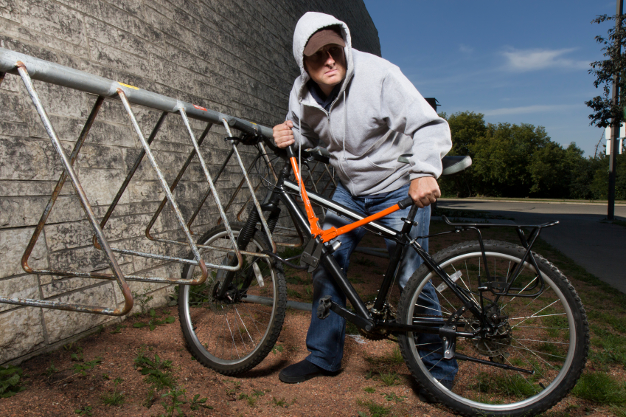
Security

Slide 2
½
Have their bike stolen in EU

Slide 3
We have a solution!

Slide 4


Slide 5
Target Market :
B2B:
Expensive Bicycle Producers
B2C:
Active cyclists

Slide 6


MARKET POSITIONING
Expensive Bicycle Producers
OWNERSHIP PROPOSITION

