Slide 1
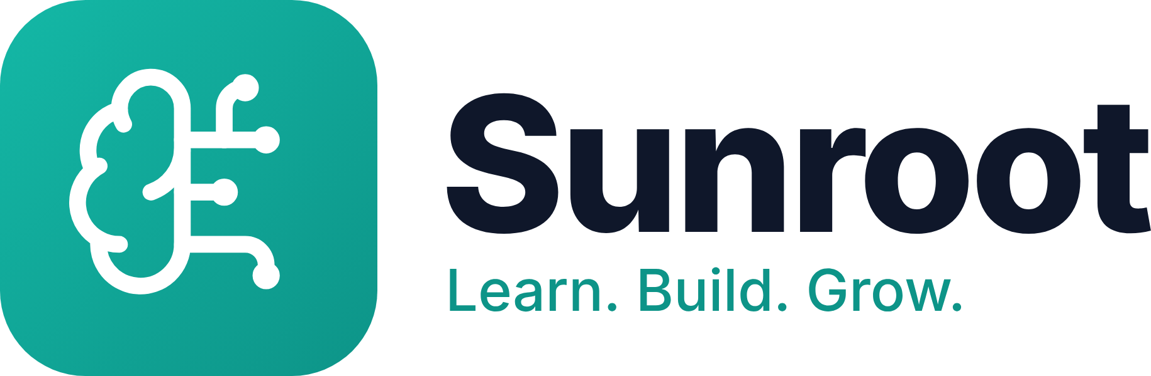

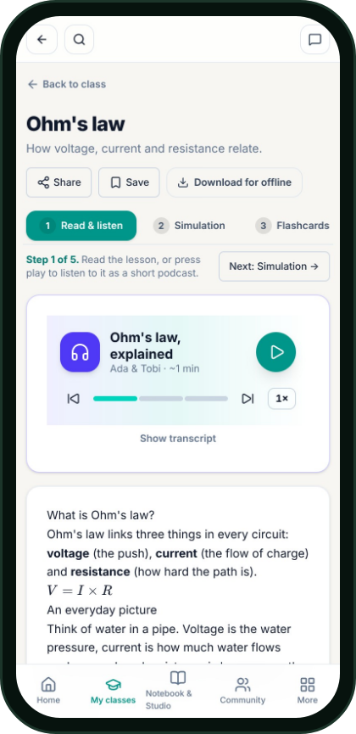
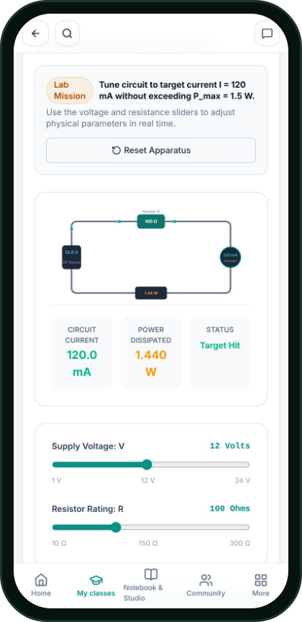
SUNROOT · AI TUTOR, NATIVE-LANGUAGE AUDIO & 3D STEM LAB
Understand it.
Build it.
Prove it.
Turning passive cramming into hands-on STEM mastery, on any phone, in every learner’s language.
Udeakpu Yahnomnso Shamaryah, Founder · sunrootlearn.vercel.app
Notes:
Hi, I’m Shamaryah, founder of Sunroot. Our promise is simple: understand it, build it, prove it. Sunroot turns passive cramming into hands-on STEM mastery, on any phone, in every learner’s language.

Slide 2
THE PROBLEM
Millions of STEM students pass exams on topics they can’t actually use.
Theory is taught without working labs. Complex ideas are locked in dense English handouts. And when a student gets stuck at 11 PM, there is nobody there to explain it simply.
📚 Cram & Forget
🔬 No Lab Access
🌙 Stuck Alone at Night
Formulas memorised for grades, gone a week later.
Most schools lack working equipment for every student.
Zero 1-on-1 support outside lecture hours.
Notes:
Everyone in this room has seen it: students pass exams on topics they can’t actually use. No working lab, dense handouts, and nobody to ask at 11 PM.

Slide 3
WHY IT MATTERS
By the time the gap shows up on exam day, it’s too late for everyone.
FOR STUDENTS
FOR LECTURERS
FOR SCHOOLS & EMPLOYERS
Forced to cram abstract equations without ever touching a circuit or simulation. One missed concept snowballs into failing the course.
Managing 100 to 500+ students with zero time to build custom simulations, audio lessons and adaptive practice for every single topic.
Lecturers only discover who was lost after final exams are graded, producing graduates with paper grades but no hands-on build confidence.
Notes:
It hurts three ways. Students cram without touching a circuit. Lecturers have no time to build labs for hundreds of students. And schools find out who was lost only after grades are out.

Slide 4
THE SUNROOT SOLUTION
A 24/7 AI tutor and virtual lab for every student, and a live mastery radar for every teacher.
Notes:
That’s Sunroot in one sentence: a 24/7 AI tutor and virtual lab for every student, and a live mastery radar for every teacher.

Slide 5
HOW IT WORKS · TEACHER IN CONTROL
From course syllabus to full interactive classroom in minutes.
1
2
3
4
5
Drop the Syllabus
AI Builds the Topic
Lecturer Approves
Students Learn 4 Ways
Live Mastery Radar
Lecturer uploads their course outline or lecture notes.
Clear notes, a 2-host podcast, a live simulation and a 60-question practice bank.
Nothing goes live until the teacher reviews, edits and pushes it.
Read & listen in 8 languages, simulate, practise, build in 3D.
Every quiz answer and circuit build updates each student’s skill score.
Notes:
Five steps. The lecturer drops in the syllabus. The AI builds each topic: notes, podcast, simulation, practice bank. The lecturer approves; nothing reaches students without that. Students learn four ways, and every answer and build updates a live mastery radar.

Slide 6
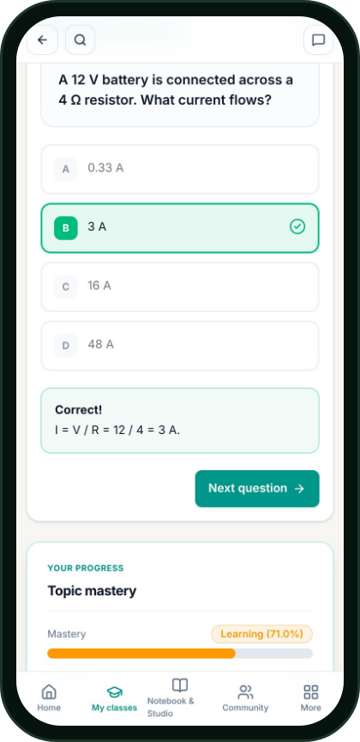
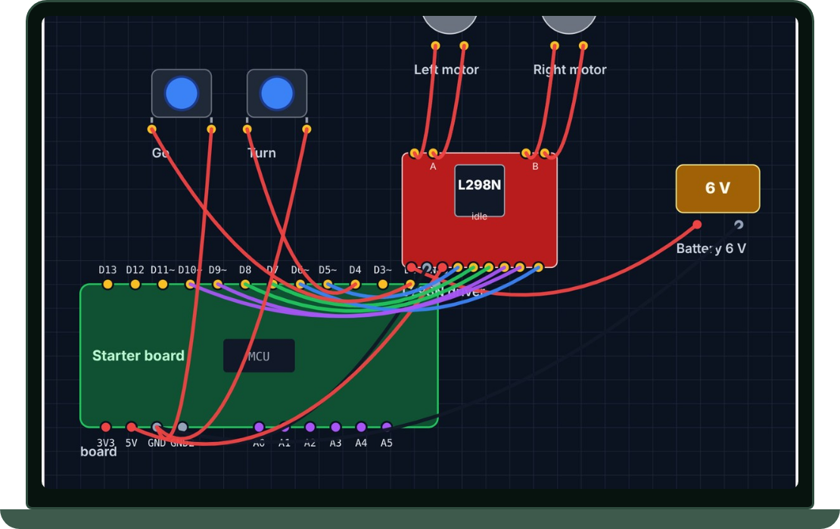
THE STUDENT EXPERIENCE
Every topic, four ways in, so no learner gets left behind.
1 · Read & Listen
2 · Simulate
3 · Practice
4 · Prove It
2-voice podcast & notes in English, Pidgin, Yorùbá, Igbo, Hausa, French, Arabic & Swahili.
Interactive physics & circuit sliders that make equations visible.
Adaptive flashcards & quizzes that focus on weak spots.
Hands-on circuit & Arduino bench where students build it from scratch.
Notes:
Every topic has four ways in: read and listen, in eight languages; simulate; practise; and prove it by building it.

Slide 7
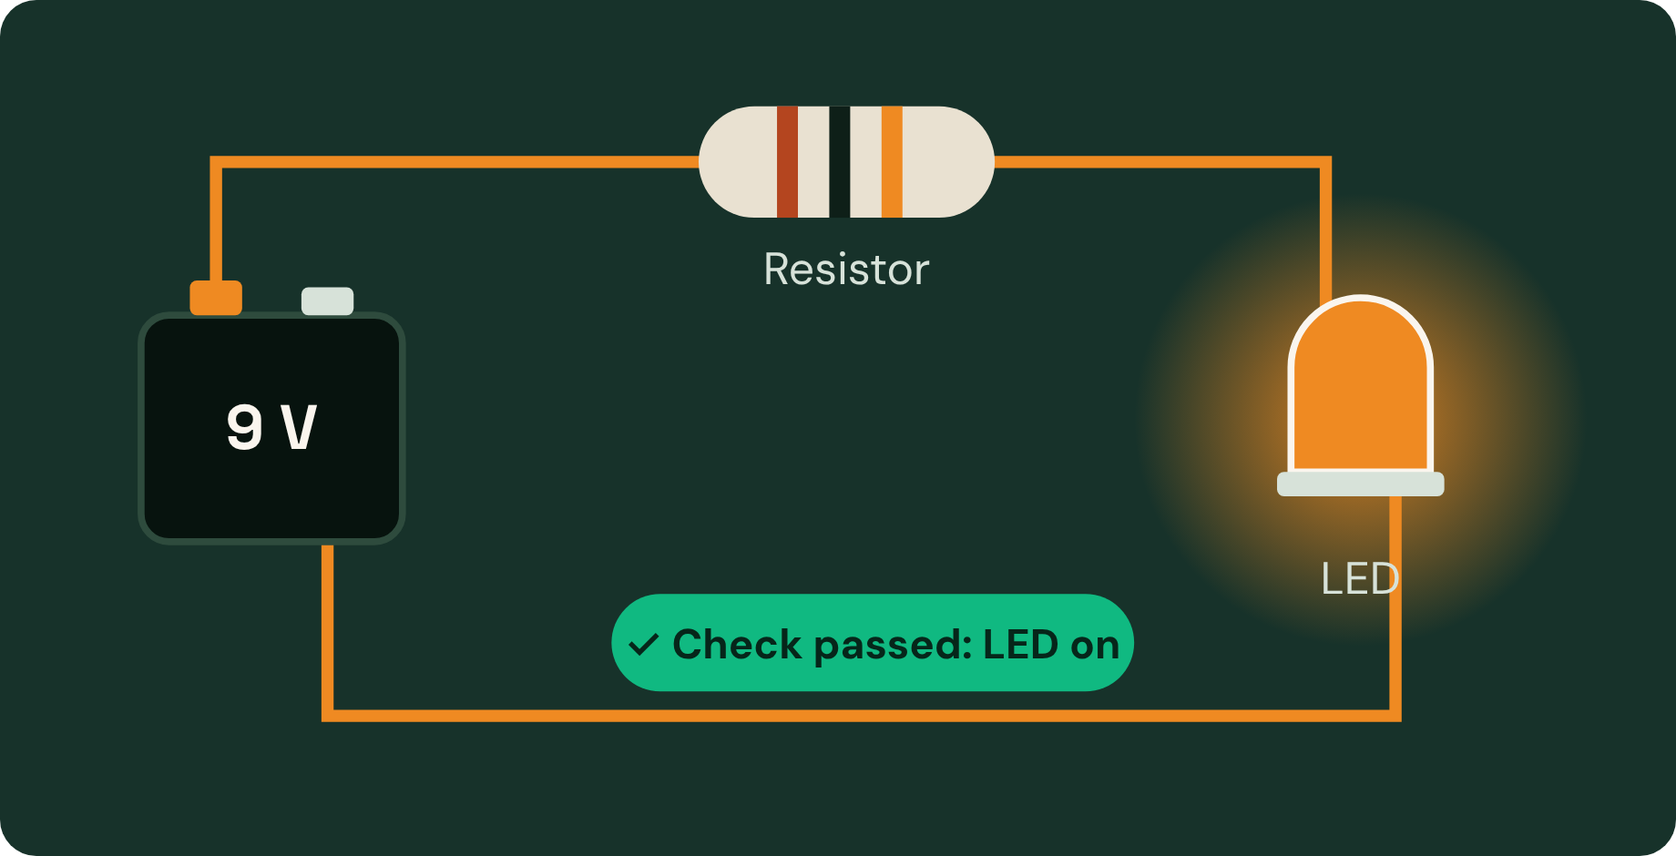
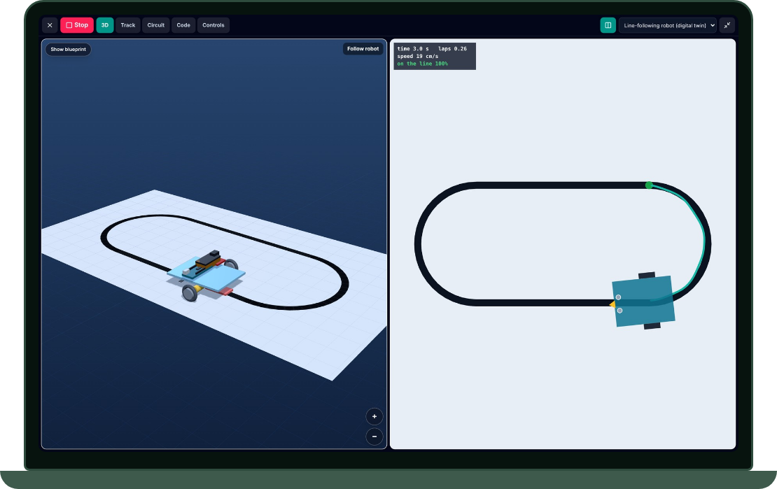
HANDS-ON VERIFICATION
If you can wire it, code it, and run it, you truly understand it.
✓
Pick & place real components on the bench
✓
Wire a complete closed loop with live current checks
✓
Write or block-code the microcontroller logic
✓
Instant physics verification: if the wiring is wrong, the simulation shows why
Notes:
This is the part you can’t fake. Students pick parts, wire the loop, code the logic, and the Studio verifies it. If the wiring is wrong, the simulation shows why.

Slide 8
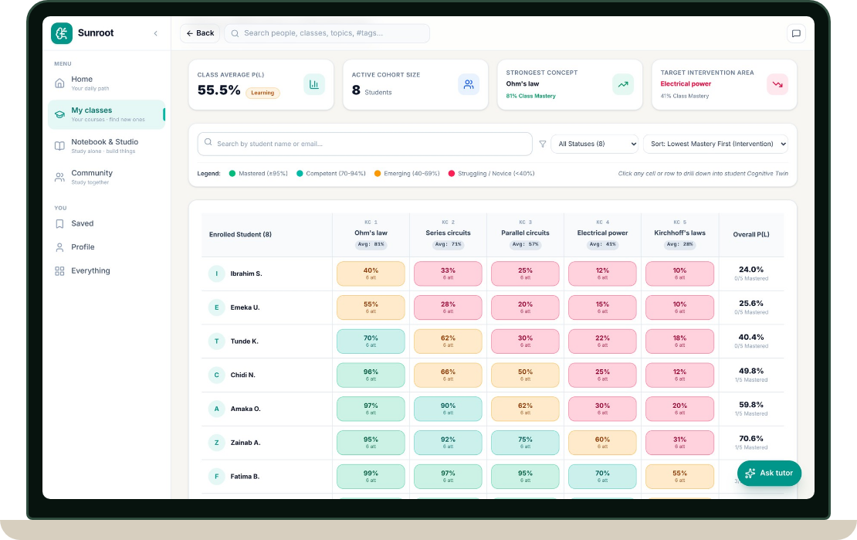
FOR EDUCATORS
Spot who is stuck, and on which exact concept, before the exam.
 | Ohm’s law | Series | Parallel | Power | Kirchhoff
Student A | Strong | Strong | Shaky | Stuck | Stuck
Student B | Strong | Shaky | Shaky | Stuck | Stuck
Student C | Strong | Strong | Strong | Shaky | Shaky
Student D | Shaky | Stuck | Stuck | Stuck | Stuck
Student E | Strong | Strong | Shaky | Shaky | Stuck
Student F | Strong | Strong | Strong | Strong | Strong
Powered by Bayesian Knowledge Tracing (BKT): tracks the real probability of mastery across every quiz, flashcard and lab build.
Notes:
For lecturers: green is strong, amber is shaky, red is stuck, per student and per concept, before the exam. It runs on Bayesian Knowledge Tracing across quizzes, flashcards and lab builds.

Slide 9
BUILT & LIVE TODAY
Production-ready, stress-tested, and live on web & mobile today.
Live on Any Device
8 Languages + Neural Voice
sunrootlearn.vercel.app is live right now on phones and laptops, with offline download and low-data mode.
Full interface, AI explanations and spoken audio lessons in English, Naijá Pidgin, Yorùbá, Igbo, Hausa, French, Arabic & Swahili.
Production-Grade Reliability
Current Stage: Launching Campus Pilots
3,900+ automated tests, multi-model AI failover, and shared audio caching: 100 students replay one recording at no extra voice cost.
Product engineering complete. Now onboarding our first [X] student users and campus study cohorts at FUTO.
Notes:
Everything you’ve seen is live today on phones and laptops, in eight languages, backed by more than 3,900 automated tests. Engineering is done; we’re launching our first campus pilots at FUTO.

Slide 10
WHAT’S NEXT
Launching our 1-term STEM classroom pilot.
Pilot Departments & Schools
Champion Lecturers & TAs
Advisors & Partners
Partnering with [number] STEM classes starting [start date] to run live topics on Sunroot.
Educators who want to turn their handouts into interactive labs and track class mastery.
Mentors and ecosystem partners to help us measure learning gains and scale across Nigerian universities.
Pilot & Growth Ask: [Insert funding / compute / partnership ask]
Notes:
Next: a one-term pilot in real STEM classes. We’re looking for pilot departments, champion lecturers and advisors. Our ask is on the slide.

Slide 11
Understand it. Build it. Prove it.
Test it on your phone right now:
sunrootlearn.vercel.app
Udeakpu Yahnomnso Shamaryah · [email / phone / X handle]
Notes:
Understand it, build it, prove it. Try Sunroot on your phone right now at sunrootlearn.vercel.app. Thank you.

