Slide 1
CS ELEC 01: COMPUTATIONAL SCIENCE
ACTIVITY 01:

Slide 2
CASE STUDY 01
Population Growth Analysis Using Numerical Methods
x
y

Slide 3
CASE # 1
SCENARIO: A local government wants to analyze how population changes over time. However, they only have yearly population data, not a continuous function.

Slide 5
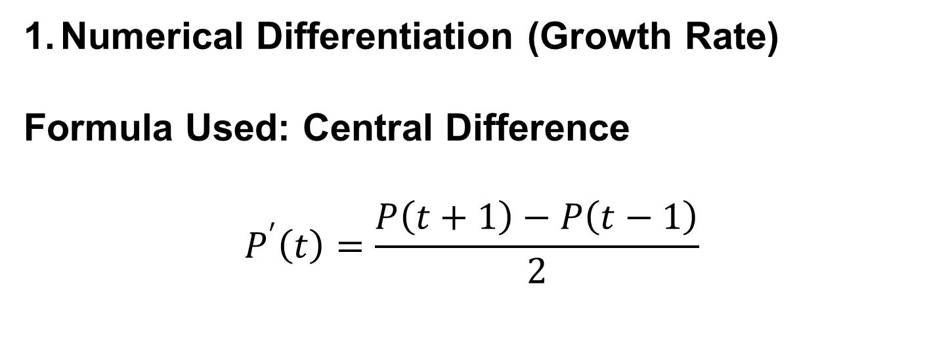
Numerical Differentiation (Growth Rate)
Formula Used: Central Difference
$$P^{′}\left(t\right)=\frac{P\left(t+1\right)−P\left(t−1\right)}{2}$$

Slide 6
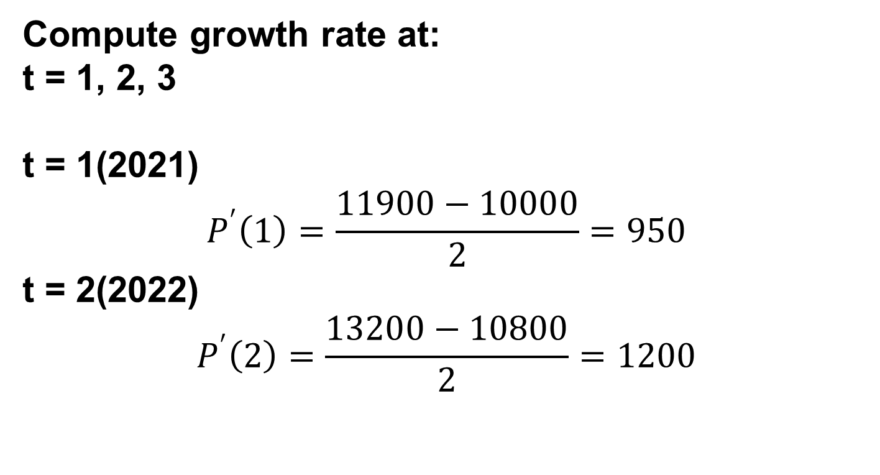
Compute growth rate at:
t = 1, 2, 3
t = 1(2021)
$$P^{′}\left(1\right)=\frac{11900−10000}{2}=950$$
t = 2(2022)
$$P^{′}\left(2\right)=\frac{13200−10800}{2}=1200$$

Slide 7
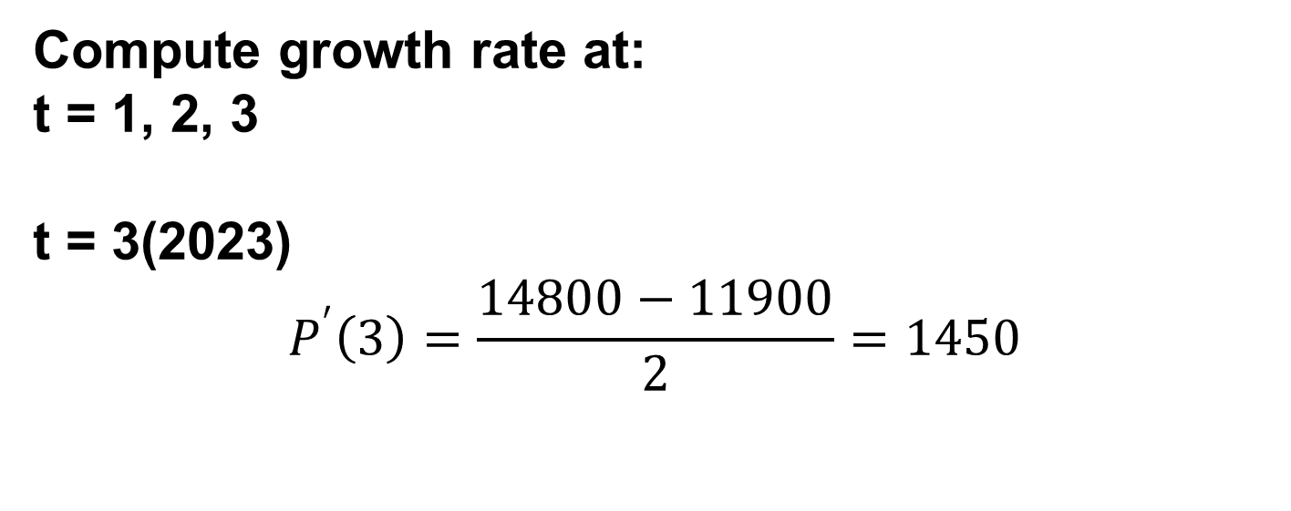
Compute growth rate at:
t = 1, 2, 3
t = 3(2023)
$$P^{′}\left(3\right)=\frac{14800−11900}{2}=1450$$

Slide 9
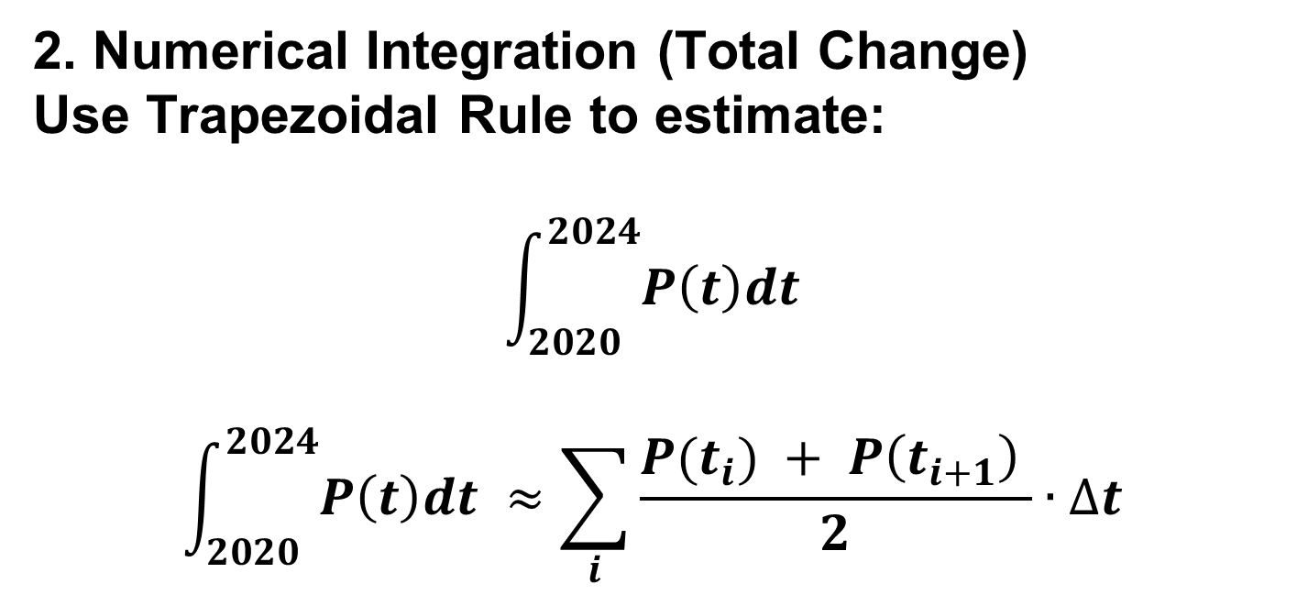
2. Numerical Integration (Total Change)
Use Trapezoidal Rule to estimate:
$$\int_{2020}^{2024}{P\left(t\right)dt }$$
$$\int_{2020}^{2024}{P\left(t\right)dt }≈\sum_{i}{\frac{P(t_{i}) + P\left(t_{i+1}\right) }{2}∙∆t }$$

Slide 11
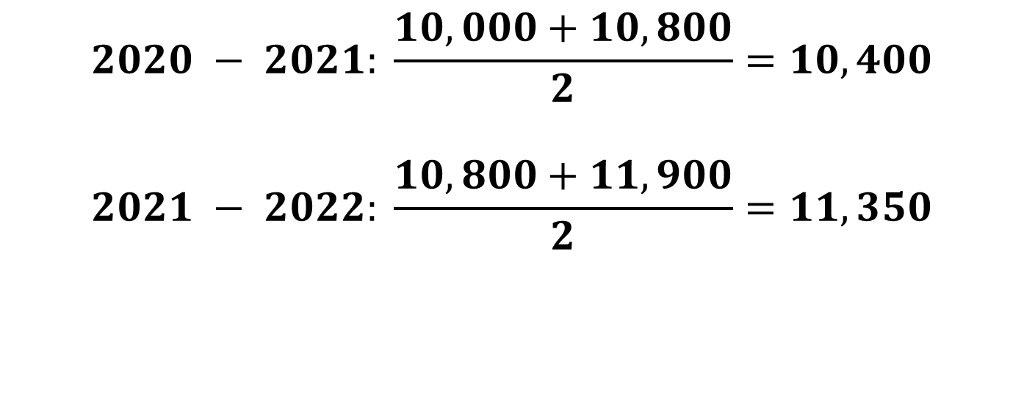
$$2020 − 2021: \frac{10,000+10,800}{2}=10,400$$
$$2021 − 2022: \frac{10,800+11,900}{2}=11,350$$

Slide 12
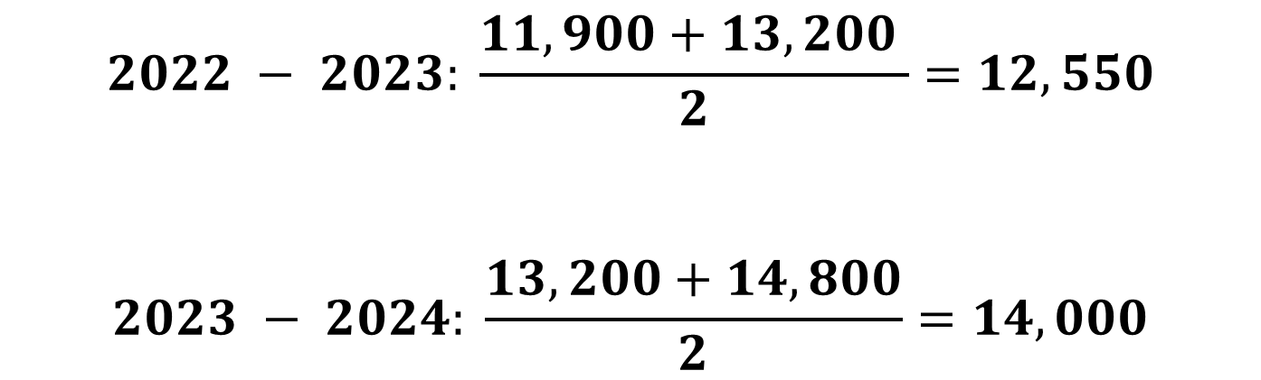
$$2022 − 2023: \frac{11,900+13,200 }{2}=12,550$$
$$2023 − 2024: \frac{13,200+14,800}{2}=14,000$$

Slide 13
Total = 10,400 + 11,350 + 12,550 + 14,000
Total = 48,300 person-years

Slide 14
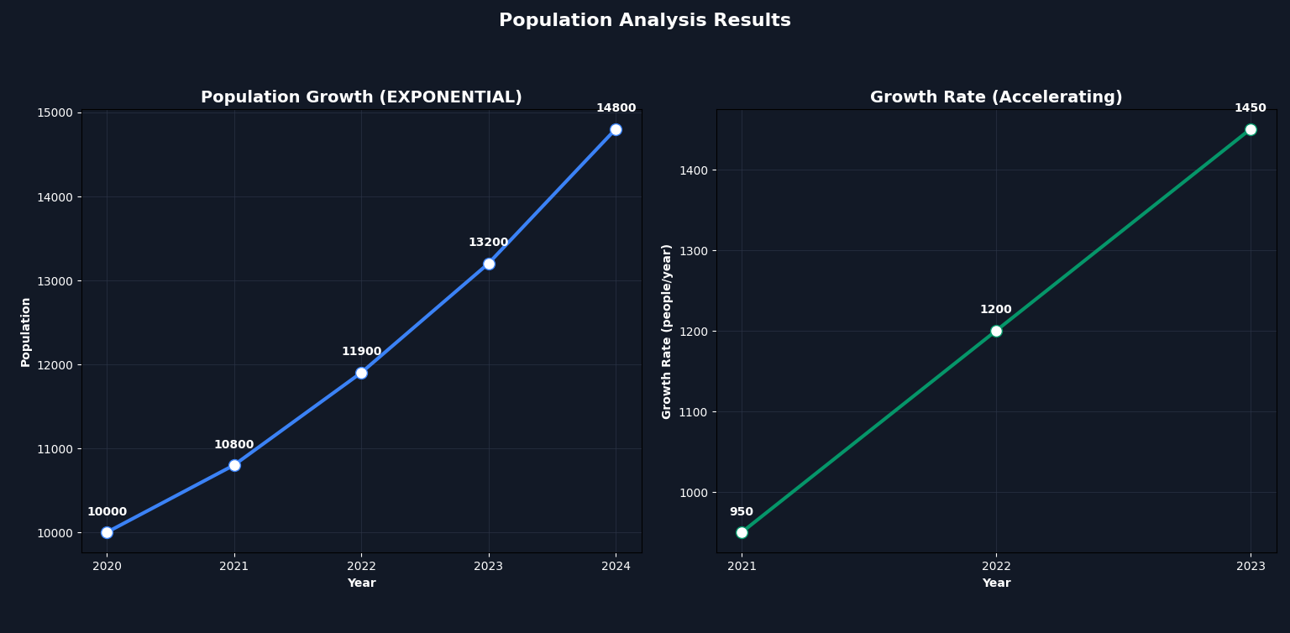
VISUALIZATION:

Slide 15
4. Analysis Questions
• When did growth accelerate most?
The entire duration (the growth rate increases steadily by 250 people/year annually).
• Is the growth linear or exponential?
Exponential (the growth rate is increasing over time, not constant).

Slide 16
Predict population in 2025
Approximately 16,500 (based on adding the current growth rate of 1,450 plus the consistent acceleration of 250).

Slide 17
CASE STUDY 02
Traffic Flow and Velocity Estimation
x
y

Slide 18
CASE # 2
SCENARIO: A traffic monitoring system records the position of a vehicle every second. Engineers want to compute velocity and total distance traveled.

Slide 19
GIVEN DATA:

Slide 20
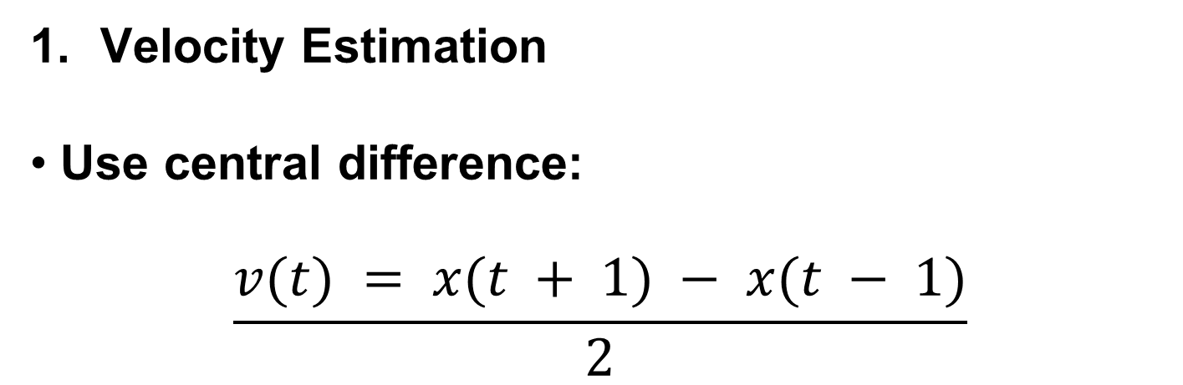
Velocity Estimation
• Use central difference:
$$\frac{v(t) = x(t + 1) − x(t − 1)}{2}$$

Slide 21

Compute velocity at:
t = 1, 2, 3, 4
t = 1
$$v(1)=\frac{15−0}{2}=7.5$$
t = 2
$$v(2)=\frac{30−5}{2}=12.5$$

Slide 22

t = 3
$$v(3)=\frac{50−15}{2}=17.5$$
t = 4
$$v(4)=\frac{75−30}{2}=22.5$$

Slide 23
VELOCITY TABLE:
Time (s) | Velocity (m/s)
1 | 7.5
2 | 12.5
3 | 17.5
4 | 22.5

Slide 24
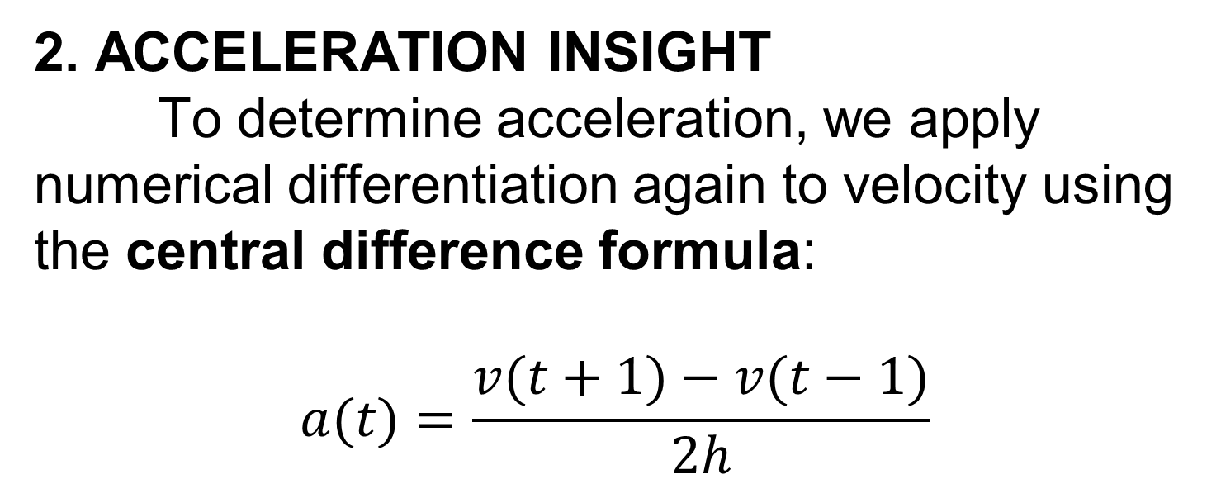
2. ACCELERATION INSIGHT
To determine acceleration, we apply numerical differentiation again to velocity using the central difference formula:
$$a(t)=\frac{v(t+1)−v(t−1)}{2h}$$

Slide 25

Since the time interval is 1 second, then:
$$h=1⇒a(t)=\frac{v(t+1)−v(t−1)}{2}$$

Slide 26
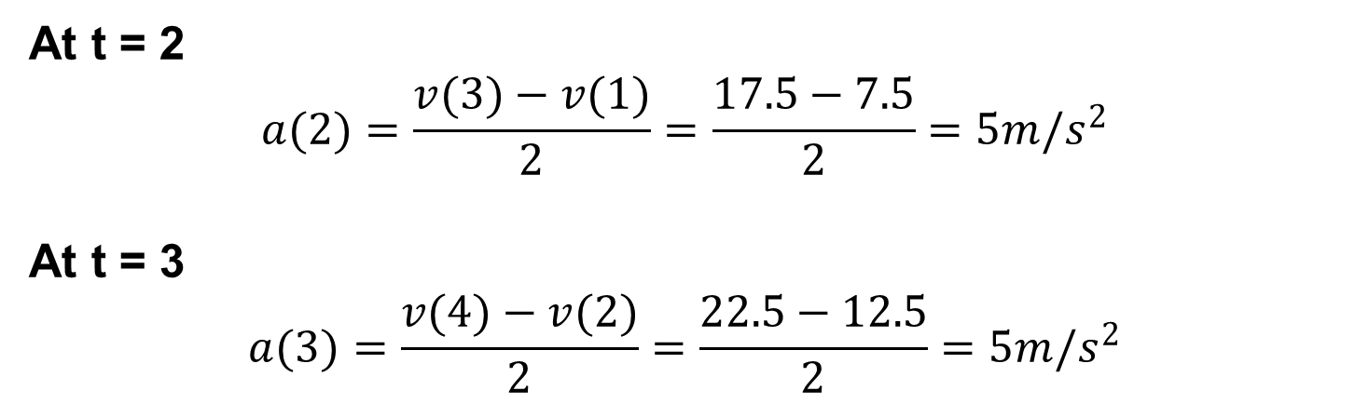
At t = 2
$$a(2)=\frac{v(3)−v(1)}{2}=\frac{17.5−7.5}{2}=5{m/s}^{2}$$
At t = 3
$$a(3)=\frac{v(4)−v(2)}{2}=\frac{22.5−12.5}{2}=5{m/s}^{2}$$

Slide 27
ACCELERATION TABLE:
Time (s) | Acceleration (m/s²)
2 | 5
3 | 5

Slide 28
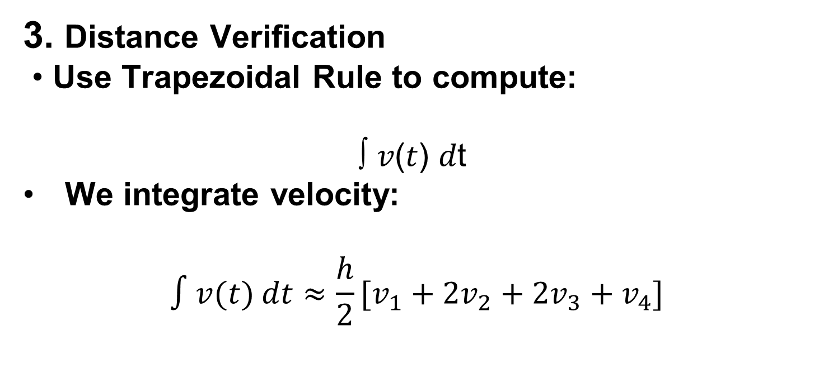
3. Distance Verification
• Use Trapezoidal Rule to compute:
∫ 𝑣(𝑡) 𝑑t
We integrate velocity:
$$∫v(t) dt≈\frac{h}{2}[v_{1}+2v_{2}+2v_{3}+v_{4}]$$

Slide 29
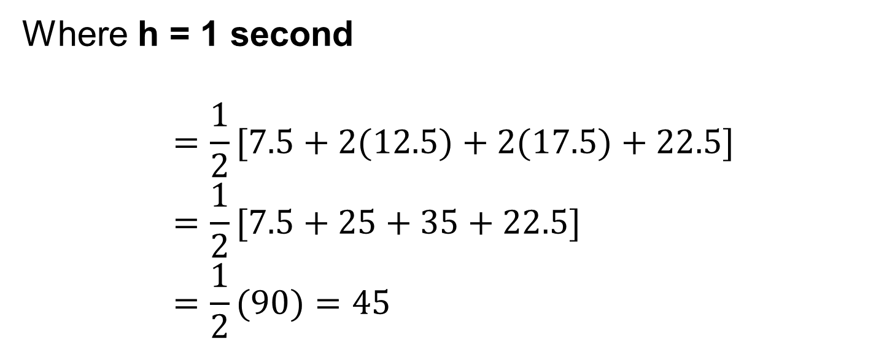
Where h = 1 second
$$=\frac{1}{2}[7.5+2(12.5)+2(17.5)+22.5] \\ =\frac{1}{2}[7.5+25+35+22.5] \\ =\frac{1}{2}(90)=45$$

Slide 30
VISUALIZATION:

Slide 31
5. Analysis Questions:
• When is the car accelerating?
Entire duration (velocity keeps increasing)
• Is motion uniform?
No (velocity changes every second)
• Identify any anomalies (sudden jumps)
None, data is consistent

Slide 32
CASE 05
Electricity Consumption and Power Analysis
x
y

Slide 33
CASE # 5
SCENARIO: A household records electric energy consumption (kWh) at different times of the day. The goal is to determine the instantaneous power usage (rate of change) and verify the total energy consumed.

Slide 35
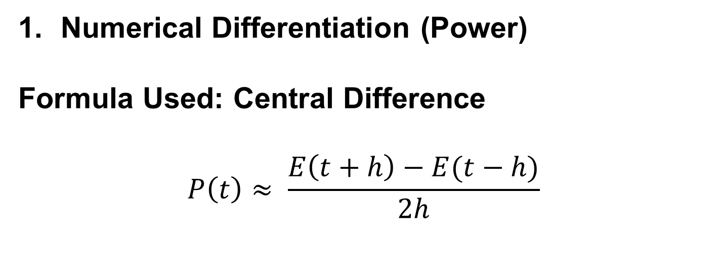
Numerical Differentiation (Power)
Formula Used: Central Difference
$$P\left(t\right)≈ \frac{E\left(t+h\right)−E(t−h)}{2h}$$

Slide 36
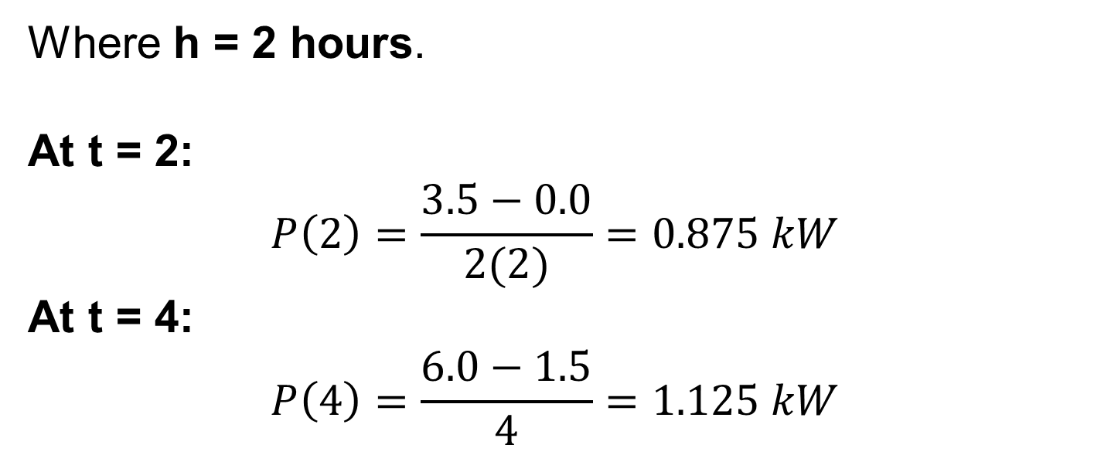
Where h = 2 hours.
At t = 2:
$$P\left(2\right)=\frac{3.5−0.0}{2(2)}=0.875 kW$$
At t = 4:
$$P\left(4\right)=\frac{6.0−1.5}{4}=1.125 kW$$

Slide 37
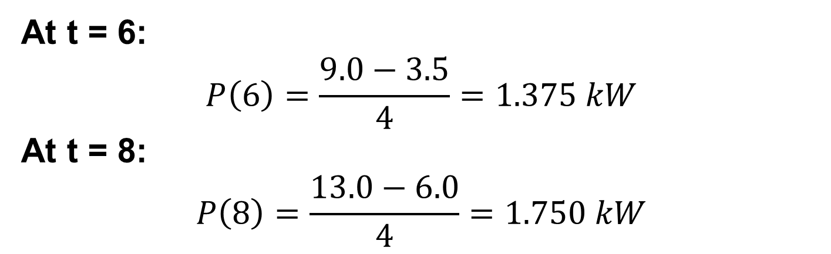
At t = 6:
$$P\left(6\right)=\frac{9.0−3.5}{4}=1.375 kW$$
At t = 8: $$P\left(8\right)=\frac{13.0−6.0}{4}=1.750 kW$$

Slide 39
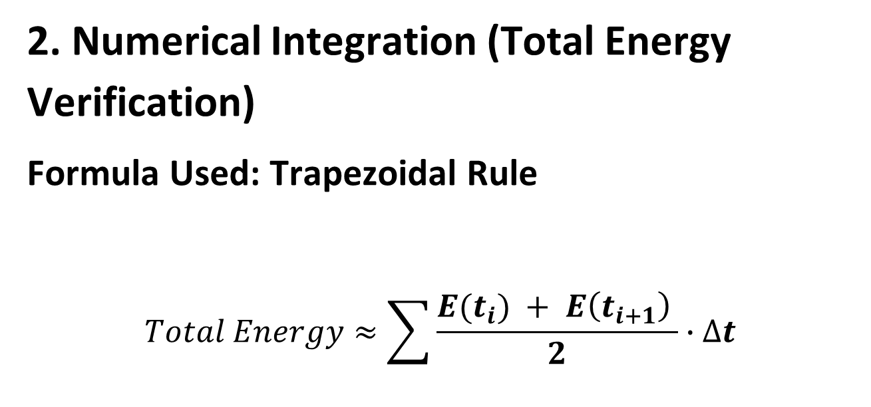
2. Numerical Integration (Total Energy Verification)
Formula Used: Trapezoidal Rule
$$Total Energy≈\sum{\frac{E(t_{i}) + E\left(t_{i+1}\right) }{2}∙∆t }$$

Slide 40
Note: Integrating the power P(t) confirms the total energy consumed over the 10-hour period is 13.0 kWh.

Slide 41
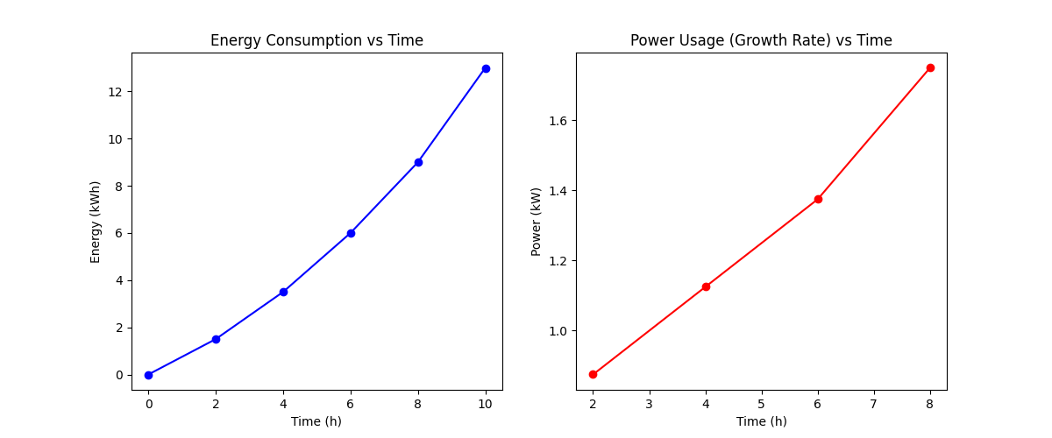
VISUALIZATION:

Slide 42
4. Analysis Questions
When is electricity usage highest?
Peak usage occurs at t = 8 hours, reaching 1.75 kW.
Is consumption steady or increasing?
It is increasing; the power consumption grows consistently at each measured interval
Suggest ways to reduce peak usage:
Shift high-energy tasks (like laundry or water heating) to the 0 - 4 hours window where power demand is lower.

