Slide 1

Online QUIZ System
Advanced Java Project
Group Members:
Ajinkya Bedekar
Anirudh Sharma
Biren Sharma
Shantanu Bahuguna
Yogesh Sharma

Slide 2
TABLES
Users
Questions
Solutions
Admin
Category
Instructions
Scores

Slide 3
Users
User_id(INTEGER) primary key
Name(VARCHAR)
Email(VARCHAR)
Password(VARCHAR)
Phone(LONGBLOB)
Image(VARCHAR)
Access(VARCHAR)

Slide 4
QUESTIONS
Q_no(INTEGER) primary_key
Question(VARCHAR(1000))
Category_id(INTEGER) foreign_key(Category.Category_id)

Slide 5
SOLUTIONS
Sol_no(INTEGER) primary_key
Q_no(INTEGER) foreign_key(Questions.Q_no)
Option_1(VARCHAR)
Option_2(VARCHAR)
Option_3(VARCHAR)
Option_4(VARCHAR)
Correct_answer(INTEGER)

Slide 6
ADMIN
Admin_id(INTEGER) primary_key
Name(VARCHAR)
Username(VARCHAR)
Password(VARCHAR)

Slide 7
CATEGORY
Category_id(INTEGER) primary_key
Category_name(VARCHAR)
Max_time(TIME)
Instructions(VARCHAR)

Slide 8
Instructions
Category_id(INTEGER) foreign_key(Category.Category_id)
Instruction_number(INTEGER)
Instruction_id(INTEGER) primary_key
Instruction(VARCHAR)

Slide 9
SCORES
User_id(INTEGER) foreign_key(Users.User_id)
Score(INTEGER)
Category_id(INTEGER) foreign_key(Category.Category_id)
Time_completed(TIME)
Date_submitted(DATE)

Slide 10
SCOPE OF THE PROJECT
Authentication
Dashboard
Profile
Category
MCQ
Admin panel

Slide 11
Time
Since the project development is agile so there can be area of development within the scope. Therefore, the time required for the development of the project may vary from 20 to 25 hours at max.

Slide 12
Roles and Responsibility
Biren Sharma: View(Jsp, CSS, JavaScript, Bootstrap, jQuery)
Ajinkya Bedekar: Database(MySQL, JDBC)
Shantanu Bahuguna: Controller(Servlet, Filters, Spring, Listener)
Yogesh Sharma: Model(Java classes, getter() and setter())
Anirudh Sharma: Content writer(Questions and Answers)
*Roles are tentative and are subjected to change according to requirement.

Slide 13
Mapping of Tables with Screens
Screen | Tables
Login | Users
Dashboard | Users, Categories, Scores
Quiz Instructions | Instructions
Quiz | Questions, Solutions
Quiz Result | Users, Solutions, Scores
Admin Panel | Users, Questions, Solutions, Admin, Category, Instructions, Scores

Slide 14
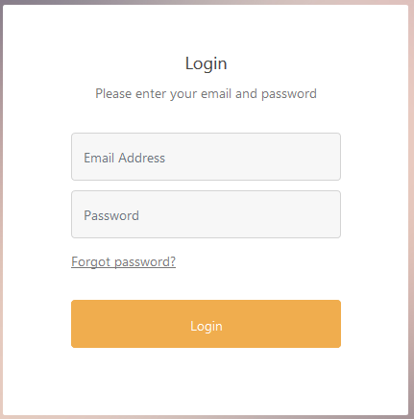
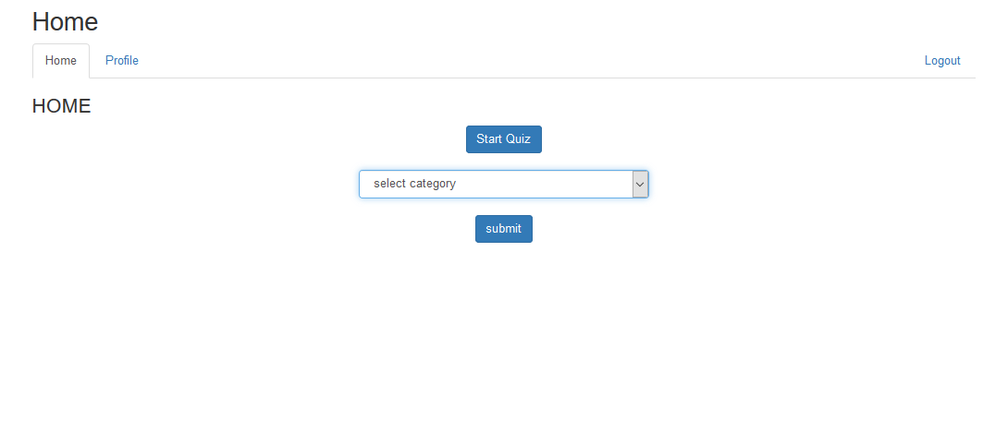
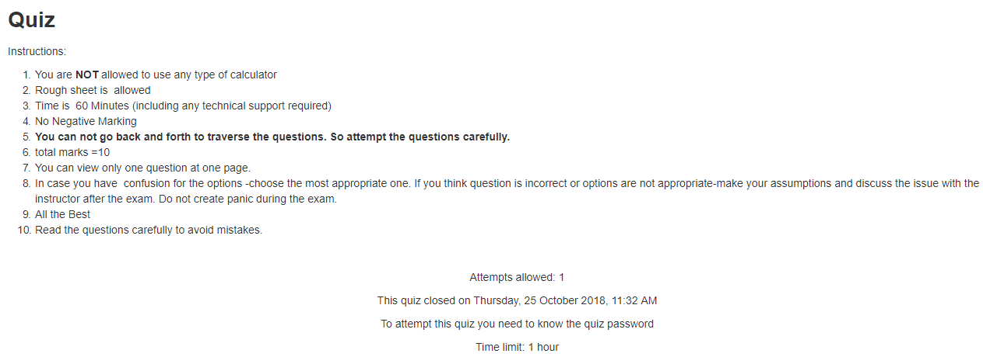
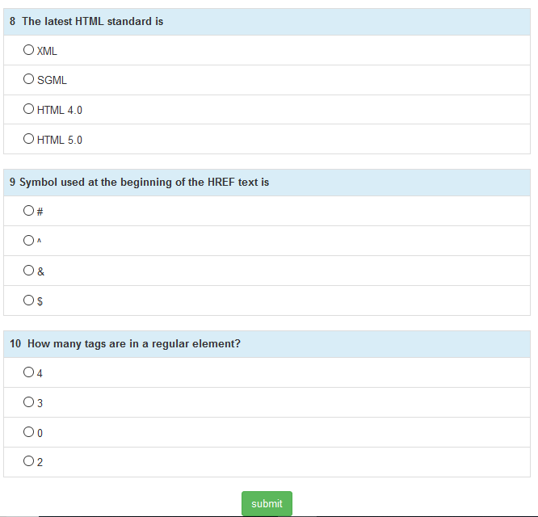
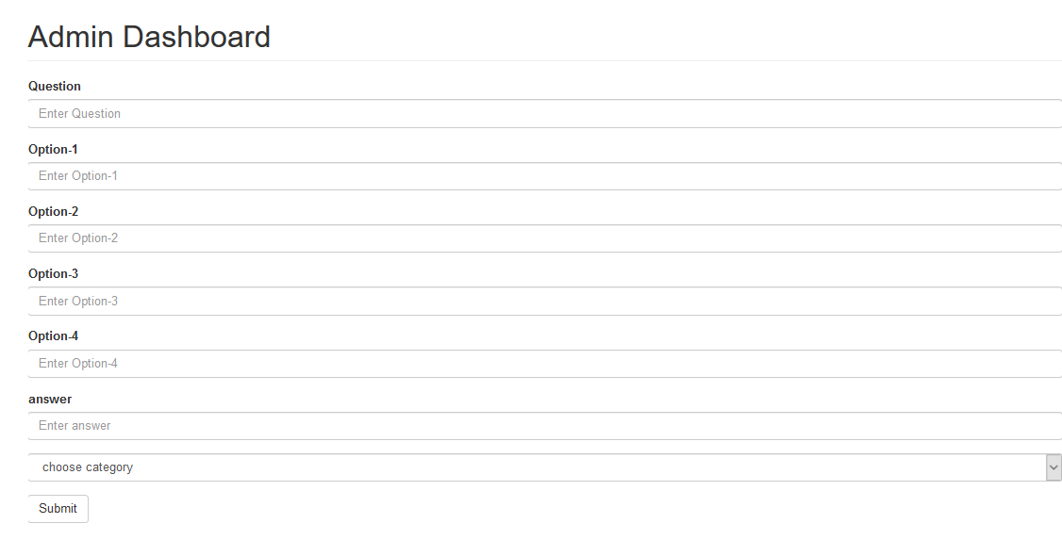
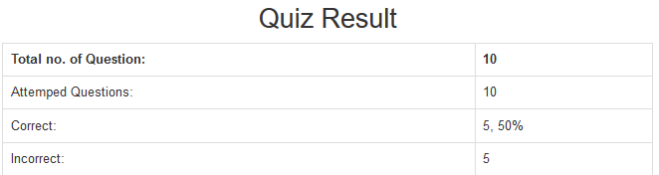
Wireframe Model

Slide 15
THANK YOU!!!

