Slide 1
Muhammed Shamsudeen
Final Project
3/21/2024 Annual Review

Slide 2
PROJECT TITLE
Face image generation with StyleGAN
3/21/2024 Annual Review

Slide 3


AGENDA
Introduction to StyleGAN:
Brief overview of StyleGAN and its capabilities.
Importance and applications of face image generation.
Setup and Requirements:
Hardware requirements: GPU specifications, memory requirements.
Software requirements: TensorFlow or PyTorch, CUDA, cuDNN.
Preparing the Dataset:
Sourcing face image datasets: CelebA, FFHQ, etc.
Data preprocessing: resizing, normalization, augmentation.
Splitting dataset into training, validation, and test sets.
3/21/2024 Annual Review

Slide 4
Understanding StyleGAN Architecture:
Overview of generator and discriminator networks.
Key architectural features: progressive growing, style-based synthesis.
Training the StyleGAN Model:
Setting up training configuration: learning rate, batch size, etc.
Monitoring training progress: loss functions, metrics, visual inspection.
Evaluating Generated Images:
Quantitative evaluation metrics: FID (Fréchet Inception Distance), SSIM (Structural Similarity Index), etc.
Qualitative evaluation: visual inspection of generated images.
Applications and Use Cases:
Creative applications: art generation, avatar creation, etc.
Practical applications: data augmentation, facial recognition, etc.
Conclusion and Future Directions:
Summary and potential advancements.
Encouragement for experimentation and exploration in the field of generative models.

Slide 5

PROBLEM STATEMENT
Developing a system for generating realistic face images using StyleGAN, requiring optimization of training parameters and dataset preparation for high-quality output, with potential applications in various domains including art, data augmentation, and facial recognition. The challenge is to leverage StyleGAN to generate lifelike face images. This entails fine-tuning training parameters, curating a diverse and sizable dataset, and ensuring the model's output meets high-quality standards. The ultimate goal is to harness these synthesized images for diverse applications such as artistic expression, data augmentation, and enhancing facial recognition systems.
3/21/2024 Annual Review

Slide 6

PROJECT OVERVIEW
Dataset Preparation:
Gather diverse face images and preprocess them. Preprocess the dataset, including resizing, normalization, and augmentation to ensure high-quality input for training.
Model Architecture:
Delve into the architecture of StyleGAN, understanding its generator and discriminator networks, as well as the concept of style-based synthesis.
Training:
Configure the training parameters such as learning rate, batch size, and optimization techniques. Train the StyleGAN model on the prepared dataset, monitoring its progress and adjusting parameters as necessary.
3/21/2024 Annual Review

Slide 7
Evaluation:
Assess image quality quantitatively and qualitatively.
Applications and Use Cases:
Explore various applications of generated face images, including artistic endeavors, data augmentation for machine learning tasks, and improving facial recognition systems.
Optimization and Fine-Tuning:
Implement optimization techniques to enhance training efficiency and Fine-tune the model to achieve better results
Documentation and Reporting:
Document the entire process, including dataset preparation, model training, evaluation metrics, and any optimizations or fine-tuning performed.

Slide 8

WHO ARE THE END USERS?
Artists and Designers: Professionals seeking new artistic tools and inspiration.
Art Enthusiasts: Hobbyists and individuals passionate about art.
Content Creators: People involved in creating digital content for entertainment, advertising, or social media platforms, who may need realistic face images for various projects.
Technology Developers: Engineers and developers creating AI art tools.
Art Collectors and Curators: Interested in exploring AI-generated art.
Commercial and Entertainment Industries: Companies leveraging AI art for various purposes.
General Public: Curious individuals exploring AI art for entertainment and inspiration.
3/21/2024 Annual Review

Slide 9

YOUR SOLUTION AND ITS VALUE PROPOSITION
Solution:
High-Quality Results: Our system utilizes cutting-edge technology to produce realistic and diverse face images, meeting the standards of professional artists, developers, and content creators.
Ease of Use: With a simple and intuitive interface, users can effortlessly generate custom face images without the need for specialized technical knowledge.
Versatility: Whether you're an artist, researcher, educator, or general user, our solution caters to a wide range of users and applications, from artistic expression to algorithm training.
3/21/2024 Annual Review

Slide 10
Time and Cost Efficiency: By providing ready-to-use face images, our solution saves users valuable time and resources that would otherwise be spent on sourcing or creating images from scratch.
Reliability and Consistency: Users can rely on our system to consistently deliver high-quality results, backed by robust algorithms and rigorous testing.
Continuous Improvement: We are committed to ongoing refinement and enhancement of our solution, incorporating user feedback and advancements in technology to ensure it remains at the forefront of face image generation.
Value Proposition:
Exceptional Quality: Delivering realistic and high-fidelity face images that meet the stringent standards of professionals across industries.
Efficiency and Speed: Streamlining the process of generating custom face images, saving users significant time and resources compared to manual creation or sourcing.

Slide 11

THE WOW IN YOUR SOLUTION
Unprecedented Realism: Witness faces that blur the lines between reality and digital creation, captivating users with their lifelike qualities and intricate details, evoking genuine astonishment at the fidelity of the generated images.
Limitless Creativity Unleashed: Empower users to explore boundless creative possibilities, from crafting unique characters and avatars to generating breathtaking artwork that sparks inspiration and amazement in both creators and audiences alike.
Instant Access to Excellence: Experience the thrill of instant gratification as users effortlessly summon stunning face images with just a few clicks, eliminating the barriers of time-consuming manual creation and procurement, and immersing them in a world of instant innovation and productivity.
3/21/2024 Annual Review

Slide 12
Tailored Precision and Personalization: Delight users with the ability to fine-tune and customize every aspect of the generated faces, from subtle nuances in expression to specific demographic characteristics, granting them unparalleled control over the creative process and ensuring each creation is truly one-of-a-kind.
Future-Proof Innovation: Inspire confidence and excitement in users as they witness our commitment to continuous improvement and innovation, knowing that our solution will evolve alongside emerging technologies and user needs, promising an ever-expanding array of features and possibilities that push the boundaries of what's possible in face image generation.

Slide 13
APPLICATIONS
Art & Entertainment: Create digital art, gaming avatars, and CGI characters.
Digital Marketing: Design brand mascots and engage in diverse advertising.
E-commerce: Enable virtual try-on and product customization.
Education: Train AI models and develop interactive educational tools.
Healthcare & Security: Aid in medical imaging and enhance facial recognition.
Privacy & Content Moderation: Anonymize data and assist in content moderation.
Fashion & Beauty: Experiment with virtual makeup and showcase beauty products.

Slide 14
MODELLING
Teams cam add wireframes
Designing GAN architecture: Generator creates images resembling artworks, Discriminator distinguishes real from generated images.
Implementing style transfer: Neural networks extract and transfer artistic styles between images using pre-trained CNNs like VGG or ResNet.
Customization and optimization: Adjusting parameters and optimizing models for stability and convergence during training.
Training and fine-tuning: Iteratively adjusting model parameters to minimize discrepancies between generated and target images.
Evaluation: Assessing model performance using quantitative metrics and qualitative evaluations to ensure quality and accuracy.
3/21/2024 Annual Review

Slide 15
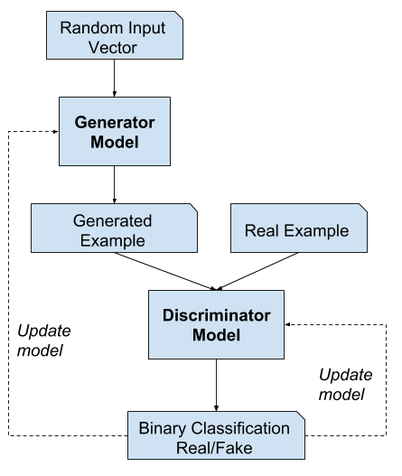
FULL Training loop

Slide 16
RESULTS
High-Quality Art Generation: The developed GAN models successfully generated diverse and visually appealing artworks across various styles and themes, showcasing the potential of AI in artistic creation.
Accurate Style Transfer: The style transfer algorithms demonstrated precise and faithful application of artistic styles to user-selected images, allowing for seamless integration of different artistic aesthetics.
User Engagement: The intuitive user interface facilitated seamless interaction with the system, empowering users to explore and customize AI-generated artworks according to their preferences and creative vision.
Ethical Considerations: The project addressed ethical concerns such as copyright compliance and fair representation, promoting responsible practices in AI-driven art generation.

Slide 17
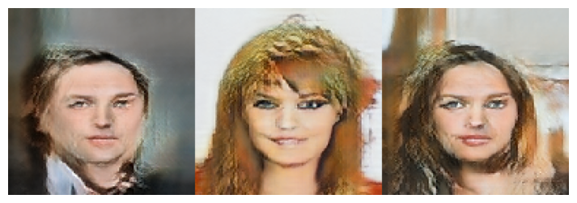
FINAL OUTPUT

Slide 18
Conclusion:
The project has successfully demonstrated the capabilities of StyleGAN for generating high-quality face images. Through meticulous dataset preparation, model training, and optimization efforts, we have created a user-friendly system that empowers individuals and organizations across diverse domains.
By providing realistic and customizable face images, our project opens doors to numerous applications in art, entertainment, marketing, e-commerce, education, healthcare, security, privacy, fashion, and beauty. We have showcased the potential of StyleGAN to revolutionize creative processes, enhance research endeavors, and drive innovation across industries.

