Slide 1
TEAM NAME :
-Member 1 : Shantanu Joshi
Member 2 : Suraj Vyavahre
THEME NAME : SOLID WASTE MANAGEMENT.

Slide 2
PROBLEM STATEMENT
Every locality has lot of Garbage and waste around which gets collected to form a heap.
This garbage heap starts when we intend to throw useless materials in our house on the roads and surroundings.
This garbage contains mostly plastic which is harmful for nature and this garbage is reason for spreading many diseases.
Hence we intend to solve following problems:
a.) Garbage pick-up based on demand
b.) Keeping streets and public spaces clean with ‘No Visible’ waste
c.)Both of above solutions will lead to ensuring Public health safety and making the environment green

Slide 3
IDEA
Users of this idea will be all the citizens of the Pune City who have any Smart phone
Benefits will be for:
a.)Citizens
b.)Government Organization
It will be based on Inter-Communication between both of them.
The idea is based on creating 2 modules in an Android application which can be installed by any citizen .The modules can be named as:
a.) Collection of Waste on Demand.
b.) Daily Garbage Collection activity.

Slide 4
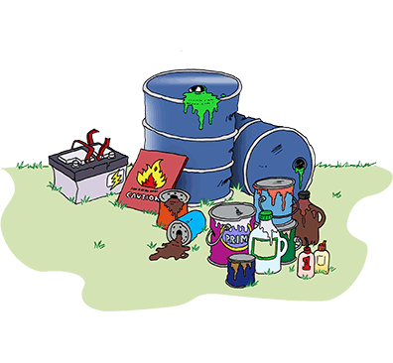
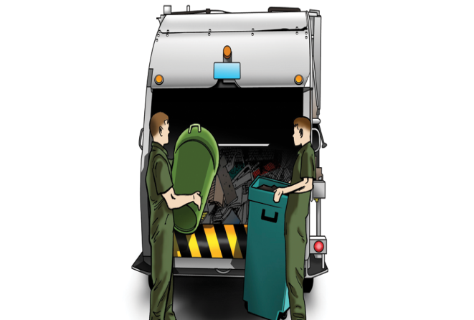


One of which contains (Collection of Waste on Demand):
a.)Any citizen who has any solid waste or is living in a locality where a lot of garbage is been dumped can send a “request” through this app to the government organizations by specifying the address of his house or locality from where waste is to be collected
b.)Government organizations can send employees to that house and can collect the garbage from the houses by giving some coupons or cash-back to the citizens based on weight of garbage
c.)This garbage can be recycled by the organization for further use and the money obtained from recycling can be used for providing cash-backs or coupons to citizens

Slide 5

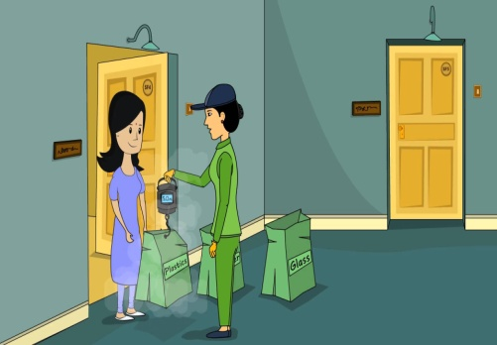
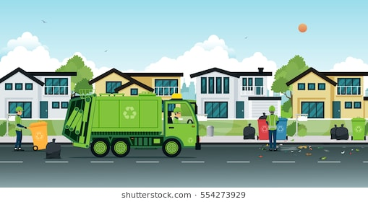

Second module contains(Daily Garbage Collection activity):
a.)Government organizations can send E-Trucks to the Buildings of the citizens in Pune and these trucks can collect the garbage on daily basis.
b.)Citizens using this app can perform daily activity by ticking on the basis of whether the garbage was collected on that day from there society or not
c.)If not the Government organizations can take any action to collect that garbage

Slide 6
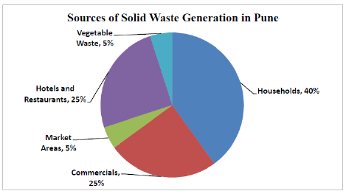
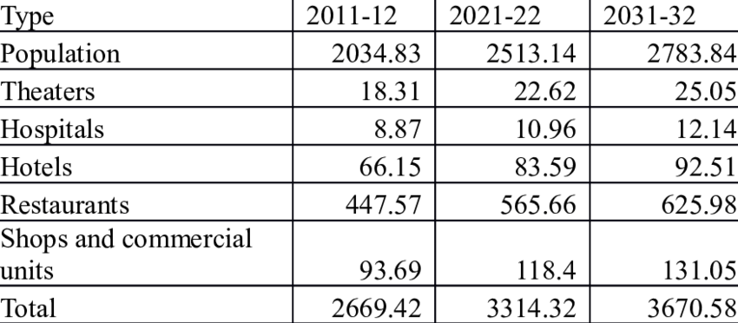
Potential Impact
All figures in tons
By 2031 if used this app all the types of waste can reduce up to 50 tons
According to the survey in 2017 , Pune is one of the fastest developing city, it generates total quantity of waste is about 1300 to 1400 metric tons per day.
If every citizen uses this application ,including the owners of the restaurants, industrialists, entrepreneurs the percentages of the above pie graph will reduce to significant amount as everyone will receive a cash-back or online shopping coupons and every citizen will eagerly participate in this .
This can even lead to 0% waste and 100% recycling and everyone can make “MONEY OUT OF WASTE” as Government can get the money by recycling the waste.

Slide 7
Some of the benefits to the Government organizations are:
Some of the benefits to the user segments are:
1.)Diseases due to dumped Garbage will reduce to tremendous amounts
2.)0% disposal of Garbage
3.)Cash-backs and coupons for Customers
4.)Garbage products can be recycled and reused
5.)Pick-up of Garbage from houses of people
6.)Management of Garbage using E-Trucks.
1.)Most of the job will be done by the Citizens only government has to just appoint people for collection of garbage
2.)Actually ,Government can increase the involvement of the citizens in this activity
3.)This will make the process more Transparent
4.)This will lead to more Employment

Slide 8
Technologies used: Android ,Firebase
Ease of implementation
All the citizens can use this as it is very handy .It is easy to implement as :
a.) No Stakeholders involved . Only at the first time we have to host this app on Play Store which requires $25 .
b.)Small number of Advertisements at the first is required
c.)Infrastructural requirement will be also not be required as almost everyone has Smart phone now-a-days .
d.)As the number of downloads of the app increases the Google starts providing some monthly funds which can be used to pay as cash backs to citizens.
Key Features:
1.)Firebase provides Analytics Free which can be used to see the downloads of the app and drawbacks if any easily
2.)Array Adapters can make the size of app less than 10 MB
3.)List can be used to display content dynamically
4.)Using Firebase the registration through Google ,github ,etc becomes easy

Slide 9
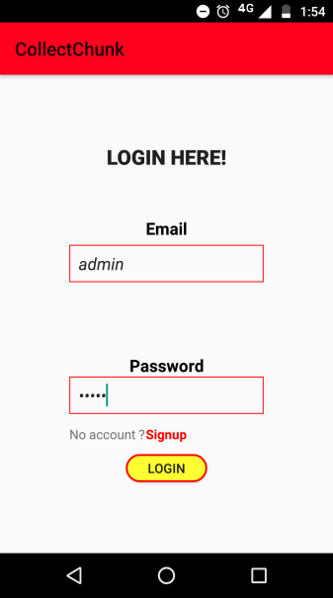
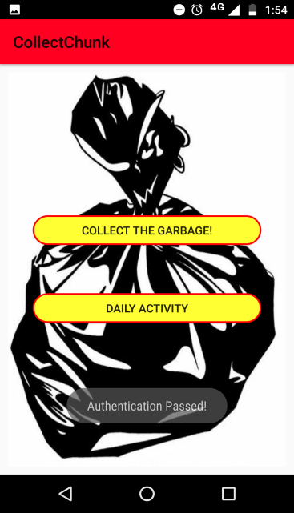
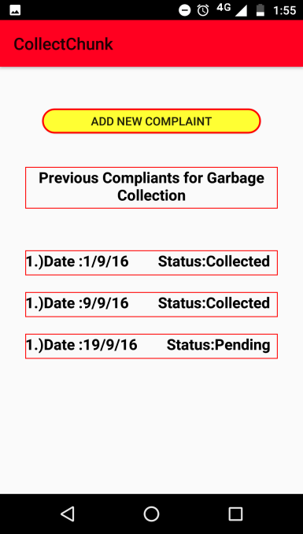
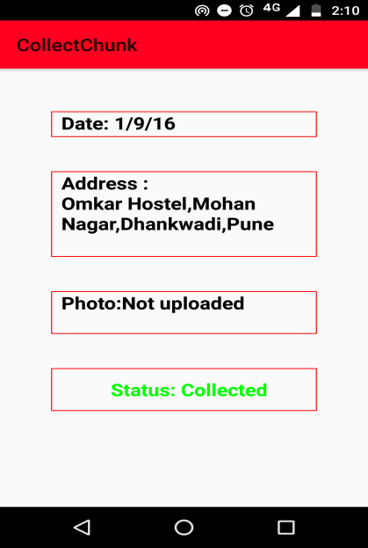
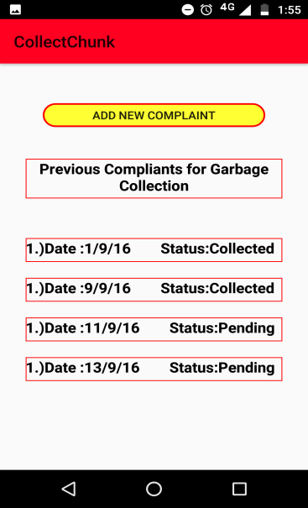
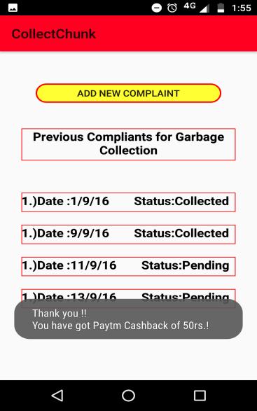
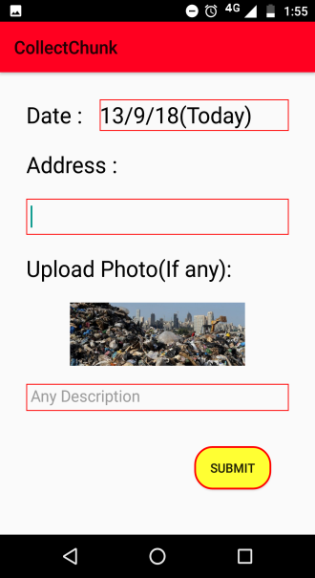
ADDITIONAL SUPPORT INFORMATION(WIREFRAMES)
See previous Complaints
Add new Complaint
Entry added to pending
CASHBACK MESSAGE

Slide 10
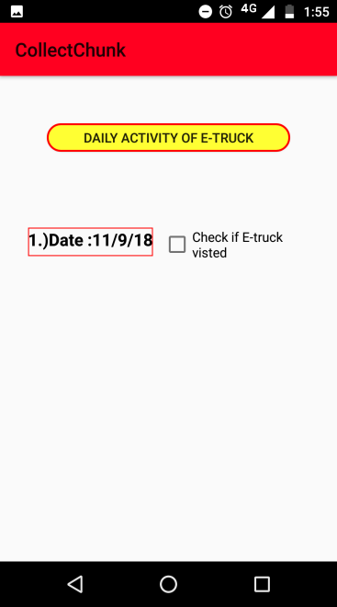
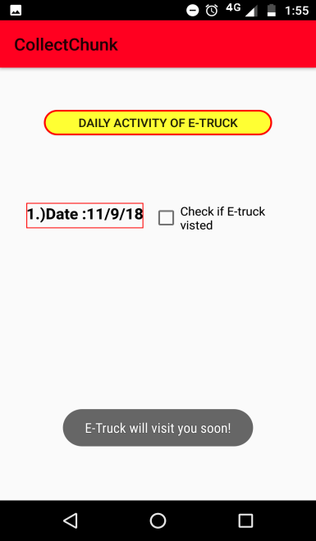
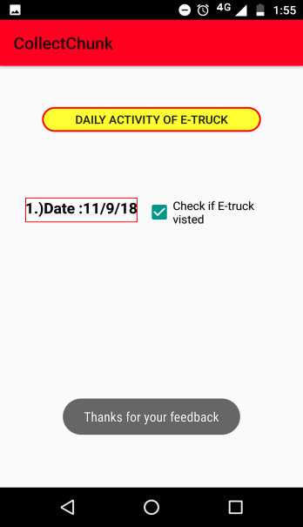
IF CHECKED E-TRUCK HAS COLLECTED THE GARBAGE
IF UNCHECKED THE BOX THE GOVERNMENT WILL SEND THE E-TRUCK
WITHOUT FAIL

Slide 11
THANK YOU ☺

