Slide 1
Test
War Stories

Slide 2



👋 Andreia “shana” Gaita
Editor Tools team lead @ GitHub
Runtime & scripting engineer @ Unity
Mono hacker @ Novell & Xamarin
sh4na (not a typo)
shana
Notes:
I am currently at GitHub and I'm the Editor Tools team lead. Before this, I was at Unity, Xamarin and Novell.
My day job for the last 12 years has been mostly open source work, and I've been in the tech industry for about 20 years.
I currently live in Copenhagen, Denmark, and I come back here regularly to remind me of what the sun looks like
So what do we do at GitHub? The Editor Tools team is responsible for integrating GitHub into tools like Visual Studio and Unity.

Slide 3
I'm not QA

Slide 4
Raspberry
SmartTV
tvOS
Android TV
ARCore
Linux
VMs
Solaris
Android
iOS
Fire OS
Gameroom
WebGL
AR Kit
3DS
XBox One
Cross-platform
XBox 360
Rift
PS3
PSVR
BSD
Wii U
Cardboard
UWP
MacOS
WMR
Windows
PS4
PS Vita
Vive
Switch
Daydream
GearVR

Slide 5
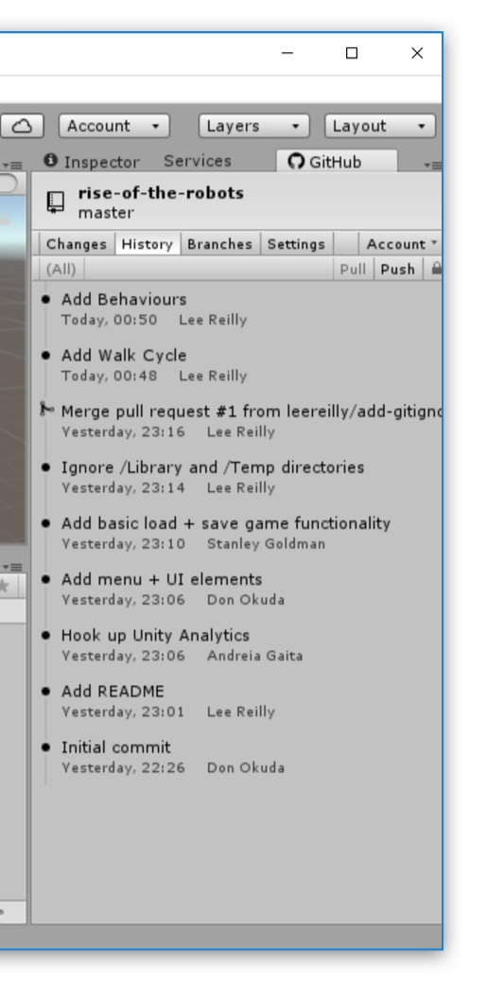
Visual Studio
Unity
Extensions
C++
C#
Notes:
We work in whatever language is required for the tool that we're building integrations for.
Every tool has its extensibility API and its preferred language for development. Visual Studio is C#, Unity is C# and C++, and something like Atom is javascript.
These are developer tools - basically build applications inside existing applications that extend existing functionality and provide new functionality for developers. Since we're GitHub, this is mostly about providing Git tools and UIs integrated into existing developer tools.
We have 300 thousand users using our integrations on a daily basis. In Visual Studio, we have all sorts of developers, ranging from open source maintainers and contributors to game developers, web developers, enterprise application developers.
No matter what you're doing in Visual Studio, at some point you're going to need to clone a repository from GitHub or publish your own project to it or share a gist of your code, and you'll be doing this through GitHub for Visual Studio.
In Unity our users are game developers working on mostly non-code assets – for code they can use Visual Studio.

Slide 6
The Mocking Incident

Slide 7
Problem #1
Organic
System Design

Slide 8
Problem #2
Implementation
Mocking

Slide 9
Problem #3
Ideal world
assumptions

Slide 10
You can shoot yourself
in the foot
with anything

Slide 11
TDD != System Design

Slide 12
A test tests things

Slide 13
Definitions of tests
Notes:
So what's it like for me, working in open source?

Slide 14
Unit tests
Integration tests

Slide 15
Assumption tests

Slide 16
Regression tests

Slide 17
Documentation tests

Slide 18
Black box tests

Slide 19
99% bug compatibility

Slide 20
Functional tests

Slide 21
The case of the missing ants

Slide 22
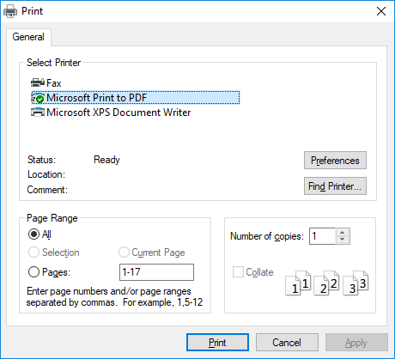

Slide 23
About those assumptions...

Slide 24
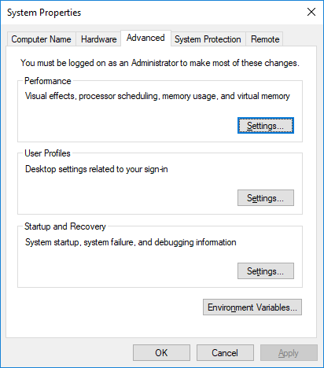
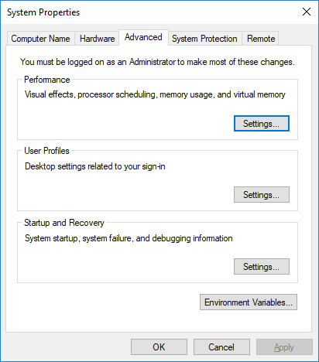

Slide 25
Check your assumptions
Test early
Test often

Slide 26
The $6500 bug

Slide 27
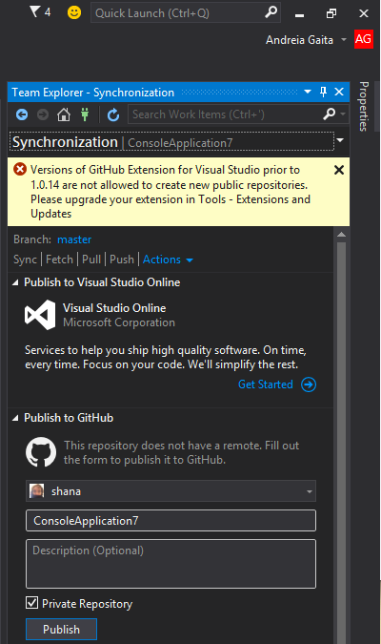

Slide 28
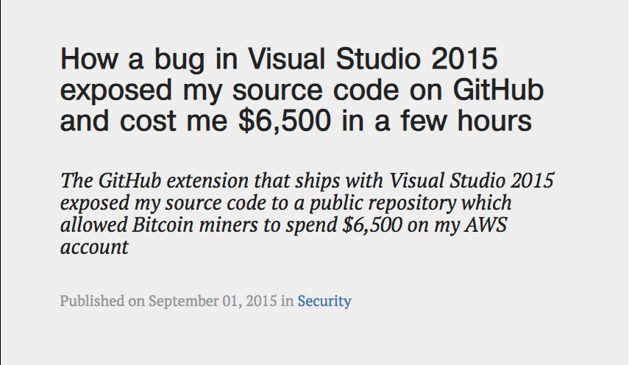

Slide 29
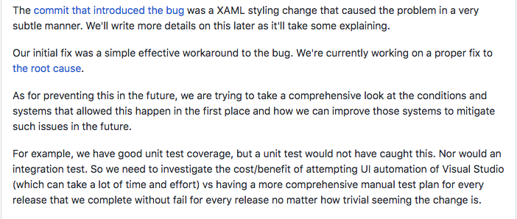

Slide 30
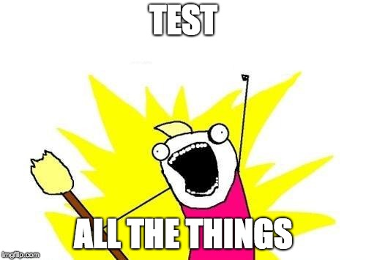

Slide 31
Thank you!
Questions anyone?
@sh4na
Andreia Gaita

Slide 32
Text
Text
Text
Text
Text
Text
Text

