Slide 1
From 0 to Open Source
Building the GitHub Extension for Visual Studio

Slide 2

Andreia Gaita
github.com/shana
twitter.com/sh4na

Slide 3
Talk roadmap
Planning
Architecture
Bumpy Road
Oh, dependencies...
Icons, how do I even
Resources Shmources
Ready, Set, Launch!
Rx.net
Resharper
Oooopsie...
Open source ALL THE THINGS!

Slide 4
Planning

Slide 5
What is GitHub for Visual Studio?
https://github.com/github/VisualStudio
Integrated with Team Explorer
Handles GitHub authentication and credentials
Sets things up so git operations in Visual Studio work
Clone repositories
Create repositories
Linking code to / opening code on GitHub
Newer features include:
Gist support
Pull Requests

Slide 6
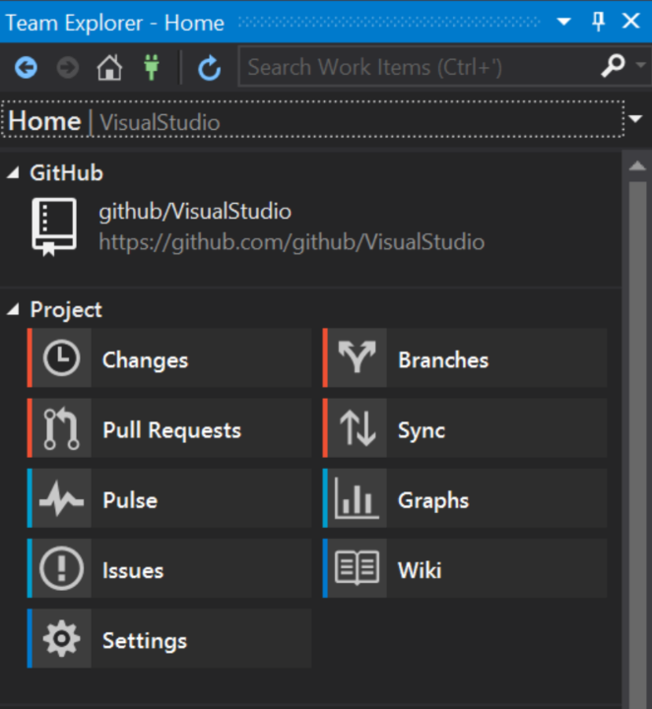
What is Team Explorer?
Team collaboration / Source control area in Visual Studio
Shipped as an extension
Allows managing source control repositories
Provides services for querying git repository information and cloning

Slide 7

The Plan
3 ½ months to ship
Started January 14, launching April 30
Close coordination with Microsoft
New APIs
Design and UI
Performance and dependencies

Slide 8
Architecture

Slide 9
The Approach
Automate as much as possible
CI
Build scripts matching Visual Studio builds
Solid architectural foundation
Splitting interfaces from implementations
Carefully controlling MEF exports
IServiceProvider is not a good thing to export
Open sourcing the code
Careful about dependencies, documentation, swear words
Splitting tasks
Phil took on the UI, taking advantage of GitHub for Windows code
I took on the VS and Team Explorer integration

Slide 10
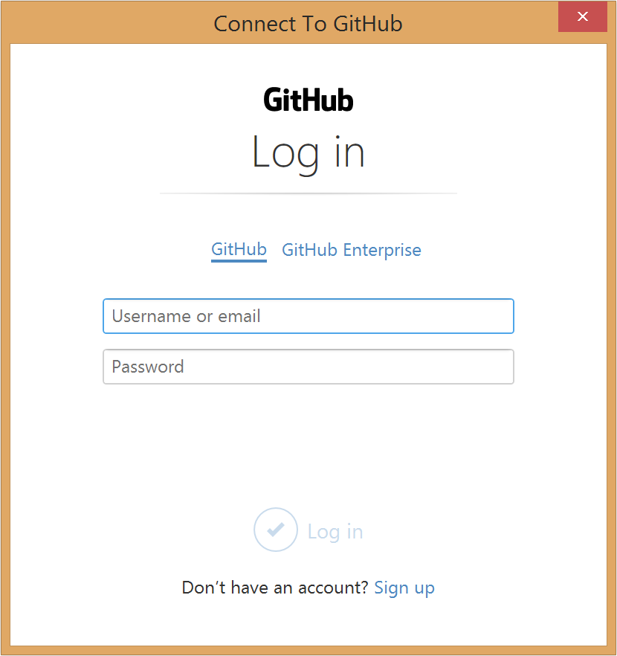
Challenges - UI
Team Explorer UI
Other UI
Implement a class, get a UI
Follows VS theme
Activated via MEF and callbacks
XAML UI, based on GitHub for Desktop
Follows GitHub design, not VS theme
Hosted in a dialog window
Notes:
10 MINUTES!!!

Slide 11
Challenges – Footprint & Performance
Reactive vs Non-Reactive code
Early on we knew that we had to be careful about performance and dependency footprint in the Team Explorer areas
Non-Reactive
Reactive
GitHub.Api
GitHub.Extensions
GitHub.Exports
GitHub.UI
GitHub.App
GitHub.Extensions.Reactive
GitHub.Exports.Reactive
GitHub.UI.Reactive
Notes:
10 MINUTES!!

Slide 12
Challenges - Testing
Unit testing is easy
Interfaces everywhere lets us unit test individual bits
Integration testing is hard
Testing UI in Visual Studio == Automating all of the Visual Studio
How to test components that rely on Visual Studio services?
You don't?
Add a layer in front of VS services and mock responses for testing

Slide 13
Challenges - Installation
Installers
The initial plan was to only ship a VSIX
A VSIX is a zip file handled by the vsixinstaller app
Microsoft asked us to ship an MSI for the dynamic installer
The dynamic installer is the (then) new installer for Visual Studio 2015
It's an installer that launches other installers.
Easy shipping and maintenance requires easy automation: WiX
Uses xml format, easy to automate
Capable of launching other installers
MSI only looks at the first 3 parts of a version, VSIX supports semver

Slide 14
Bumpy road

Slide 15
Dependency clashes
Depending on specific versions of an assembly - nuget
Plugin-based model == Potential X copies of the same assembly
Any extension might load similar assemblies with different versions
Team Explorer ships with libgit2sharp
Splat, ReactiveUI, Octokit, libgit2sharp...

Slide 16

Dependency clashes
Depending on specific versions of an assembly - nuget
Plugin-based model == Potential X copies of the same assembly
Any extension might load similar assemblies with different versions
Team Explorer ships with libgit2sharp
Splat, ReactiveUI, Octokit, libgit2sharp...
Solution: Fork and Sign (and sigh)

Slide 17
Icons, How Do I Even
Extensions load BMPs from image strips
Doesn't really scale well for different DPIs
Who wants to edit image strips with bitmaps??
<Bitmaps>
<Bitmap guid="guidWidgetIcons" href="WidgetToolbarIcons_32.bmp" />
<Bitmap guid="guidWidgetIcons2" resID="IDBMP_WIDGETICONS" usedList="1, 2, 3, 4"/>
</Bitmaps>

Slide 18
Icons, How Do I Even
Extensions load BMPs from image strips
Doesn't really scale well for different DPIs
Who wants to edit image strips with bitmaps??
Solution: Image manifest to the rescue!
Include xaml files
https://github.com/github/VisualStudio/blob/master/src/GitHub.VisualStudio/GitHub.VisualStudio.imagemanifest
Magic line in .vsct: <CommandFlag>IconIsMoniker</CommandFlag>
<Bitmaps>
<Bitmap guid="guidWidgetIcons" href="WidgetToolbarIcons_32.bmp" />
<Bitmap guid="guidWidgetIcons2" resID="IDBMP_WIDGETICONS" usedList="1, 2, 3, 4"/>
</Bitmaps>

Slide 19
Resource Caching
Caching resources
No place to put global resources loaded with the extension
No automatically loaded design-time xaml resources
No easy way to share resources

Slide 20
Resource Caching
Caching resources
No place to put global resources loaded with the extension
No automatically loaded design-time xaml resources
No easy way to share resources
Solution: Each project with resources has a SharedDictionary.xaml
<ResourceDictionary.MergedDictionaries>
<cache:SharedDictionaryManager
Source="pack://application:,,,/GitHub.VisualStudio;component/SharedDictionary.xaml" />
</ResourceDictionary.MergedDictionaries>
Notes:
20 MINUTES!!

Slide 21
Resource Caching
<ResourceDictionary.MergedDictionaries>
<cache:SharedDictionaryManager
Source="pack://application:,,,/GitHub.VisualStudio;component/SharedDictionary.xaml" />
</ResourceDictionary.MergedDictionaries>
But App.xaml is "special", only loaded once at design-time and runtime
SharedDictionary.xaml on its own is not enough
Still loaded for every xaml that includes it
Notes:
20 MINUTES!!!

Slide 22
Resource Caching
<ResourceDictionary.MergedDictionaries>
<cache:SharedDictionaryManager
Source="pack://application:,,,/GitHub.VisualStudio;component/SharedDictionary.xaml" />
</ResourceDictionary.MergedDictionaries>
But App.xaml is "special", only loaded once at design-time and runtime
SharedDictionary.xaml on its own is not enough
Still loaded for every xaml that includes it
Solution: Hijack the Source property implementation:
https://github.com/github/VisualStudio/blob/af81bbfc48c362f498d27c5b6cfd448bf9485422/src/GitHub.VisualStudio/Helpers/SharedDictionaryManager.cs#L80-L100

Slide 23
Oh, Resources...
Xaml designer ignores Source property, so you can't see the imported styles at design time
Team Explorer loads our UI so early, assemblies can't be found

Slide 24
Ready, Set, Launch!

Slide 25
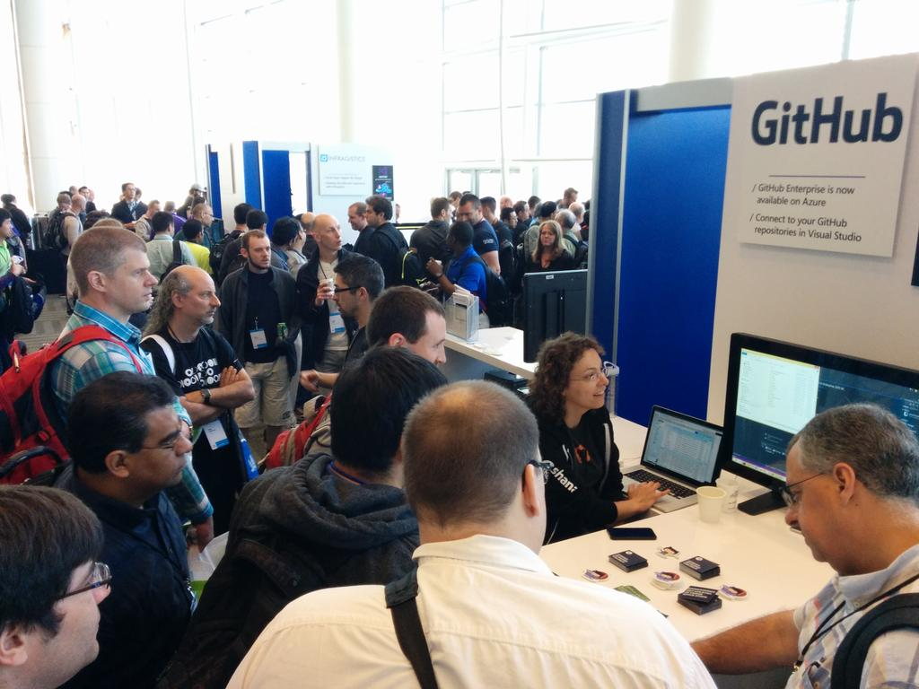
Launch Day!
Launched April 30 2015 at BUILD!
Lots of great conversations!
Excitement after 4 months of crazy work!
A few crash reports...

Slide 26
Rx.NET, or How To Break Everything
Remember how I was very careful about forking and signing everything?
Rx.NET is signed
Same assembly shipped twice, one built with .NET 4.0, another 4.5
Same version, same signing key

Slide 27
Rx.NET, or How To Break Everything
Remember how I was very careful about forking and signing everything?
Rx.NET is signed
Same assembly shipped twice, one built with .NET 4.0, another 4.5
Same version, same signing key
The version built with .NET 4.5 has EXTRA METHODS
+ Xamarin shipped with the .NET 4.0 version of Rx.Net
+ GHfVS is .NET 4.5

Slide 28
Rx.NET, or How To Break Everything

Slide 29
Resharper
Reports that typing was extremely slow in the login dialog, only when Resharper was loaded.
Resharper devs suggest it might be threading issues, because Resharper injects itself into every window in VS.
But why would there be threading issues?

Slide 30
Resharper
Reports that typing was extremely slow in the login dialog, only when Resharper was loaded.
Resharper devs suggest it might be threading issues, because Resharper injects itself into every window in VS.
But why would there be threading issues?
https://github.com/shana/splat/blob/6a0eb8cb7a5d4f2a2ff04f7bc9534f7cf059ff7a/Splat/PlatformModeDetector.cs#L18-L26
https://github.com/shana/ReactiveUI/blob/GHfVS/ReactiveUI/RxApp.cs - L110-L112
Notes:
30 MINUTES!!!

Slide 31
The $6500 bug
https://github.com/github/VisualStudio/issues/62
http://news.softpedia.com/news/a-bug-in-the-github-extension-for-visual-studio-made-a-developer-lose-6-500-5-800-490720.shtml
The checkbox didn't match the Team Explorer style.
Checkbox with checkbox + textblock inside, so hover styles work
But... ReactiveUI listens for Checked property changed, deep down, not RoutedEvent
Result: event handled by inner checkbox, property bound to outer checkbox
Please please please never commit AWS keys!
Notes:
30 MINUTES!!

Slide 32
The $6500 bug
First alert around midnight CET (3pm PT)
4AM CET, fix
5AM CET, new version published
7AM CET, GitHub API blocks affected versions of the extension
Advantages of a distributed team
Fully documented build and deployment procedures

Slide 33



Slide 34

July 20, 2015

Slide 35
Moving from private to public
New, clean repository
Migrate relevant issues
git-filter-branch ftw
GitHub client id/secret data needs to be private
Never ever ever ever commit signing certificates or passwords to a repo
But if you do, git-filter-branch ftw
Clean up useless binaries from the history
Private submodule for private bits
Comprehensive commit messages help everyone

Slide 36
Public is more than code
Process for open sourcing projects
Contributor guidelines
General documentation
Can anyone build it?
Code conventions
License
Commitment to supporting contributors
Open communication channels
Take advantage of commit history as documentation
Migrating history is essential

Slide 37
Balancing contributors and product quality
Library vs Application
Design and UX guidelines
Users should always be on the latest version
Never ever ever ever ever crash
If we crash, so does Visual Studio
Long contribution acceptance cycle
Lots of polish required
Lots of code reviews
Multiple features complicate branch merging
How to keep contributors happy?
Contributors!
jau228
georgebearden
austin94
lathejockey81

Slide 38
Thank you!!
Andreia Gaita
github.com/github/VisualStudio
github.com/shana
twitter.com/sh4na
Contributors welcome!!
Notes:
40 MINUTES!!!

