Slide 1
Confessions
of a cross-platform engineer

Slide 2



Andreia Gaita
sh4na (not a typo)
shana
Currently at GitHub
Formerly at Novell, Xamarin, Unity...

Slide 3
What is a cross-platform engineer?

Slide 4


Slide 5
Code tailored
to the platform

Slide 6
Platform:
OS + Environment
Notes:
OS + environment
this is hardware architecture
also the available system APIs and services
possibly UI if it's different enough to merit specific code
for instance, Windows (regardless of version) is one platform, but Windows Store Apps is a separate platform
Android vs Android TV

Slide 7
Web Apps?
Native UI Apps
Native Tools (no UI)
Libraries
Runtimes
Notes:
Web Apps are by definition the most cross-platform, but at the same time the most removed from the specifics of the platform.

Slide 8
the problem of
Native xplat apps

Slide 9
Native UI apps
hit every problem
and then some

Slide 10
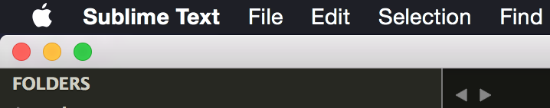
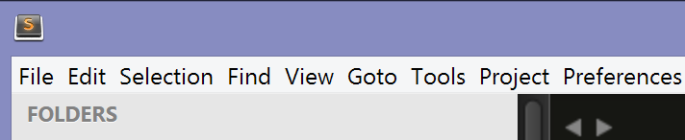
Notes:
If you've used more than one OS, you'll know that everyone does it differently.

Slide 11
Shortcuts
Notifications
Design
Platform styles
App switching
Widgets
Menus

Slide 12
Detour!

Slide 13
Editors
Where are my options?
Living the xplat life
Shortcuts
Shells
Notes:
As a cross-platform developer, I am forced to constantly switch between OSes for my development
This means that I can't get used to using specialized OS-specific development tools (like VS)
Switching OSes means different shortcuts
different shells
Remembering where the options are per OS

Slide 14
Detour done! (for now)
Notes:
Going back to native UI apps! Platform integration

Slide 15
Installers
Services
Launchers
Platform Integration
Filesystem quirks
Installation paths
Notes:
Besides UI-specific issues, native apps also need to integrate with the platform.
Case sensitivity.
Platform installers.
Running services.
Where do you put things?
Library/ApplicationSupport vs ~home/.local vs ProgramData vs ???

Slide 16
Split codebase
Native UI toolkits?

Slide 17
One codebase
Xplat UI toolkits?

Slide 18
One codebase
Roll your own UI?

Slide 19
Mobile
One codebase
to bind them all?
(hint: perhaps not)
Desktop
Notes:
Sharing some code is useful
Mobile has resource constraints, UI constraints
Mobile apps should be designed mobile-first
Sharing skills is more important

Slide 20
Xamarin.Forms
Kyvi
Decisions, decisions
Electron
wxWidgets

Slide 21
The layered approach
UI Layer: Non-native (WebKit, OpenGL...)
Logic layer: xplat language
Unity, Electron, Kyvi...

Slide 22
Libraries, tools and runtimes
Native non-UI

Slide 23
Structure of a framework
High-level API
Platform abstraction
Generated API?
Platform-specific code
I/O
Services
Designed to be consumed by others
Not necessarily the same language
...
Hide platform quirks
Consumed by high-level API

Slide 24











Suppose you want
to target...
Notes:
Suppose you want to make something that targets a large subset of these platforms (or all of them)
Maybe you want to build a VR latency measurer
A media server
A new source control system
A game, rolling your own tech
The more platforms you want to target...

Slide 25
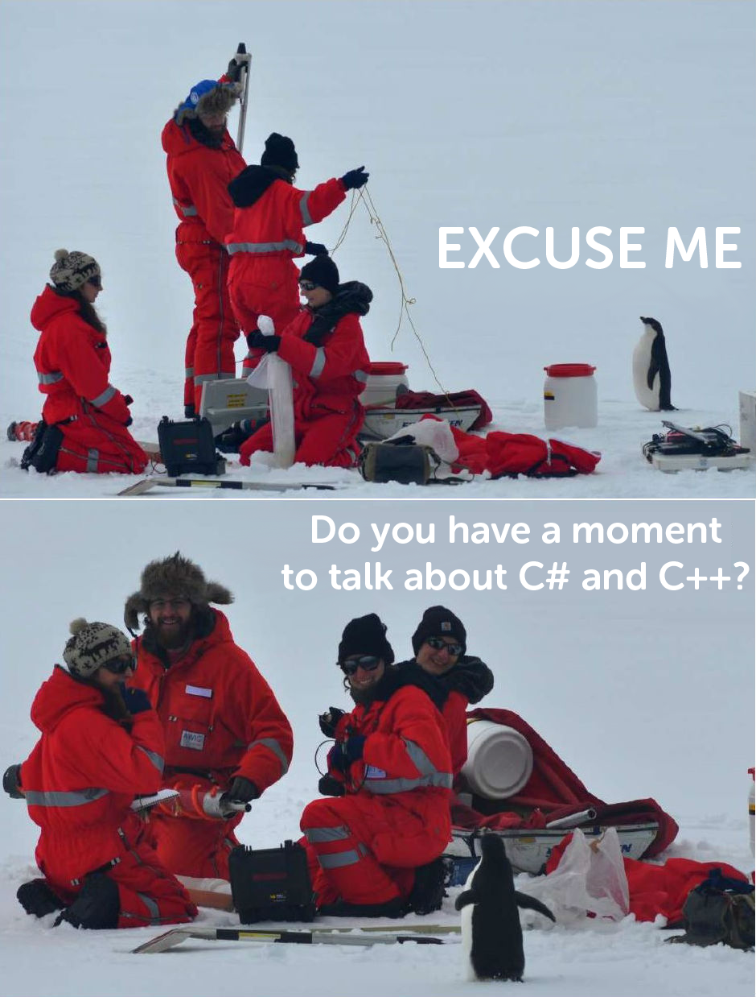
Notes:
the fewer your language and framework options are going to be

Slide 26
C++11 with GCC and Clang
http://goo.gl/WB4I3f
Notes:
C++11 and above is an interesting option.
Languages are only useful alongside libraries for math and threading and file access, etc.
Many times, the choice is less about the language and more about the libraries they have.
C++11 comes with new stl libs which are implemented more or less everywhere, which makes it a ridiculously powerful and portable language.
You can read more about it in the article I'm linking there.

Slide 27
C# and Mono
Runs on
10 20 30 platforms everywhere

Slide 28
(Why not both?)
Notes:
Combining multiple languages is very common and very powerful
A higher level language and API for fast development and iteration
Lower level runtime layer for tight platform integration
Unity C#-C++

Slide 29
Layers! Multiple libraries UI on top
Notes:
Should be.
Hard split of UI and business logic
Can do it in any language, really

Slide 30
Building things

Slide 31
Constraints on your primary platform:
Target platforms
Languages & frameworks
Notes:
Choosing a primary platform from which to cross-compile
Choosing an IDE

Slide 32
Story time
Notes:
I've had several projects where I've had to build for multiple platforms locally
Windows not an option
Mono for Android builds could be done from Linux or OSX
Small game engine targetting iOS and OSX narrows choice to OSX as the easiest platform to cross-compile from
Doesn't mean I will primarily develop on it, because I really like VS, so...

Slide 33
Visual Studio
XCode
Generate project files
Insert popular target platform IDE here

Slide 34
Choose targets
Choose language / framework
Choose source
Choose build tools

Slide 35
Build system?
Cross-platform
Multiple targets, decent granularity
Customizable and extendable
Parallelizable
Maintained and documented
Notes:
Debug and Release, architecture specific
Compiler flags, adding new compilers, calling native tools, adding flags easily
Conditional source file compilation

Slide 36
cmake
autotools
msbuild/xbuild
Examples
jam
gradle
ninja

Slide 37
perl
python
Scripting the tools
native shell scripts

Slide 38
Story time
Notes:
Unity build system – jam, perl, code generator

Slide 39
There's more! do I have time?
Tests
CI
Dependencies
Packaging

Slide 40
Be
adaptable

Slide 41
It's going to be
uncomfortable
deal with it

Slide 42
Thank you!
Questions anyone?
sh4na
Andreia Gaita
shana

