Slide 1
Poking Git
Advanced Git Techniques

Slide 2



Andreia Gaita
sh4na (not a typo)
shana
Editor Tools team lead at GitHub

Slide 3
https://shana.github.io/talks/

Slide 4
The Index

Slide 5
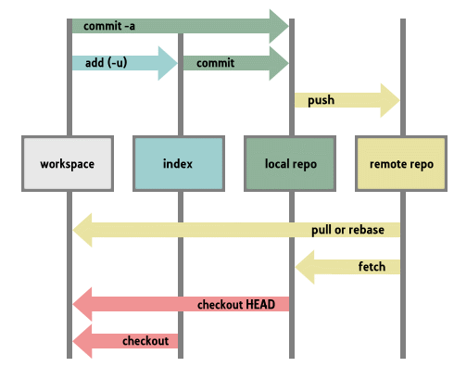
4 levels

Slide 6
Index or Staging Area
git add
git add -p
git mv
git rm
git rm --cached

Slide 7
Navigating History

Slide 8
History as a tree

Slide 9
Branches == labels

Slide 10
There's a HEAD

Slide 11
Reset

Slide 12
Moving around
git reset --hard
Changes the HEAD
Updates files on disk
git reset --soft
Changes the HEAD
Does not update files on disk

Slide 13
But move where?
commit_hash
HEAD~n
where n is a number (go back n commits)
HEAD@{n}
where n is a number (go back n commits)

Slide 14
Stashing

Slide 15
A stack of changes

Slide 16
Stashing
git stash
git stash list [-u]
git stash show [-u]
git stash apply
git stash pop
git stash branch[name]

Slide 17
Rebase

Slide 18
git rebase [commit or branch]
finds the common commit of the two trees – point1
"saves" all the commits from point1 to the current HEAD
resets HEAD to commit or branch passed to the rebase command
applies all the commits from step 2, one by one

Slide 19
When to rebase
Single person branch
i.e., there's no PR for it (yet)
Avoid force-push on branches with more than 1 contributor

Slide 20
Merge vs Rebase

Slide 21
Why rebase
Backing up work in progress
Cleaning history before a PR review

Slide 22
Why merge
Branch is being reviewed
Multiple contributors
force-push will cause conflicts for other people

Slide 23
Reflog

Slide 24
Bisect

Slide 25
Moving around again
git bisect automates history navigation
Binary search on a range of commits

Slide 26
Large Files

Slide 27
git lfs install
git lfs track '*.jpg'

Slide 28
Submodules

Slide 29
For dependencies

Slide 30
Branch filtering

Slide 31
Oops you committed a password

Slide 32
git filter-branch

Slide 33
Thank you!
Questions anyone?
sh4na
Andreia Gaita
shana

