Slide 1
Typescript => IL => Game Modding
Supercharged

Slide 2



👋 Andreia “shana” Gaita
Editor Tools tech lead @ GitHub
Runtime & scripting engineer @ Unity
Mono hacker @ Novell & Xamarin
sh4na (not a typo)
shana
Notes:
I am currently at GitHub and I'm the Editor Tools team lead. Before this, I was at Unity, Xamarin and Novell.
My day job for the last 12 years has been mostly open source work, and I've been in the tech industry for about 20 years.
I currently live in Copenhagen, Denmark, and I come back here regularly to remind me of what the sun looks like
So what do we do at GitHub? The Editor Tools team is responsible for integrating GitHub into tools like Visual Studio and Unity.

Slide 3
Languages in game development

Slide 4
Game Engine
C/C++/…
Notes:
Games, like everything, are built on layers of technology. The lowest layer is the game engine, and game engines are built using whatever language the developers choose as most efficient at putting pixels on a screen really really fast while still portable enough to run it on multiple platforms. C/C++ is a common choice.

Slide 5
Game Engine
C/C++/…
Scripting
C#/Lua/Basic/Scheme/F#/…
Notes:
The game engine is like your own personal mini-OS abstraction that the game runs on. As such, people building things for this personal mini-OS don't want to care about the details, they just want to get things done. People like gameplay programmers and level designers are not spending time tweaking the engine, they're spending their time building the game with tools that are optimized for building gameplay and designing levels.

Slide 6
Game Engine
C/C++/…
Scripting
C#/Lua/Basic/Scheme/F#/…
Notes:
At this point, it's not very efficient to have them do this directly in the engine code, so you add a layer on top that they can use to describe what the game has to do and talk to the engine, without having to be knee deep in engine code. This is where a scripting language comes in, picked to be optimal for the tasks that people building the game itself need to do. In a lot of cases this isn't the same language that the engine is built on.

Slide 7
Uncharted

Slide 8
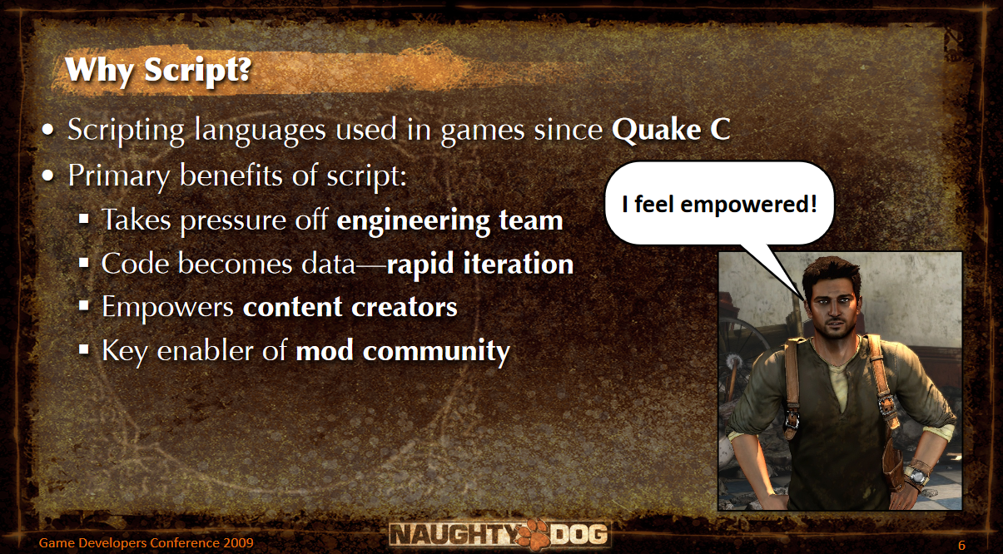
Notes:
I got interested in this subject when I saw the slides for a GDC talk given by Naughty Dog in 2009, talking about their approach to scripting when making the Uncharted series.
They looked at what a game is from the lens of a designer, decided that the language for the engine is not suited for this task, and built a simplified Lisp/Scheme language that their designers use to script the game, all the NPCs, events, story, dialog, etc, etc.
This also happens to be an excellent way to provide a community with game modding tools. You can't just give them access to the engine code, but with the whole game built on a modular system with a scripting language, you basically get community modding almost for free.

Slide 9
Neverwinter Nights

Slide 10
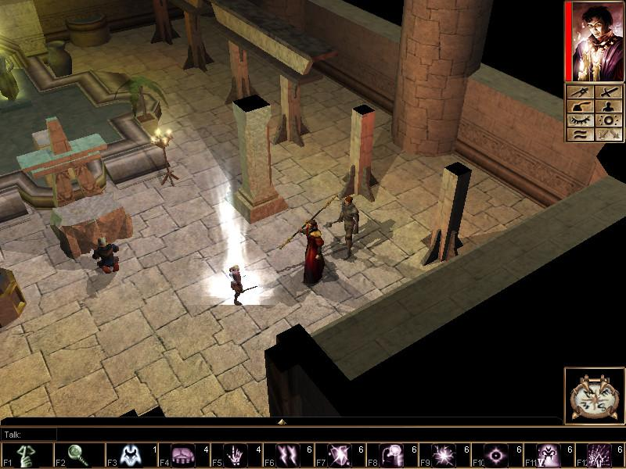
Notes:
A while ago my partner and I started playing around with the idea of building a Neverwinter-Nights-type game.
Neverwinter Nights is an RPG by BioWare, released in 2002, based on the D&D 3rd edition rules. What sets Neverwinter Nights apart is their fully scriptable runtime and modding tools, that allow anyone to build their own game and run that game for others in multiplayer mode.

Slide 11
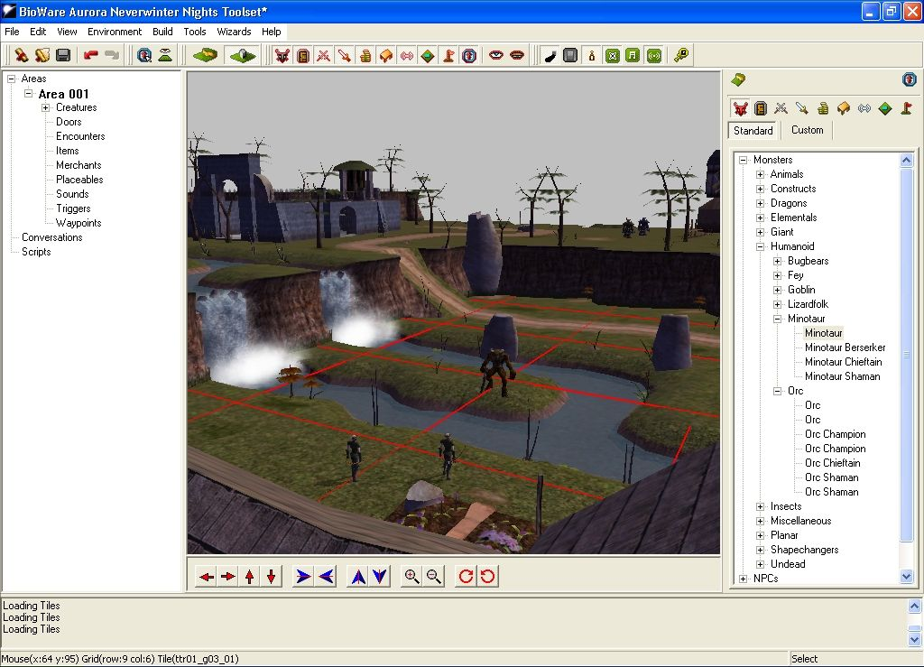
Notes:
Anyone can fire up a server and get their friends to play in a shared world, and a server admin can take over an NPC and interact with the players in real time, bypassing the scripted dialog trees, if they want.

Slide 12
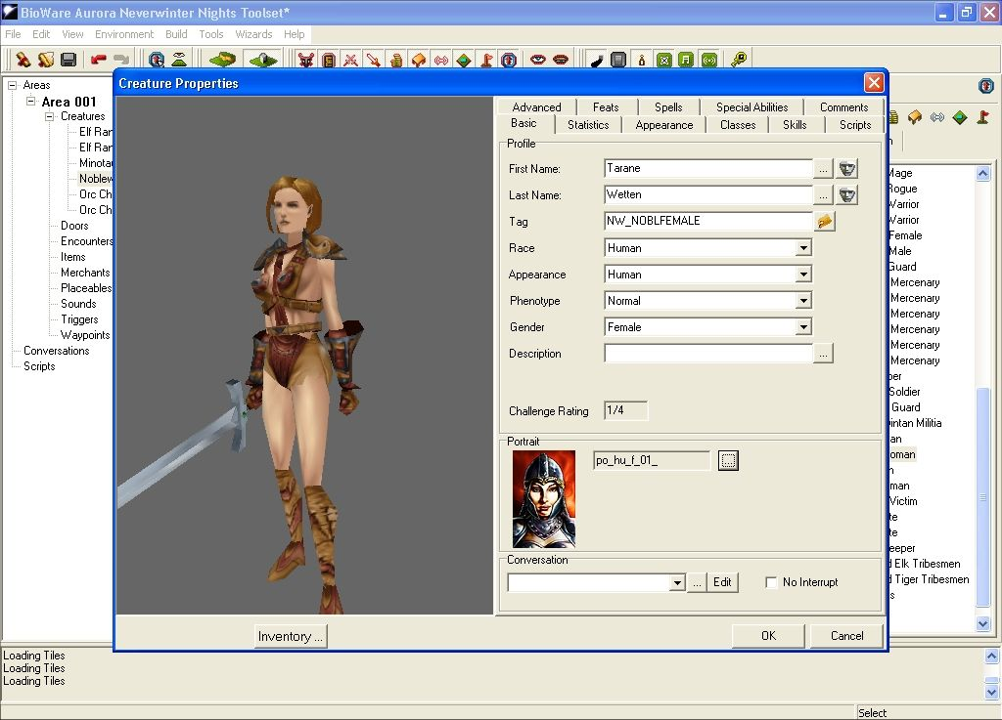
Notes:
We both really miss a good online multiplayer community RPG, so we kinda went "that would be cool, we should build that". Since we both know Unity3D, that was the obvious choice - and Unity has two nice things going for it for this project - a really powerful scripting language in C#, and Mono under the hood. Having Mono means having all the needed tools to compile and reload code at runtime in a cross-platform way without system dependencies.

Slide 13
Thank you!
Questions anyone?
@sh4na
Andreia Gaita

Slide 14
Text
Text
Text
Text
Text
Text
Text

