Slide 1
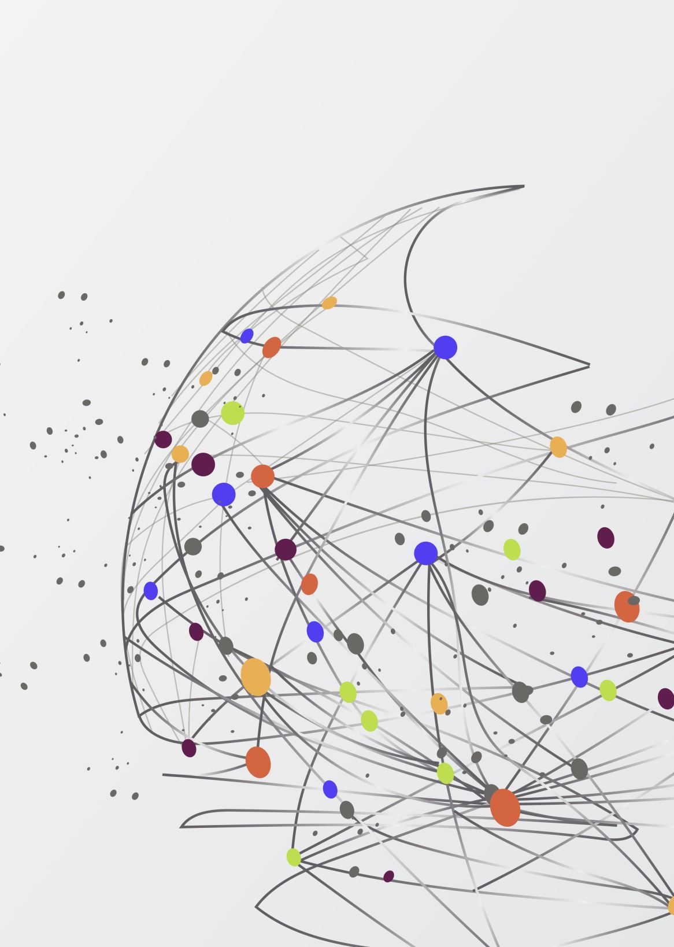
Similarity
How do we judge the likeness of two songs?

Slide 2
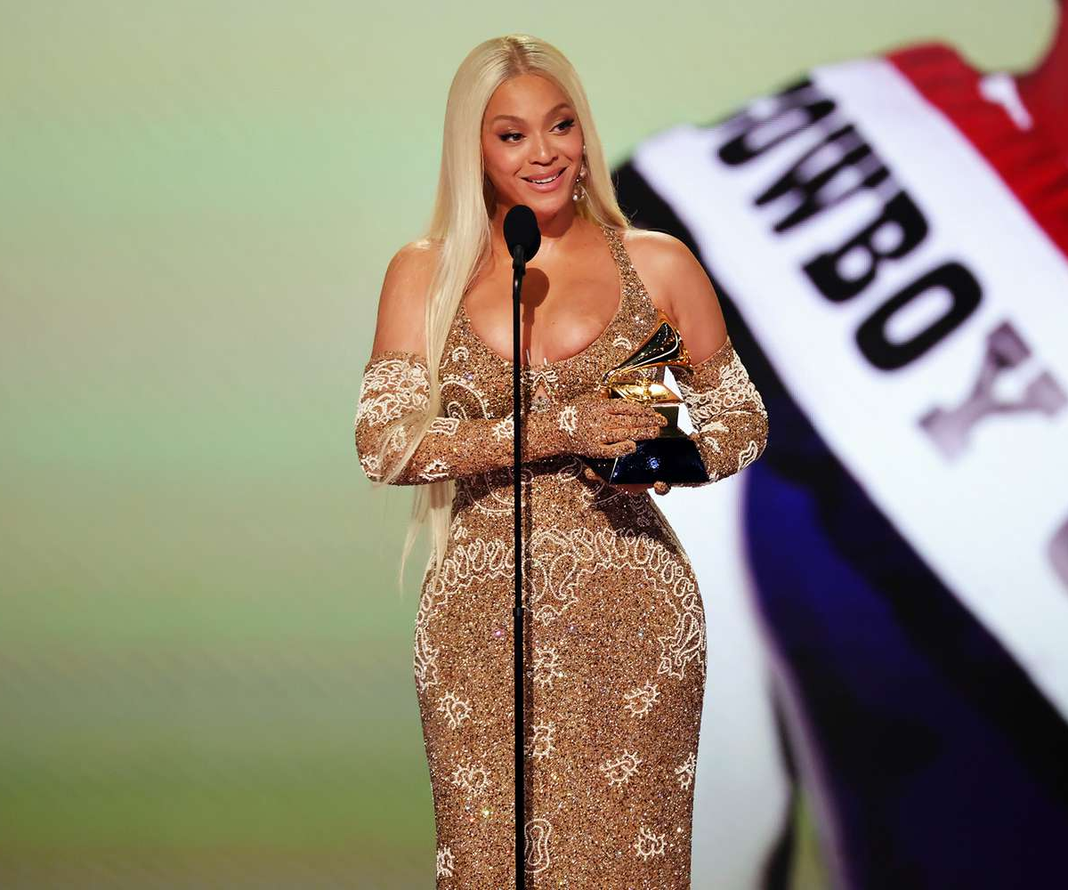
Beyonce on Genre
“I think sometimes 'genre' is a code word to keep us in our place as artists.”
“I just want to encourage people to do what they're passionate about and to stay consistent”

Slide 3
How would you grade these?

Slide 4
How do we think of music as similar or not?
Similarity as Spatial Distance
Similarity as Feature Set Interaction
Similarity as Transformation
Similarity as Alignment

Slide 5
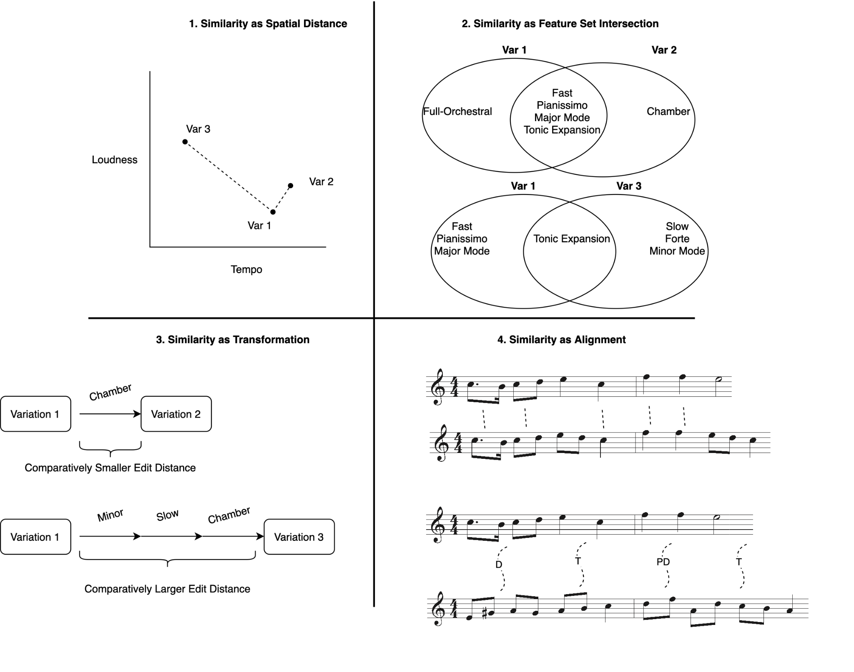

Slide 6
Similarity as Transformation
What is the distance between:
“Dan Shanahan” and Irish rugby star “Dan Sheehan”?
Dan Shanahan → Dan Sh?eehan (1 deletion)
Dan Shanahan → Dan Sheehan (2 substitutions)
Levenshtein Distance == 3!

Slide 7
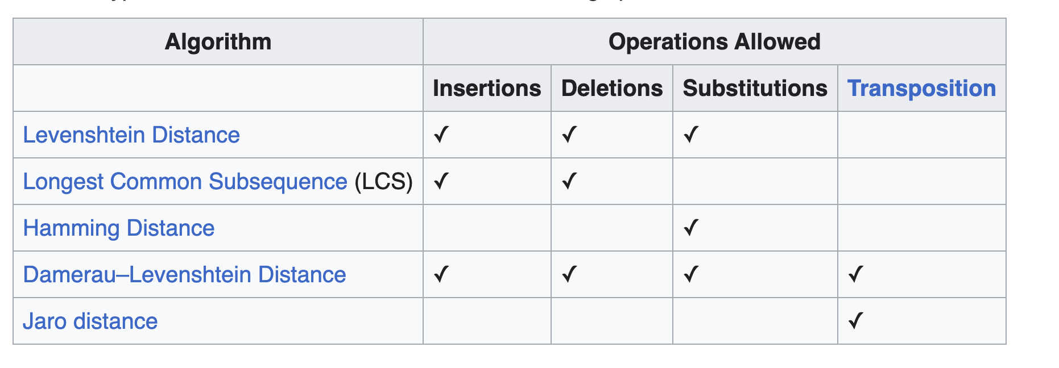
Similarity as Transformation
Helpful table from Wikipedia

Slide 8
Edit Distance

Slide 9



Edit Distance
Edit Distance of 2?
Edit distance of 12, if only looking at pitches…

Slide 10
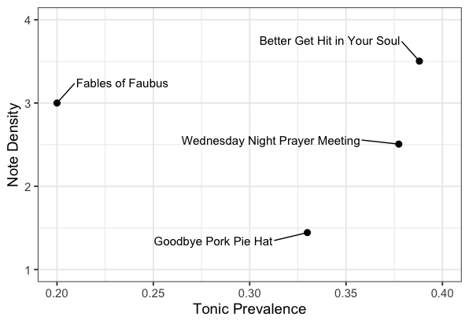
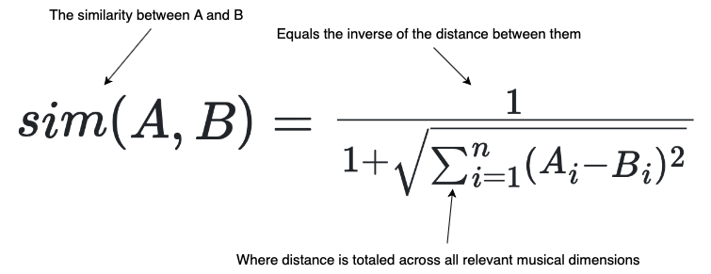
Similarity as Spatial Distance

Slide 11
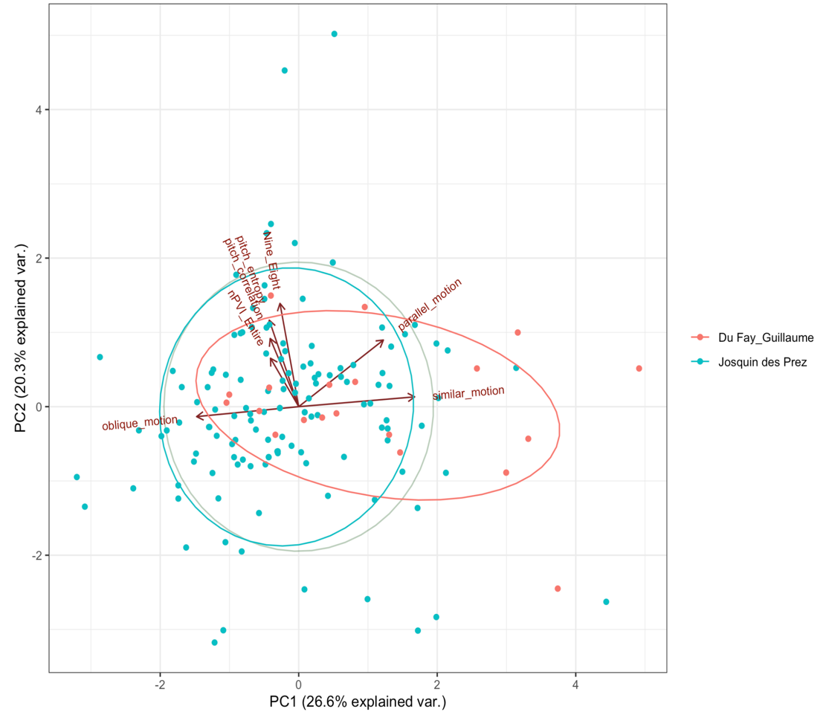
Similarity as Spatial Distance

Slide 12
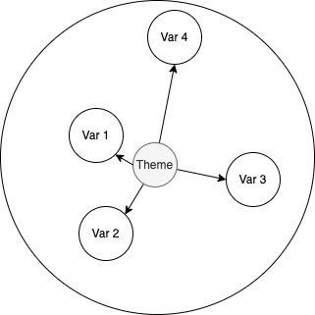
Theme and Variations

Slide 13
Limitations of a Spatial Distance Approach
Because identical objects have the same “address” in space, they must then always be the same level of similar to one another.
Krumhansl (1979) observed that it is easier to judge two chords to be identical if they are central to the key rather than out-of-key.
Some objects are easier to recognize as similar than others.
Think of the classification work from Week 1: knowledge of something informs how you judge it to be similar.

Slide 14
Limitations of a Spatial Distance Approach
The problem of symmetry:
Similarity of A and B must be the same as that between B and A.
James Bartlett and Jay Dowling (1988) found that when a diatonic melody followed a highly chromatic one, participants tended to judge the two to be more similar than when the presentation order was reversed.
Phenomena differ in terms of our familiarity and fluency with them:
Unfamiliar → familiar is easier than familiar → unfamiliar

Slide 15

Limitations of a Spatial Distance Approach
The problem of transitivity (or “triangle inequality”):
Jamaica is similar to Cuba (because of geographical proximity);
Cuba is similar to Russia (because of their political affinity);
Jamaica and Russia are not similar at all.
In other words, if A is similar to B, and B is similar to C, then A should not be too dissimilar to C.

Slide 16
Limitations of a Spatial Distance Approach
To summarize:
Spatial accounts assume reflexivity, symmetry, and transitivity
But these assumptions are frequently at odds with perceptual judgments of similarity.

Slide 17
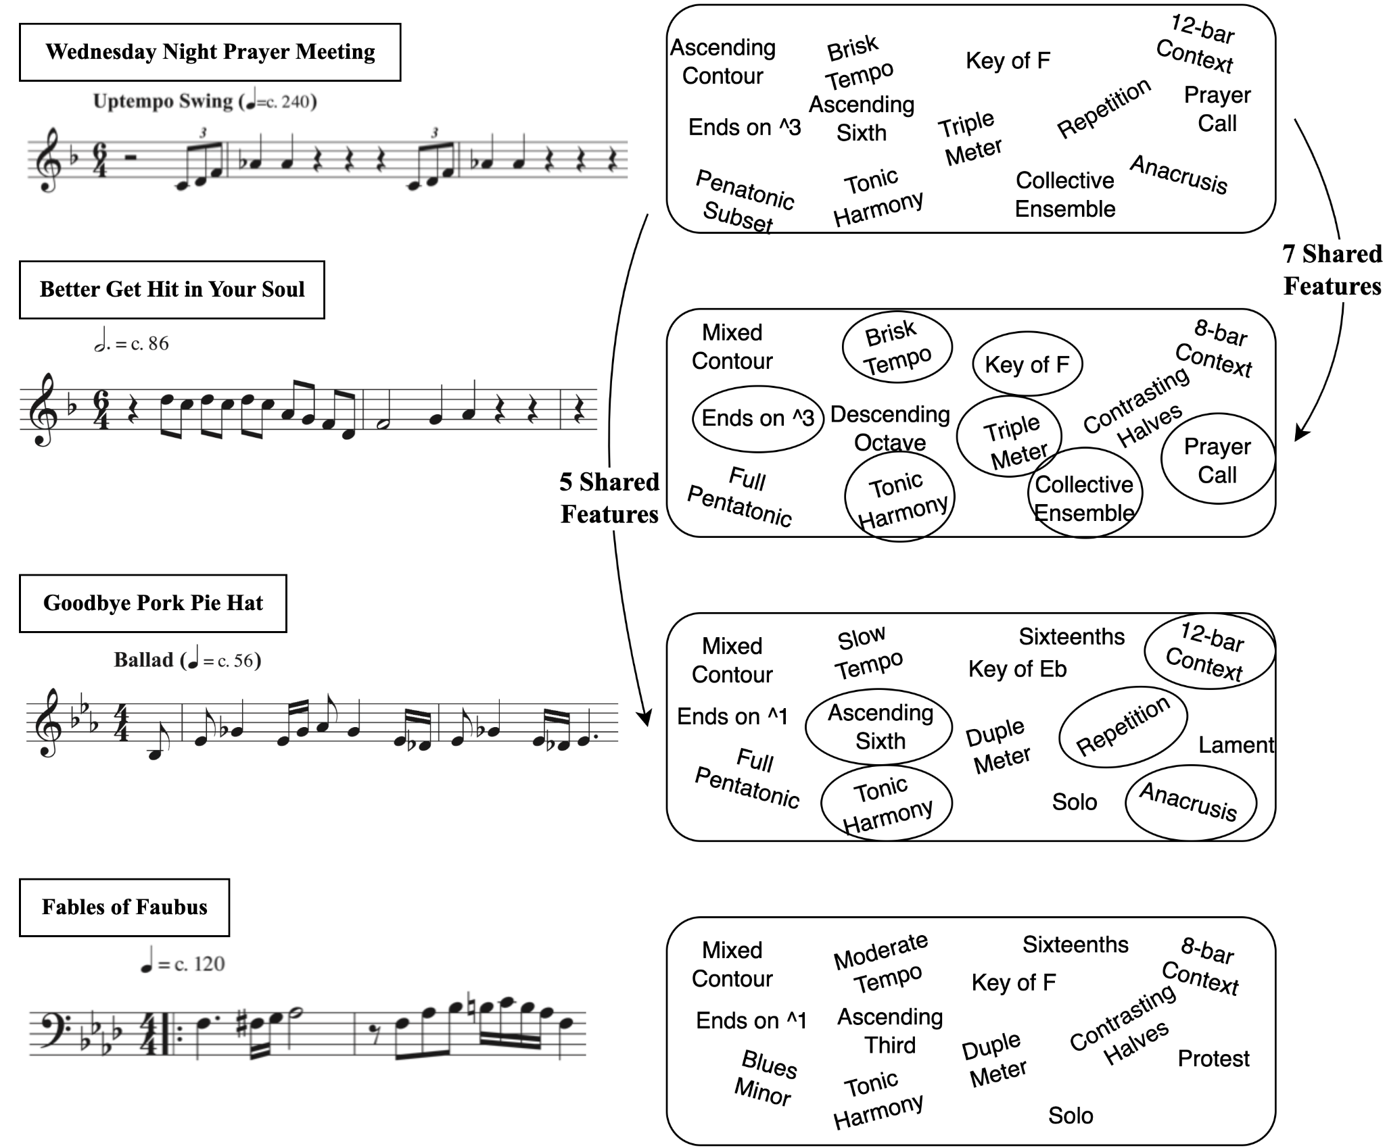
Similarity as Feature-Set Interaction
Tversky argued that similarity is perceived in terms of discrete features.
The perceived similarity between two objects increases when they have more features in common and decreases when they have more unique features.

Slide 18
Similarity as Feature-Set Interaction
Tversky:
The importance of features should vary as a function of their salience.
Salience is measured through two types of factors: intensive and diagnostic.
Intensive: the brightness of a light; the loudness of a tone; the saturation of a color.
Diagnostic: the “classificatory significance of the features”.
Features become more salient when they help to distinguish objects from one another—in other words, when they become more analytically useful or “diagnostic.”

Slide 19
Similarity as Feature-Set Interaction
Tversky:
The importance of features should vary as a function of their salience.
Salience is measured through two types of factors: intensive and diagnostic.
Intensive: the brightness of a light; the loudness of a tone; the saturation of a color.
Diagnostic: the “classificatory significance of the features”.
Features become more salient when they help to distinguish objects from one another—in other words, when they become more analytically useful or “diagnostic.”

Slide 20
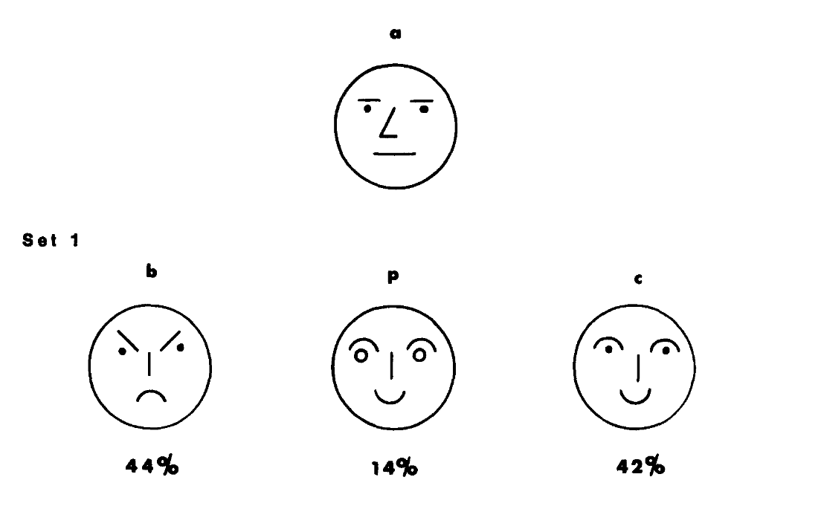
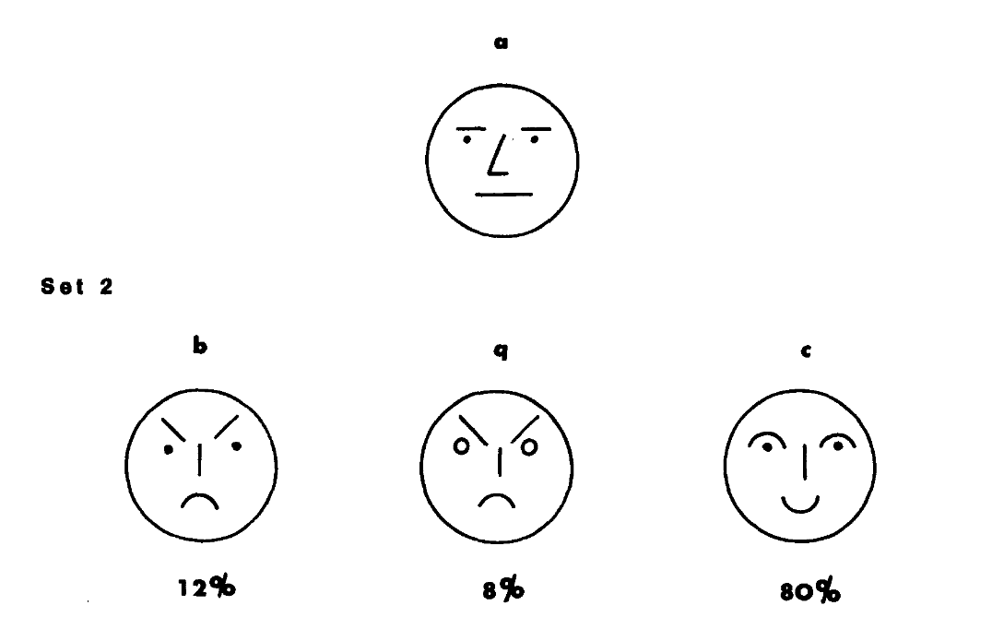
Similarity as Feature-Set Interaction
Notes:
The four faces of each set were displayed in a row to 25 participants, asked to put them into two groups.
In group 1, people put C and P together. The smiling faces. And A and B, the non-smiing faces together.
In B, the frowing faces were grouped together.
So the changing of P and Q actually changed where A would be grouped.

Slide 21
Similarity as Feature-Set Interaction
“smiling has a greater diagnostic value in Set 1 than in Set 2, whereas frowning has a greater diagnostic value in Set 2 than in Set 1.”
Notes:
The four faces of each set were displayed in a row to 25 participants, asked to put them into two groups.
In group 1, people put C and P together. The smiling faces. And A and B, the non-smiing faces together.
In B, the frowing faces were grouped together.
So the changing of P and Q actually changed where A would be grouped.

Slide 22
Similarity as Feature-Set Interaction
“the similarity of a (which has a neutral expression) to b (which is frowning) should be greater in Set 1, where they are grouped together, than in Set 2, where they are grouped separately. Likewise, the similarity of a to c (which is smiling) should be greater in Set 2, where they are grouped together, than in Set 1, where they are not.” (Tversky, p.342)
Notes:
The four faces of each set were displayed in a row to 25 participants, asked to put them into two groups.
In group 1, people put C and P together. The smiling faces. And A and B, the non-smiing faces together.
In B, the frowing faces were grouped together.
So the changing of P and Q actually changed where A would be grouped.

Slide 23
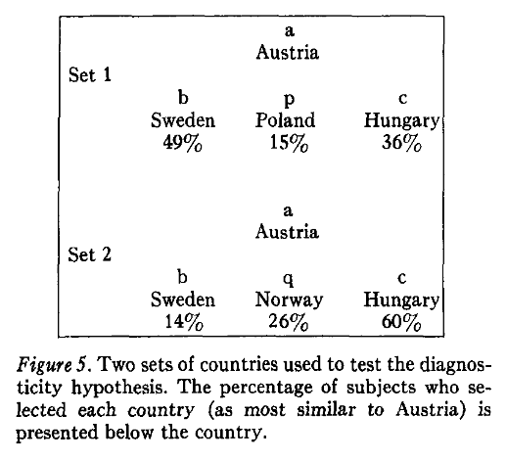
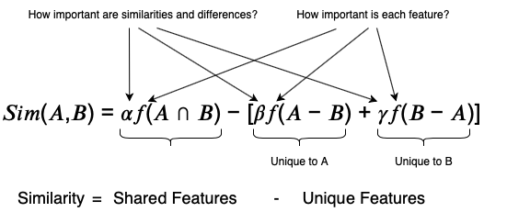
Similarity as Feature-Set Interaction
Notes:
Asked participants to group countries, and the substitution of Poland for Norway changed the grouping from Sweden to Hungary.

Slide 24
Similarity as Feature-Set Interaction
Müllensiefen and Pendzich (2009):
applied a variant of Tversky’s equation to model similarity in terms of melodic interval n-grams.
Measuring each n-gram’s salience as a function of its frequency in a corpus of melodies (less frequent n-grams were considered more salient), they showed that melodic similarity resulting from Tversky’s equation succeeded in predicting over 90% of plagiarism court case outcomes.
The winning model relied on the asymmetry assumption:
features shared with the plaintiff’s song mattered more than those unique to the defendant’s.

Slide 25
Similarity as Feature-Set Interaction
Lamont and Dibben (2001) presented listeners with pieces by Beethoven and Schoenberg and asked them to rate similarity between pairs of excerpts.
For Beethoven piece:
dynamics, texture, and articulation mattered more for similarity judgments,
For the Schoenberg piece, tempo and dynamics were most important.
They concluded that “the pieces set their own similarity criteria,”
Tversky’s notion that feature importance should vary as a function of context.

Slide 26
Limitations of a Feature-Set Interaction Approach
We are talking about the features, but not necessarily the connections between the features.
Feature lists lack higher order structure (they are what psychologists call unstructured representations).
We might argue that musical similarity, however, requires the connections between parts of the list.
Perhaps the temporality of music is important here.

Slide 27
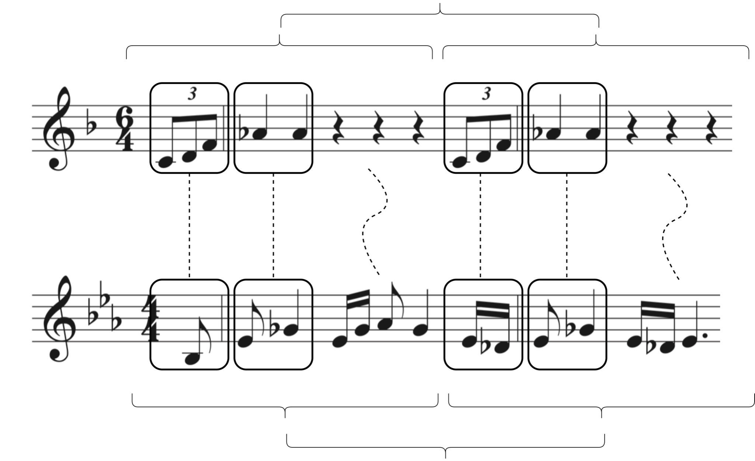
Similarity as Alignment (See Gentner, 1983)
Juxtaposing two things, looking beyond differences in the structural content, but look at higher order connections:
Both motives are in two halves
Both have repetition (one exact, one varied)
Each half has an upbeat, etc
By aligning them you can also foreground between the two.
No a priori knowledge assumed.

Slide 28

Exercise
Break into 4 groups
You have an index card with your song on it.
Group them into similar songs
Discuss why you grouped them as such.
Which approach did you use?
What features were “diagnostic”?
Be prepared to defend your grouping!

