Slide 1
Detect and Analyze User Groups According to the ICT literacy and Usage using Segmentation based approach

Slide 2
Variables Used
ICT Usage
1.Desktop/Laptop/Tablet Usage
2. Smart Phone usage
3. Internet usage
4. Social connectivity. (ex. chat Sites, blogging, managing web sites..etc..)
5. Social Media usage (Whatsap,viber, skype, insta….etc)
ICT Literacy
Number of Skills from mentioned 15 skills
Highest ICT Education Level

Slide 3
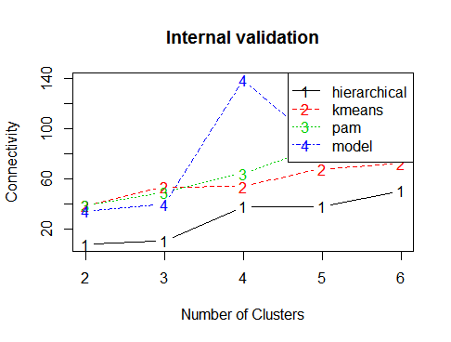
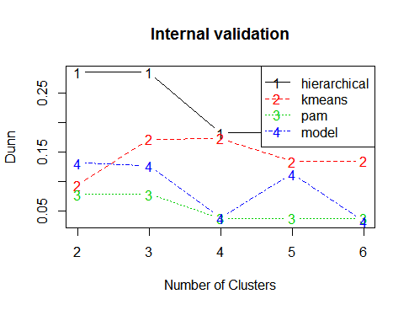
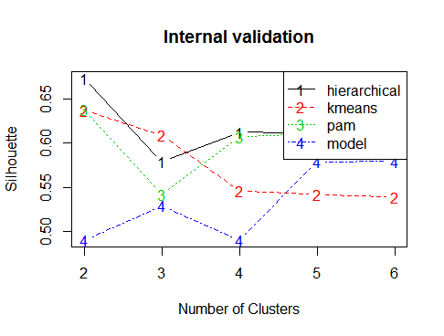
Approach
Cluster analysis using mentioned variables.
Steps :
1. Check data set is able to cluster (Using Hopkins statistics)
Hopkins statistics : 0.1465195
2. Select best Algorithm to cluster (Connectivity, Dunn, Silhouette indexes)

Slide 4
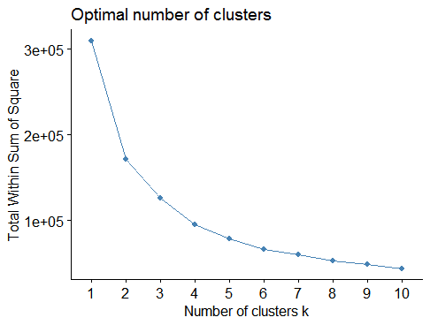
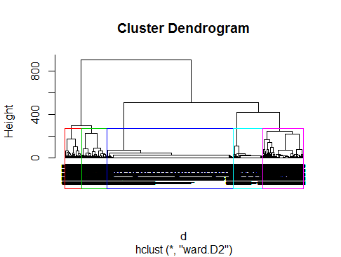
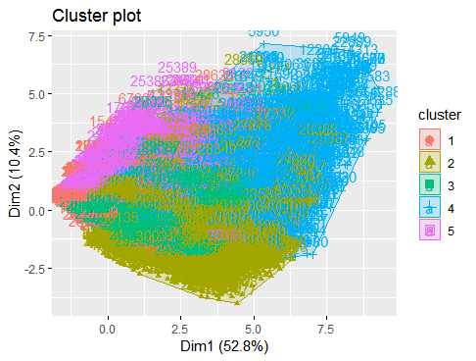
Approach –CNTD
3. Select the number of clusters.
4. Hierarchical clustering Approach

Slide 5
Analyze the Segments
Distribution of Cluster
Notes:
Cluster 1 have higher number of people compared t the other clusters

Slide 6
Analyze the Segments
Category
Notes:
Many people in cluster 1 belongs to the rural area while higher number of people in cluster 5 belongs to the urban area

Slide 7
Analyze the Segments
ICT Usage
Notes:
People in cluster 4 and 5 have higher ICT usage compared to the people in Cluster 1 and 2 and 3

Slide 8
Analyze the Segments
ICT Literacy
Notes:
People in cluster 4 and 5 also have high ICT literacy compared to the cluster 1 and 3. But people in cluster 2 also have good ICT literacy even they do not have good ICT usage.

Slide 9
Analyze the Segments
Employment Status
Notes:
High percentage of the people in cluster 4 and 5 are employed while unemployed percentage is lower. But unemployed percentage of the cluster 1 ,2,3 is higher compated to the 4 and 5. This may be a reasn for lower ICT usage and Literacy in cluster 1 and 2 people.

Slide 10
Analyze the Segments
Education Level
Notes:
Many people in cluster 1 have higher education as the school education while many people in the cluster 5 have certificate level. People in cluster 5 have high higer studies people compared to the other clusters. Also cluster 1 contain no school people.

Slide 11
Analyze the Segments
Provinces
Notes:
Many people in cluster 1 are belongs to the northern ,central and southern provinces,

Slide 12
Analyze the Segments
Reason for not Availability of ICT facility
Notes:
Many people in cluster 1 have higher education as the school education while many people in the cluster 5 have certificate level. People in cluster 5 have high higer studies people compared to the other clusters. Also cluster 1 contain no school people.

Slide 13
Analyze the Segments
Areas to consider when implementing ICT related Activities
in Sri Lanka:

Slide 14
Conclusions
People in cluster 1,2 seems to be lower ICT usage compared to the people in cluster 4 and 5
Possible reasons:
1. Higher number of people in Cluster 1 belongs to the rural areas
2. Maximum Education level in cluster 1 is school education.
3. There is higher percentage of unemployed people in cluster 1.
4. Many people in cluster 1 belongs to the Northern, Southern and Central provinces
5. Reason for not availability of ICT facility
Northern province :Facilities are not necessary
Central and southern Provinces : cost of service is too high

