Slide 1


Environmental Conservation - Grant Proposal Writing Assistant
- Leveraging Generative AI to Accelerate Grant Proposal Success
Presenter: Shan Ali Shah Sayed

Slide 2

Challenges Faced by Environmental Conservation Team
Environmental Conservation relies heavily on external grants to fund critical
projects like water conservation, wildlife protection, and pollution reduction.
Crafting compelling grant proposals is essential but comes with challenges.
01
Time-Intensive Process: Writing detailed, tailored proposals
takes weeks, slowing down funding acquisition.
02
Limited Expertise: Aligning proposals with funder priorities
often requires specialized skills the team lacks
03
Customizability Issues: Adapting proposals for diverse funders
missions, priorities, and requirements is cumbersome.

Slide 3

Vision for the Grant Proposal Writing Assistant
What is it?
A Generative AI-powered application designed to automate and
streamline grant proposal writing.
Ensures proposals are tailored to funder priorities while reducing
time and effort.
Objectives:
EXPECTED BENEFITS:
Efficiency: Reduce proposal-writing time by 70%.
Alignment: Ensure alignment with funder-specific
missions and focus areas.
Impact: Increase grant approval rates by producing
high-quality proposals.
More time for environmental projects.
Higher success rate in securing funds.
Lower dependency on external grant-writing
consultants.

Slide 4

HOW the Grant Proposal Assistant WORKS
Workflow Overview:
Step 1: Input Collection - Gather project and funder details.
Step 2: NLP Processing - Use LangChain to structure prompts and generate content.
Step 3: Proposal Generation - AI creates a tailored grant proposal introduction.
Step 4: Output Delivery - Present a polished draft to the user.
Technologies Used:
LangChain: For prompt templating and conversational AI chains.
OpenAI GPT-4: For natural language generation.
Python: For implementation and prototyping.

Slide 5

Key Features of the Grant Proposal Assistant
Dynamic Proposal Writing:
Generates proposals tailored to funder priorities.
Includes measurable outcomes and community engagement emphasis.
User-Friendly Interface:
Simple input fields for project and funder details.
Outputs in grant-ready language.
Customizable Templates:
Adapts to different funder requirements and missions.
Integration of NLP Techniques:
Leverages LangChain to process structured prompts efficiently.
Ensures clarity, alignment, and persuasiveness in generated proposals.

Slide 6

Demonstrating the Prototype
Steps in the Prototype:
Step 1 - Input Collection: Collects data like project title, description, objectives, funder
mission, focus areas, and requirements as shown below:

Slide 7
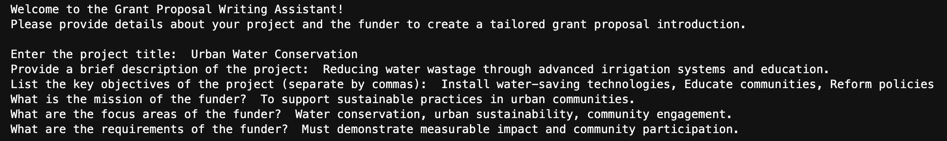
Demonstrating the Prototype
As shown in the previous slide, our inputs have been recorded and the output will
be generated based on our answers to the questions:
Step 2 - Processing with LangChain: Formats the input into structured prompts for GPT-4.

Slide 8

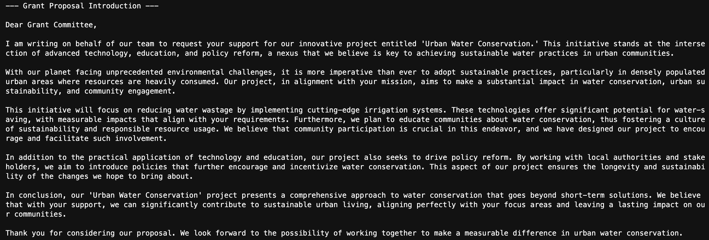
Demonstrating the Prototype
Step 3 - Output Generation: Produces a polished grant proposal as per our given input
as shown below:

Slide 9
Impact of the AI-Powered Assistant
BENEFITS:
Efficiency: Automates proposal writing, reducing time from weeks to hours.
Alignment: Ensures proposals match funder priorities.
Scalability: Can be adapted for multiple funders and projects.
Cost-Effectiveness: Reduces reliance on external consultants.
Real-World Impact:
Enables the team to focus more on executing environmental projects.
Increases likelihood of securing critical funding.

Slide 10
Challenges and Risk Mitigation
Potential Challenges:
Data Privacy: Sensitive funder information may be exposed.
Customizability: Adapting to highly specific funder requirements might need manual tweaking.
Adoption Resistance: Team members may be hesitant to trust AI-generated content.
Mitigation Strategies:
Encrypt user data to ensure privacy.
Offer flexible templates to handle diverse funder requirements.
Conduct training sessions to familiarize the team with the tool.

Slide 11
THANK YOU

