Slide 1


Skyline Capital Partners
Strategic Investment Plan
Investment Analyst:
Shan Ali Shah Sayed
7 March 2025

Slide 2
Executive Summary
New Hope emerges as the most profitable and balanced market for investment.
Key findings from market analysis and risk assessment.
Simulation confirms optimal unit mix with 55 Studio Units and 30 1-Bedroom Units for maximizing profitability.
Recommended steps for Skyline’s investment strategy.

Slide 3
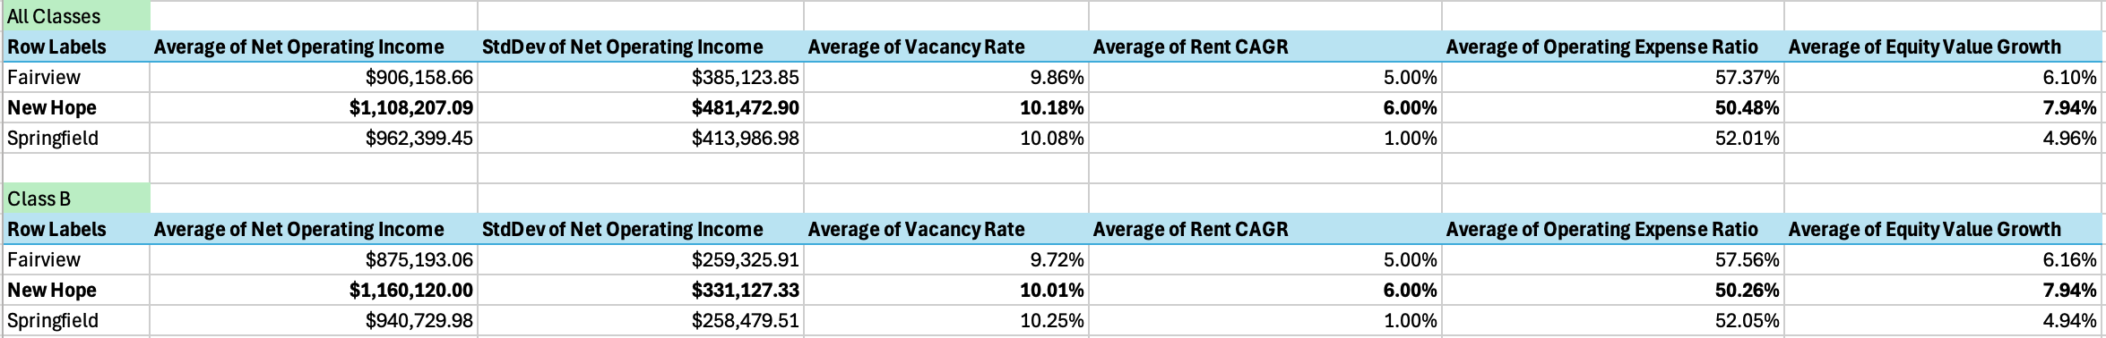
Market Selection Analysis - Key Insights
New Hope (Best Choice):
Highest NOI ($1,160,120) and strongest rent growth (6%).
Lowest expense ratio (50.26%), ensuring efficient cost management.
Trade-off: Slightly higher vacancy risk (10.01%).
Fairview (Moderate Choice):
Moderate rent growth (5%) but highest expense ratio (57.56%).
Equity value growth (6.16%) is reasonable.
Trade-off: Profitability is limited unless costs are reduced.
Springfield (Least Attractive):
Lowest rent CAGR (1%) and lowest equity value growth (4.94%).
Moderate NOI ($940,730) but higher vacancy risk (10.25%).
Trade-off: Offers stability but fewer growth opportunities.

Slide 4
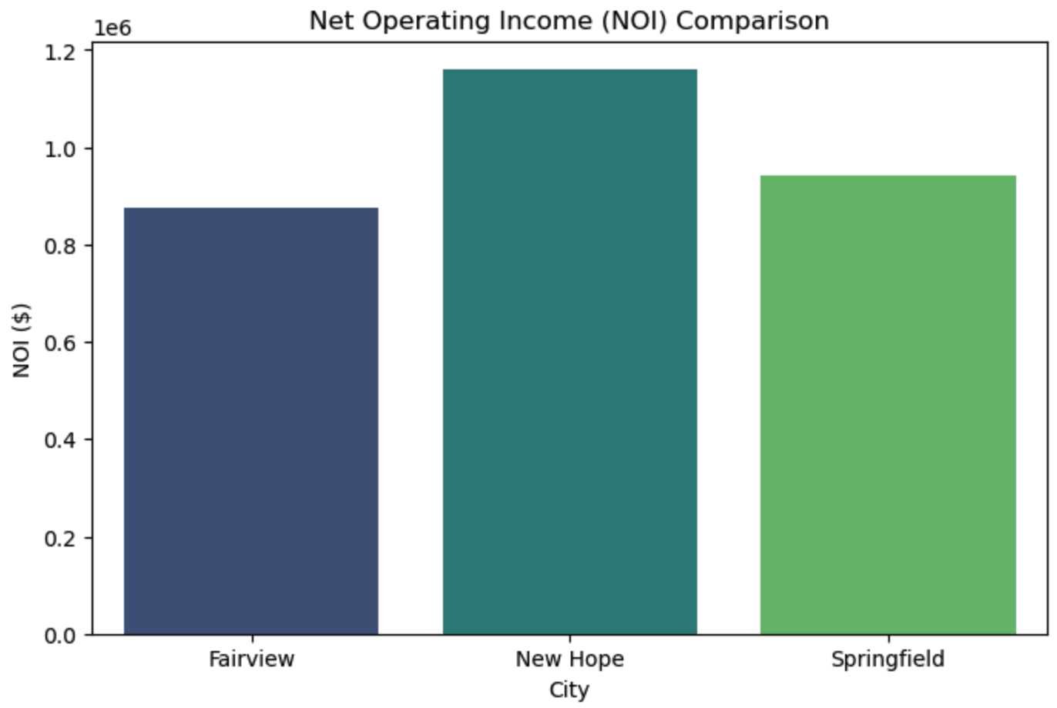
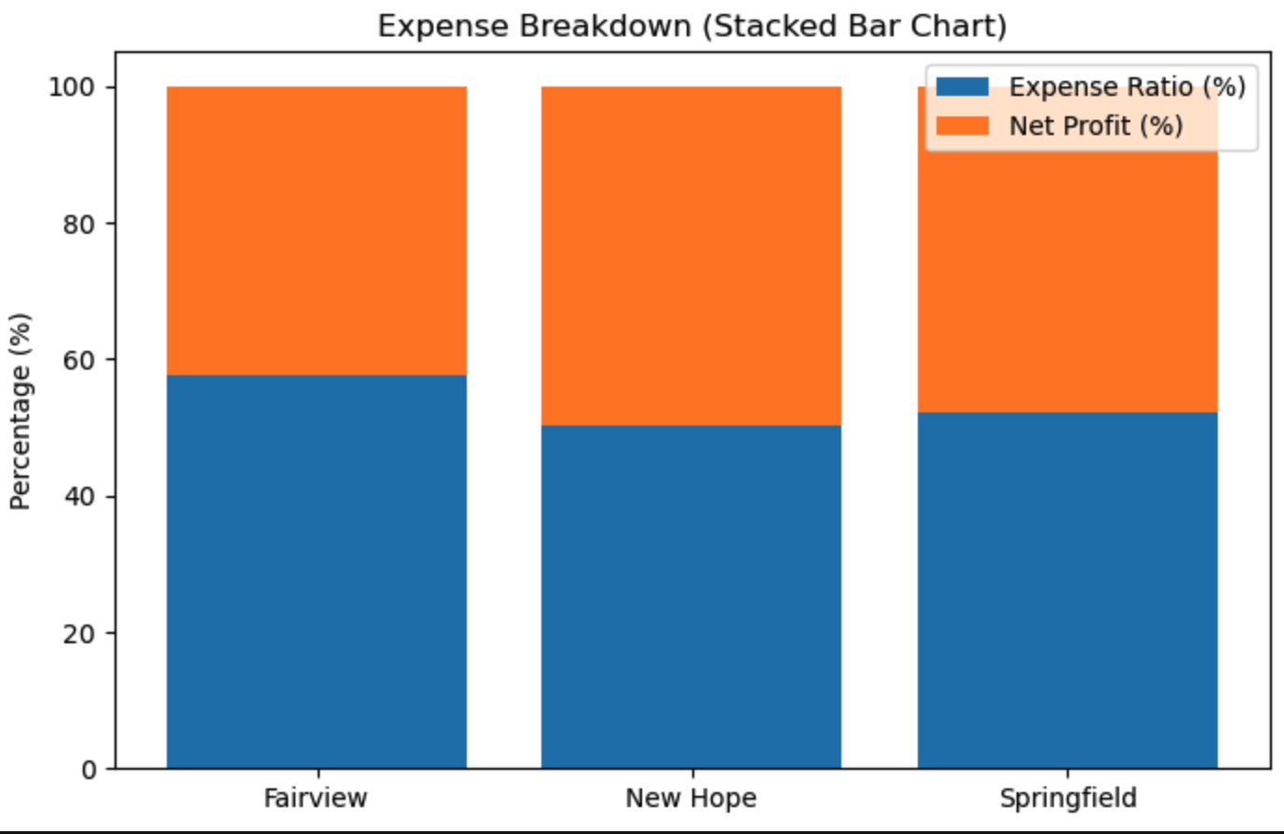
Market Selection Analysis - Key Insights
New Hope (Best Choice):
New Hope: Highest NOI and lowest expenses, maximizing profitability.
Fairview: Highest expenses, limiting net profit.
Springfield: Moderate expenses but lower growth potential.

Slide 5
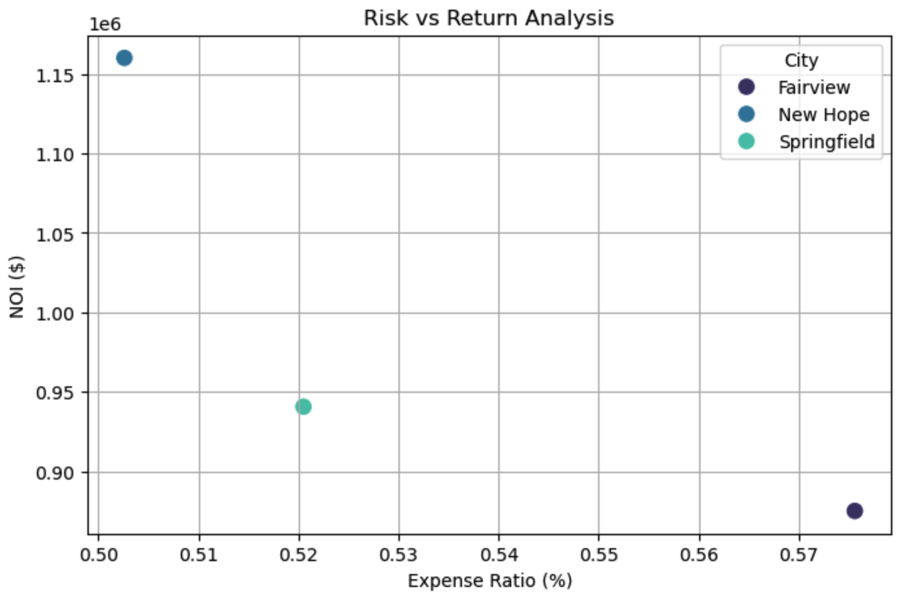
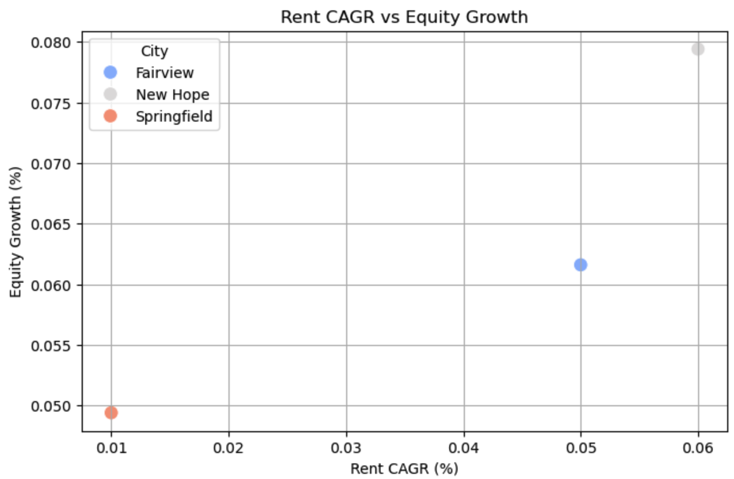
Market Selection Analysis - Key Insights
Risk vs Return:
New Hope achieves the highest NOI with the lowest expense ratio, offering the best return-risk balance.
Fairview has the highest expenses, reducing profitability.
Springfield maintains moderate NOI but at a higher risk level.
Rent CAGR vs Equity Growth:
New Hope leads in equity growth and rent CAGR, reinforcing its strong long-term value.
Fairview shows moderate equity growth but weaker rent CAGR.
Springfield reflects the lowest growth potential.

Slide 6
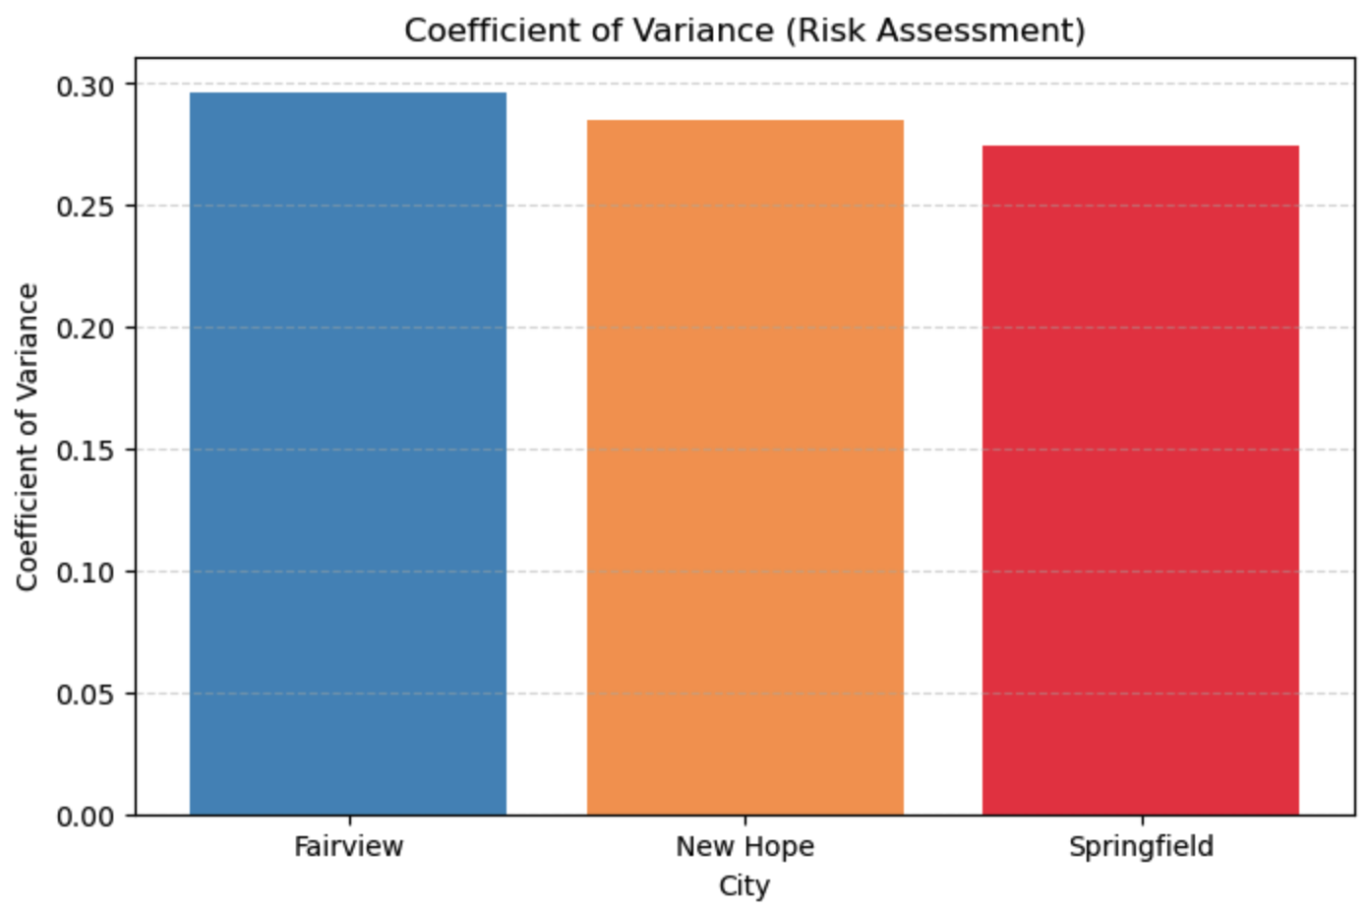
Risk Analysis - Market Comparison
Coefficient of Variance reveals risk balance:
New Hope achieves the best risk-return tradeoff.
Fairview is stable but less profitable.
Springfield carries the most risk with fewer returns.

Slide 7
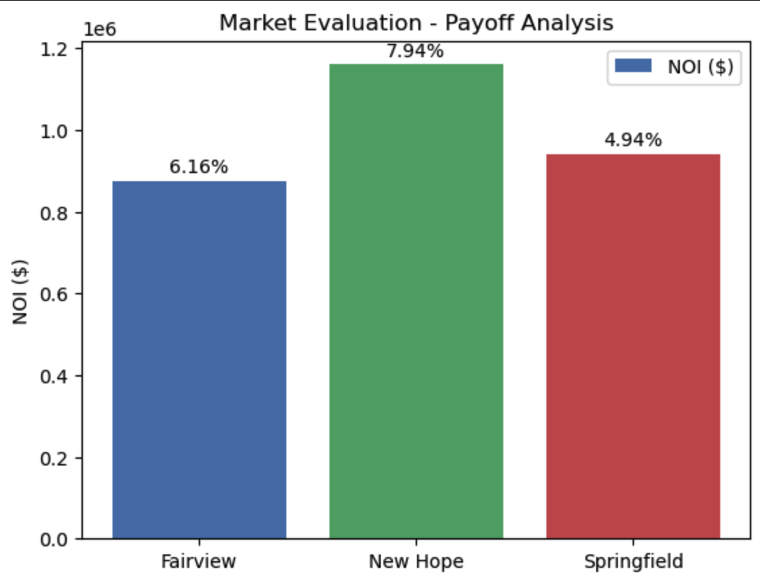
Payoff Analysis - Balancing Risk & Return
New Hope stands out as the most profitable option with the highest Net Operating Income (NOI) of $1,160,120 and the strongest equity growth of 7.94%.
Fairview follows with moderate profitability, featuring an NOI of $875,193 and equity growth of 6.16%.
Springfield has the lowest NOI at $940,730 and the weakest equity growth of 4.94%, reflecting limited growth potential.

Slide 8
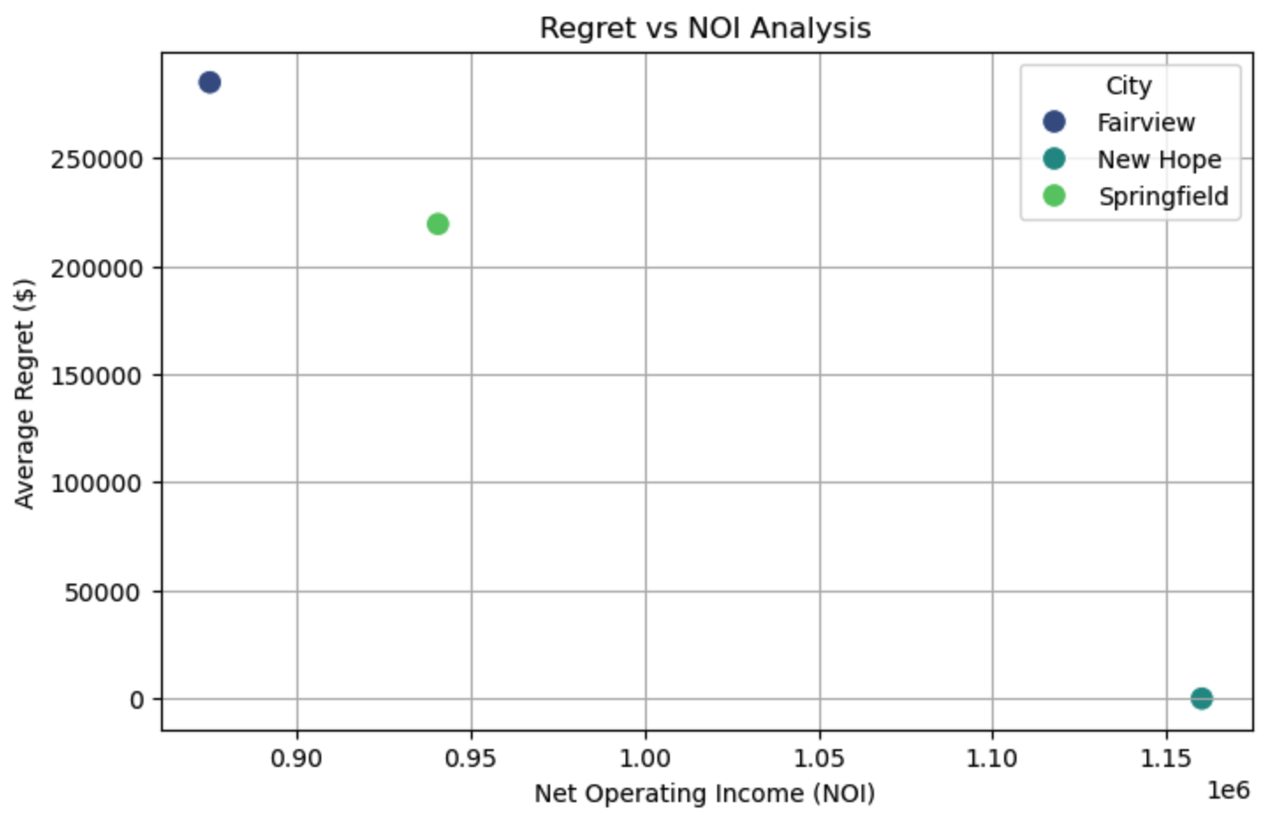
Regret Analysis - Investment Strategy
New Hope achieves the highest NOI with zero regret, reinforcing its position as the most stable and profitable investment choice.
Fairview shows moderate regret values but struggles with cost inefficiency, limiting profitability despite stability.
Springfield carries the highest regret risk, indicating higher uncertainty and less predictable returns.

Slide 9
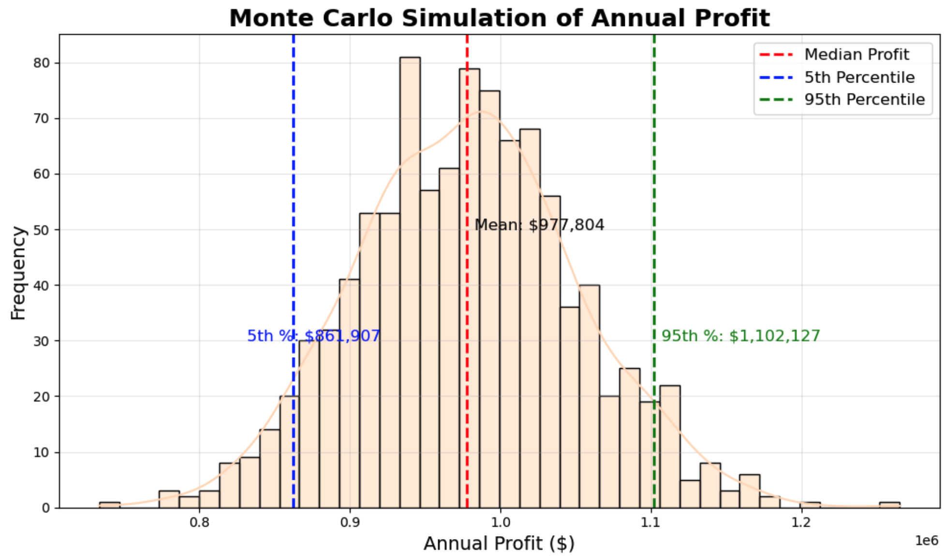
Unit Mix Optimization – Monte Carlo Simulation for Annual Profit
Mean Annual Profit: $977,804
5th Percentile: $861,907 (Lower risk boundary)
95th Percentile: $1,102,127 (Upper profit potential)
Distribution indicates a balanced trade-off between risk and return.
The results confirm the chosen unit mix effectively manages uncertainty while maximizing expected returns.

Slide 10
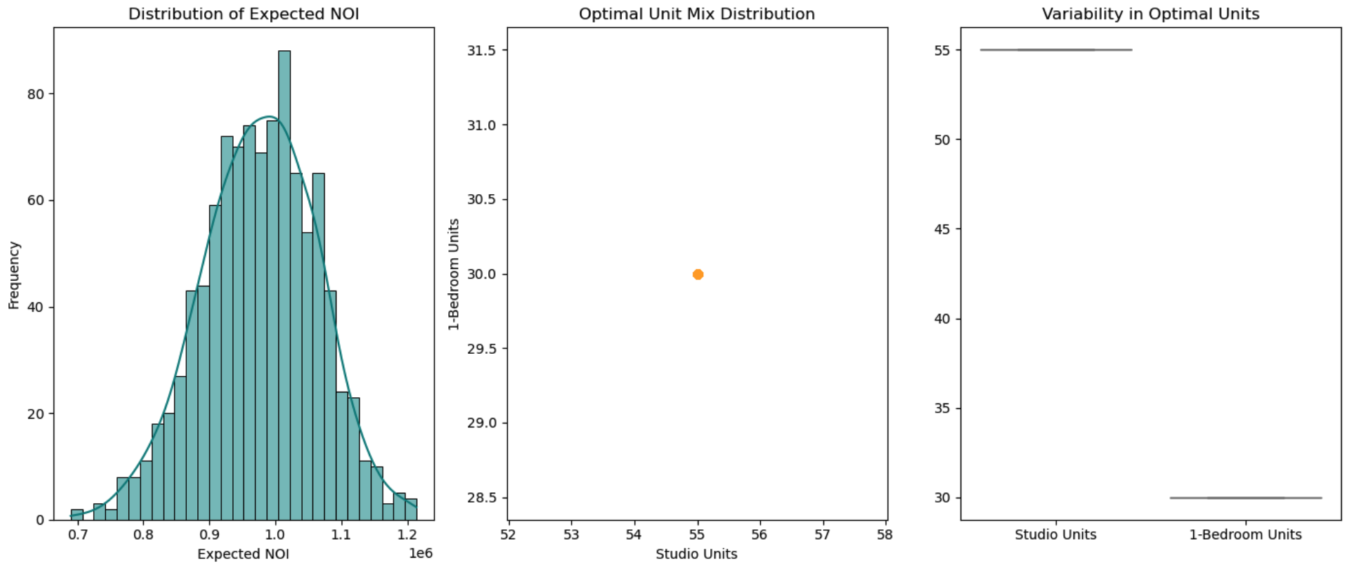
Unit Mix Optimization – Key Insights
Optimal Configuration: 55 Studio Units and 30 One-Bedroom Units
The identified unit mix shows minimal variability, ensuring predictable outcomes.
Stability in unit allocation indicates a well-balanced design that can withstand cost and occupancy fluctuations.
Strong clustering around the optimal mix reinforces its reliability in maximizing profitability.

Slide 11
Conclusion & Recommendations
New Hope is the optimal investment choice, delivering the highest NOI and equity growth with minimal regret values.
The chosen unit mix of 55 Studio Units and 30 One-Bedroom Units maximizes profit potential while ensuring stable occupancy and manageable risk.
Monte Carlo simulation confirms that the strategy offers a balanced risk-return tradeoff, with expected profits consistently aligned with investor objectives.
The analysis highlights New Hope’s ability to deliver strong returns even in less favorable conditions, reinforcing its position as the most profitable and stable investment choice.

Slide 12
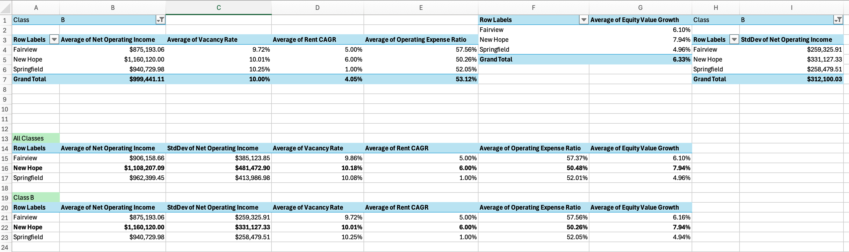
Appendix - Microsoft Excel
Microsoft Excel was used for calculations on provided data.

Slide 13
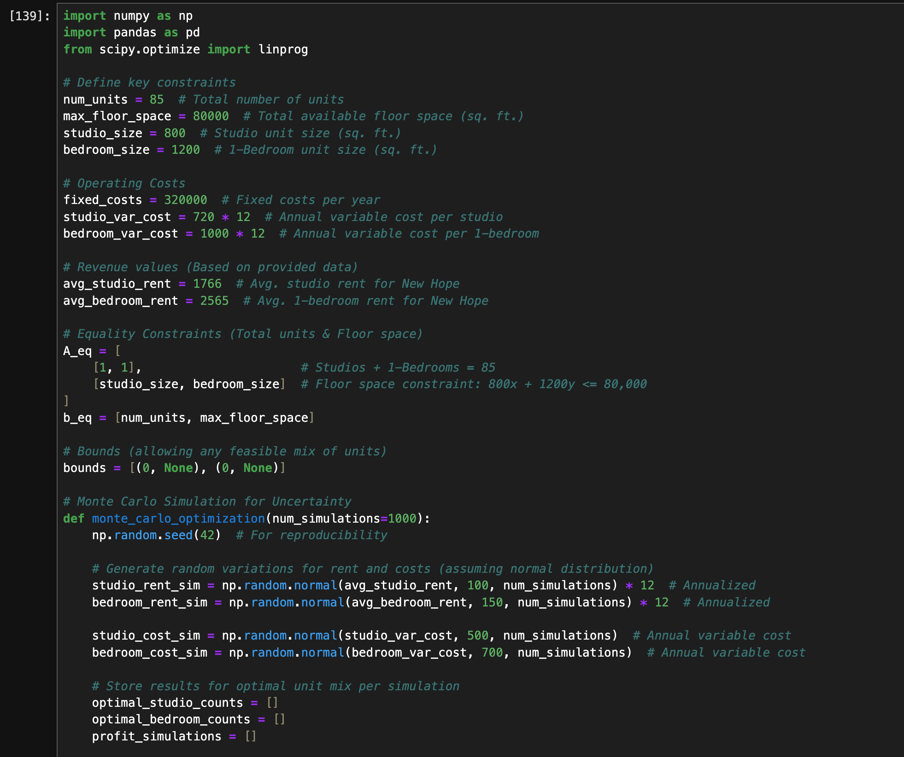
Appendix - Gen AI Use
Coding was executed with the help of ChatGPT.

