Slide 1
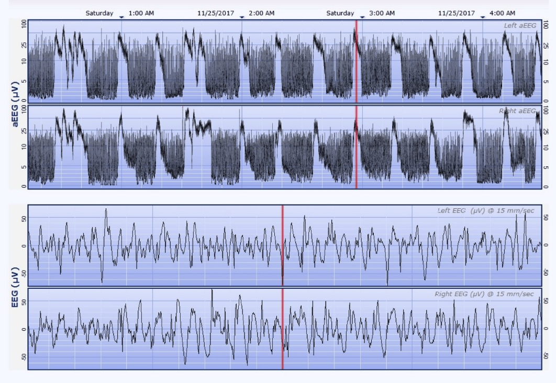
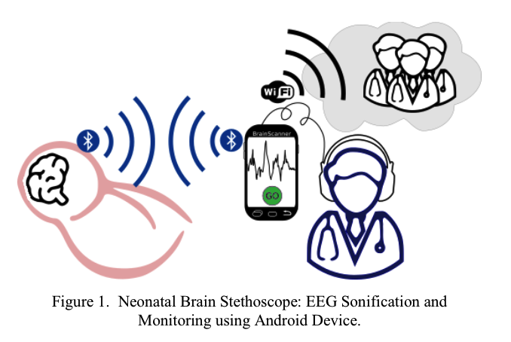
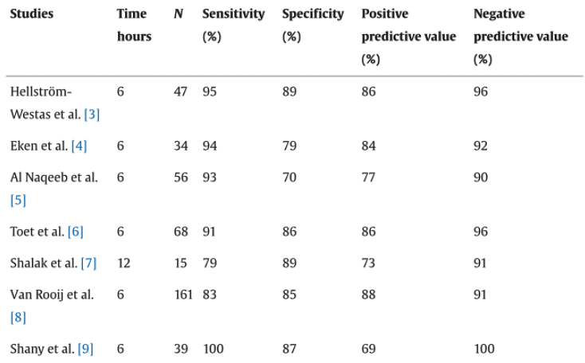
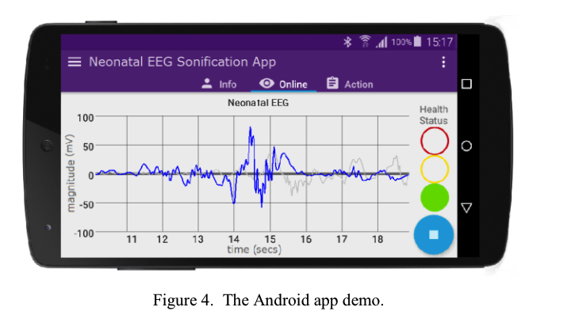
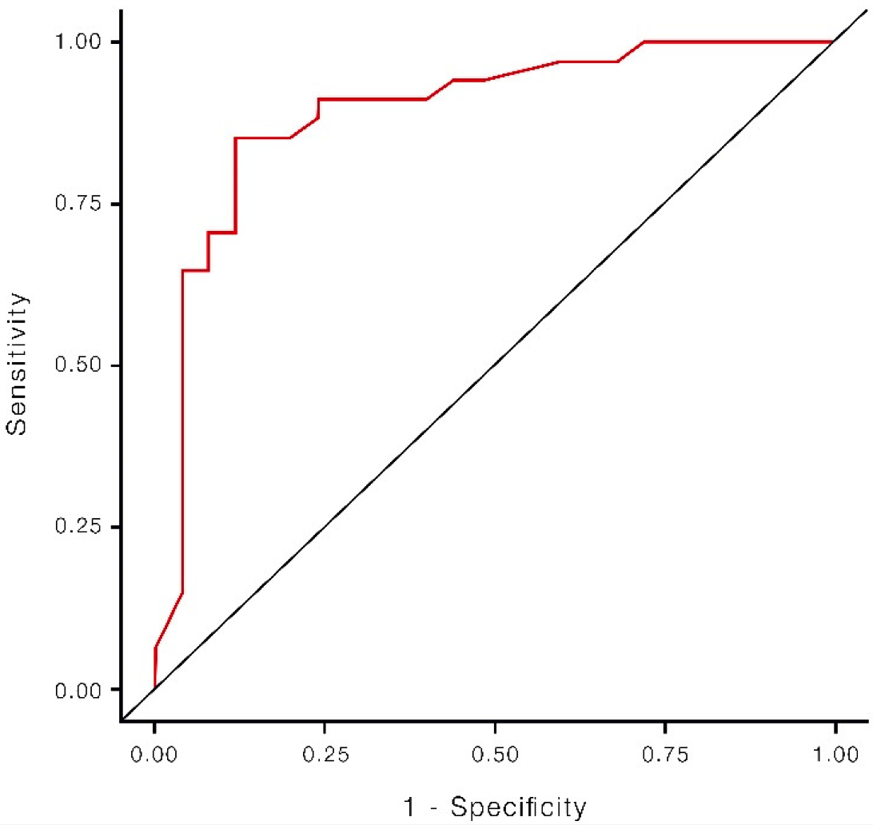
Adaptive Telemetry Systems for Monitoring Neonatal Neurodevelopment
Shanaya I. Malik
Department of Computer Science and Engineering, University of California, Santa Cruz
Introduction
Methodology
Case Studies
Future Developments
Significance of Monitoring
Neonatal brain injuries require continuous monitoring
Technological Integration
Advanced technologies improved neonatal neurodevelopment
aEEG
Effective for infants with suspected seizures
NIRS
Continuous monitoring of cerebral oxygenation
Innovations
Portable, low-cost EEG systems for sonification and visualization
Integration of aEEG in Neonatal Care
Electrodes placed on scalp
Signal processing is amplified and displayed
Implementation of Portable EEG Monitoring
Portable EEG devices transmit signals
Visualized on smartphone
Data Collection and Analysis
Detection of abnormalities
Algorithms identify neurological patterns
Case Study 1: Use of aEEG in Full-Term Infants with Hypoxia-Ischemia
Study with 68 infants monitored using aEEG
Resulted in detecting seizures and abnormal aEEG patterns
Case Study 2: Portable EEG Monitoring in Resource-Limited Settings
Portable EEG monitoring in rural area
Resulted in increased access to and affordable monitoring
Improving Sensor Technology
Develop algorithms to reduce noise
Use infection-resistant materials
Advanced Data Analysis
Use AI to predict adverse events
Cost Reduction and Accessibility
Develop portable monitoring systems
Improve affordability
Standardization of Protocols
Implement standardized guidelines
Conclusion
Technological Integration
aEEG, NIRS, and portable EEG systems
Benefits
Continuous, non-invasive assessments
Early diagnosis and timely intervention
Accessibility
Portable, low-cost EEG systems
Challenges
Address signal interference, data integration, cost
Predicting Neurodevelopment Patterns
Predictive Values of aEEG Patterns
Studies assessed first 3-12 hours of life to predict brain outcomes
Sensitivity: 79% - 100%
Specificity: 70% - 89%
Positive Predictive Value
Likelihood from 69% to 88% that infant will have health issue
Negative Predictive Value
90% to 100% successful prediction for infant’s health
Technological Overview
Amplitude-Integrated EEG (aEEG): Monitoring for seizure detection and prognostic evaluation
Near Infrared Spectroscopy (NIRS): Non-invasive technology measuring cerebral oxygenation
Portable EEG Monitoring and Sonification: Low-cost, portable EEG systems
Clinical Implications and Outcomes
Improved Early Diagnosis
aEEG and NIRS in NICUs enhances early diagnosis
Enhanced Safety
Improve patient safety
Reduced Infant Mortality Rates
Monitoring technologies in NICUs reduce death
Broader Accessibility and Cost-Effectiveness
Portable EEG systems using smartphone technology
Clinical Training and Awareness
Proper training essential for effective use of aEEG and NIRS
References
Toet, M. C., & Lemmers, P. M. A. (2024). Brain Monitoring in Neonates. Web of Science. Retrieved from https://www.webofscience.com/wos/woscc/full-record/WOS:000263512700003.
Nicklin, S., Wickramasinghe, Y. A., & Spencer, S. A. (2024). Neonatal Intensive Care Monitoring. Current Paediatrics. Retrieved from
https://www.sciencedirect.com/science/article/pii/S0957583903001283.
Poveda, J., O'Sullivan, M., Popovici, E., & Temko, A. (2017). Portable neonatal EEG monitoring and sonification on an Android device. In Proc. 2017 39th Annual International Conference of the IEEE Engineering in Medicine and Biology Society (EMBC) (pp. 2018-2021). Jeju, Korea (South). doi: 10.1109/EMBC.2017.8037248

