Slide 1
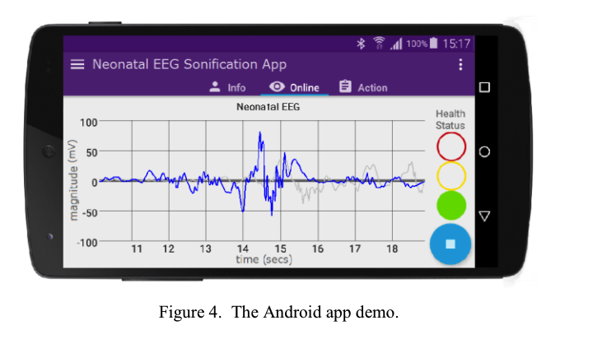
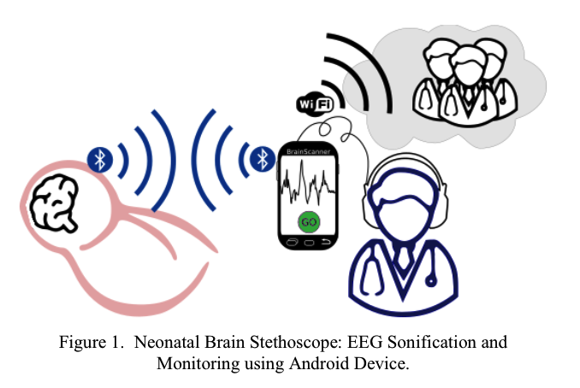
Adaptive Telemetry Systems for Monitoring Neonatal Neurodevelopment
Add Author Names and Information
Department of Computer Science and Engineering, University of California, Santa Cruz
Abstract
Technological Overview
Results
Future Developments
Advancements in Monitoring
Integrating aEEG and NIRS enhances neonatal neurodevelopment monitoring
aEEG Benefits
Effective for full-term infants with hypoxia-ischemia, improving prognostic evaluations
NIRS Benefits
Provides continuous monitoring of cerebral oxygenation for neonates
Innovations
Portable, low-cost EEG systems enable real-time sonification
NICU Application
Enhances monitoring precision, increases patient safety, and enables early intervention in NICUs
Study Focus
Reviews current practices, technological advancements, and future directions
Amplitude-Integrated EEG (aEEG): Simplified continuous EEG monitoring used in NICUs for seizure detection and prognostic evaluation
Near Infrared Spectroscopy (NIRS): Non-invasive technology measuring cerebral oxygenation through real-time monitoring
Portable EEG Monitoring and Sonification: Low-cost, portable EEG systems
Case Study 1: Use of aEEG in Full-Term Infants with Hypoxia-Ischemia
Background: A study involving 68 full-term infants with hypoxia-ischemia monitored using aEEG within the first 6 hours after birth. Method: Continuous aEEG monitoring was performed to assess brain activity and detect seizure occurrences.
Seizure Detection: aEEG successfully detected subclinical seizures that were not observable through clinical signs alone.
Prognostic Value: Persistent abnormal aEEG patterns (e.g., burst suppression, low voltage) within the first 24 hours were highly predictive of adverse neurodevelopmental outcomes at 18-24 months.
Outcome Improvement: Early intervention based on aEEG findings improved the management and outcomes of these infants.
Case Study 2: NIRS Monitoring During Cardiac Surgery
Background: Application of NIRS in a cohort of neonates undergoing cardiac surgery to monitor cerebral oxygenation. Method: Continuous NIRS monitoring was used to track changes in cerebral oxygen saturation (rSO2) during and after surgery. Results:
Real-Time Monitoring: NIRS provided continuous, real-time data on cerebral oxygen levels, enabling timely adjustments to ventilation and oxygenation strategies.
Improved Outcomes: Infants monitored with NIRS showed reduced incidence of perioperative cerebral hypoxia, leading to better postoperative neurological outcomes.
Trend Analysis: Analysis of rSO2 trends helped identify infants at risk of secondary brain injuries, allowing for prompt clinical interventions.
Case Study 3: Portable EEG Monitoring in Resource-Limited Settings
Background: Introduction of portable EEG monitoring using smartphone technology in a rural healthcare setting. Method: Portable EEG devices transmitted brain activity data to smartphones, where it was sonified and visualized for real-time monitoring by clinical staff. Results:
Accessibility: Portable EEG systems significantly increased access to advanced neurodevelopmental monitoring in resource-limited settings.
Cost-Effectiveness: The low-cost technology provided an affordable solution for continuous EEG monitoring, reducing the need for expensive traditional equipment.
Enhanced Monitoring: Real-time sonification of EEG allowed non-specialist clinical staff to detect and respond to abnormal brain activity promptly, improving overall neonatal care.
Improving Sensor Technology
Enhanced Signal Processing: Develop sophisticated algorithms to reduce noise and artefacts.
Biocompatible Materials: Use materials that reduce infection risk and improve patient comfort.
Advanced Data Analysis
AI and Machine Learning: Utilize AI to analyze data, identify patterns, and predict adverse events.
Integrated Systems: Develop systems that combine data from multiple technologies for a comprehensive view.
Cost Reduction and Accessibility
Portable Solutions: Promote the development of affordable, portable monitoring systems.
Funding and Support: Increase funding to make these technologies accessible in resource-limited settings.
Training and Education
Comprehensive Training: Establish robust training programs for clinical staff.
Collaborative Research: Encourage research collaborations to drive innovation.
Standardization of Protocols
Guidelines and Quality Assurance: Develop and implement standardized guidelines and quality assurance programs.
Methodology
Integration of aEEG in Neonatal Care
Amplitude-integrated electroencephalography (aEEG) is integrated into neonatal care through continuous monitoring systems placed at the bedside. Electrode Placement: Electrodes are placed parietally on the infant's scalp (P3 and P4 positions) to capture EEG signals.
Signal Processing: Signals are amplified and filtered to minimize artefacts, then displayed on a semilogarithmic scale for easy interpretation.
Monitoring and Interpretation: aEEG traces are continuously monitored for patterns indicating seizures or other abnormalities.
Application of NIRS in NICUs
Near Infrared Spectroscopy (NIRS) is applied in NICUs to monitor cerebral oxygenation non-invasively. Sensor Placement: NIRS sensors are placed on the neonatal skull to measure the absorption of near-infrared light by oxygenated and deoxygenated hemoglobin.
Data Acquisition: Continuous data on cerebral oxygen saturation (rSO2) and fractional tissue oxygen extraction (FTOE) are collected.
Trend Analysis: Data trends are analyzed to detect significant changes in cerebral oxygenation, which can indicate hypoxia or other critical conditions
Implementation of Portable EEG Monitoring
The implementation of portable EEG monitoring involves the use of smartphone technology and Bluetooth-enabled EEG acquisition devices. Device Setup: Portable EEG devices such as OpenBCI or g.MOBIlab+ are set up to capture EEG signals and transmit them via Bluetooth to an Android smartphone.
Signal Processing: The EEG signals are processed in real-time using a phase vocoder algorithm to convert the electrical activity into an audible format.
Real-Time Sonification: The processed signals are sonified and visualized on the smartphone, allowing clinical staff to monitor brain activity through sound, which can be more intuitive and faster to interpret.
Data Collection and Analysis
Continuous Monitoring: Continuous data collection ensures real-time monitoring and immediate detection of abnormalities.
Data Storage: Collected data are stored for further analysis and review.
Algorithmic Analysis: Advanced algorithms analyze the data to identify patterns and trends that indicate neurological issues or improvements.
Clinical Interpretation: Trained clinical staff interpret the analyzed data to make informed decisions about patient care.
Introduction
Conclusion
Significance of Monitoring
Neonatal brain injuries require continuous monitoring
Technological Integration
Advanced technologies like aEEG and NIRS have improved neonatal neurodevelopment monitoring
aEEG
Effective for infants with hypoxia-ischemia and suspected seizures
NIRS
Continuous monitoring of cerebral oxygenation
Innovations
Portable, low-cost EEG systems for sonification and visualization
The integration of amplitude-integrated electroencephalography (aEEG), Near Infrared Spectroscopy (NIRS), and portable EEG monitoring systems represents a significant advancement in neonatal neurodevelopment monitoring. These technologies provide continuous, non-invasive assessment of neural functions and cerebral oxygenation, enabling early diagnosis and timely intervention for neurological conditions in newborns. The studies and case analyses presented demonstrate the efficacy of these technologies in improving neurodevelopmental outcomes, reducing infant mortality rates, and enhancing patient safety.
The use of portable, low-cost EEG systems further broadens the accessibility of advanced monitoring solutions, particularly in resource-limited settings. However, challenges such as signal interference, data integration, cost, and the need for standardized protocols must be addressed to fully realize the potential of these technologies.
Clinical Implications and Outcomes
Improved Early Diagnosis
The integration of aEEG and NIRS in NICUs enhances early diagnosis of neurological conditions in newborns.
Enhanced Patient Safety
aEEG and NIRS improve patient safety through continuous, non-invasive neural and cerebral oxygenation assessments.
Reduced Infant Mortality Rates
Continuous monitoring technologies in NICUs are linked to reduced infant mortality rates.
Broader Accessibility and Cost-Effectiveness
Portable EEG systems using smartphone technology make advanced monitoring accessible in resource-limited settings
Clinical Training and Awareness
Proper training is essential for the effective use of aEEG and NIRS.
References
Toet, M. C., & Lemmers, P. M. A. (2024). Brain Monitoring in Neonates. Web of Science. Retrieved from https://www.webofscience.com/wos/woscc/full-record/WOS:000263512700003.
Nicklin, S., Wickramasinghe, Y. A., & Spencer, S. A. (2024). Neonatal Intensive Care Monitoring. Current Paediatrics. Retrieved from https://www.sciencedirect.com/science/article/pii/S0957583903001283.
Poveda, J., O'Sullivan, M., Popovici, E., & Temko, A. (2017). Portable neonatal EEG monitoring and sonification on an Android device. In Proc. 2017 39th Annual International Conference of the IEEE Engineering in Medicine and Biology Society (EMBC) (pp. 2018-2021). Jeju, Korea (South). doi: 10.1109/EMBC.2017.8037248

