Slide 1


Web Call
Example Application
Shanbo Li
shanbo@kth.se

Slide 2
Agenda
Background
Introduction
Solution
Application
Comparison and Evaluation
Conclusion
Demo

Slide 3
Background

Slide 4
Background
VoIP technology
VoIP market
  2007, subscribers for VoIP are fewer than 80 million
  2011, more than 135 million
  2012, about 250 million
Competition
  VoIP service provider
  VoIP client

Slide 5
Introduction

Slide 6
Web Call Example Application
A project at Ericsson Developer Connection (EDC), Ericsson AB
Former name Web Call SDK
SIP Call Component (High level VoIP Call API)
Web Applications
  Desktop browser view, mobile browser view
Web Service Interface
Java ME client

Slide 7
Why Web Call Example Application?
No need of a SIP phone
No need of a SIP client
Normal phone
Normal computers
Multi-account
Contact book and synchronize

Slide 8
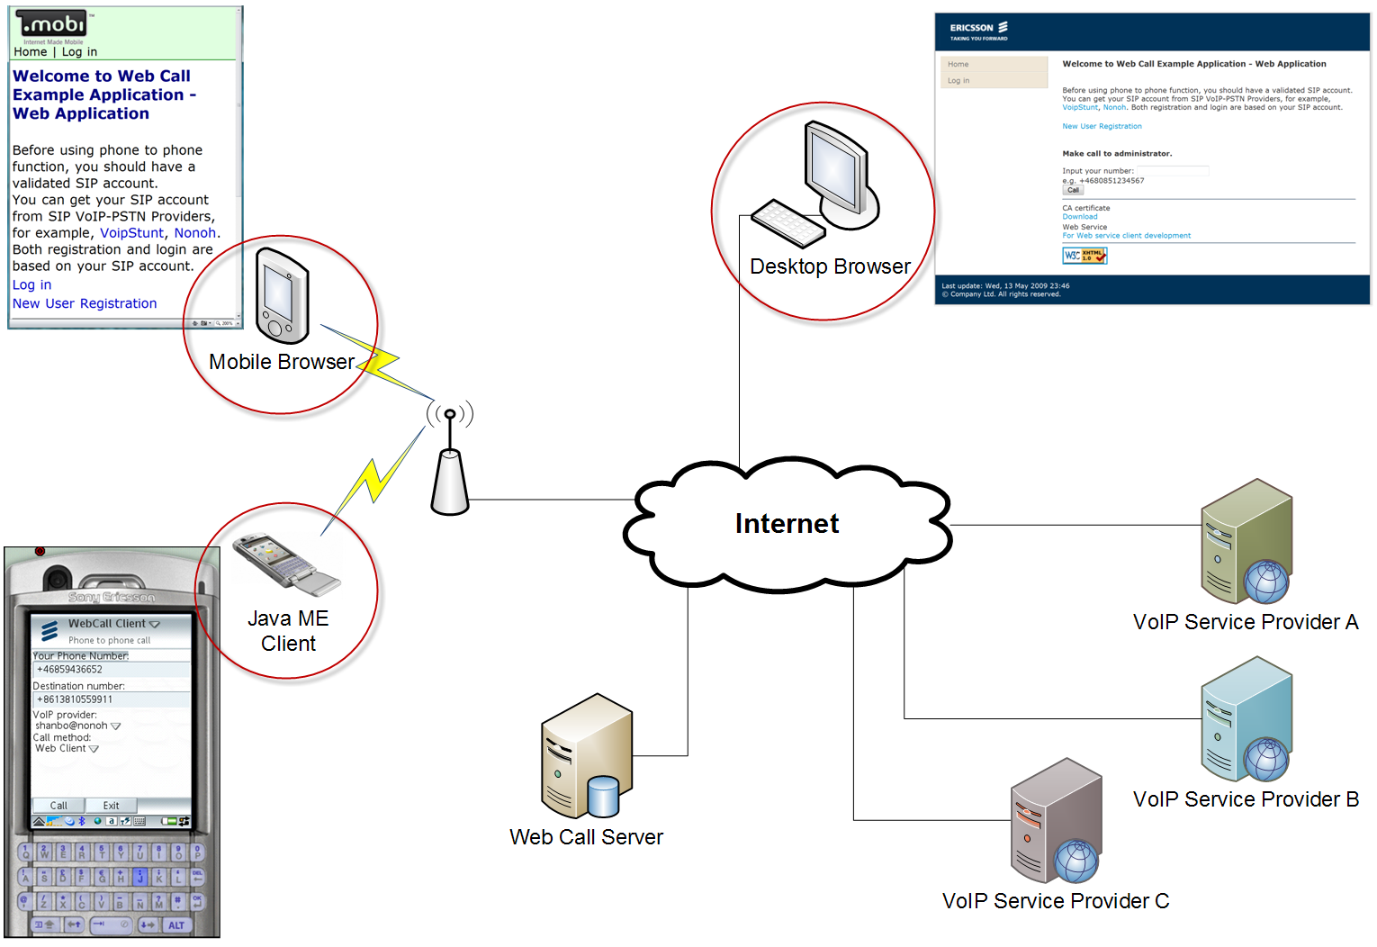
Use case overview
Make VoIP phone calls

Slide 9
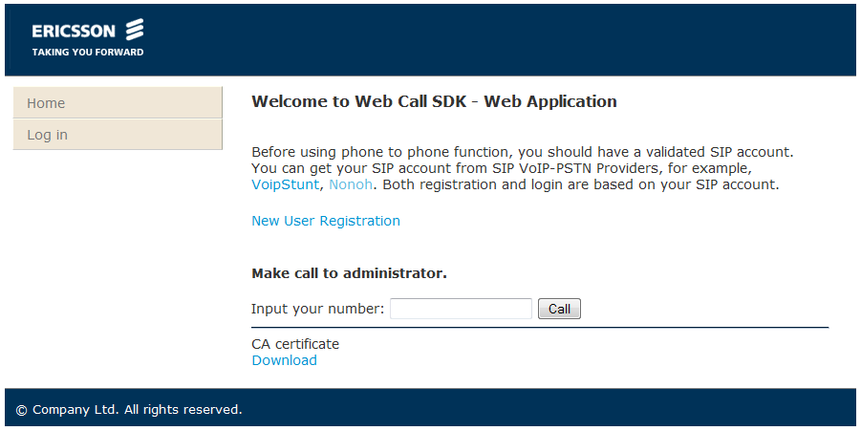
Desktop browser view
XHTML

Slide 10
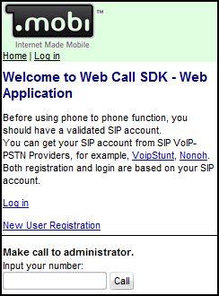
Mobile browser view
XHTML MP 1.1

Slide 11
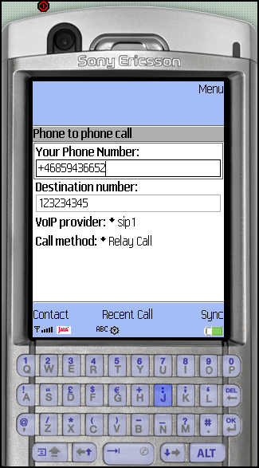
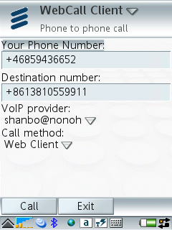
Java ME client
Java ME
JSR 172 web services
JSR 75 (Optional)

Slide 12
Solution

Slide 13
Background Knowledge
SIP
  Session Initial Protocol
  is a signaling protocol
  Defined in RFC 3261
SDP
  Session Description Protocol
  A format for describing streaming media initialization parameters
  Defined in RFC 4566
RTP
  Real-time Transport Protocol
  defines a standardized packet format for delivering audio and video over the Internet.
  Defined in RFC 3550

Slide 14
SIP message
A INVITE message from Alice to Bob
INVITE sip:bob@example.com SIP/2.0
Via: SIP/2.0/UDP pc1.example.com
Max-Forward: 70
To: "Bob" <sip:bob@example.com>
From: "Alice" <sip:alice@example.com>;tag=123
Call-ID: 1234567890@172.1.2.2
CSeq: 1 INVITE
Contact: <sip:alice@pc1.example.com>
Content-Type: application/sdp
Content-Length: 200
(Alice’s SDP not shown)

Slide 15
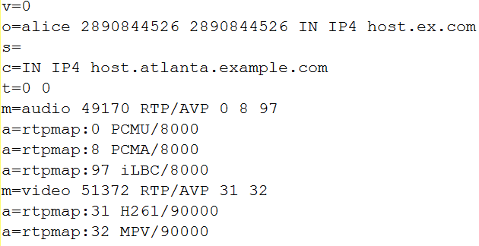
SDP message
Version number Media
Origin Attribute
Subject
Connection Data
Time

Slide 16
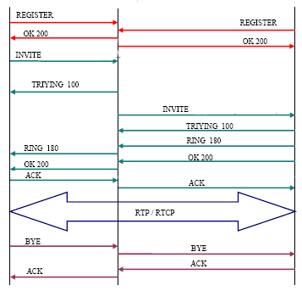
SIP flow (w/ proxy)
Client A calls Client B
Client A
Proxy
Client B
Figure taken from VoIPForo

Slide 17
Call method
Relay Call
Third party call
  Call transfer
  Re-invite
  SDP swap
  Web client

Slide 18
Call method
Relay Call
Third party call
  Call transfer
  Re-invite
  SDP swap
  Web client

Slide 19
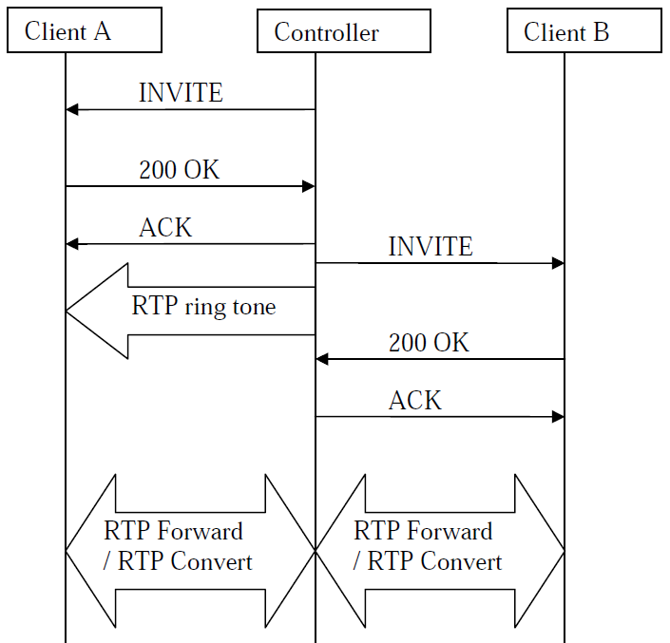
Relay Call solution
The original solution of web call example application
Figure taken from Web Call SDK by Yuening Chen

Slide 20
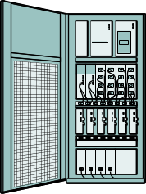


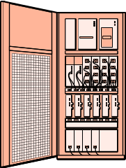


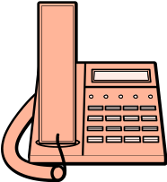

Relay Call
Control Signal
Media Flow
SIP
SIP
RTP
ISUP
PSTN Gateway
RTP
SIP
SIP
VoIP service provider
PCM
VoIP service provider
RTP
RTP
PSTN Gateway
GSM Base Station
PCM
ISUP
ISUP
PCM
Web Call Server
(Back-to-Back User Agent)
(media bridge)
ISUP = ISDN User Part
ISDN = Integrated Services Digital Network
PCM = Pulse-code modulation
Client A
Client B

Slide 21
Call method
Relay Call
Third party call
  Call transfer
  Re-invite
  SDP swap
  Web client

Slide 22
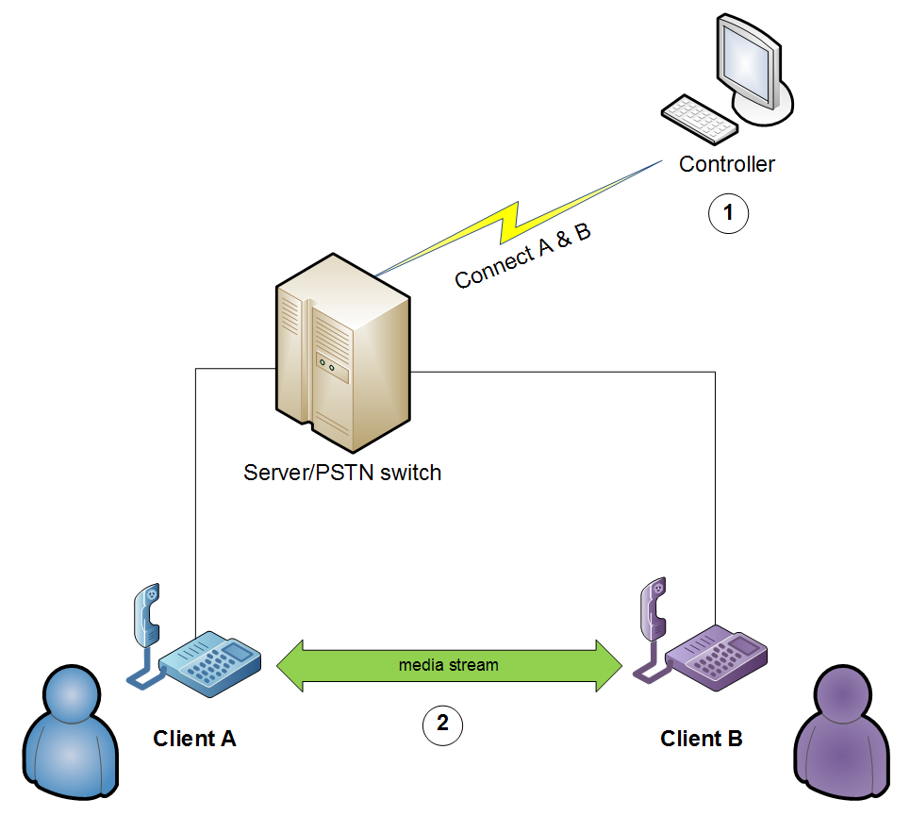
Third Party Call

Slide 23
Third Party Call
Control Signal
Media Flow
RTP
PSTN Gateway
SIP
PCM
SIP
PSTN Gateway
ISUP
ISUP
VoIP service provider
PCM
SIP
GSM Base Station
ISUP
PCM
Web Call Server
(User Agent)
ISUP = ISDN User Part
ISDN = Integrated Services Digital Network
PCM = Pulse-code modulation
Client A
Client B

Slide 24
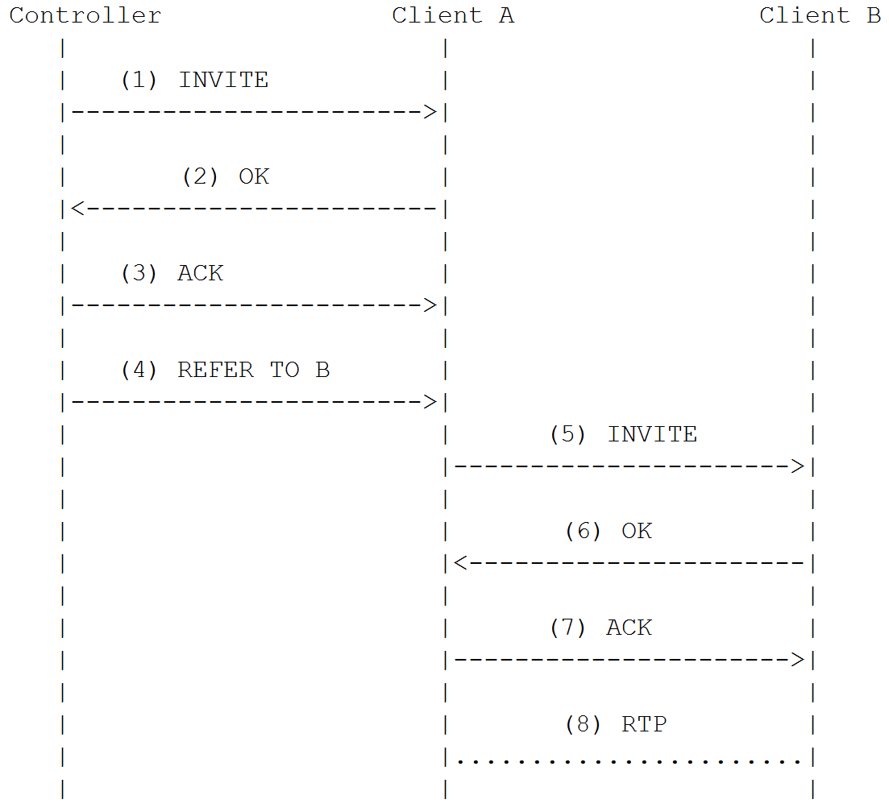
Call Transfer
Use REFER method defined in RFC 3515
Figure according to
RFC 3515

Slide 25
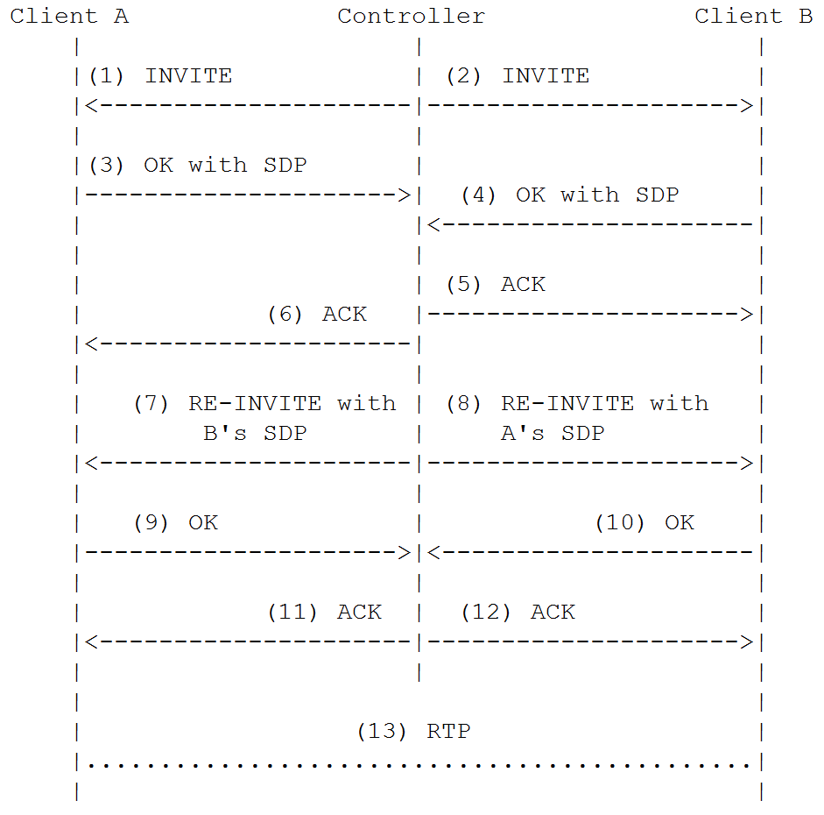
Re-invite

Slide 26
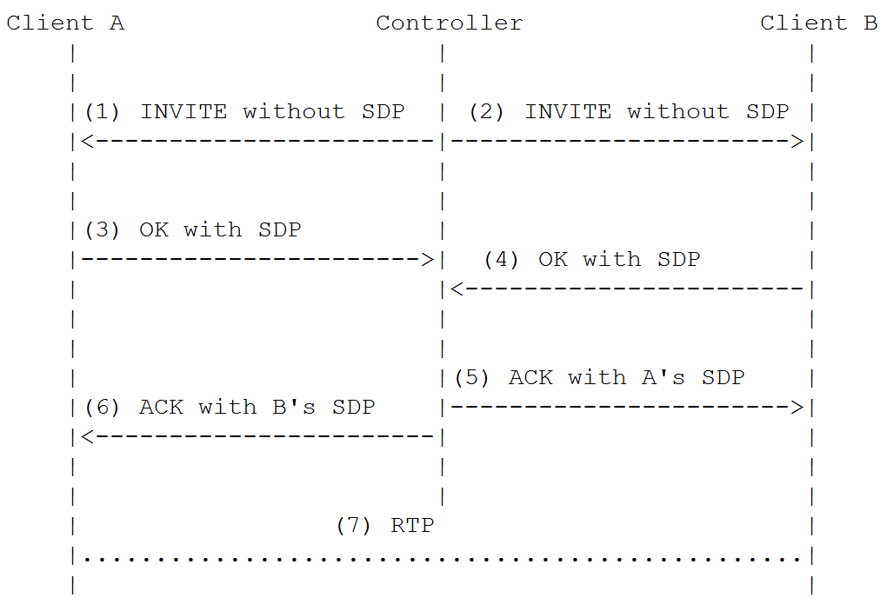
SDP swap

Slide 27
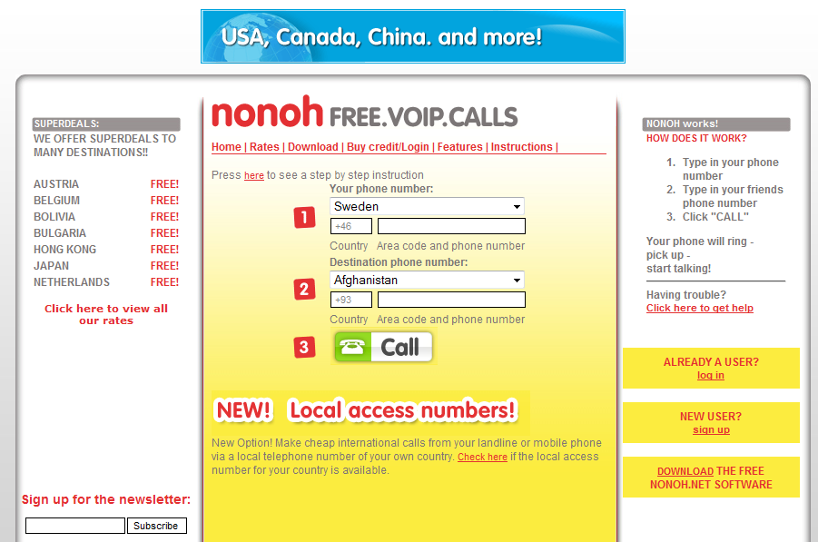


Web Client
Simulate a web browser
Scallope API
HTTP

Slide 28
Application

Slide 29
Application
SIP Call Component
Web Application
Web Service Interface
Java ME Client

Slide 30
Architecture overview
XHTML | XHTML-MP
Java ME Client
Mobile Front Controller
Web Service
interface
Web Application
SIP Call
Component
(core)
User Database
Utility
Database

Slide 31
SIP CALL COMPONENT

Slide 32
SIP Call Component
A high-level VoIP call API
Relay Call Controller
Third Party Call Controller

Slide 33
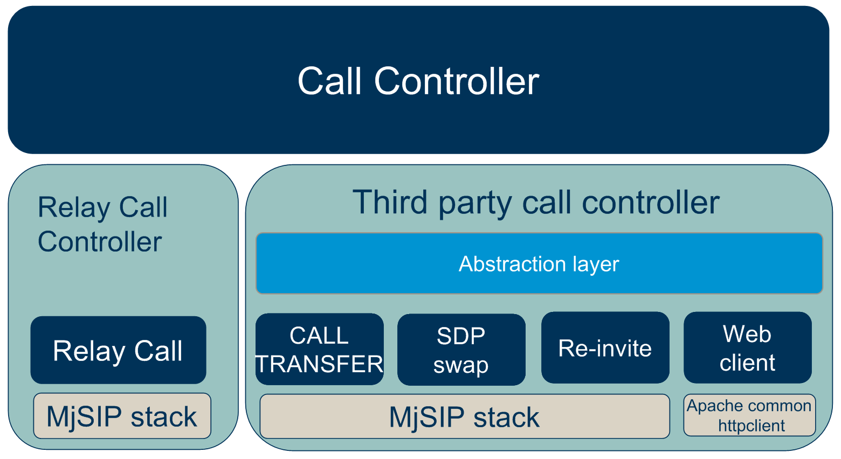
SIP Call Component
Architecture

Slide 34
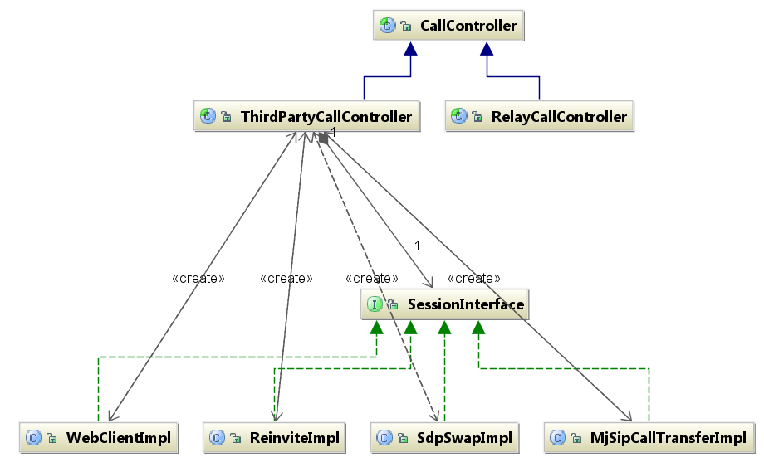
Call Controller

Slide 35
WEB APPLICATION

Slide 36
Web Application
Mobile Front Controller
Dual-view
Phone Call
Database

Slide 37
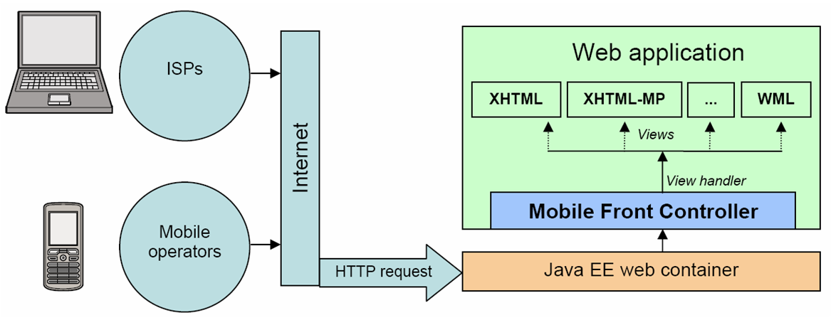
Mobile Front Controller
A light-weight Java EE framework at Ericsson Developer Connection
Different type of browsers go to different views

Slide 38
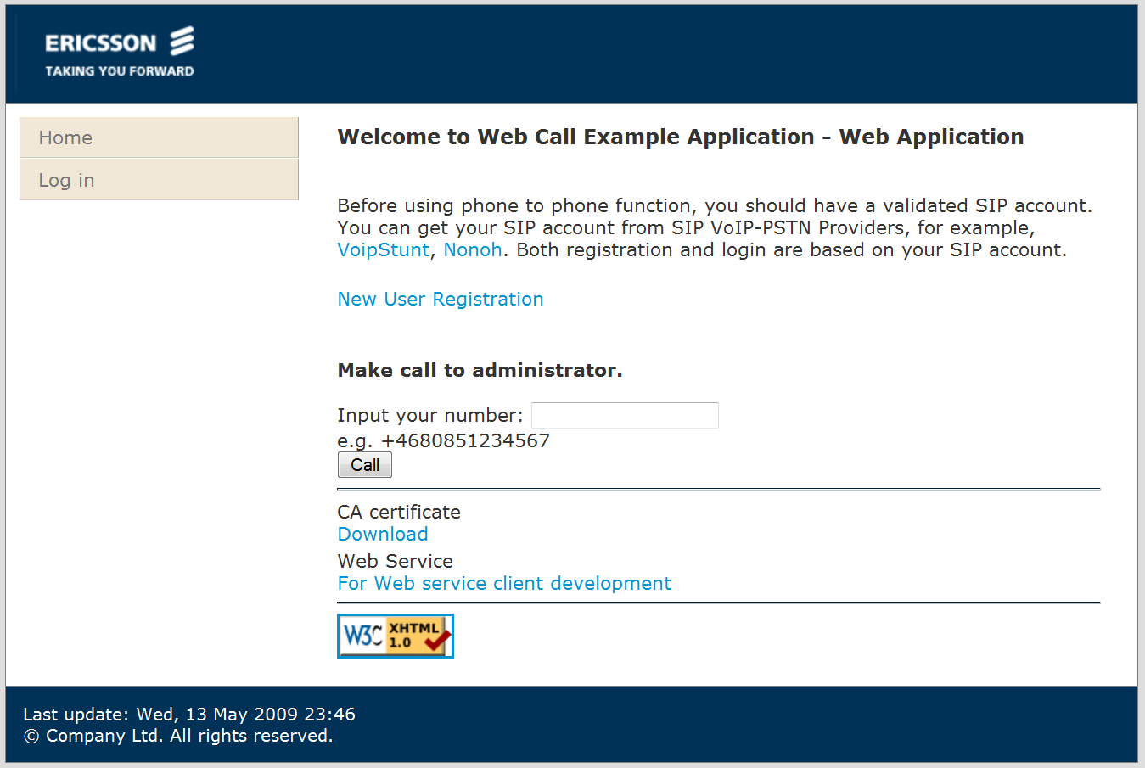
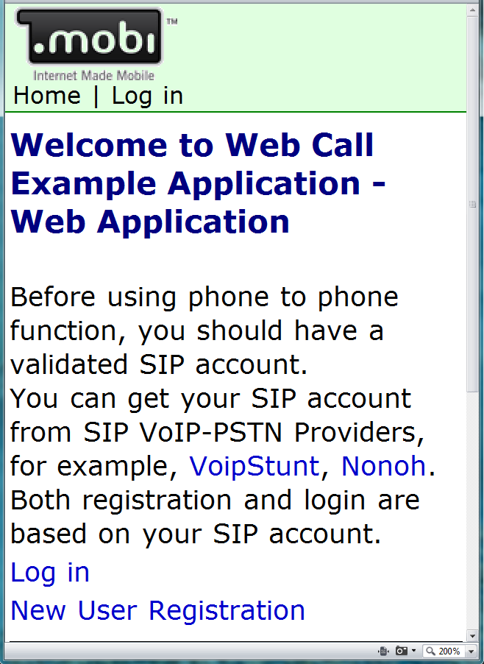
Dual-view

Slide 39
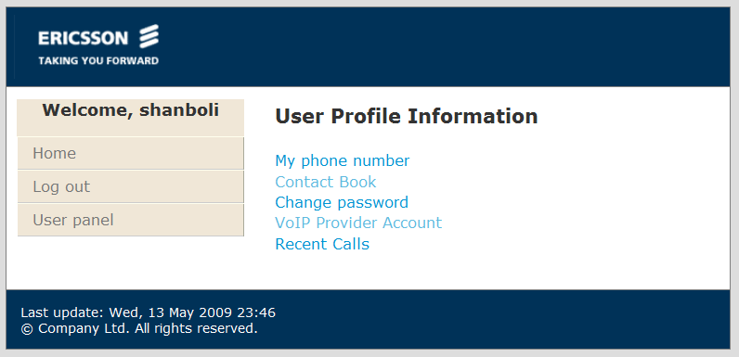
User Profile

Slide 40
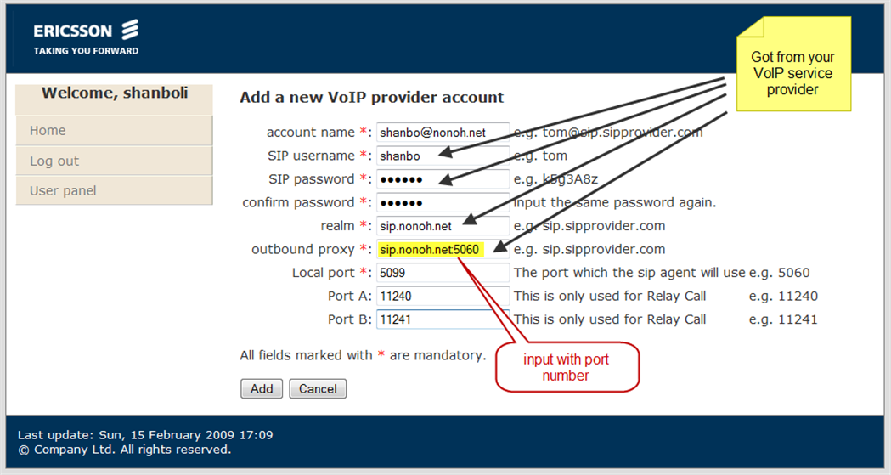
SIP Account

Slide 41
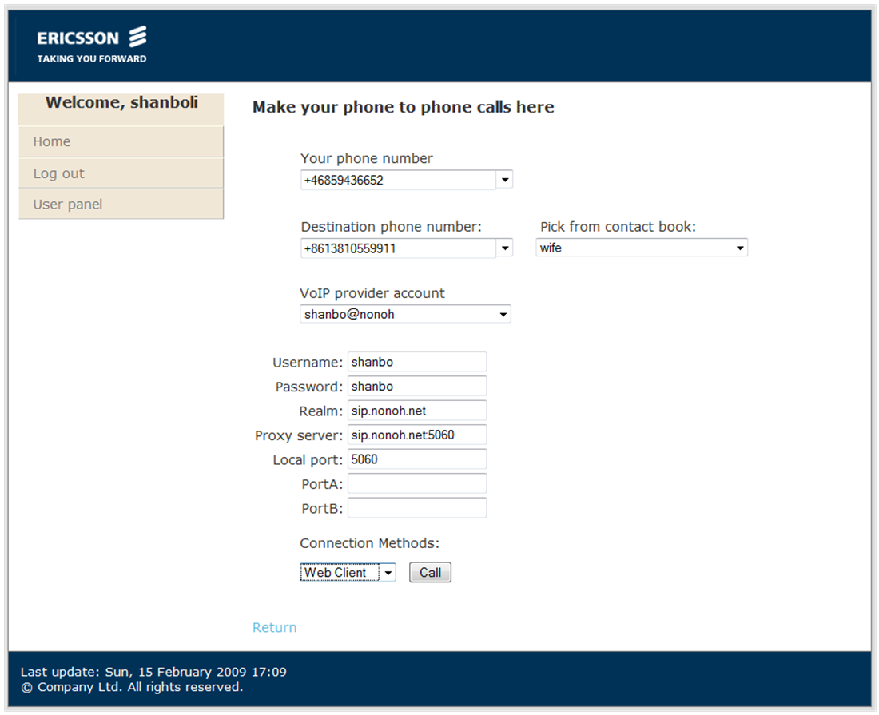
VoIP Phone Call

Slide 42
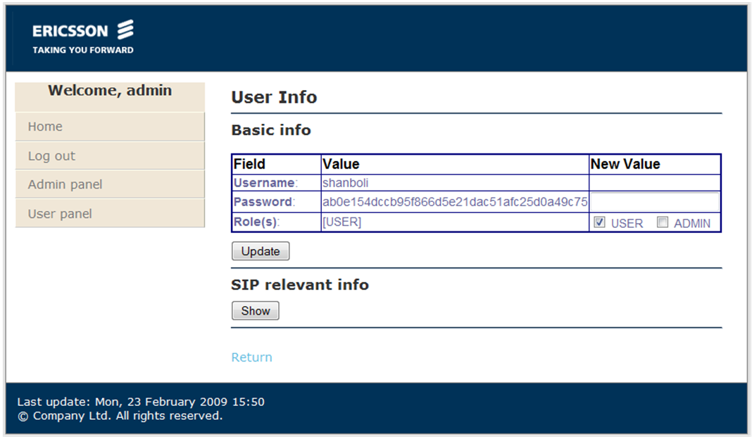
Admin & Management

Slide 43
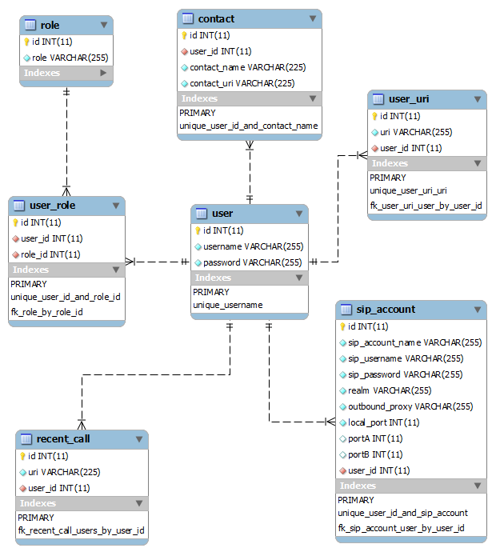
Database

Slide 44
WEB SERVICE INTERFACE

Slide 45
Web Service Interface
SOAP web service interface
Based on Metro
Can have variety of clients
Methods:
  getContacts
  getRecentCalls
  getSipAccounts
  getImplTypes
  call
  cancelCall
  getState
  syncContacts

Slide 46
JAVA ME CLIENT

Slide 47
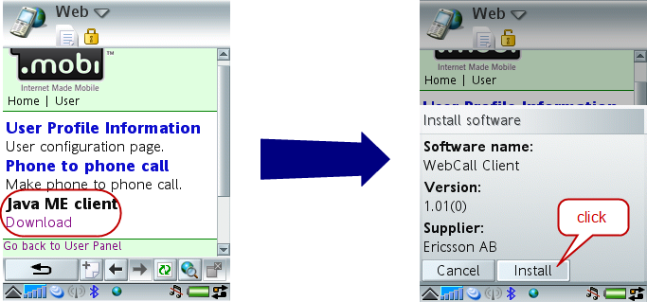
Install

Slide 48
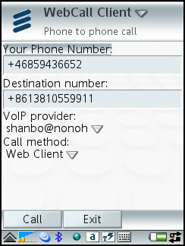
Main Form

Slide 49
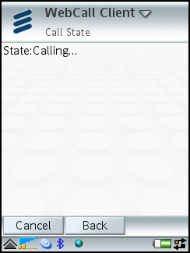
Call State

Slide 50
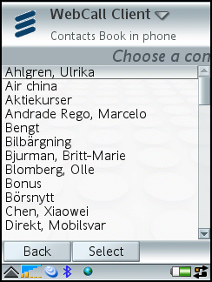
PIM Contacts

Slide 51
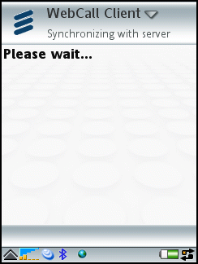
Synchronize

Slide 52
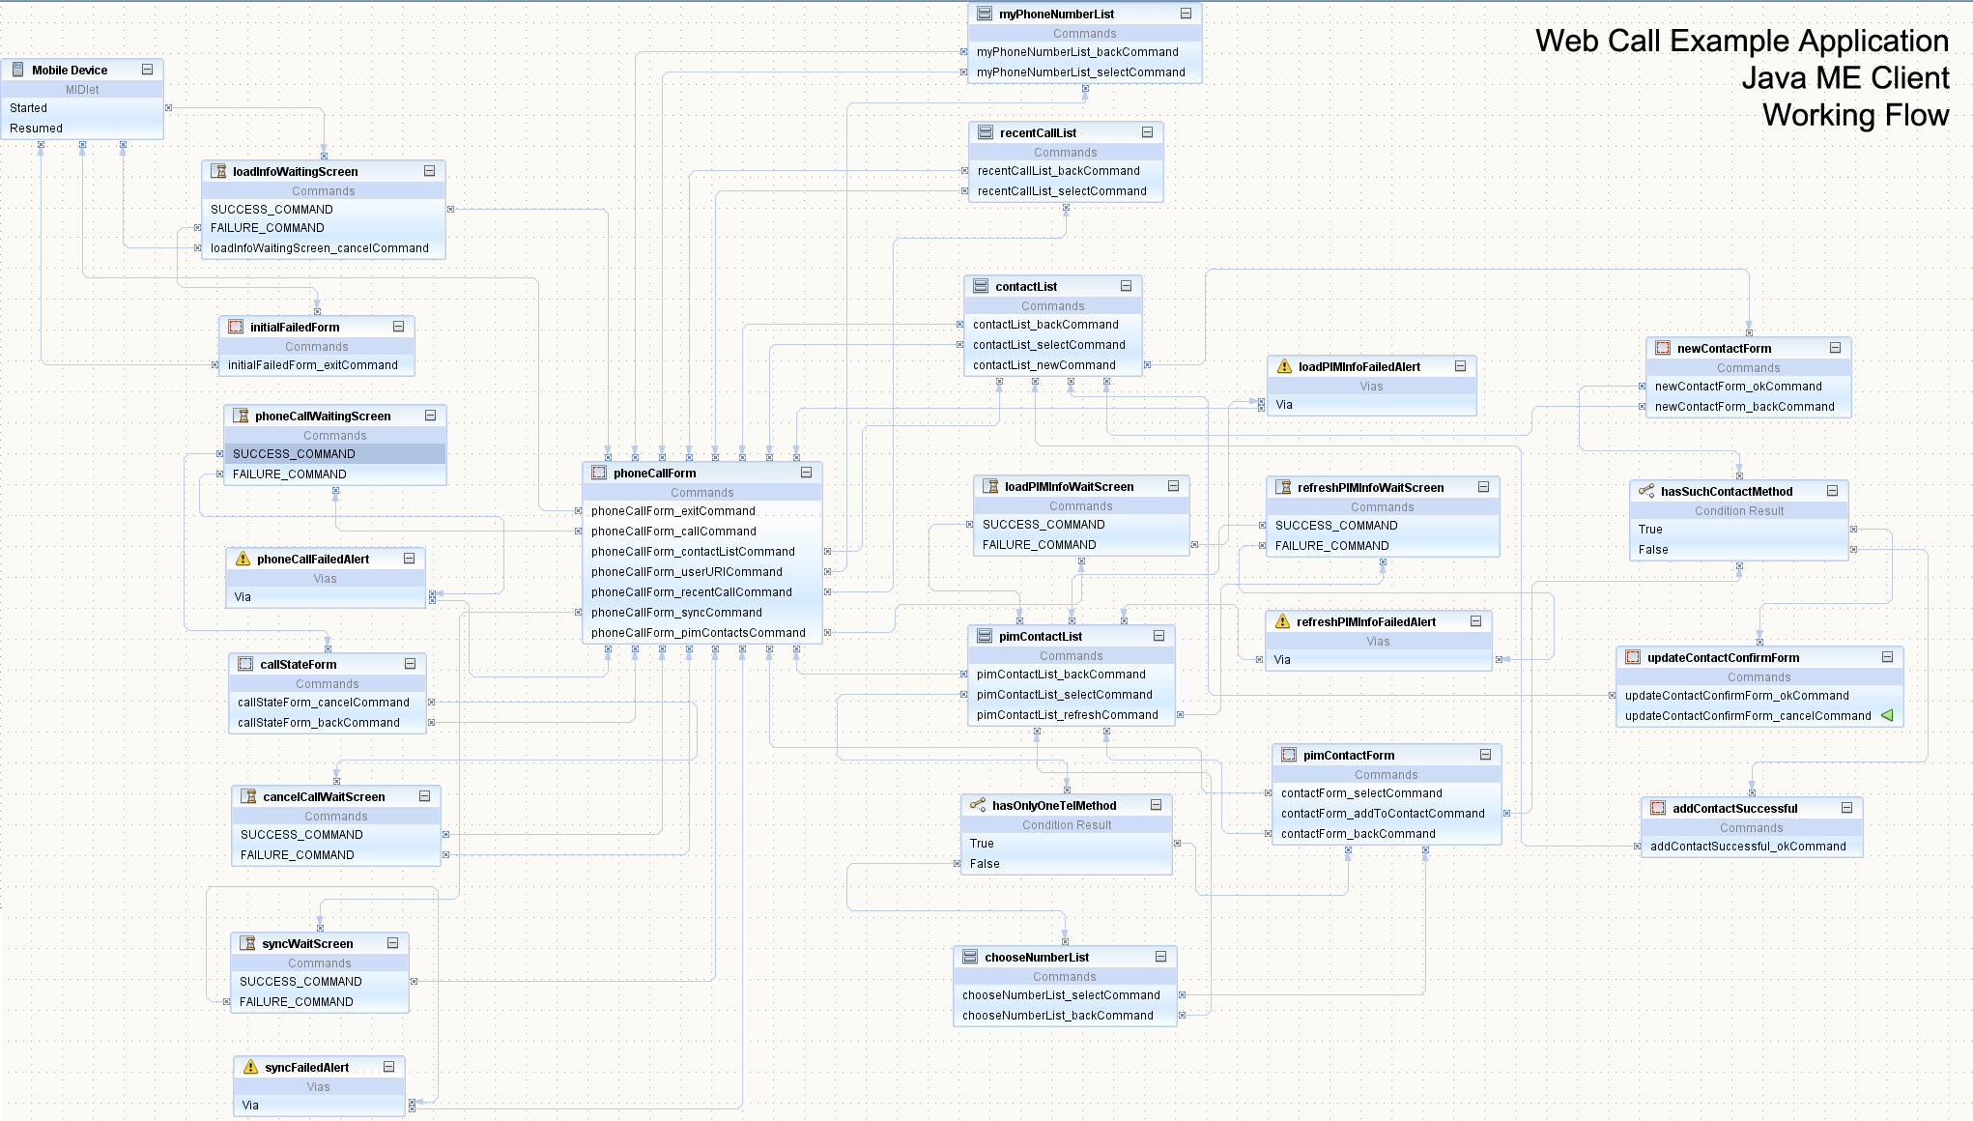
Java ME client Working Flow

Slide 53
Architecture
User Interface
VMD-based UI
Generic UI
Business Logic
Web Call Client
Record Store
Manager
Web Service client stub
PIM Contact
Helper
Java ME API
JSR 172
JSR 75
…

Slide 54
COMPARISION AND
EVALUATION

Slide 55
Test platform
Ericsson SDS (simulate a IMS environment)
Nonoh.net (real VoIP service provider)
PhonerLite
Express Talk
Mobile phone

Slide 56
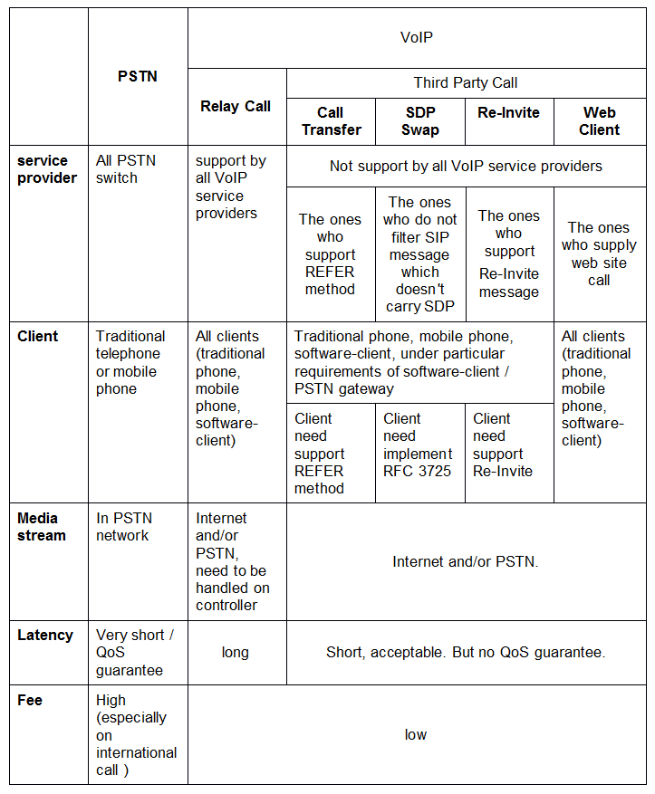
Comparison of
Call Methods

Slide 57
Comparison of Portal
Desktop Browser View
  Special designed for desktop browser
  Full function
  Computer is a MUST
Mobile Browser View
  Special designed for mobile browser
  Small size of screen
  Mobile device
Java ME Client
  Special designed for fast dial
  Can load the native contact book
  Need JSR 172(web service API) and JSR 75 (PIM)

Slide 58
Future Work

Slide 59
Future Work
RESTful API
iGoogle gadget
Vista / Windows 7 gadget
Google desktop gadget
Facebook application

Slide 60
Conclusion

Slide 61
Conclusion
Standalone VoIP call API
  Relay Call
  Third Party Call
    Call Transfer
    SDP Swap
    Re-inivte
    Web Client
Web Application
  Dual-view
  Contacts
  Multi VoIP Account
Java ME Client
Web Service Interface

Slide 62

Achievement
Web Call Example Application is used as the base library of Ericsson’s demo of Using REST and Web Services to Mash Up Communications Capabilities at Java One 2009

Slide 63

Demo

Slide 64


