Slide 1

Web Call
Example Application
Shanbo Li
shanbo.li@ericsson.com

Slide 2
Agenda
Introduction
Demo
Design description
Q&A

Slide 3
Background
Competition in VoIP market
SIP client software
Web based SIP phone calls
Web Call SDK
SIP Call Component (core)
Development of Web 2.0 applications

Slide 4
Introduction
SIP Call Component (core)
  High level API
  Client-to-Client SIP call
Integrated web application
  Based on Mobile front Controller
  web service Components

Slide 5
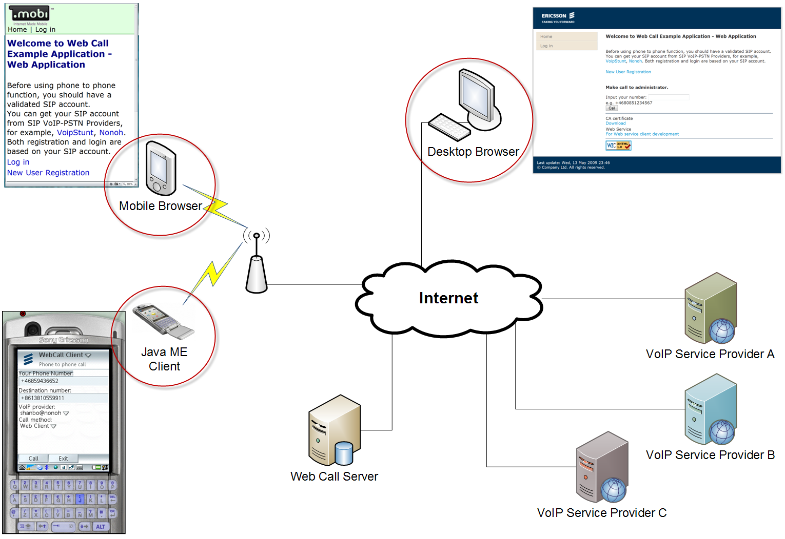
Use case overview

Slide 6
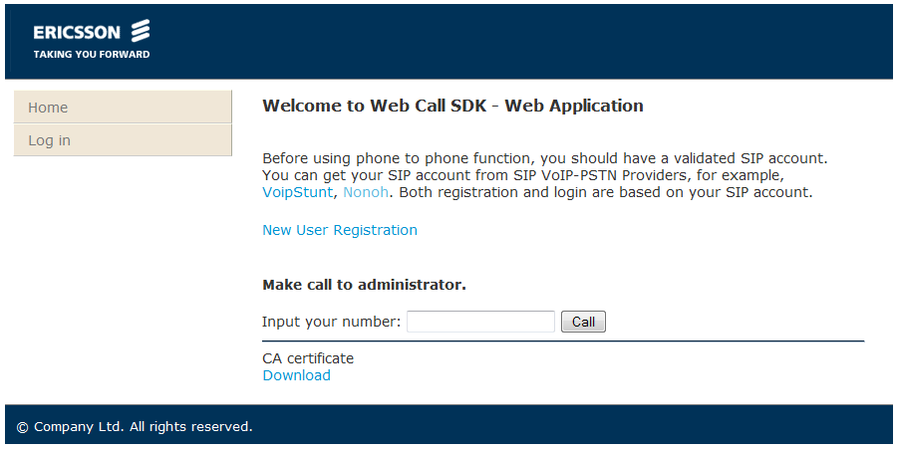
Desktop browser view
XHTML

Slide 7
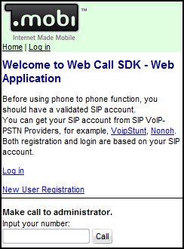
Mobile browser view
XHTML MP 1.1

Slide 8
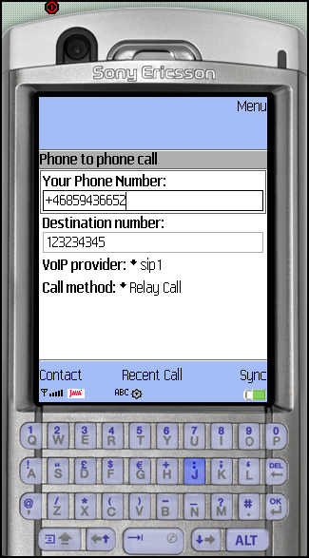
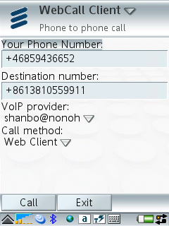
Java ME client
Java ME
JSR 172 web services

Slide 9

Demo

Slide 10
Demo
Try it:
  http://peteryeung.homeip.net/WebCall/
Laptop:
  Desktop browser view
P1:
  Mobile browser view
P990:
  Java ME client

Slide 11
Agenda
Introduction
Demo
Design description
Q&A

Slide 12
Call method
Relay Call
Third party call
  Call transfer
  Re-invite
  SDP swap
  Web client

Slide 13
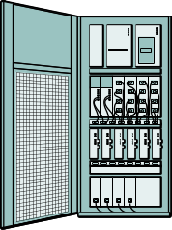

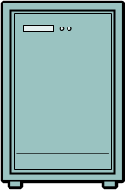
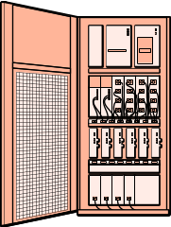

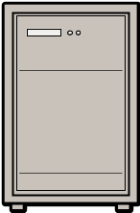
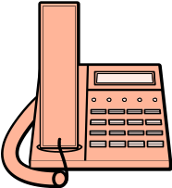

Relay Call
Control Signal
Media Flow
SIP
SIP
RTP
ISUP
PSTN Gateway
RTP
SIP
SIP
VoIP service provider
PCM
VoIP service provider
RTP
RTP
PSTN Gateway
GSM Base Station
PCM
ISUP
ISUP
PCM
Web Call Server
(Back-to-Back User Agent)
(media bridge)
Client A
Client B

Slide 14
Third Party Call
Control Signal
Media Flow
RTP
PSTN Gateway
SIP
PCM
SIP
PSTN Gateway
ISUP
ISUP
VoIP service provider
PCM
SIP
GSM Base Station
ISUP
PCM
Web Call Server
(User Agent)
Client A
Client B

Slide 15
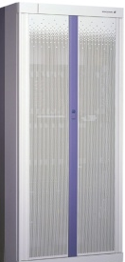


Relay Call solution
Client A
Controller
(initiator)
Client B
SIP Provider
INVITE
SIP
Phone
-to-
Phone
call
Controller
(UA)
Mobile
Device
200 OK
SIP proxy servers
ACK
INVITE
SIP proxy servers
RTP
(RING TONE)
200 OK
ACK
RTP
RTP
User Agent Client
PSTN Gateway
BYE
200 OK
BYE
200 OK

Slide 16
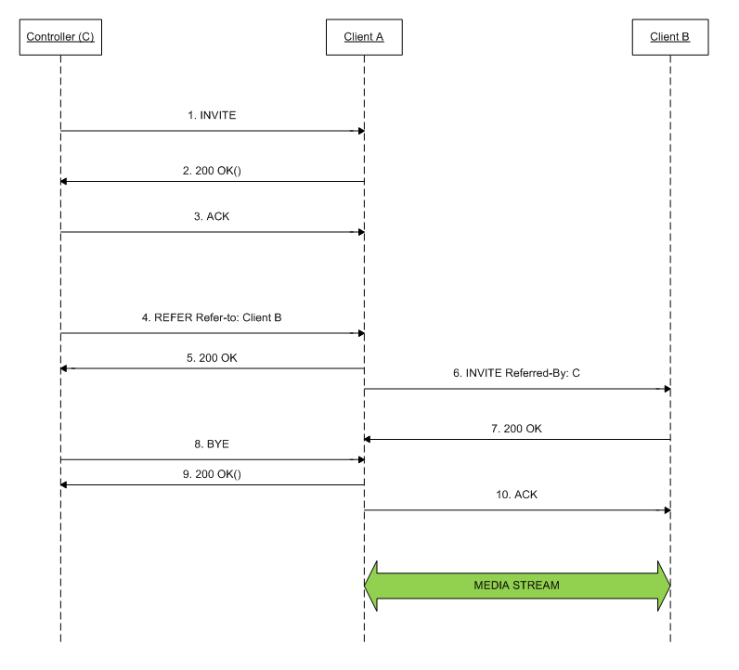
Call Transfer
Use REFER method defined in RFC 3515

Slide 17
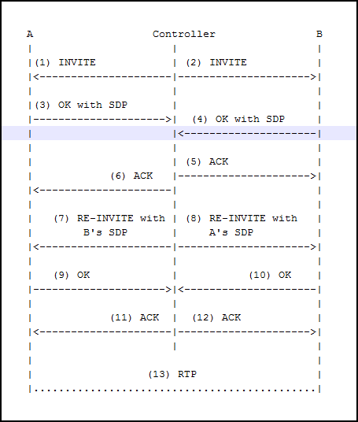
Re-invite

Slide 18
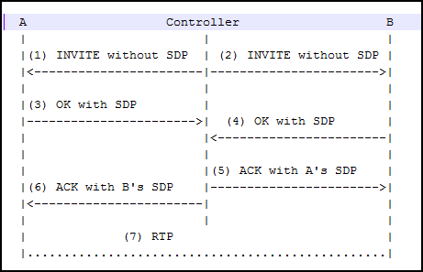
SDP swap

Slide 19
Web Client
Simulate a web browser

Slide 20
Architecture (brief)
XHTML | XHTML-MP
Java ME Client
Mobile Front Controller
Web Service
interface
Web Application
SIP Call
Component
(core)
User Database
Utility
Database

Slide 21
Five Layers (from design rule)
JavaBean for synchronized communication
OOP use-case based API layer
Business logic layer
Abstraction layer
Protocol stack

Slide 22
SIP Call Component (core)
Call Controller
Relay Call Controller
Third party call controller
Abstraction layer
Re-invite
Re-invite
Re-invite
Web
client
CALL
TRANSFER
Web
client
CALL
TRANSFER
CALL
TRANSFER
CALL
TRANSFER
SDP
swap
SDP
swap
SDP
swap
Relay Call
SDP
swap
MjSIP stack
MjSIP stack
Apache common
httpclient

Slide 23
Java ME web service client
User Interface
VMD-based UI
Generic UI
Business Logic
Web Call Client
Record Store
Manager
Web Service client stub
PIM Contact
Helper
Java ME API
JSR 172
JSR 75
…

Slide 24
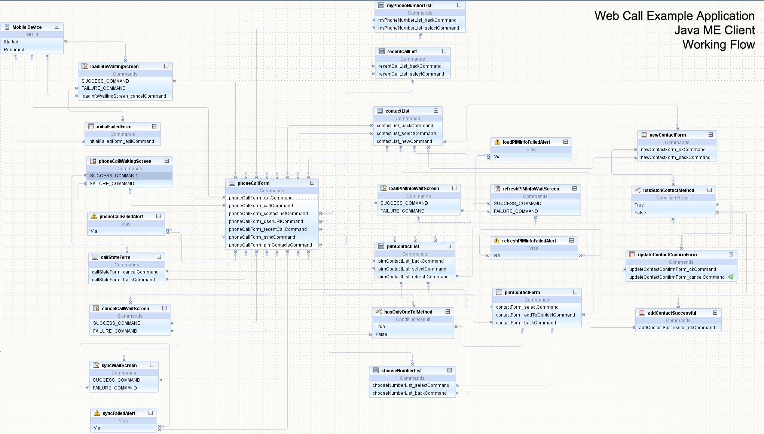
Java ME client Working Flow

Slide 25
Test platform
Ericsson SDS
Nonoh.net
PhonerLite
Express Talk
Mobile phone

Slide 26
Future Work
iGoogle gadget
Vista sidebar gadget
Google desktop gadget
Facebook application

Slide 27


