Slide 2
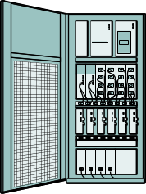


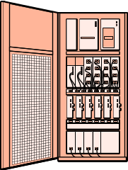

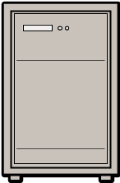
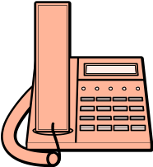

Relay Call
Control Signal
Media Flow
SIP
SIP
RTP
ISUP
PSTN Gateway
RTP
SIP
SIP
VoIP service provider
PCM
VoIP service provider
RTP
RTP
PSTN Gateway
GSM Base Station
PCM
ISUP
ISUP
PCM
Web Call Server
(Back-to-Back User Agent)
(media bridge)
Client A
Client B

Slide 3
Third Party Call
Control Signal
Media Flow
RTP
PSTN Gateway
SIP
PCM
SIP
PSTN Gateway
ISUP
ISUP
VoIP service provider
PCM
SIP
GSM Base Station
ISUP
PCM
Web Call Server
(User Agent)
Client A
Client B

Slide 4


