Slide 1


Using REST and Web Services to Mash Up Communications Capabilities
Peter Yeung – Developer Strategist
Elena Fersman – Tech Solution Owner
Ericsson AB, Business Unit Multimedia
Ericsson Developer Connection
Speaker logo centered below image

Slide 2
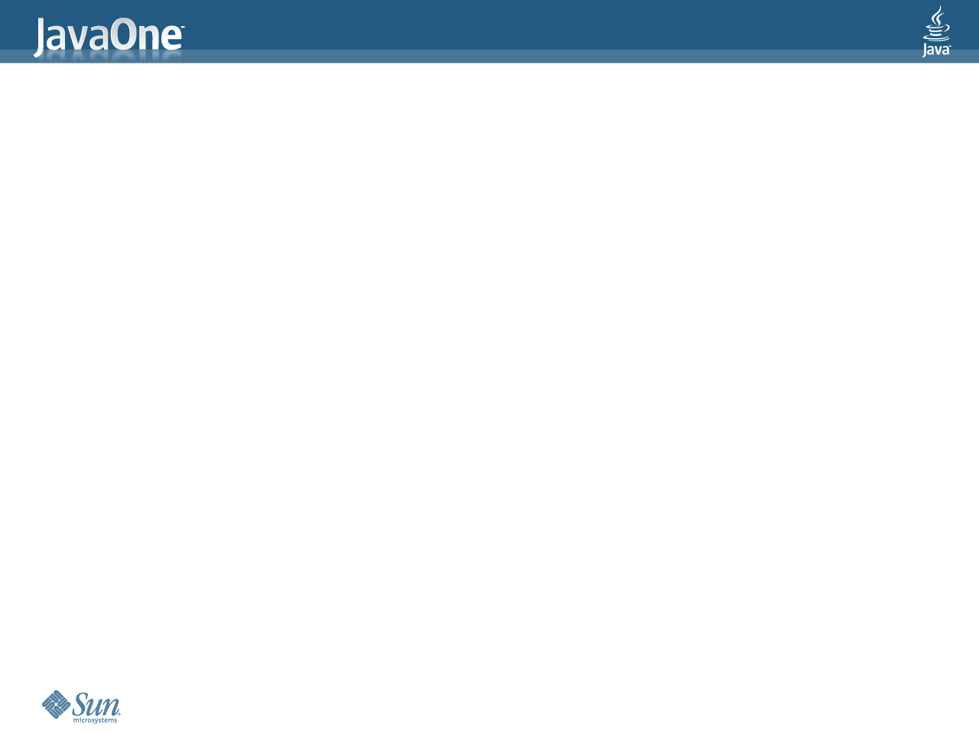
Agenda
BOF 4355, 02-June 20:30-21:20
  The things you probably already know...
  ...and the REST
  REST in use
  Mash-up – combining services
  Demo
  Developer Strategy
  Behind the scenes
  SOP
  Q&A

Slide 3
The things you probably already know...
Computer to computer communication
  Different interfaces and protocols
Human to computer communication
  User interface
Communication on the Web
  From the server to the human
  The HTTP protocol
  The web browser (Internet Explorer, Firefox, Opera, Safari etc.)

Slide 4
...and the REST
Representational state transfer (REST)
Dynamic and interactive content on web pages
  Reusing existing services – why build a new map service when I can use Google’s service?
  Combining services (mash-ups)
A need to communicate between browsers and servers with those services
The term REST is often used loosely to describe a simple interface for communication over HTTP
HTTP is already known by the large mass of web developers

Slide 5
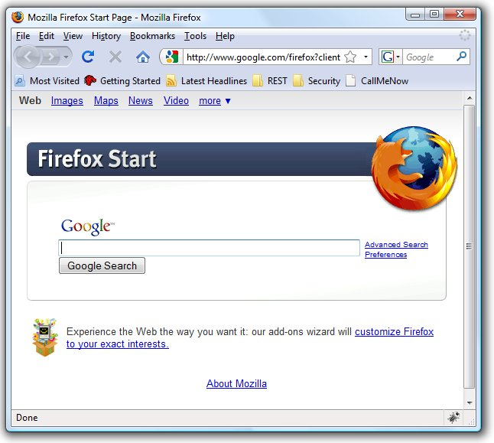
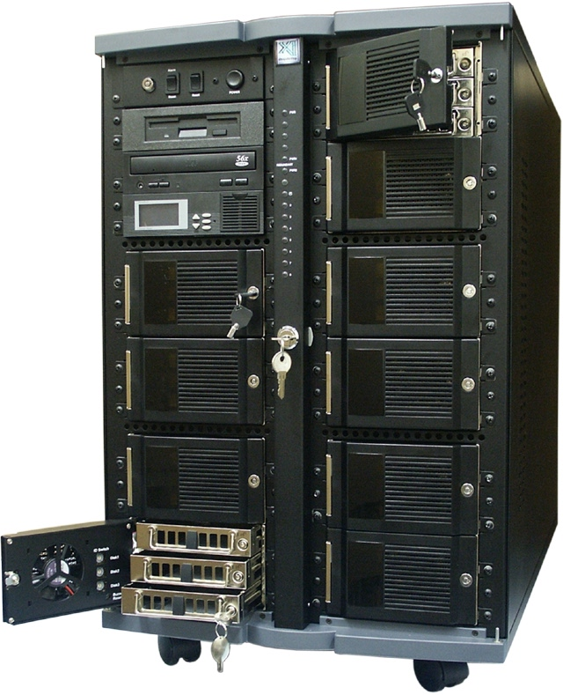
REST in use
REST client
REST server
HTTP

Slide 6


Mash-up – combining services
Display all of your friends on a Map
Display friends
Web server
REST server
Geocoder service
REST client
REST server
Proxy-style REST
For Server-side Mashup
Maps
service
Client-style REST
For Client-side Mashup

Slide 7
Our goal
To target the large amount of end-users on Internet by offering them Telco capabilities via client-style REST

Slide 8
REST Use Cases
Demo1: Pure HTML:
  Redirect Client style
Demo2: Javascript/DHTM:
  Direct Client style
Demo3: Desktop Widget:
  Proxy/Client style
Demo4: Thin fat client:
  JavaFX+Direct Client style

Slide 9

Call Me Now service
“Call Me Now” Service example
showing 3rd party call capability
Based on REST HTTP GET URL:
http://callmenow.kicks-ass.net/callA? _x000b_clientA=070243528 &
username=peter.yeung

Slide 10
Time for some demo....

Slide 11
Demo1 – Web widgets with
REST Client redirect style
This demo shows how easy a user can add a “Call Me Now” capabilities to any internet Blog, this demo shows it with http://blogg.se/
The blog web site has no connection with the network operator i.e. the new business is user-driven/pushed.
The REST client redirect style shows how easy a user can add 3 lines of common HTML without using any Javascript.

Slide 12
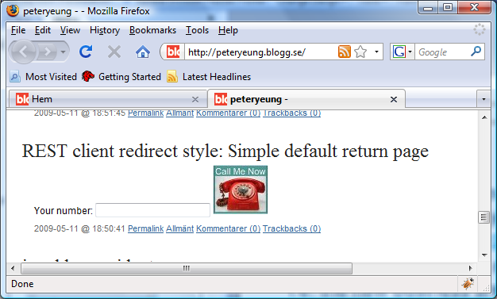
Web Widget with simple REST client redirect style

Slide 13
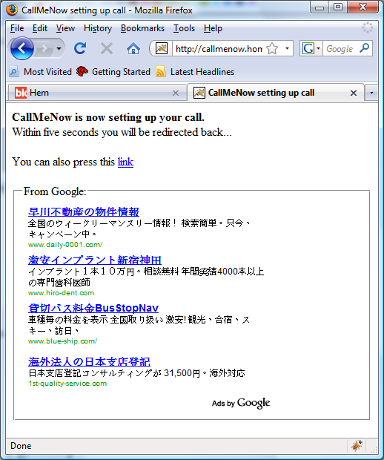
Redirect to a page with ads before return back
Information about call setup
Advertising for sponsor this service
with e.g. ads related to the dialed number.

Slide 14
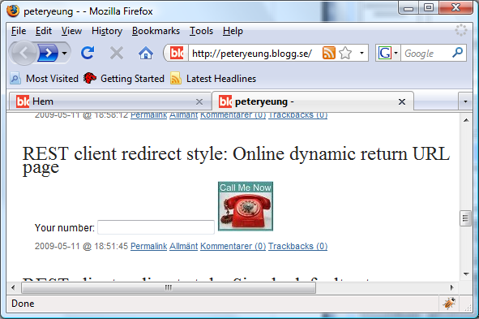
Web Widget with dynamic REST client redirect style

Slide 15
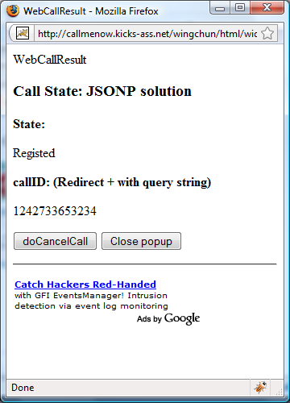
Pop-up with status and control page
Call status of call
e.g. user no longer needs to listen to a callback tone.
Call ID for trace the call
Easy to control the call
Advertising for sponsor this service
with e.g. ads related to the dialed number.

Slide 16
Demo 2 – Web widget with
REST Client direct style
This demo shows how easy a user can add a “Call Me Now”
Better user experience

Slide 17
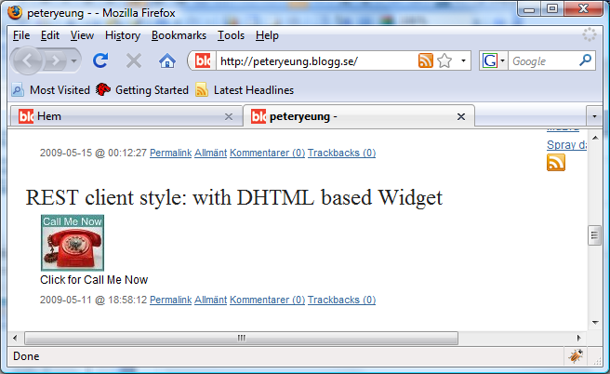
DHTML telco widget on a blog

Slide 18
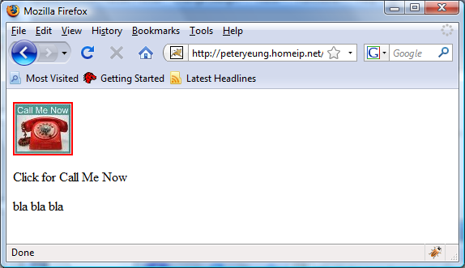
In simple static HTML page

Slide 19
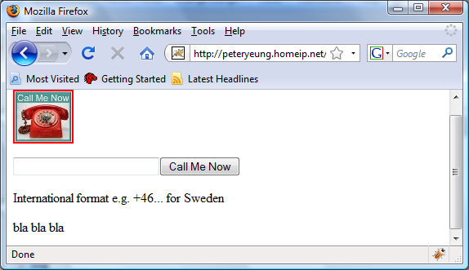
Dynamic HTML tags is generated after click on the image

Slide 20
User only needs to past 3 rows of common HTML code for a user customized design
<script type="text/javascript" src=“***/CallMeNow.js"></script>
<a href="#h" onclick="showCall('callMeNowId')"><img src=“***"/></a>
<div id="callMeNowId">Click for Call Me Now</div>

Slide 21
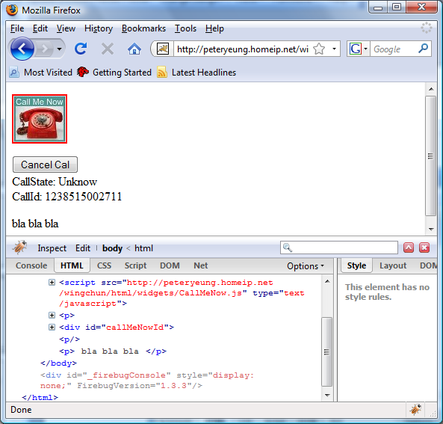
Call id is returned back with polling of call state
Status and control
Dynamic generated
Script src for JSONP

Slide 22
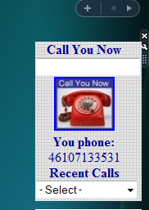
On Windows Vista sidebar
Demo 3 – Desktop Gadget/widgets with
Proxy style REST

Slide 23
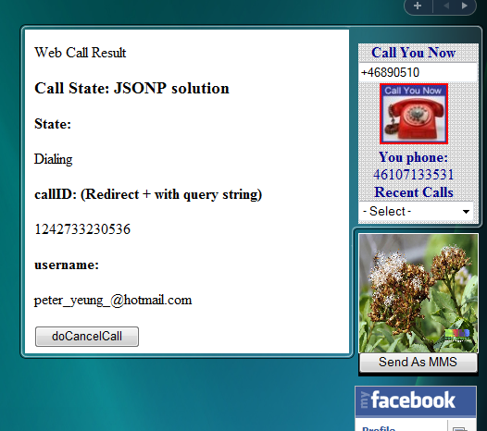
Status and control page fly-out generated from server

Slide 24
Demo 4 – JavaFX Web widget
REST client style
Pros
Better user experience
Multi-platform
Cons
Difficult to customize
Latest Java installed is prerequisite

Slide 25
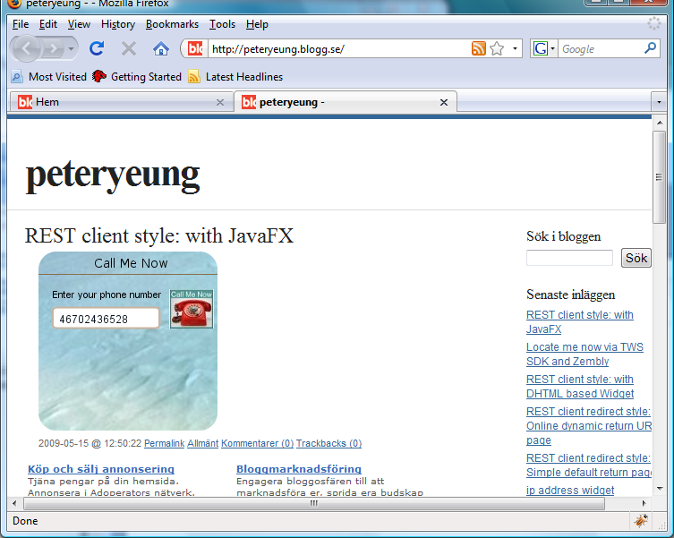
JavaFX teleo widget on a blog

Slide 26
Developer Strategy

Slide 27

Exposing Telecom capabilities/services evolution
User designed services &
User generated content
User
Driven
REST – client-style, redirect-style
Internet & web applications
REST/RESTful ws – HTTP, proxy-style
IT
Developer
Driven
Parlay X – SOAP
Parlay OSA – Corba IIOP, distrubueted computing
Walled garden
Telco
Expert
Driven
IN – e.g. SS7, AXE etc.
digitalization

Slide 28
Strategy Background
Enabling of User Designed Service for User Generated Content
Independence
No relation between blogs / web provider and network operator
No hard integration with the telco capability
Works everywhere
Works in non dynamic Web pages in e.g. web hotels
Easy to work with GCI e.g. ASP.NET, JSP, PHP, RUBY etc.
(i.e. light integration on presentation layer)

Slide 29
The REST Strategy
Summary for the “REST for next generation Telco” strategy:
Increasing the utilization of Operators’ telecom capability assets,
Make it available for the Web 2.0 by:
  Independence with Web Service Provider & Community provider
  user driven
  Loose coupling with users/developers
Target the mass market:
Long-tail user generated web content/services
Long-tail web developers

Slide 30
Behind the scenes

Slide 31



Physical Deployment architecture
User design service & generated content
Independent
Web Server
Hosted by Peters HomePC at home
REST server
WebCall
REST
GateWay
WebCall
Application
CallMeNow
Proxy
SOP restriction
REST
SOAP
SIP
VoIP
Operator
REST
Proxy Style
Direct Client Style
Redirect Client Style
Mobile
Front
Controller
Mobile
Front
Controller
Proxy Style REST
Wing Chun
Community
application
Mobile
Front
Controller

Slide 32
Same Origin Policy (SOP)
Problem:
Restriction of cross-domain references from Javascript in browsers (Demo2) due to security reasons
Consequence:
AJAX cannot be used because
  Web Page comes from one web server domain (e.g. blogg.se)
  REST interface is from another domain (e.g. telco.com)
Solution:
Dynamic Script Src + JSONP (REST direct client style)
  Based on DHTML

Slide 33
AJAX vs Dynamic Script SRC
Both can be used for Web client Technology for polling
AJAX is restricted with Same Origin Policy (SOP)
Dynamic Script src is not restricted to SOP

Slide 34
AJAX based on XHR (Xml Http Request)
function ajaxGet(url, contentType, callbackFunction) {
var xmlHttpRequest = createXMLHttpRequest();
xmlHttpRequest.open("GET", url, true);
xmlHttpRequest.setRequestHeader("Content-Type", contentType);
// make sure the result isn't cached
xmlHttpRequest.setRequestHeader("If-Modified-Since", new Date(0));
xmlHttpRequest.onreadystatechange = function() {
if (xmlHttpRequest.readyState == 4 && xmlHttpRequest.status == 200) {
if (contentType == "text/xml") {
callbackFunction(xmlHttpRequest.responseXML);
} else {
callbackFunction(xmlHttpRequest.responseText);
}
}
};
xmlHttpRequest.send(null);
}

Slide 35
Dynamic Script Src with JSONP
Uses JSONP (JSON Padding) for callbacks
Uses DOM/Java Script for create Script node
function checkStateCreateJSONP(callbackFunction) {
var script =document.createElement("script");
script.id = 'jsonp';
script.src = 'http://127.0.0.1/ajax/jsonp.json?'+'callbackFunction='+callbackFunction;
script.type = 'application/javascript';
document.body.appendChild(script);
}
Callback with JSONP
function callbackStatus (jsonObject) {
isClosed = jsonObject.closed == 1;
if (!isClosed) {
updatePage(jsonObject.callState);
checkStateRemoveJSONP('jsonp');
setTimeout("checkStateCreateJSONP('callbackStatus')", interval);
}
}

Slide 36

Peter Yeung
Elena Fersman
Peter.yeung@ericsson.com
Elena.fersman@ericsson.com
Ericsson Developer Connection
http://www.ericsson.com/developer/

Slide 37
Slide Heading: 36pt
Subhead: 28pt
All text is Arial
Level One bullet point: 28pt
  Level Two bullet: 26pt
    Level Three: 22pt
      Level Four and subsequent: 18pt
Text block is aligned to the left

Slide 38
Slide Heading: 36pt
Subhead: 28pt
All text is Arial
Level One bullet point: 28pt
  Level Two bullet: 26pt
    Level Three: 22pt
      Level Four and subsequent: 18pt
Text block is aligned to the left

Slide 39
Slide Heading: 36pt
Subhead: 28pt
All text is Arial
Level One bullet point: 28pt
  Level Two bullet: 26pt
    Level Three: 22pt
      Level Four and subsequent: 18pt
Text block is aligned to the left

Slide 40
Slide Heading: 36pt
Subhead: 28pt
All text is Arial
Level One bullet point: 28pt
  Level Two bullet: 26pt
    Level Three: 22pt
      Level Four and subsequent: 18pt
Text block is aligned to the left

Slide 41


