Slide 1
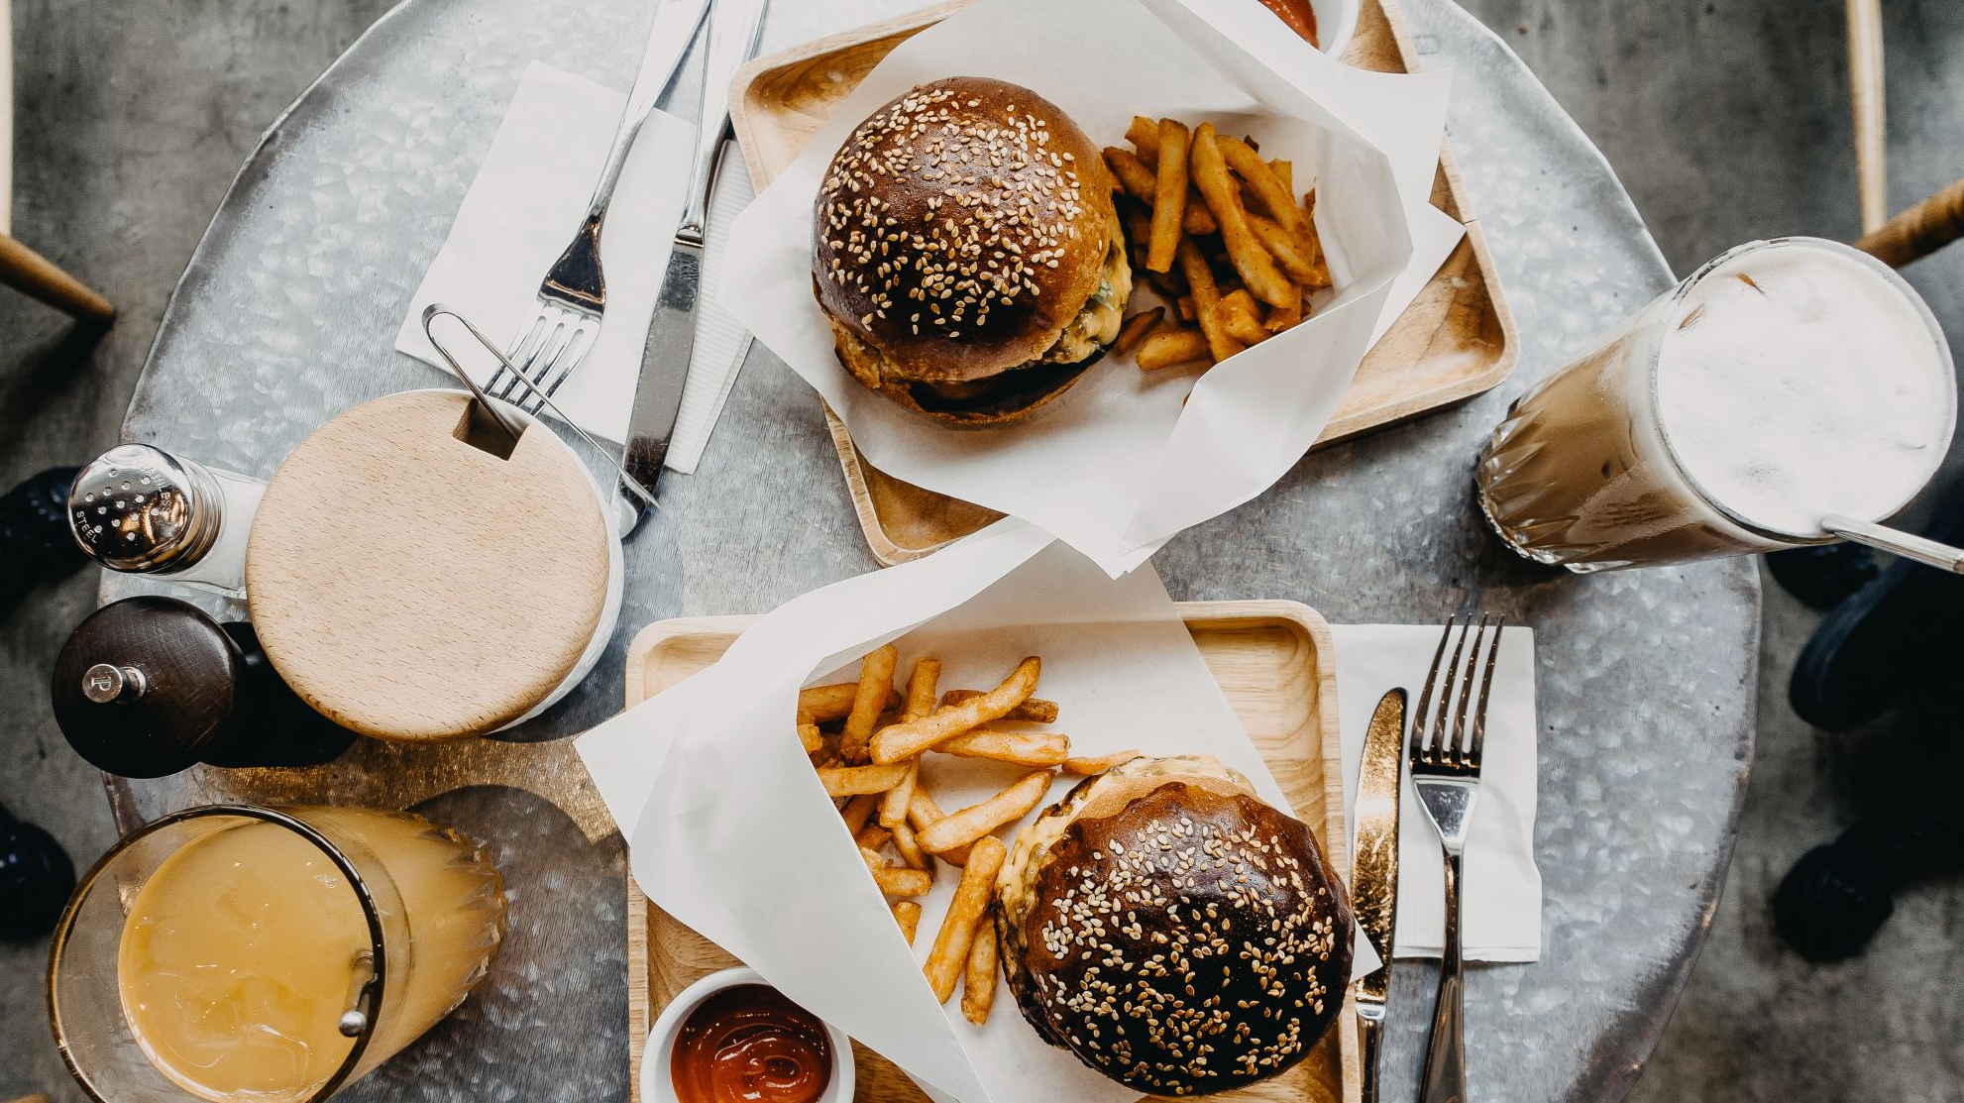
Where’s My Dinner?
Food Delivery Time EDA
Sean Hand

Slide 2

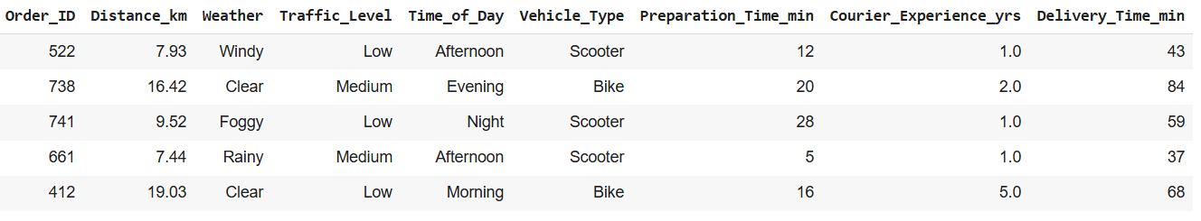
The Data!
9 Columns x 884 rows after dropping 40 rows containing null values

Slide 3
Goals/Questions
My initial goal was to look at the data and determine which values would have the biggest effect on delivery time.
Next, I wanted to make ML models to see if I could predict the time an order would take based on the variables.
Finally, I wanted to classify if an order would be late or not based off the features.

Slide 4
Predictions
My (obvious) prediction is going to be that distance will have the biggest overall effect on delivery time.
While metrics such as weather, traffic levels, and vehicle type may also have a big effect distance will have the biggest by far.

Slide 5
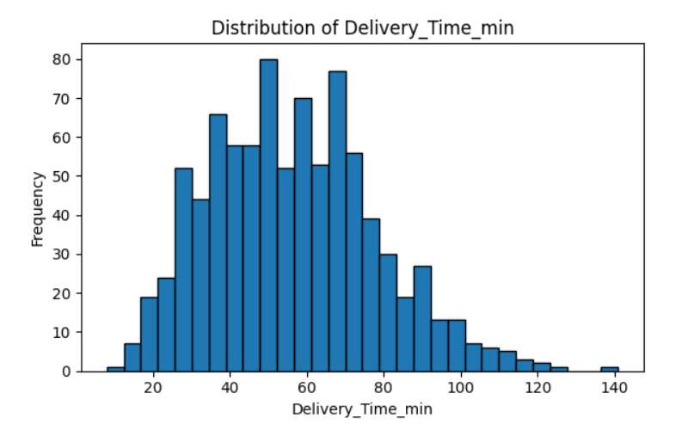

Delivery Time Distrubution
This shows the distribution of delivery times, and the frequency of said times.
Also shown is the average delivery time which was 56.43 minutes.

Slide 6

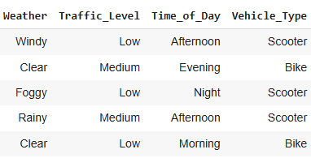
Data encoding
To start, there were some interesting features such as Vehicle_Type, Weather, Time_of_day, and Traffic_levels. However, all four of those were categorical data types.
I used one hot encoding, to split those features to give them values that would allow for linear regression.

Slide 7
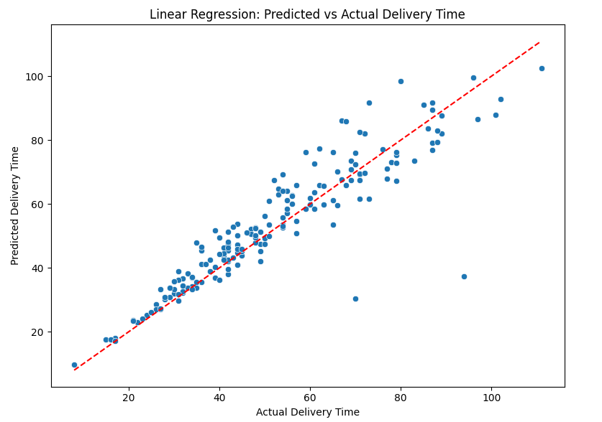
Linear Regression (1/3)
The variables that were encoded previously were put into a Linear model to see what effects each variable would have on delivery time.
Following this Scatterplot, we can
infer that our model fits quite well
because our data points trend
towards the regression line.

Slide 8
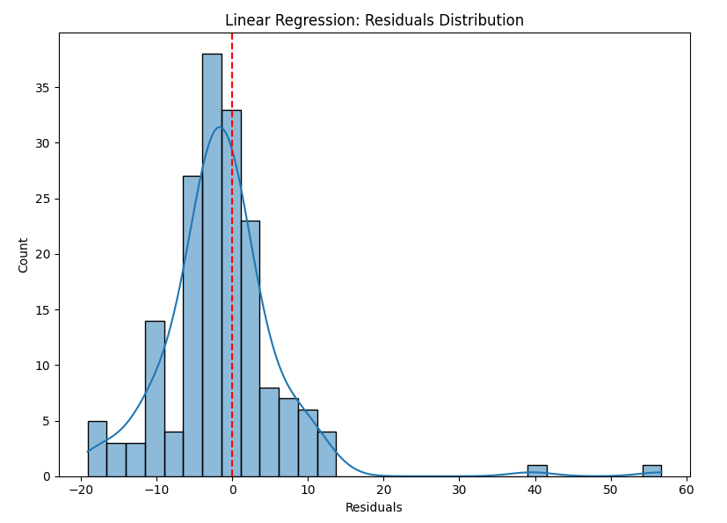

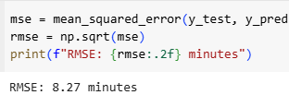
Linear Regression (2/3)
As you can see, based off our R2 Score, MSE, and RSME our model is decently fitted. It could definitely be improved with more data which is likely the biggest thing holding it back.
Since the average Delivery Time is 56 minutes, an error time of 8.27 minutes. is pretty good.

Slide 9
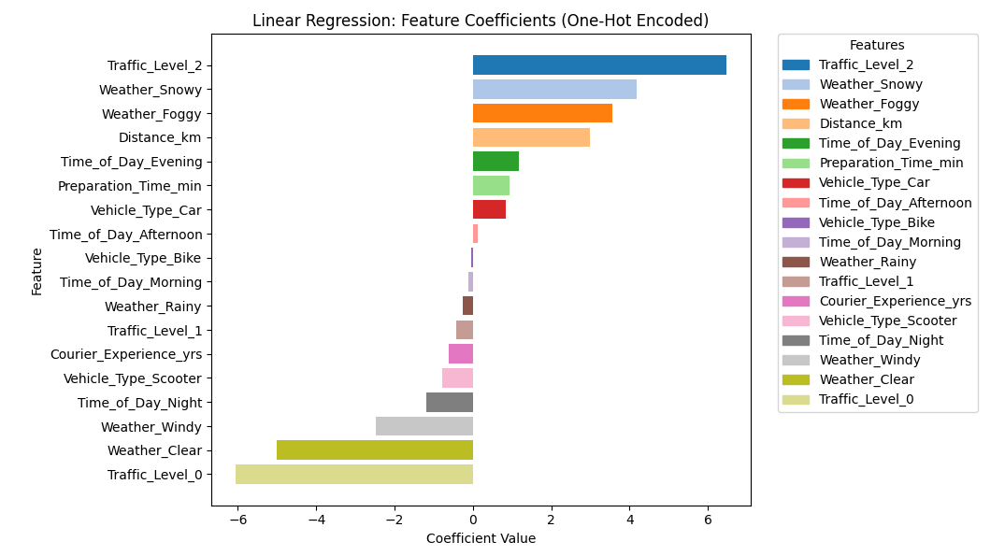
Linear Regression (3/3)
Shown are the effects each feature had on delivery time.
Funny enough, I was wrong and actually high levels of traffic, and weather have bigger effects on delivery time.
That said, we don’t know where this data set was collected from. It was likely in a populated city, and depending on location this data could drastically change.

Slide 10
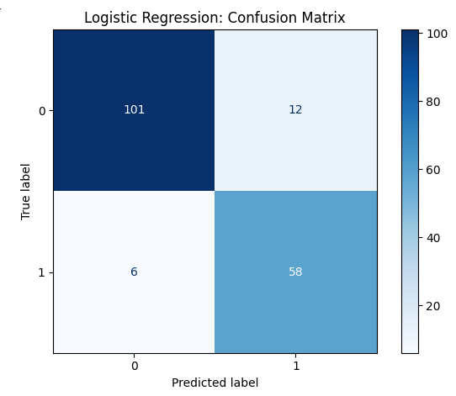

Logistic Regression (1/2)
At the beginning of the presentation we determined that the average delivery time for an order was 56.43 minutes.
Using this data as a threshold for our logistic model we are able to determine if an order will be late or not.
Based off the confusion matrix our model is performing quite well with 90% (89.83) of our predictions being true positives and true negatives.

Slide 11
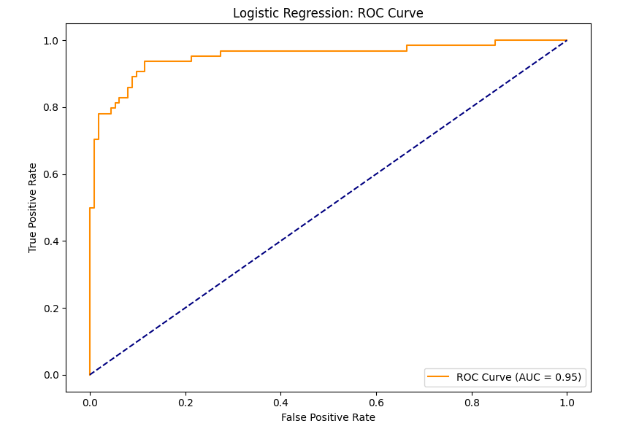
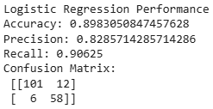
Logistic Regression (2/2)
Based off our ROC curve our data is performing well.
All of our performance metrics around high as well, with our precision score of .82 being the lowest.

Slide 12

Conclusions
In the end, based off our linear model traffic, and weather have the biggest effects, with multiple categories being on the high and low end meaning they have the biggest effects on if an order will be late or not.
It was also determined that you can predict if an order will be late or not depending on what the values in each row are.
Using our logistic model determined using our average delivery time if an order was late or not.
However, it was also determined that this dataset is really only useful in the city it was recorded in. Making entries into the data from your home city may not produce the same results. You may encounter heavier traffic more often in more populated cities and weather will vary depending on geographical location.

