Slide 1
Question :
Implement a dashboard for the data team where the members can check Taxi Availability in Singapore and also address the following queries a. Top 10 areas of highest Taxi Population (One can adjust/group destinations together for brevity) b. Top 10 areas of lowest taxi population c. Hourly taxi availability across Singapore
Alert Mechanism that will inform Data team on areas with no taxi availabilities

Slide 2
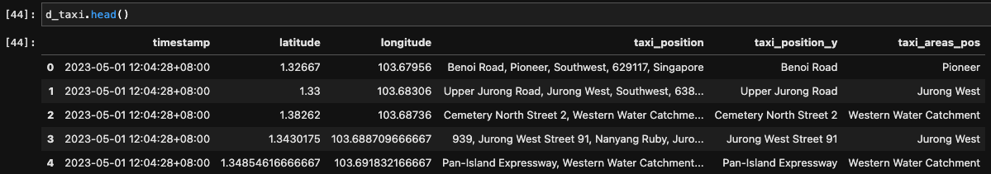
Answer :
Implement a dashboard for the data team where the members can check Taxi Availability in Singapore and also address the following queries a. Top 10 areas of highest Taxi Population (One can adjust/group destinations together for brevity)

Slide 3
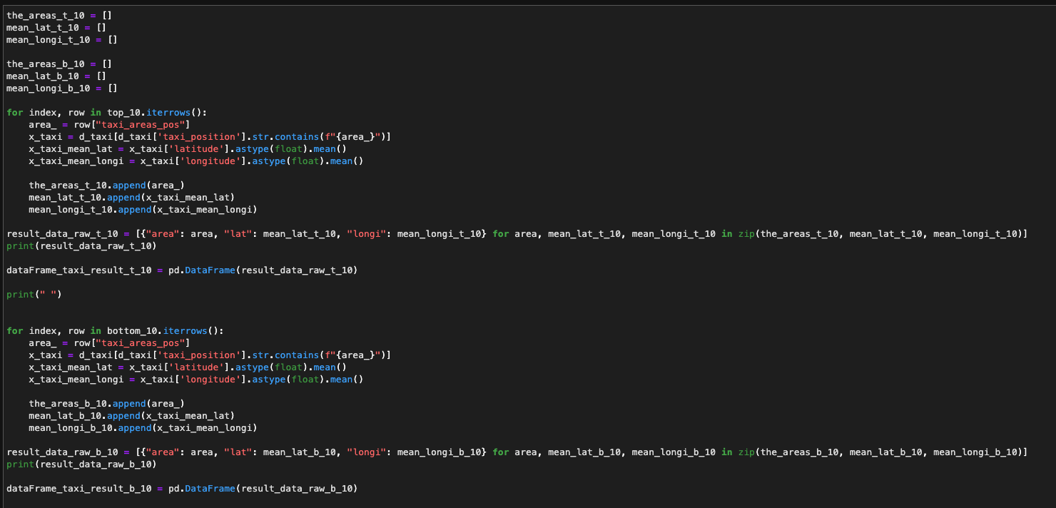
Answer :

Slide 4
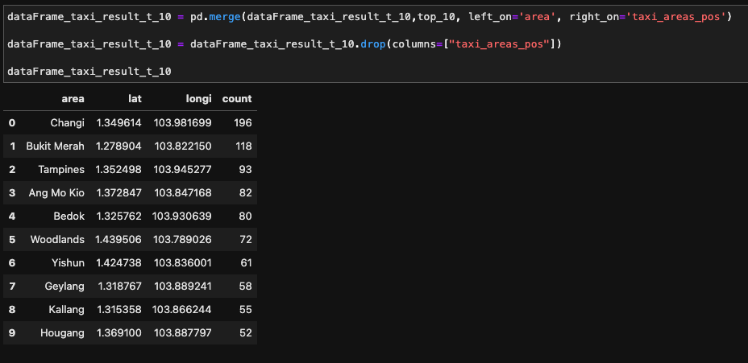
Answer :

Slide 5
Answer :
Implement a dashboard for the data team where the members can check Taxi Availability in Singapore and also address the following queries b. Top 10 areas of lowest taxi population

Slide 6
Answer :

Slide 7
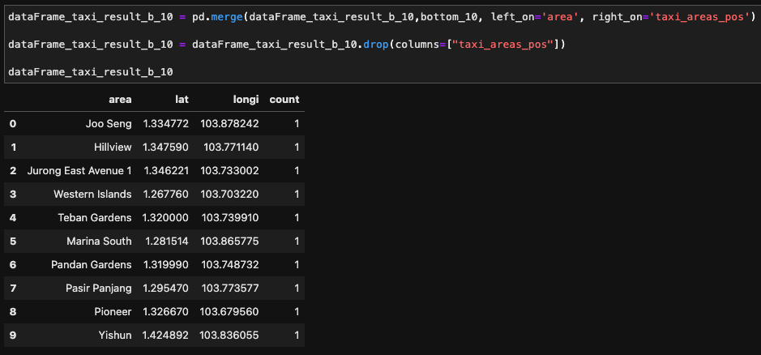
Answer :

Slide 8
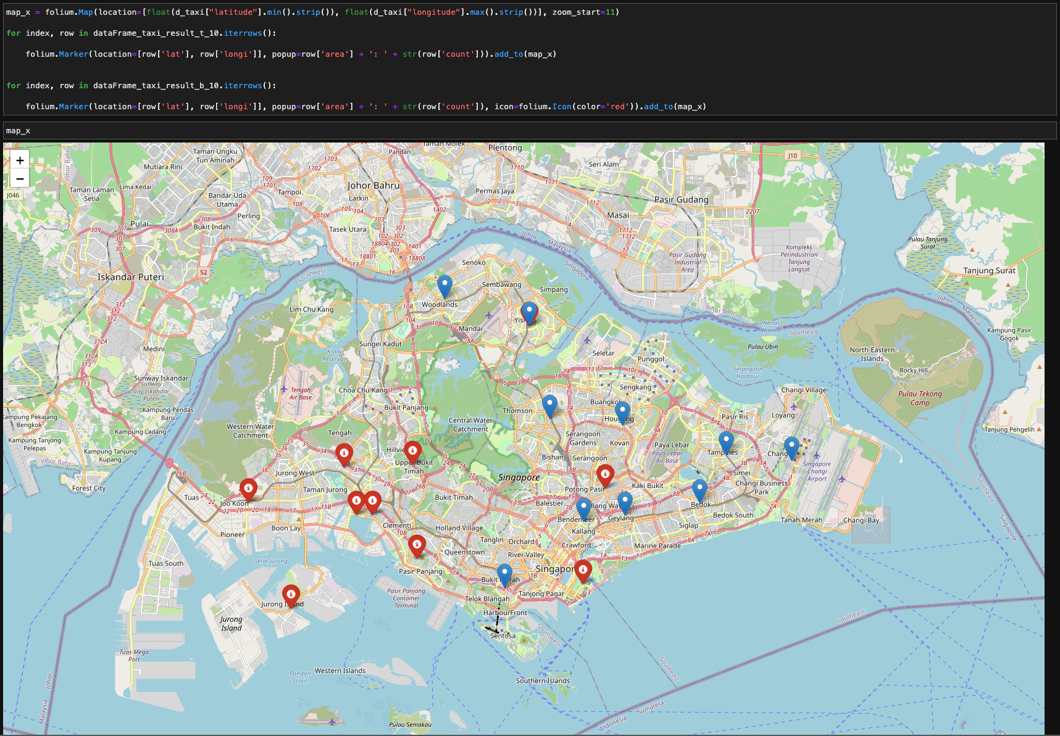
Answer :

Slide 9
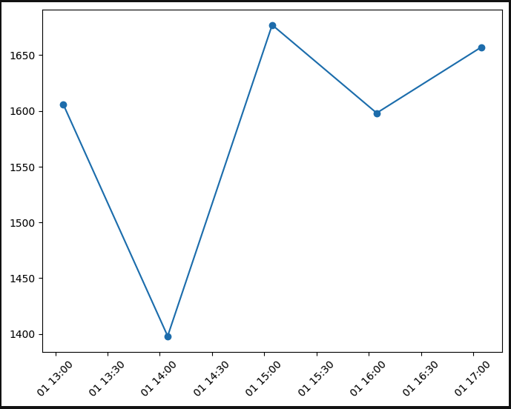
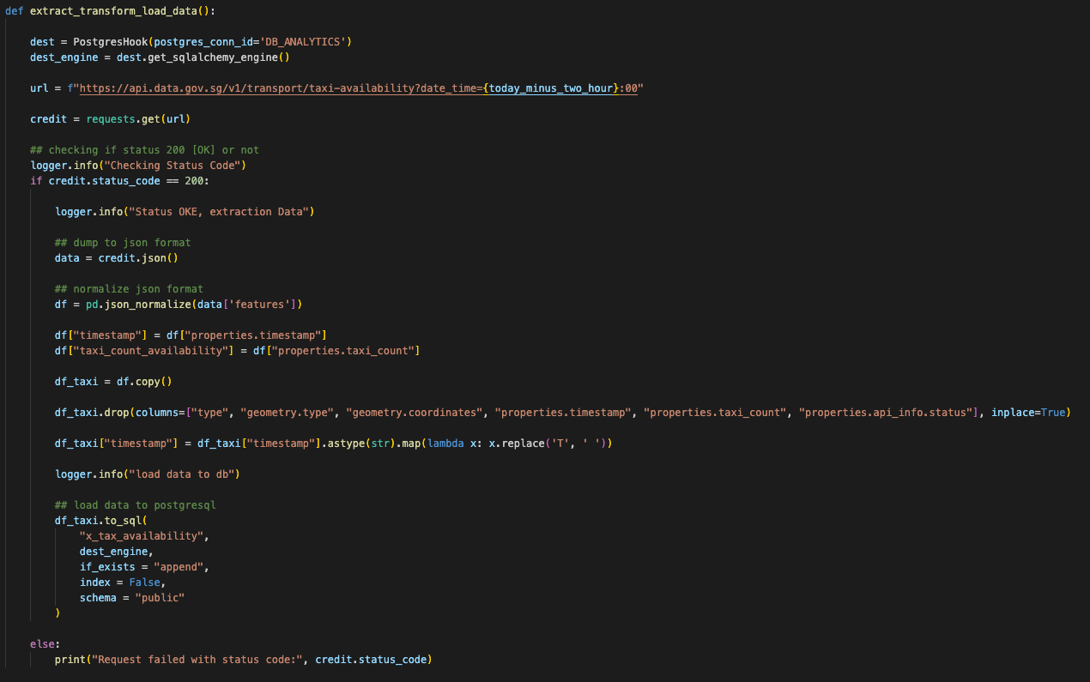
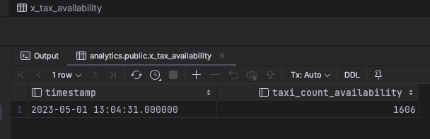
Answer :
Implement a dashboard for the data team where the members can check Taxi Availability in Singapore and also address the following queries c. Hourly taxi availability across Singapore

Slide 10
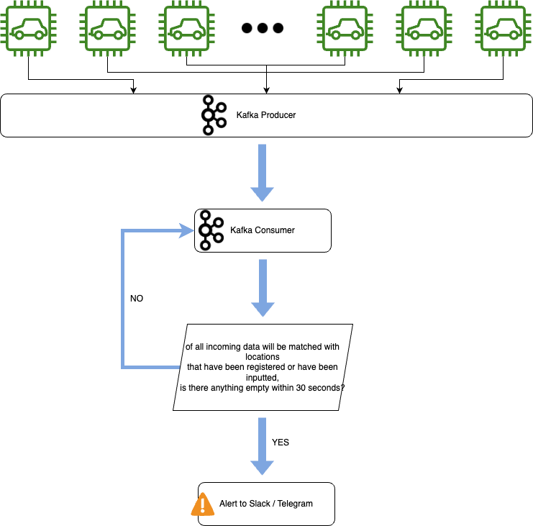
Answer :
2. Alert Mechanism that will inform Data team on areas with no taxi availabilities

