Slide 1
XgBoost
Algorithm
Coefficient Crusaders: Shane Sarabdial, Noelle Kiesz, Kendra Johnson, Miko Le

Slide 2
TABLE OF CONTENTS
1.
2.
3.
4.
INTRO TO XGBOOST
DATASET 1: CARS93
What it is and how it works?
Predict Car Prices
DATASET 2: POKEMON
DATASET 3: HEART DISEASE
Determine Legendary Pokemon
Heart Disease Classification

Slide 3
1
What is XGBoost?

Slide 4
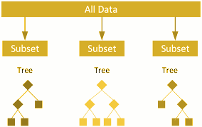
XGBoost: Gradient boosting library with decisions tree as a base model
Commonly used for classification and regression
How it Works: sequences of decision trees and correct errors made by previous trees
Target dataset: Categorical and Continuous variables
Hyperparameters:
Learning rate
The number of trees
Maximum depth of each tree

Slide 5
ADVANTAGES
DISADVANTAGES
XGBOOST vs LINEAR REGRESSION
Speed and Accuracy
Ability to handle missing values
Prevent Overfitting
Regularization
Sampling
Pruning
Early Stopping
Not ideal with outliers
Manually create dummy variable
Requires careful parameter tuning
XGBoost is more complex, better with big datasets
Linear Regression is easier to implement and faster to train, more fitted with small datasets.

Slide 6
Scoring Metris
1. Mean Squared Error: Takes the squared distance between the actual and predicted. The closer the MSE is to 0 the better our model is.
2. ROC Curve: The ratio between true positive rate(TPR) and false positive rate (FPR). TPR/FPR is optimal when TRP is 1 and FRP is 0 resulting in a vertical line.

Slide 7
2
Car Price Prediction with XGBoost

Slide 8
Dataset Characteristics
Source
The data was sourced from kaggle.
Size
Data Types
The data 92 rows and 27 columns
The data has a combination of categorical and numeric values

Slide 9
Features
1. Manufacturer
2. Model
3. Type
4. Minimum Price
5. Price
6. Max Price
7. MPG City
8. MPG HighWay
9. AirBags
10. Drive Train
11. Cylinders
12. Engine Size
13. Horsepower
14. RPM
15. Rev per mile
16. Manual Transition
17. Fuel Tank Capacity
18. Passengers
19. Length
20. Wheelbase
21. Width
22. Turn Circle
23. Rear seat room
24. Luggage room
25. Weight
26. Origin
27. Make

Slide 10
Data preprocessing
STAGE 1
Converted columns to proper data types. Checked for nulls and outliers.
STAGE 2
Dropped Luggage and Rear room columns.
STAGE 3
Create dummy variables for categorical columns (8 columns).
STAGE 4
Split data into train and test.

Slide 11
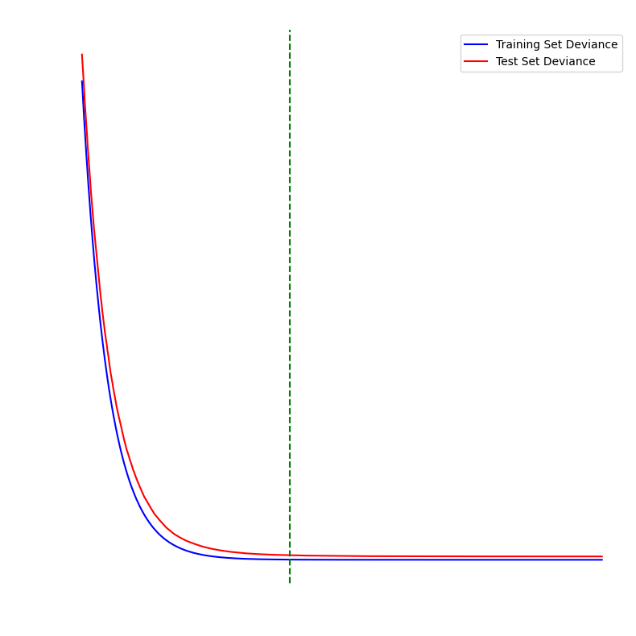
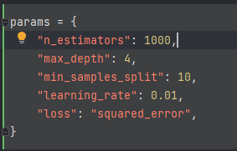
Testing
Our model is not overfitted and performs slightly worse than the training MSE. However, after 400 iterations we get marginal improvements in score and it’s not worth the extra processing power.

Slide 12
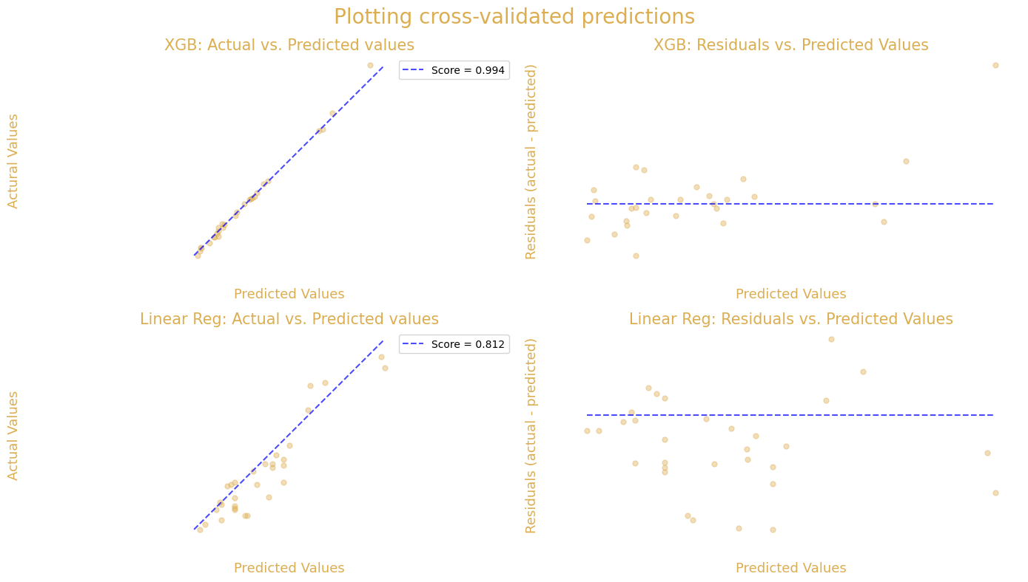
XGB compared to Linear Regression

Slide 13
3
Pokemon Classification with XGBoost

Slide 14

Dataset Characteristics
Source
The data was sourced from Kaggle
Size
Data Types
The data was 800 rows and 13 columns
The data has a combination of categorical and numeric values and a Boolean

Slide 15
Features
1. Name
2. Type 1
3. Type 2
4. Total
5. HP
6. Attack
7. Defense
8. Sp. Attack
9. Sp. Defense
10. Speed
11. Generation
12. Legendary

Slide 16
Data Processing
STAGE 1
Check for data types and nulls.
STAGE 2
Replacing Nulls with ‘None’
Creating Dummy Variables for Type 1 and Type 2
STAGE 3
STAGE 4
Split into test and train data

Slide 17
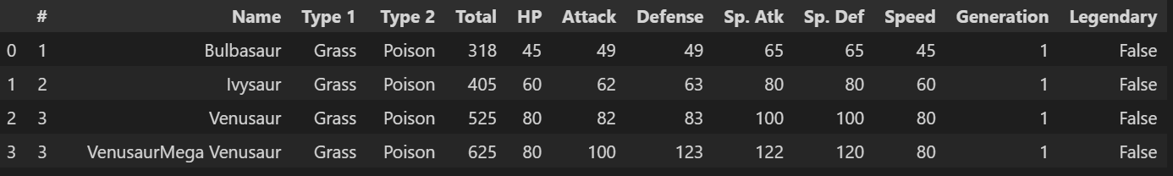
Data and Accuracy

Slide 18
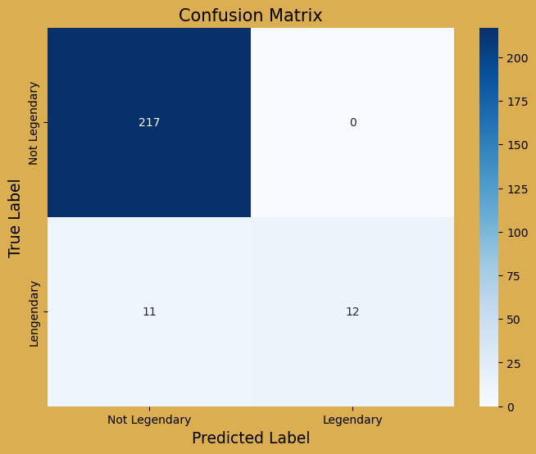
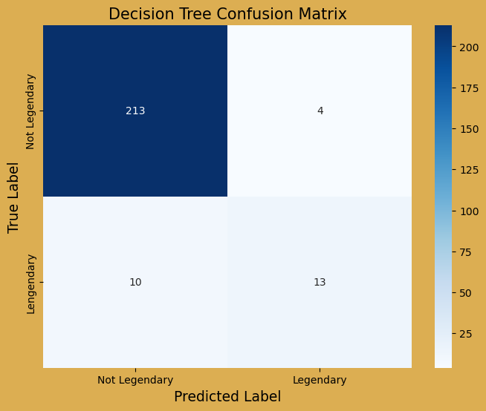
Confusion Matrix Compared to Decision Tree

Slide 19
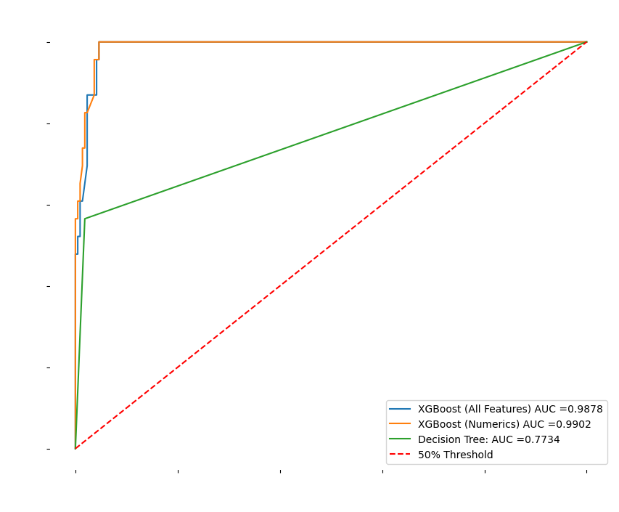
Testing
Both models trained by XGBoost perform similarly.

Slide 20
4
Heart Disease Classification with XGBoost

Slide 21
Dataset Characteristics
Source
Balance
The data was sourced from kaggle.
The data is imbalanced with 292,422 negatives vs 27,373 positive cases
Size
Data Types
The data has 311,936 rows and 18 columns
The data has a combination of categorical and numeric values

Slide 22
Features
1. Heart Disease
2. BMI
3. Smoking
4. Alcohol Drinking
5. Stroke
6. Physical Health
7. Mental Health
8. Driff Walking
9. Sex
10. Age Group
11. Race
12. Diabetic
13. Physical Activity
14. General Health
15. Sleep Time
16. Asthma
17. Kidney Disease
18. Skin Cancer

Slide 23
Data preprocessing
STAGE 1
Check for data types and nulls.
STAGE 2
Removed outliers that were 3 standard deviations away in BMI and Sleep Time columns.
STAGE 3
Create dummy variables for categorical columns (14 columns).
STAGE 4
Split data into train and test.
STAGE 5
Rebalanced train data with a Random Over Sampler from imbalance learn library.

Slide 24

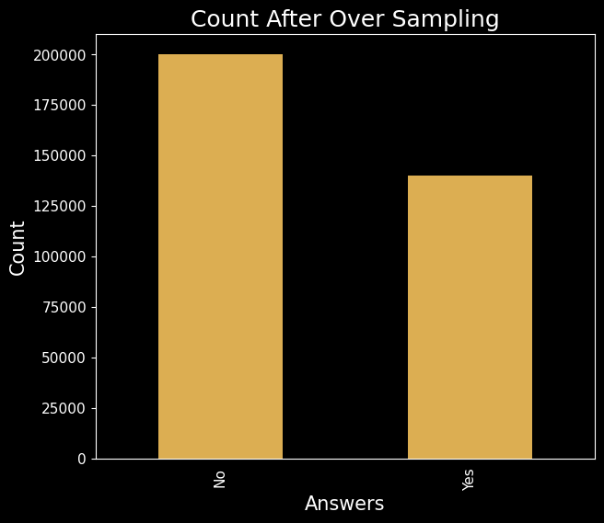
Over Sampling

Slide 25
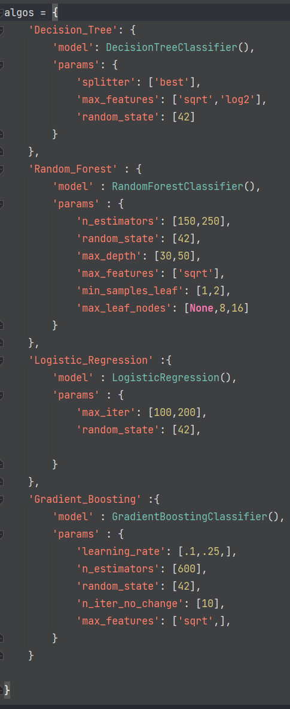
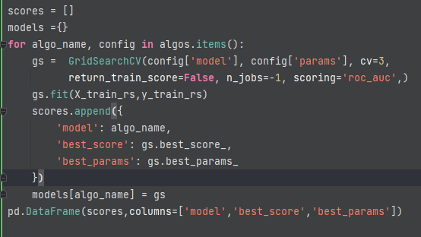
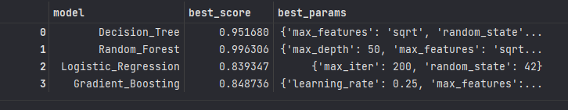
GridSearchCV

Slide 26
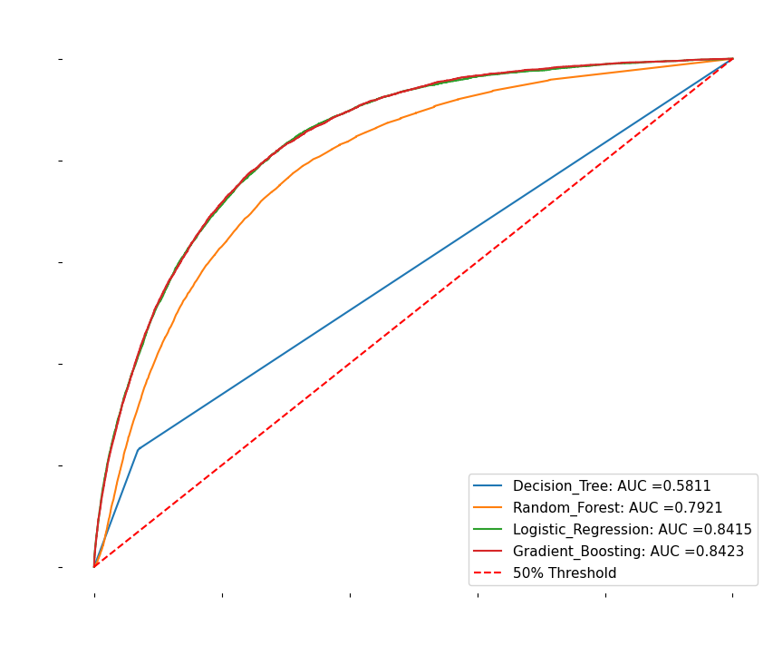
Testing
Although Decision Tree and Random Forest did well on the training data they tend to overfit. Using the test set we can see Logistic Regression and and Gradient Boosting got similar score to their training scores.
Model | Train Score | Test Score
Decision Tree | 0.951 | 0.581
Random Forest | 0.996 | 0.792
Logistic Regression | 0.839 | 0.841
Gradient Boosting | 0.848 | 0.842

Slide 27
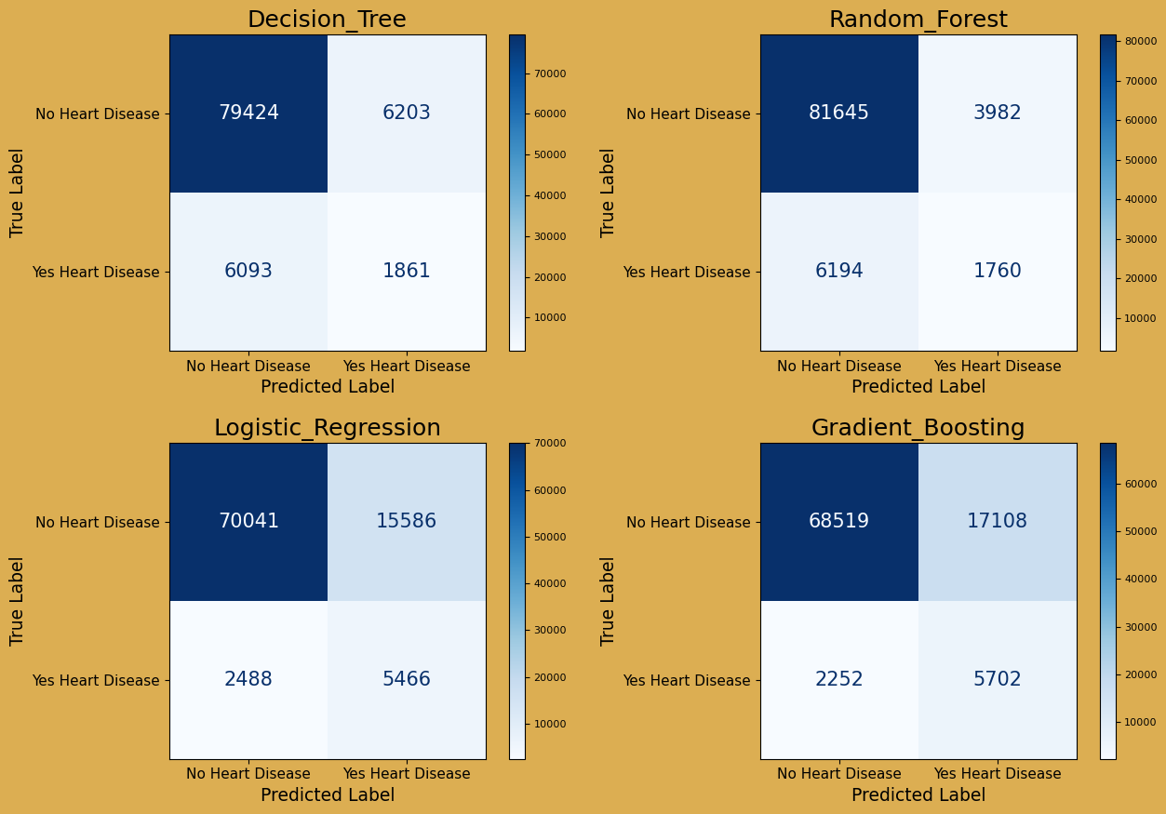
Confusion Matrix
The Decision Tree and Random Forest have high accuracy meaning they correctly predicted True Positives and True Negatives more. However, they have low precision meaning they have more False Positives and False Negatives. When there is heart disease the Decision Tree and Random Forest predict “No heart disease” more than Logistic Regression and Gradient Boosting. In health care precision is more important than accuracy. There is a trade off between accuracy and precision.

Slide 28
RESOURCES
Sklearn
Roc Curve
Mean Squared Error
XGBoost
Parameter Tuning

