Slide 1
Ptys 551 - Lab Demo 3
ISIS and Radiometric Processing

Slide 2
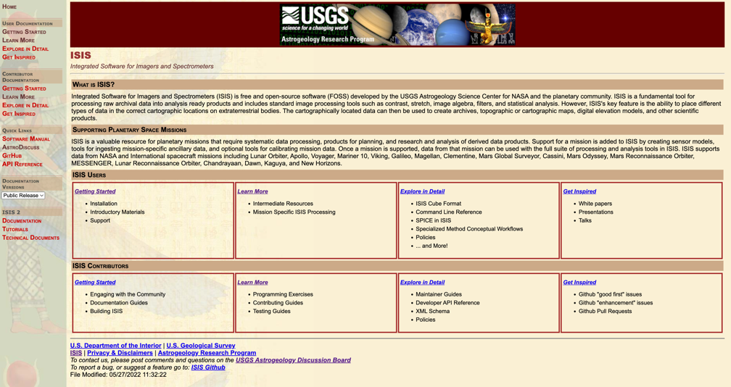
ISIS online
https://isis.astrogeology.usgs.gov/8.2.0/index.html
https://github.com/DOI-USGS/ISIS3

Slide 3
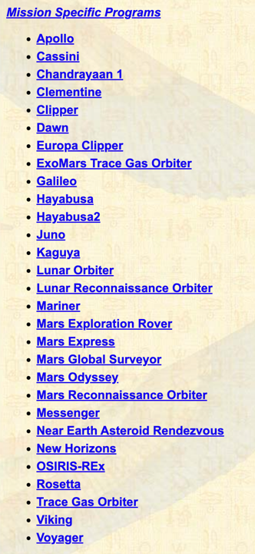
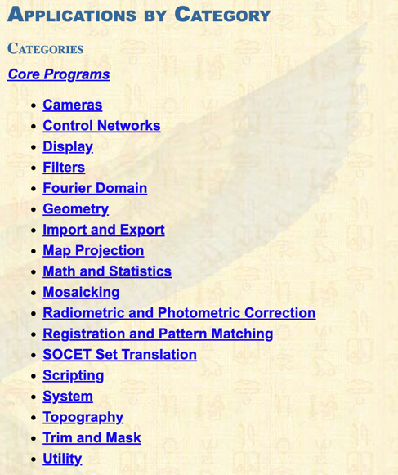
ISIS online
About 400 programs divided into ‘core’ and ‘mission-specific’

Slide 4
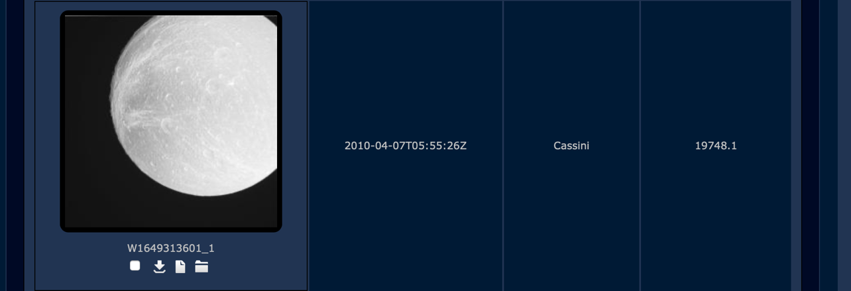
Example data from the Planetary Image Atlas or Pilot
Let’s look at Dione!
W1649313601_1.IMG
W1714685178_1.IMG

Slide 5
Several steps to run through
Ingest data into ISIS:
Usually done with an instrument-specific program. ciss2isis in this case.
Inspect cube with qview (pan/zoom, contrast, shadow measurements, etc…)
Inspect cub labels with catlab
Add info with
spiceinit (uses USGS SPICE web service)
footprintinit
camstats
View Footprint locations with qmos
Add backpanes of useful data with phocube

Slide 6
Command line methods for Dione images
ciss2isis from=W1649313601_1.LBL to=W1649313601_1.lev0.cub
spiceinit from=W1649313601_1.lev0.cub web=yes url=https://astrogeology.usgs.gov/apis/ale/v0.9.1/spiceserver/
footprintinit from=W1649313601_1.lev0.cub
cisscal from=W1649313601_1.lev0.cub to=W1649313601_1.lev1.cub
phocube from=W1649313601_1.lev1.cub to=W1649313601_1.lev1.pho.cub dn=yes alldns=yes
ciss2isis from=W1714685178_1.LBL to=W1714685178_1.lev0.cub
spiceinit from=W1714685178_1.lev0.cub web=yes url=https://astrogeology.usgs.gov/apis/ale/v0.9.1/spiceserver/
footprintinit from=W1714685178_1.lev0.cub
cisscal from=W1714685178_1.lev0.cub to=W1714685178_1.lev1.cub
phocube from=W1714685178_1.lev1.cub to=W1714685178_1.lev1.pho.cub dn=yes alldns=yes
grid from=W1649313601_1.lev1.cub to=W1649313601_1.lev1.grid.cub loninc=30.0
camtrim from=W1649313601_1.lev1.grid.cub to=W1649313601_1.lev1.grid.trim.cub minlat=-45 maxlat=45 minlon=260 maxlon=360
photrim from=W1649313601_1.lev1.grid.cub to=W1649313601_1.lev1.photrim.cub maxemission=45.0 maxphase=9.0
catlab from=W1649313601_1.lev1.cub
camstats from=W1649313601_1.lev1.cub
cathist from=W1649313601_1.lev1.cub
qmos *.lev1.cub
qview W1714685178_1.*.cub

Slide 7
Command line methods for CTX images
mroctx2isis from=B09_013297_1984_XN_18N074W.IMG to=B09_013297_1984_XN_18N074W.lev0.cub
spiceinit from=B09_013297_1984_XN_18N074W.lev0.cub web=yes url=https://astrogeology.usgs.gov/apis/ale/v0.9.1/spiceserver/
ctxcal from=B09_013297_1984_XN_18N074W.lev0.cub to=B09_013297_1984_XN_18N074W.cal.cub
ctxevenodd from=B09_013297_1984_XN_18N074W.cal.cub to=B09_013297_1984_XN_18N074W.lev1.lev1.cub
mroctx2isis from=N06_064643_1114_XN_68S358W.IMG to=N06_064643_1114_XN_68S358W.lev0.cub
spiceinit from=N06_064643_1114_XN_68S358W.lev0.cub web=yes url=https://astrogeology.usgs.gov/apis/ale/v0.9.1/spiceserver/
ctxcal from=N06_064643_1114_XN_68S358W.lev0.cub to=N06_064643_1114_XN_68S358W.cal.cub
ctxevenodd from=N06_064643_1114_XN_68S358W.cal.cub to=N06_064643_1114_XN_68S358W.lev1.lev1.cub

Slide 8
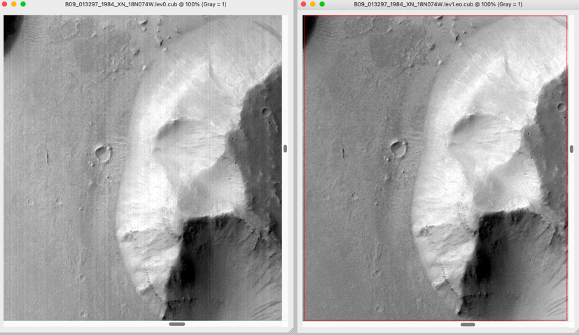
Radiometric Cal
Usually done with an instrument-specific program. cisscal in the Dione Case.
Inspect cube with qview (pan/zoom, contrast, shadow measurements, etc…)
Inspect history with cathist
Add a lon/lat grid with grid
Trim cubes with lon/lat camtrim
or with inc/emm/phase photrim
Try a more obvious example with CTX data
mroctx2isis
spiceinit
ctxcal
ctxevenodd

Slide 9
Photometry
Do a cos(i) correction with cosi
cosi from=W1714685178_1.lev1.cub to=W1714685178_1.lev1_COSI.cub
Do some math with fx e.g. Lommel-Seeliger geometry correction
fx f1=W1714685178_1.lev1.cub to=W1714685178_1.lev1_LS.cub equation=”4.0*f1/cos(rads(ina(f1))) * (cos(rads(ina(f1))) + cos(rads(ema(f1))))"
qview W1714685178_1.lev1_LS.cub W1714685178_1.lev1_COSI.cub
Or try something more complicated with photomet
photomet from=W1714685178_1.lev1.cub to=W1714685178_1.lev1.mn.cub maxemission=88.0 phtname=minnaert k=0.5 normname=albedo incref=00 incmat=90 thresh=30 albedo=1
qview W1714685178_1.lev1_LS.cub W1714685178_1.lev1_COSI.cub W1714685178_1.lev1.mn.cub

Slide 10
Illuminating Topography
Prepare a CTX image
mroctx2isis from=N06_064643_1114_XN_68S358W.IMG to=N06_064643_1114_XN_68S358W.lev0.cub
spiceinit from=N06_064643_1114_XN_68S358W.lev0.cub web=yes url=https://astrogeology.usgs.gov/apis/ale/v0.9.1/spiceserver/
ctxcal from=N06_064643_1114_XN_68S358W.lev0.cub to=N06_064643_1114_XN_68S358W.cal.cub
ctxevenodd from=N06_064643_1114_XN_68S358W.cal.cub to=N06_064643_1114_XN_68S358W.lev1.cub
Use reduce to make this tractable in our lab session
Make a radius cube with fx and clean it up with demprep
reduce from=N06_064643_1114_XN_68S358W.lev1.cub to=N06_064643_1114_XN_68S358W.lev1.reduced.cub sscale=2.0 lscale=2.0
fx f1=N06_064643_1114_XN_68S358W.lev1.reduced.cub to=N06_064643_1114_XN_68S358W.lev1.reduced.radius.cub equation="radius(f1)"
Shade the DEM with shade or shadow
shade from=N06_064643_1114_XN_68S358W.lev1.reduced.radius.cub to=N06_064643_1114_XN_68S358W.lev1.reduced.shade.cub azimuth=270.0 pixelresol=12.0
photomet can also use DEMs instead of Ellipsoids for more accurate results
More sophisticated shading with real shadows can be done with shadow, but requires map-projected cubes

