Slide 1
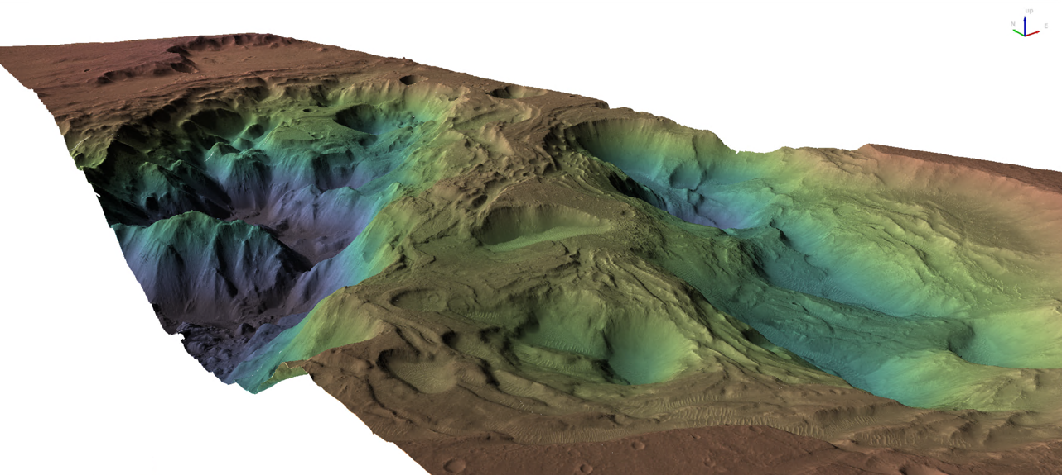
Ptys 551 – Lab 6
Stereogrammetry with Ames Stereo Pipeline
F21_044073_1653_XN_14S037W
F22_044218_1653_XN_14S037W

Slide 2
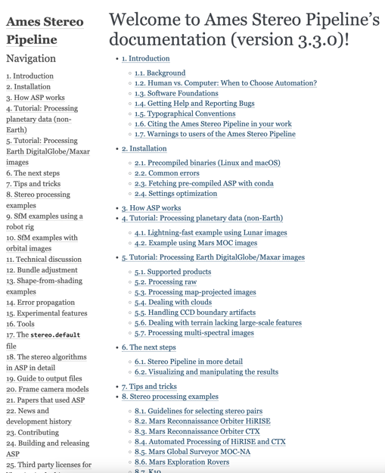
Ames Stereo Pipeline
https://stereopipeline.readthedocs.io/en/latest/index.html
V3.3 released in August 2023
V3.4-alpha on website
We’ll use Ames Stereo Pipeline (ASP)
(and some ISIS, GDAL and QGIS)
Beyer, Ross A., Oleg Alexandrov, and Scott McMichael. 2018. The Ames Stereo Pipeline: NASA’s open source software for deriving and processing terrain data. Earth and Space Science, 5. https://doi.org/10.1029/2018EA000409.

Slide 3
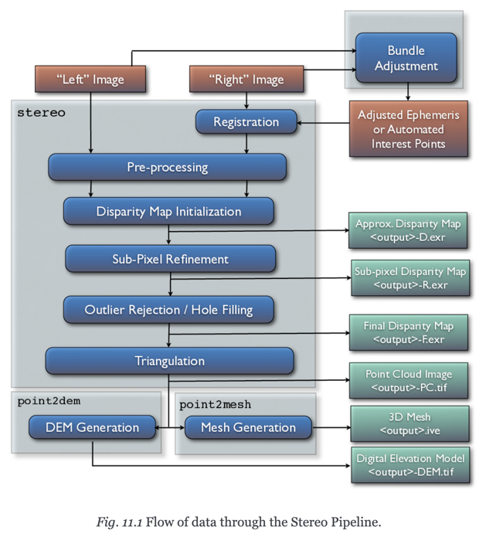
ASP method
Pre-processing
Radiometric cleanup and adding SPICE data
Bundle Adjustment (optional, but better)
Map projection (optional, but better)
Stereo step
Disparity calculations
Triangulation
DEM production
Convert from pointcloud
Fill holes (optional, but better)

Slide 4
Get the data
A CTX stereo pair of Osuga Valles
http://pds-imaging.jpl.nasa.gov/data/mro/mars_reconnaissance_orbiter/ctx/mrox_2475/data/F22_044218_1653_XN_14S037W.IMG
http://pds-imaging.jpl.nasa.gov/data/mro/mars_reconnaissance_orbiter/ctx/mrox_2469/data/F21_044073_1653_XN_14S037W.IMG
And an overlapping HiRISE DTM for comparison…
https://www.uahirise.org/PDS/DTM/ESP/ORB_039300_039399/ESP_039326_1650_ESP_039181_1650/DTEED_039326_1650_039181_1650_A01.IMG
A cutout of the global MOLA DTM over the right area is provided in:
megt_lab6_shifted.tif
Copy these files and the contents of ASP_support_files into some working directory

Slide 5
Pre-processing – Cleanup the data
Import the PDS files into the USGS ISIS software (bundled with ASP)
Add the SPICE info on spacecraft pointing and position (note we use the USGS SPICE web service – the URL changed recently and may change again in future ISIS releases)
Calibrate the image and remove an annoying even/odd pixel brightness offset
mroctx2isis from=F21_044073_1653_XN_14S037W.IMG to=F21_044073_1653_XN_14S037W.lev0.cub
mroctx2isis from=F22_044218_1653_XN_14S037W.IMG to=F22_044218_1653_XN_14S037W.lev0.cub
spiceinit from=F21_044073_1653_XN_14S037W.lev0.cub web=true url=https://astrogeology.usgs.gov/apis/ale/v0.9.1/spiceserver/
spiceinit from=F22_044218_1653_XN_14S037W.lev0.cub web=true url=https://astrogeology.usgs.gov/apis/ale/v0.9.1/spiceserver/
ctxcal from=F21_044073_1653_XN_14S037W.lev0.cub to=F21_044073_1653_XN_14S037W.cal.cub
ctxcal from=F22_044218_1653_XN_14S037W.lev0.cub to=F22_044218_1653_XN_14S037W.cal.cub
ctxevenodd from=F21_044073_1653_XN_14S037W.cal.cub to=F21_044073_1653_XN_14S037W.lev1.cub
ctxevenodd from=F22_044218_1653_XN_14S037W.cal.cub to=F22_044218_1653_XN_14S037W.lev1.cub

Slide 6
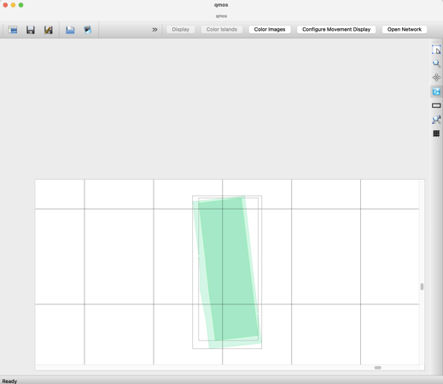
Pre-processing – Bundle Adjust
Seed a grid of control points (seedgrid or autoseed)
Search for matches between the two images (pointreg)
Update the camera pointing (jigsaw)
First, we add footprint info to the cubes and look at the result in qmos
footprintinit from=F21_044073_1653_XN_14S037W.lev1.cub linc=100 sinc=100 increaseprecision=true
footprintinit from=F22_044218_1653_XN_14S037W.lev1.cub linc=100 sinc=100 increaseprecision=true
ls -1 *.lev1.cub > cube.lis
qmos cube.lis

Slide 7
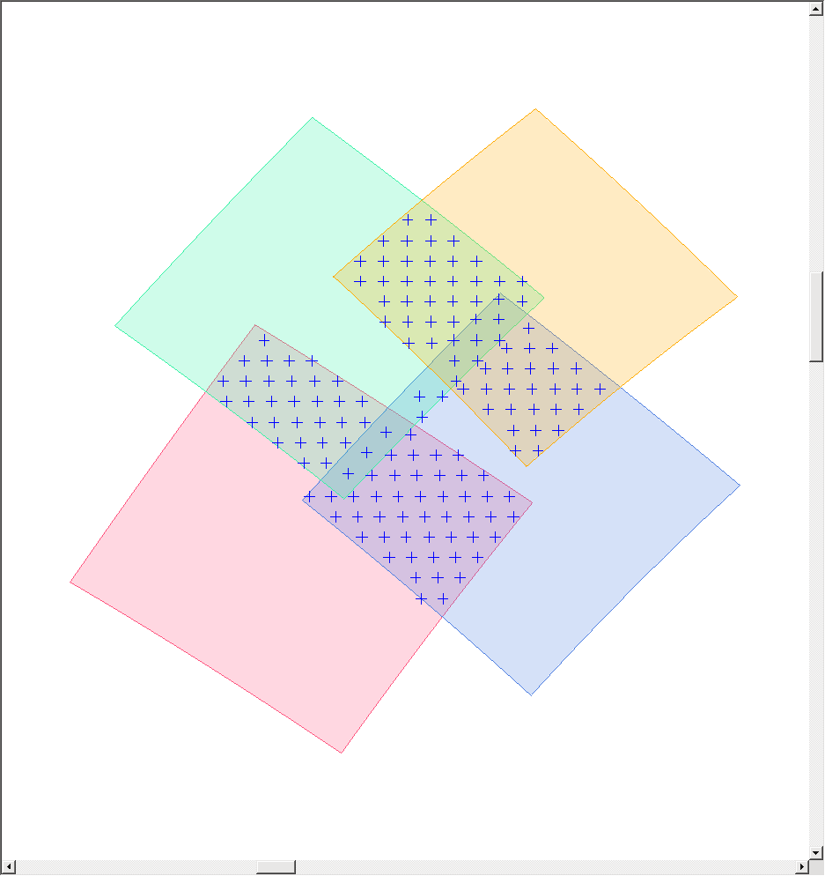
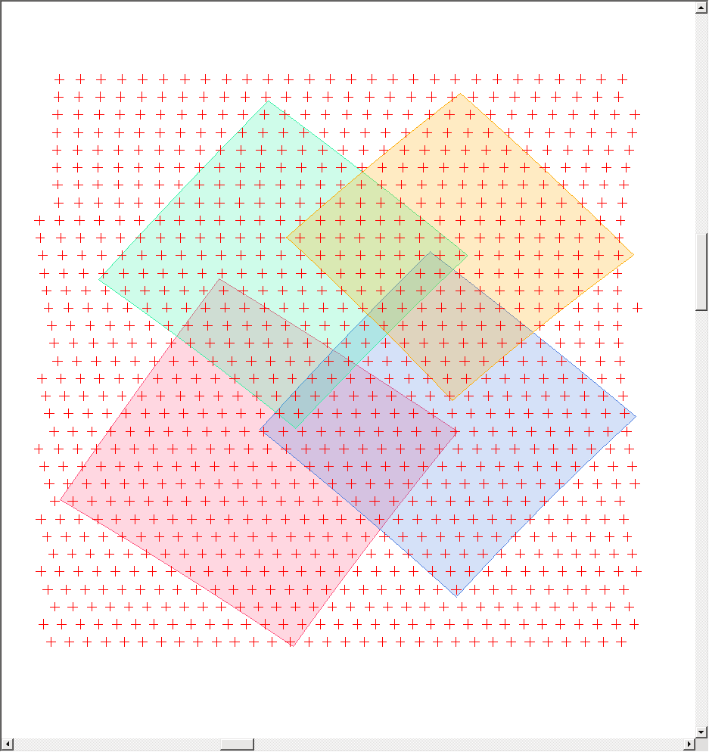
Pre-processing – Bundle Adjust
findimageoverlaps
autoseed – creates points based on your image overlaps
seedgrid – only knows about the lat/lon/spacing
cnetadd – adds the image list you’re using
cnetedit – downselects to the points that cover the images
Two possible strategies
We use this one
seedgrid target=mars minlat=-15.4 maxlat=-13.8 minlon=322 maxlon=323 spacing=latlon latstep=0.025 lonstep=0.025 networkid="workshop" pointid="?????" description="ctx" onet=seed.net
cnetadd addlist=cube.lis deffile=validmeasure.def retrieval=point onet=cnetadd.net polygon=true extract=modified cnet=seed.net
cnetedit cnet=cnetadd.net onet=cnetadd-edt.net

Slide 8
Pre-processing – Bundle Adjust… def files
validmeasure.def file determines where seedgrid points are valid (and so retained)
Many criteria can be specified…
Group = ValidMeasure
MinDN = double
MaxDN = double
MinEmission = double
MaxEmission = double
MinIncidence = double
MaxIncidence = double
MinResolution = double
MaxResolution = double
PixelsFromEdge = integer OR MetersFromEdge = double
SampleResidual = double
LineResidual = double
ResidualMagnitude = double
EndGroup
We use a simplified version of this today
Group = ValidMeasure
PixelsFromEdge = 20
EndGroup

Slide 9
Pre-processing – pointreg
Object = AutoRegistration
Group = Algorithm
Name = MaximumCorrelation
Tolerance = 0.8
End_Group
Group = PatternChip
Samples = 31
Lines = 31
End_Group
Group = SearchChip
Samples = 101
Lines = 101
End_Group
Group = SurfaceModel
DistanceTolerance = 1.5
WindowSize = 7
End_Group
End_Object
End
Another def file (pointreg_P31x31_S101x101.def) describes how to do the pattern matching. e.g.
How large is the pattern?
How large is the search area?
How good a match is ok?
pointreg fromlist=cube.lis cnet=cnetadd-edt.net onet=control_pointreg.net deffile=pointreg_P31x31_S101x101.def
cnetedit cnet=control_pointreg.net onet=control_pointreg_edit.net

Slide 10
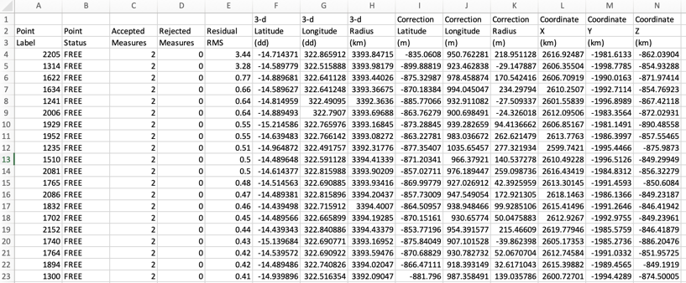
Pre-processing – jigsaw
We first run jigsaw as a dry-run i.e. no change to the image cubes
jigsaw fromlist=cube.lis update=no twist=no radius=yes cnet=control_pointreg_edit.net onet=control_ba.net model1=huber file_prefix="jig_" maxits=200 sigma0=1.0e-4
We then check the residuals for all the points in the jigsaw solution to see if there are any problematic ones…
Open the file jig__bundleout_points.csv and sort by the Residual RMS (column E)

Slide 11
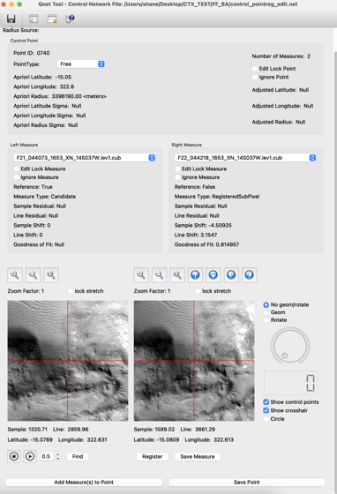
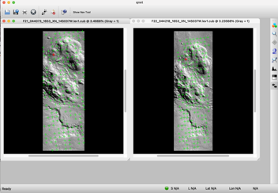
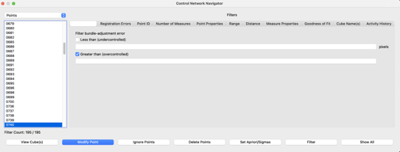
Pre-processing – Check the Control network with Qnet
Start qnet
File -> Open control network and cube list
Select cube.lis and control_pointreg_edit.net
Select the first control point listed in the ‘Control Network Navigator’ window. Click the ‘View Cube(s)’ button.
Click any of the points on the image display to open the Qnet tool.
In the Qnet tool you can delete or modify points, blink-compare them etc…
Some networks are huge... The global MDIS mosaic control net has 12.5 million points

Slide 12
Pre-processing – jigsaw (if using bundle adjustment)
For real this time…
If you updated anything in qnet, then use that new network here
jigsaw fromlist=cube.lis update=yes twist=no radius=yes cnet=control_pointreg_edit2.net onet=control_ba.net model1=huber file_prefix="jig2_" maxits=200 sigma0=1.0e-4
Bundle adjustment can give weird results in some cases… before proceeding to the stereo step it’s worth checking the map cubes
Oftentimes a denser point network can resolve issues (brute force still has its place I guess)

Slide 13
Pre-processing – map projection
Map projection in ISIS uses the cam2map program
(note: ASP also has its own mapproject and bundleadjust programs that we’re skipping over here)
It also helps to trim the images to have the same range and for them to have the same map-projected resolution
The ISIS program camrange will report the min/max lon/lat , that can be used to trip cam2map output
Picking the worst of the two input resolutions for the map projection is best (camrange will report resolutions too)
…but… ASP provides a handy tool to figure out the trimming and resolution for you and automatically call cam2map
cam2map4stereo.py -r 6 F21_044073_1653_XN_14S037W.lev1.cub F22_044218_1653_XN_14S037W.lev1.cub
Notes: We’re being a bit lazy and letting ISIS chose its default map projection of sinusoidal
The above is equivalent to the mess below…
camrange from=F21_044073_1653_XN_14S037W.lev1.cub to=/Users/shane/Desktop/CTX_TEST/FF_BA/camrange5a7pe1yc.txt
camrange from=F22_044218_1653_XN_14S037W.lev1.cub to=/Users/shane/Desktop/CTX_TEST/FF_BA/camrangevurhis9e.txt
**** A lot of manual copying and pasting ****
cam2map from=F21_044073_1653_XN_14S037W.lev1.cub to=F21_044073_1653_XN_14S037W.lev1.map.cub pixres=MPP resolution=6 defaultrange=MAP minlat=-15.757918811984 maxlat=-14.152004194745 minlon=322.01922770159 maxlon=322.46938740363
cam2map from=F22_044218_1653_XN_14S037W.lev1.cub to=F22_044218_1653_XN_14S037W.lev1.map.cub pixres=MPP resolution=6 defaultrange=MAP minlat=-15.757918811984 maxlat=-14.152004194745 minlon=322.01922770159 maxlon=322.46938740363

Slide 14
ASP method
Pre-processing
Radiometric cleanup and adding SPICE data
Bundle Adjustment (optional, but better)
Map projection (optional, but better)
Stereo step
Disparity calculations
Triangulation
DEM production
Convert from pointcloud
Fill holes (optional, but better)

Slide 15
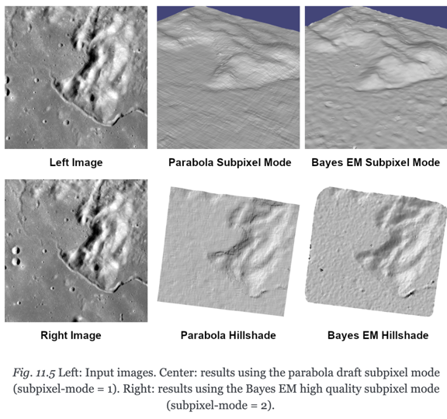
Stereo step
Starting the stereo process is the easy (albeit lengthy) part!
parallel_stereo -s stereo.map F21_044073_1653_XN_14S037W.map.cub F22_044218_1653_XN_14S037W.map.cub run_new/run_new
Review the stereo.map file…
Discuss alignment method (epipolar vs mapprojected)
- we’ll use alignment-method none
Discuss subpixel refinement
- we’ll use subpixel-mode 1
- i.e. the fast parabolic matching

Slide 16
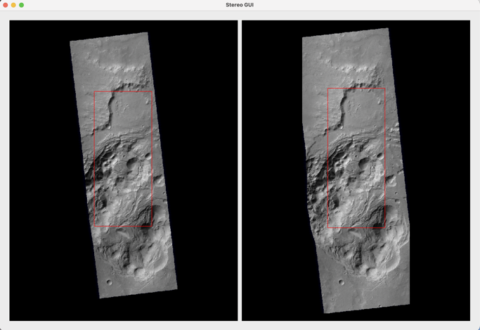
Stereo step – stereo GUI
One can alternatively select sub-regions and run parallel_stereo with the stereo_gui program
stereo_gui F21_044073_1653_XN_14S037W.map.cub F22_044218_1653_XN_14S037W.map.cub gui/gui
Use cmd/ctrl and the left mouse button to select areas and the run menu to start the stereo run. The equivalent commands will appear in your terminal window.
parallel_stereo F21_044073_1653_XN_14S037W.map.cub F22_044218_1653_XN_14S037W.map.cub gui/gui --left-image-crop-win 1369 3530 3216 7496 --right-image-crop-win 1435 3352 3194 7763
We’ll skip this and just run the whole image

Slide 17
ASP method
Pre-processing
Radiometric cleanup and adding SPICE data
Bundle Adjustment (optional, but better)
Map projection (optional, but better)
Stereo step
Disparity calculations
Triangulation
DEM production
Convert from pointcloud
Fill holes (optional, but better)

Slide 18
DEM production
Hurrah! We have a pointcloud!! Not super useful yet, but an achievement nonetheless
First let’s get some 2D products to view like a DEM, a triangulation error map, and an orthoimage
point2dem --errorimage --orthoimage run_new/run_new-L.tif run_new/run_new-PC.tif
hillshade --azimuth 300 --elevation 20 run_new/run_new-DEM.tif -o run_new/run_new-HILL.tif
dem_geoid run_new/run_new-DEM.tif -o run_new/run_new-DEM
This last step changes the DEM values from planetary radii relative to the ellipsoid to planetary radii relative to the aeroid (i.e. topography). It also makes it comparable to the MOLA dataset (which unfortunately uses an ellipsoid of 3396km rather than 3396.19km)

Slide 19
DEM production
Here’s some commands to copy files to a folder on the windows desktop
Replace the highlighted text with the path to your Desktop folder
ln -s /Users/shane/Desktop Desktop
mkdir Desktop/GIS
cp run_new/run_new-DEM.tif Desktop/GIS
cp run_new/run_new-DEM-adj.tif Desktop/GIS
cp run_new/run_new-HILL.tif Desktop/GIS
cp run_new/run_new-DRG.tif Desktop/GIS
cp run_new/run_new-IntersectionErr.tif Desktop/GIS
Let’s open up QGIS and take a look at what we got

Slide 20
DEM production
Holes in the DEM come from difficult-to-match areas that are bland, saturated, in deep shadow etc…
There’s not much we can do to fix that, but we can paper it over.
Options include gridding the DEM at coarser resolution (default is the image resolution) or interpolating over holes
Use -tr for gridding to specify pixel size
Or --dem-hole-fill-len for interpolating over holes of a given size
point2dem --orthoimage-hole-fill-len 300 --dem-hole-fill-len 300 --errorimage --orthoimage run_new/run_new-L.tif run_new/run_new-PC.tif
hillshade --azimuth 300 --elevation 20 run_new/run_new-DEM.tif -o run_new/run_new-HILL.tif
dem_geoid run_new/run_new-DEM.tif -o run_new/run_new-DEM

Slide 21
DEM production
Here’s some commands to copy files from the WSL system to a folder on the windows desktop
cp run_new/run_new-DEM-adj.tif Desktop/GIS
cp run_new/run_new-HILL.tif Desktop/GIS
cp run_new/run_new-DRG.tif Desktop/GIS
Let’s open up QGIS and take a look at what we got

Slide 22
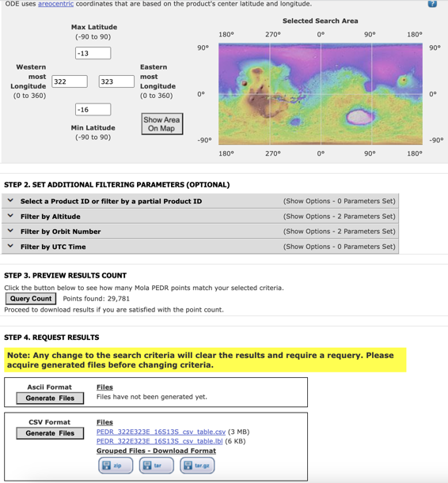
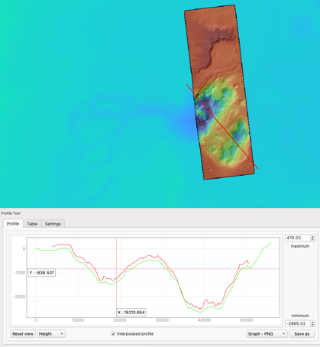
DEM production
Additional alignment to the MOLA dataset is necessary
The ASP tool pc_align can be used to achieve this.
First, a CSV of MOLA points is needed and can be retrieved from here:
https://ode.rsl.wustl.edu/mars/datapointsearch.aspx

Slide 23
DEM production
Here we’ll use pc_align to fit the ASP DEM to the much sparser MOLA points … but usually the sparse data are fit to the dense data instead, so we’ll actually fit the MOLA points to ASP and then use the inverse transform.
The --max_displacement argument must be large enough to incorporate the mismatch
Using this transformed point cloud, we’ll grid a new DEM, make a new hillshade, and adjust again to the Aeroid
pc_align --max-displacement 1000 --csv-format 1:lon,2:lat,5:radius_m run_new/run_new-DEM.tif PEDR_322E323E_16S13S_csv_table.csv --save-inv-transformed-reference-points -o stereo/run-align
point2dem stereo/run-align-trans_reference.tif
hillshade --azimuth 300 --elevation 20 stereo/run-align-trans_reference-DEM.tif -o stereo/run-align-trans_reference-HILL.tif
dem_geoid stereo/run-align-trans_reference-DEM.tif -o stereo/run-align-trans_reference-DEM
Copy (yet more) files into the Desktop folder and take a peek with the QGIS profile tool
cp stereo/run-align-trans_reference-DEM-adj.tif Desktop/GIS
cp stereo/run-align-trans_reference-HILL.tif Desktop/GIS
Checkout the change in discrepancy with MOLA in these files:
head stereo/run-align-beg_errors.csv
head stereo/run-align-end_errors.csv

Slide 24
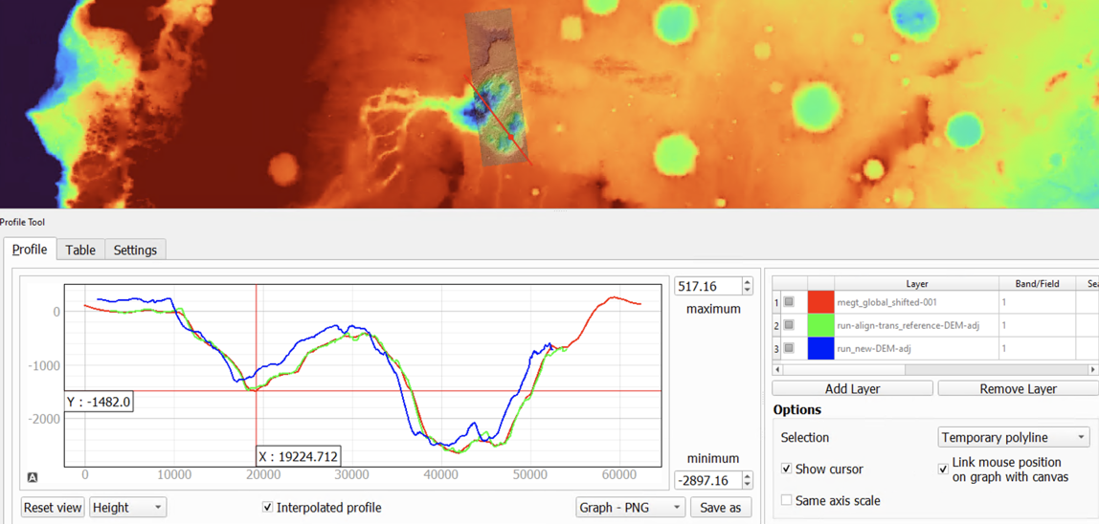
DEM production
🥳
Our new DEM (green profile) agrees very well with MOLA (red profile)!!

Slide 25
DEM production
What about new orthoimages? Trickier… we need to:
Adjust the lev1 cubes to the new MOLA match from pc_align with the bundle_adjust program
Map project these cubes onto the newly adjusted DEM – but only the ASP mapproject program will understand this so we’ll forgo cam2map and use mapproject
bundle_adjust F21_044073_1653_XN_14S037W.lev1.cub F22_044218_1653_XN_14S037W.lev1.cub --initial-transform stereo/run-align-inverse-transform.txt --apply-initial-transform-only -o ba_align/run
mapproject stereo/run-align-trans_reference-DEM.tif F21_044073_1653_XN_14S037W.lev1.cub left_map.tif --bundle-adjust-prefix ba_align/run
mapproject stereo/run-align-trans_reference-DEM.tif F22_044218_1653_XN_14S037W.lev1.cub right_map.tif --bundle-adjust-prefix ba_align/run
Copy (yet more) files into the Desktop folder and take a peek with QGIS – try to flip between the two ortho images
cp left_map.tif Desktop/GIS
cp right_map.tif Desktop/GIS

Slide 26
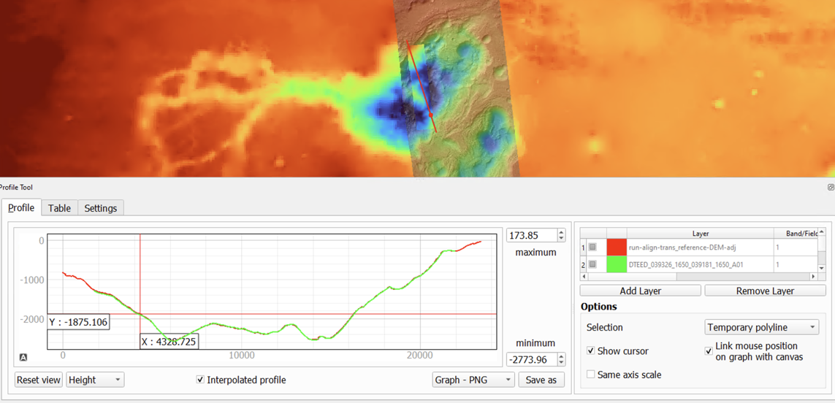
Full Circle?
🥳
Our new CTX DEM (red profile) from ASP agrees very well with a HiRISE stereo DEM from Socet Set (DTEED_039326_1650_039181_1650_A01; green profile)! Of course, we’re very zoomed out…

Slide 27
Here’s a (2x exaggerated) 3D view in QGIS of left.tif colorized with the DTM
Tile resolution 512px
Map tile resolution 1024px
Osuga Valles!

