Slide 1
Theme 5
A web portal for booking cinema tickets/theatre shows
Title:?

Slide 2
Site Map
Home
Movies
Buy Tickets
Contact
Log in
Members
Promotions
Cinemas

Slide 4
Movie
Video: trailer
Now showing
Coming soon
Image slider
Seat numbers: button, click the seats that the person wants
Cost of number of seats in total
Home
Log in
Register
Guest log in
Contact Us
Footer, Navigation bar, Drop Down List,
Calendar
Form including: Name, hp no, email, button
Movie theater: 2 location?, list down the location, how to get there
Buttons: buy tickets
Cost of the tickets, when click the tickets, add together
Background of the webpage:
Theme of the webpage:

Slide 5
PG13 , NC16, M18
Select a cinema
Select a movie
Select date & time
Table
2 Cinema:

Slide 6
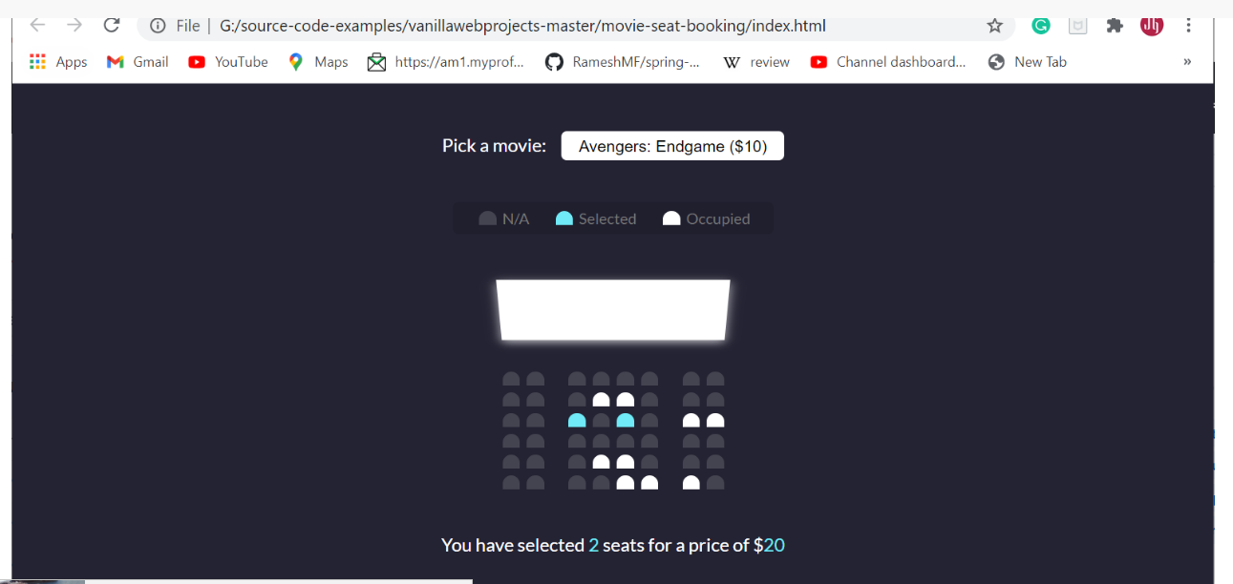
Seat references
https://www.sourcecodeexamples.net/2020/12/movie-seat-booking-project-with.html

Slide 7
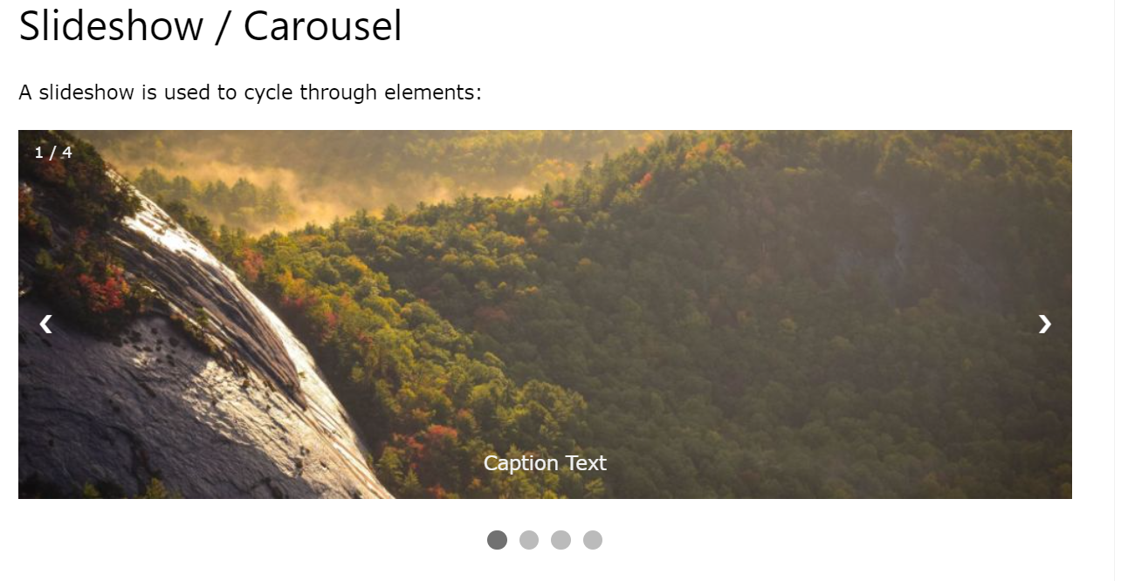
https://www.w3schools.com/howto/howto_js_slideshow.asp

Slide 8
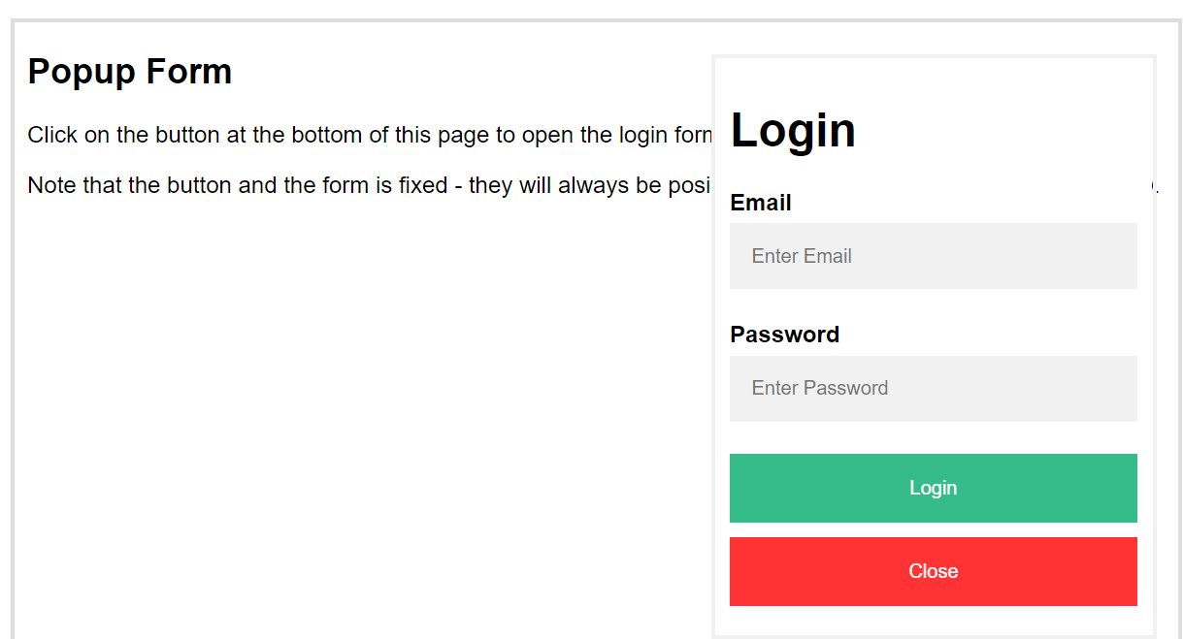
https://www.w3schools.com/howto/howto_js_popup_form.asp

Slide 9
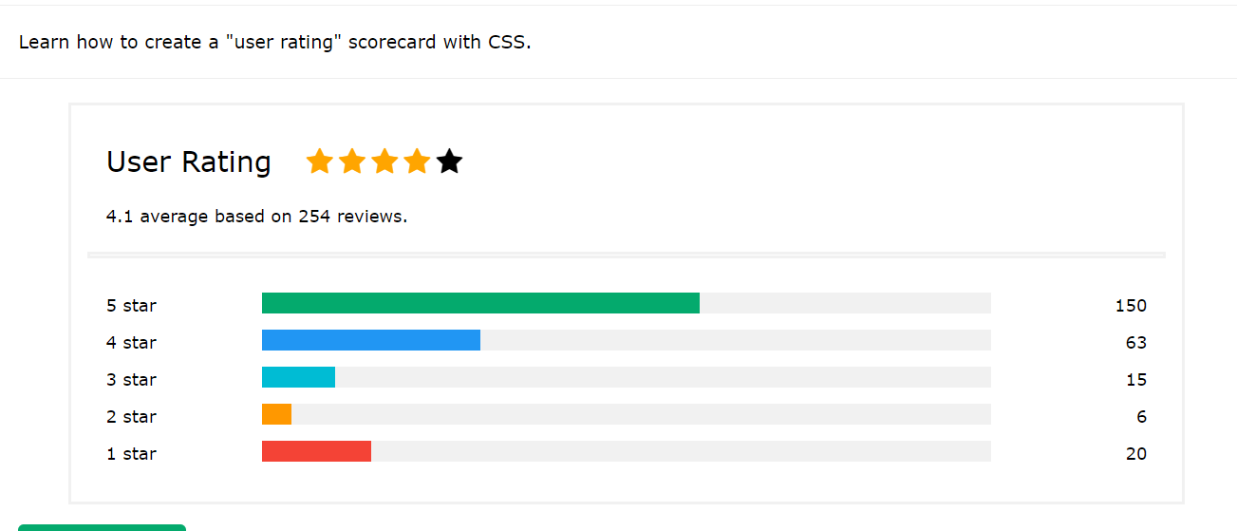
For movies
https://www.w3schools.com/howto/howto_css_user_rating.asp

Slide 10
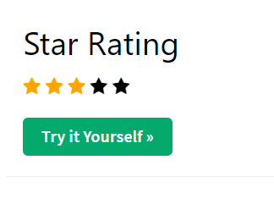
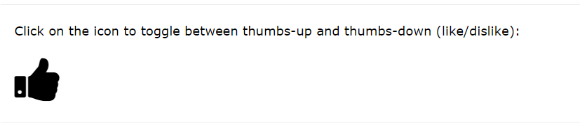
https://www.w3schools.com/howto/howto_css_star_rating.asp
https://www.w3schools.com/howto/howto_js_toggle_like.asp

Slide 11
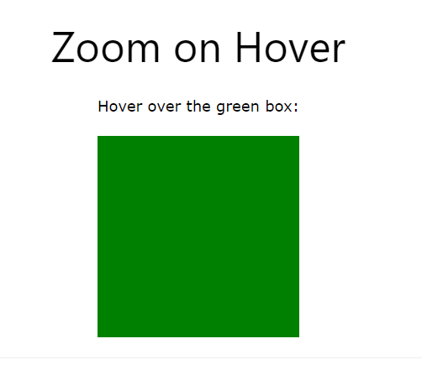
https://www.w3schools.com/howto/howto_css_zoom_hover.asp

Slide 12
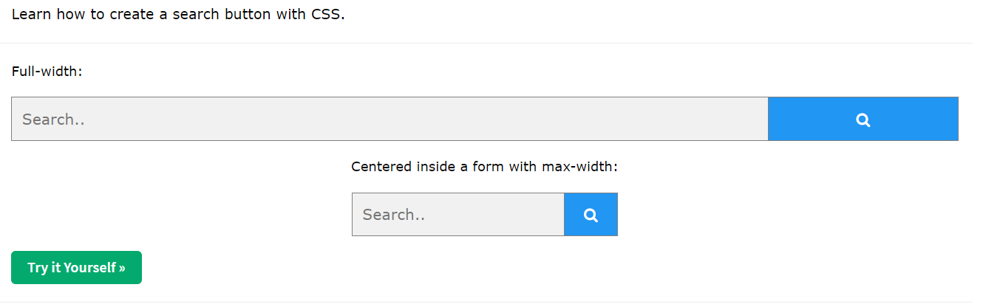
https://www.w3schools.com/howto/howto_css_search_button.asp

Slide 14
Additional components
Sign up for members: free 2 tickets/pop corn/drinks
Tier: Green, Silver, Gold
Green Members: 2 free pop corn/drinks Per month
Silver Members: 2 free movie tickets and additional free 2 pop corn Medium, 2 medium drinks
Gold Members: birthday months
Family Package
Couple Package
Single Package
Terms and conditions
Pop corn: Medium, Large
Flavor of pop corn: Caramel,
Drinks: Medium, Large
Selection of the drinks: Coke, Root Beer, Orange juice, Sprite

Slide 15
Wire frame
Wrapper/container
Navigation bar
Menu icon
Footer: copyright
Need height/width?
Content
logo
Laptop size/phone size?

Slide 16

Main
Wrapper/Container
Log in | Register
Navigation Bar
Home | Movies | Cinemas | Buy Tickets | Promotions | Contact
Image Slider
Footer

Slide 17
Navigation bar ??? With hover
Home | Movies | Cinemas | Buy Tickets | Promotions | Contact

Slide 18
Buttons
Log in | Register

Slide 19
Home

Slide 20
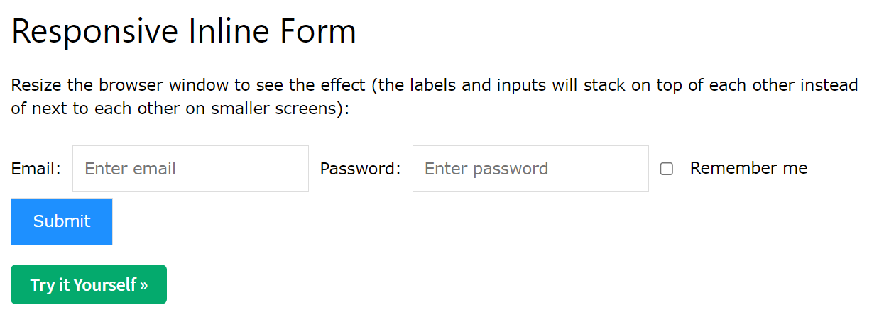
Log in
https://www.w3schools.com/howto/howto_css_inline_form.asp
<form class="form-inline" action="/action_page.php"> <label for="email">Email:</label> <input type="email" id="email" placeholder="Enter email" name="email"> <label for="pwd">Password:</label> <input type="password" id="pwd" placeholder="Enter password" name="pswd"> <label> <input type="checkbox" name="remember"> Remember me </label> <button type="submit">Submit</button> </form>

Slide 21
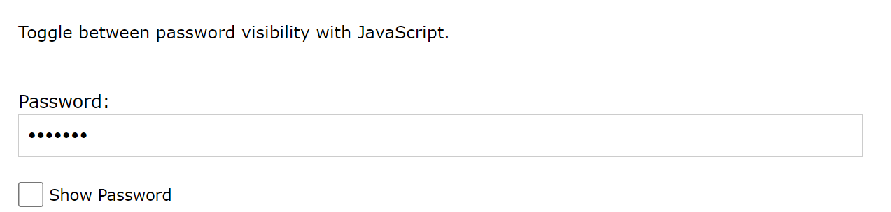
https://www.w3schools.com/howto/howto_js_toggle_password.asp

Slide 22
Register
https://www.w3schools.com/howto/howto_css_signup_form.asp
<form action="action_page.php" style="border:1px solid #ccc"> <div class="container"> <h1>Sign Up</h1> <p>Please fill in this form to create an account.</p> <hr> <label for="email"><b>Email</b></label> <input type="text" placeholder="Enter Email" name="email" required> <label for="psw"><b>Password</b></label> <input type="password" placeholder="Enter Password" name="psw" required> <label for="psw-repeat"><b>Repeat Password</b></label> <input type="password" placeholder="Repeat Password" name="psw-repeat" required> <label> <input type="checkbox" checked="checked" name="remember" style="margin-bottom:15px"> Remember me </label> <p>By creating an account you agree to our <a href="#" style="color:dodgerblue">Terms & Privacy</a>.</p> <div class="clearfix"> <button type="button" class="cancelbtn">Cancel</button> <button type="submit" class="signupbtn">Sign Up</button> </div> </div> </form>
References: https://www.gv.com.sg/GVMCRegistration

Slide 23
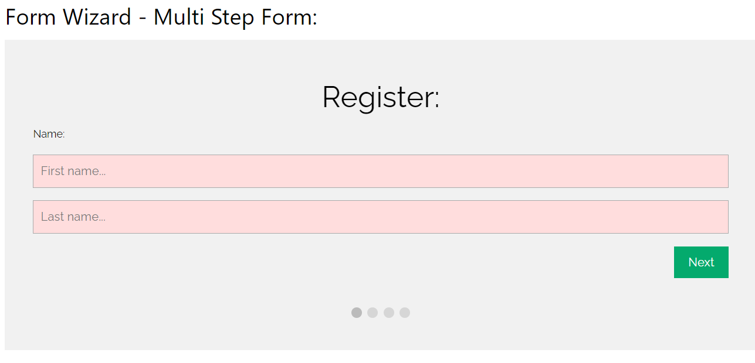
https://www.w3schools.com/howto/howto_js_form_steps.asp

Slide 24
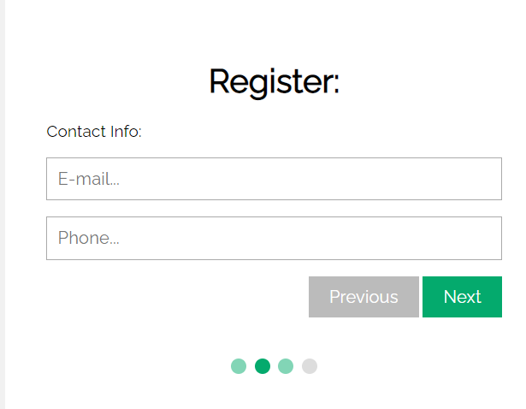
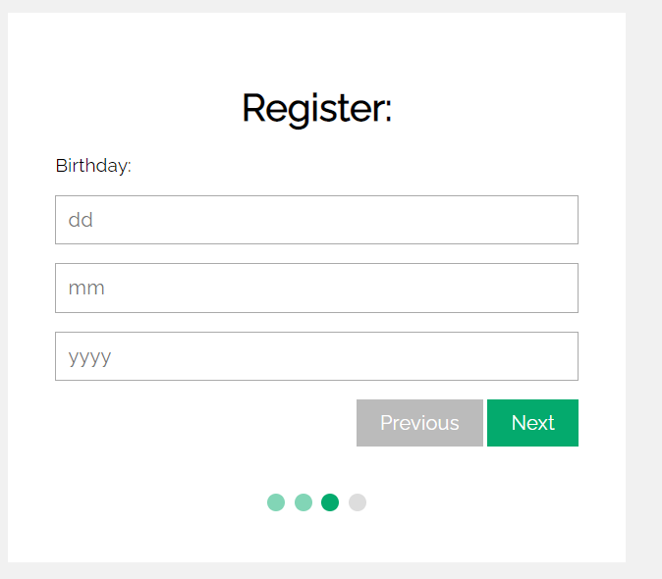

Slide 25
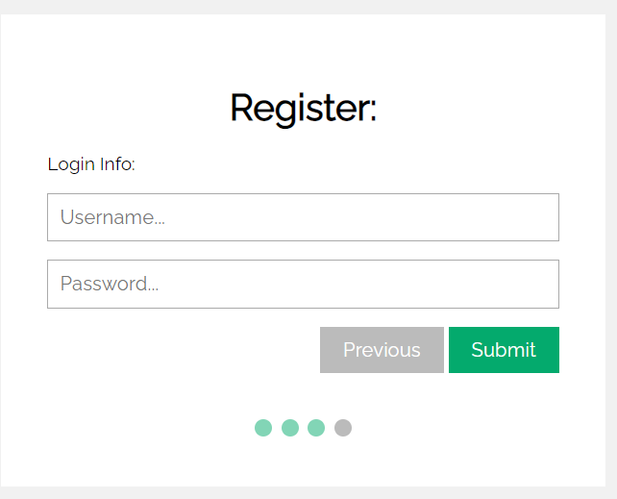

Slide 26
Promotions
Picture | Description
Picture | Description
Table form

Slide 27
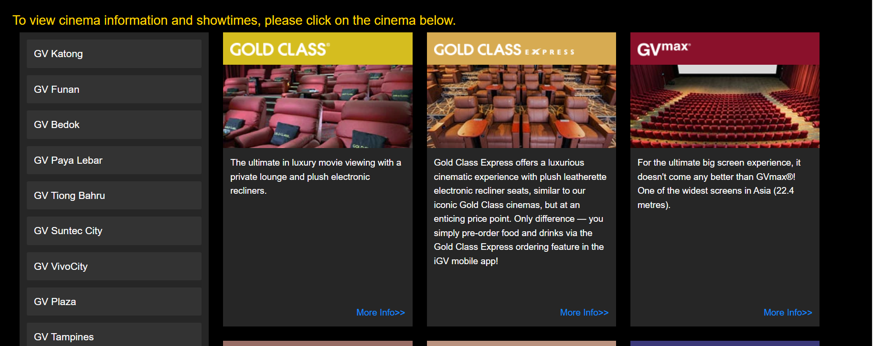
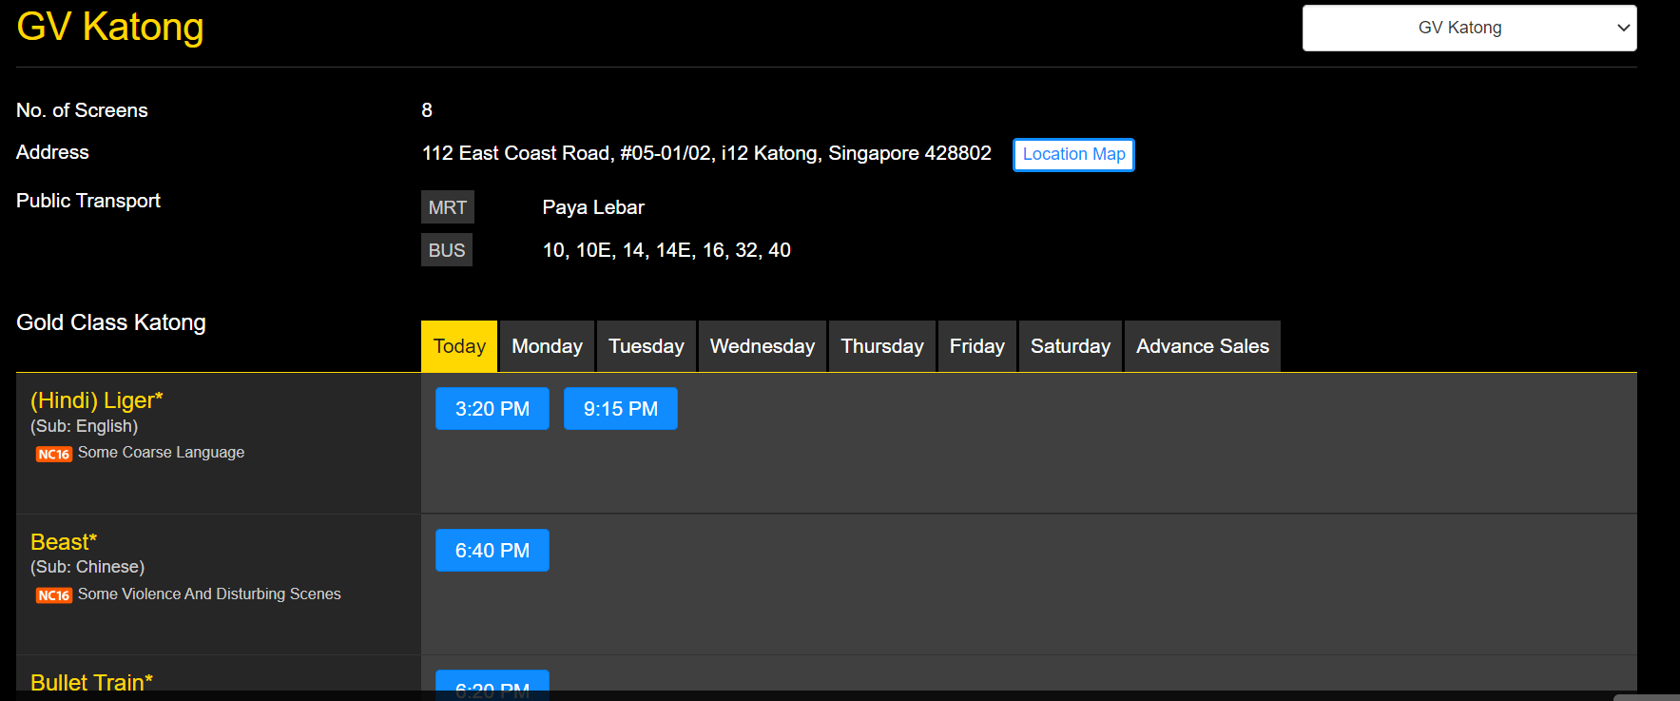
Cinemas
Table form

Slide 28
Movies
Movies
Picture | Cinemas: Drop down list Date and Time | Book Now: Button
Picture | Cinemas Date and Time | Book Now: Button
Table form

Slide 29
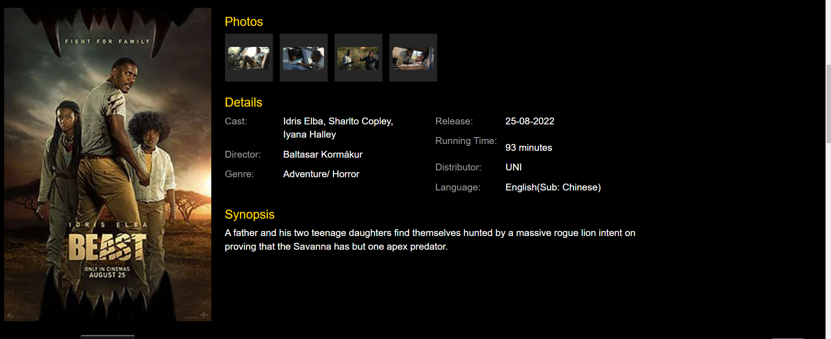
example

Slide 30
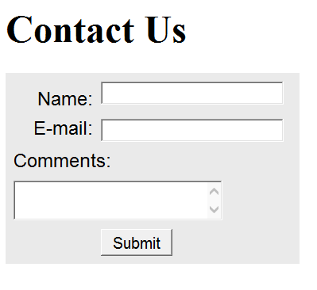
Contact
<style>form { background-color:#eaeaea; font-family: Arial, sans-serif; width: 350px; padding: 10px;}label { float: left; clear: left; display: block; width: 100px; text-align: right; padding-right: 10px; margin-top: 10px; }input, textarea { margin-top: 10px; display: block;}#mySubmit { margin-left: 110px; }</style>
<body><h1>Contact Us</h1><form method="post" action="show_post.php"> <label for="myName">Name:</label> <input type="text" name="myName" id="myName"> <label for="myEmail">E-mail:</label> <input type="text" name="myEmail" id="myEmail"> <label for="myComments">Comments:</label> <textarea name="myComments" id="myComments" rows="2" cols="20"></textarea> <input id="mySubmit" type="submit" value="Submit"></form></body>
Add another button for Reset beside Submit , value: clear

Slide 31
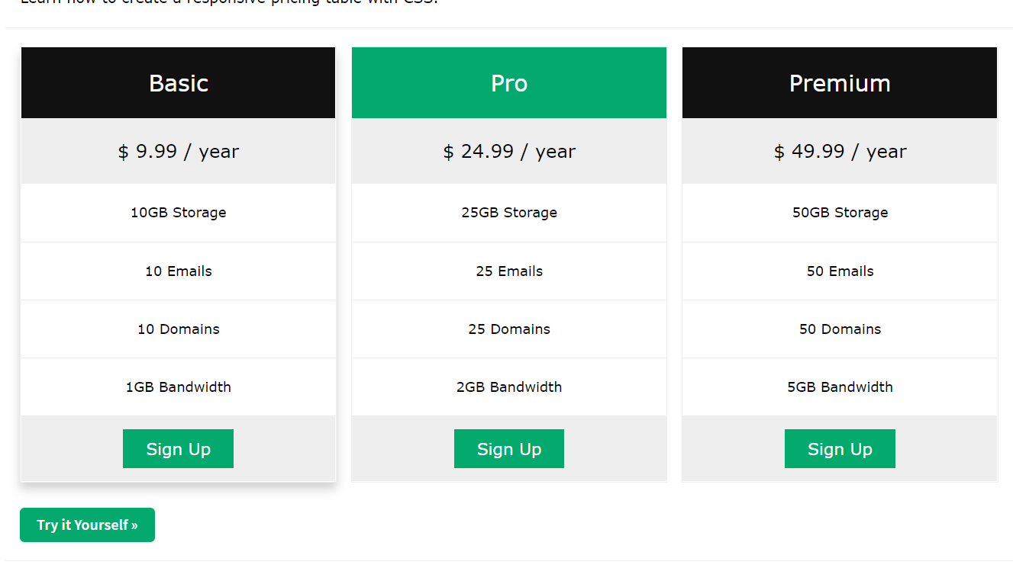
Members
https://www.w3schools.com/howto/tryit.asp?filename=tryhow_css_pricing_table

Slide 32
