Slide 1
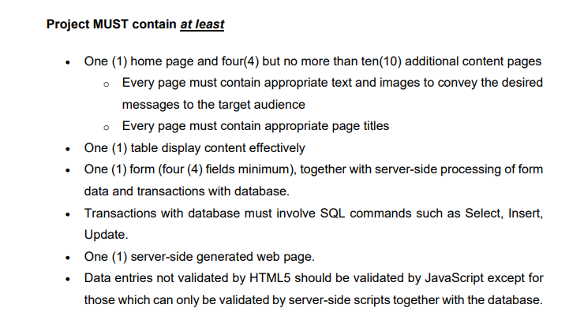
Web pages for wireframes
Logo
Home page (1)
Contact page
Movie page
Promotion page ver1 or
Promotion page ver2
Login page (optional) X
Register page (optional) X
Payment page
Payment successful
Payment unsuccessful
Location page (cinema) x
BuyTicket Page
Member page (optional) x
Seating page
Now showing
Coming soon

Slide 2
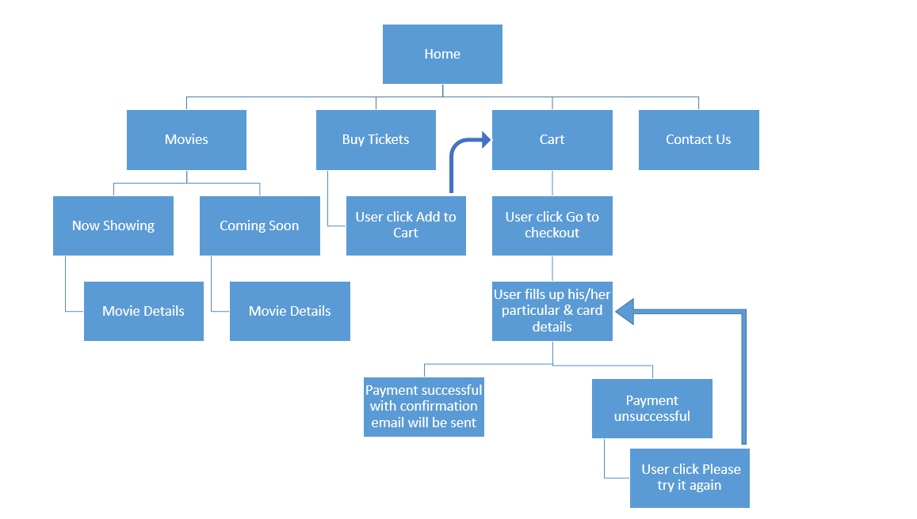

Slide 3
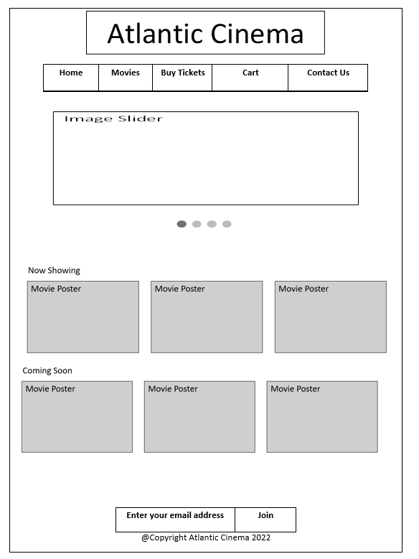
LATEST
When user click home page

Slide 4
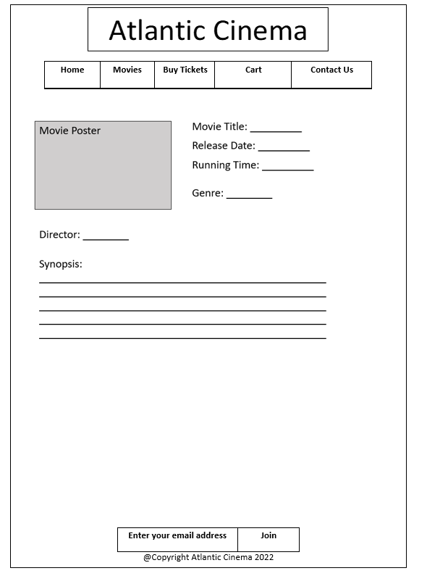
When user click under now showing
Movie poster

Slide 5
When user click under coming soon
Movie poster

Slide 6
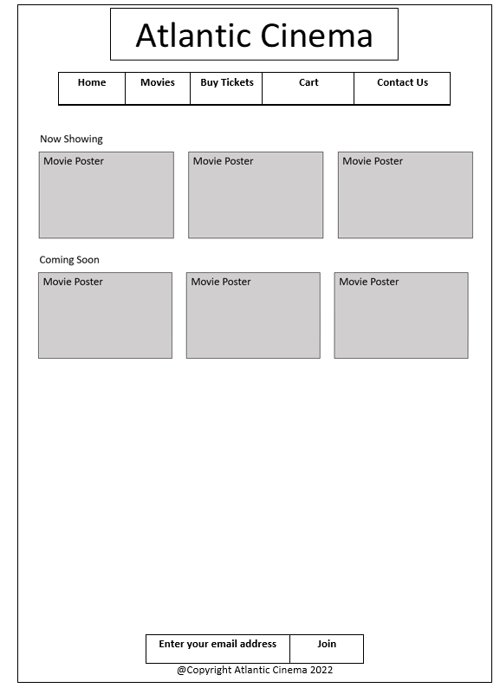
LATEST
When user click movies page

Slide 7
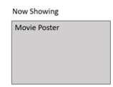
When the user click

Slide 9
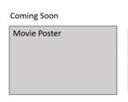
When the user click

Slide 11
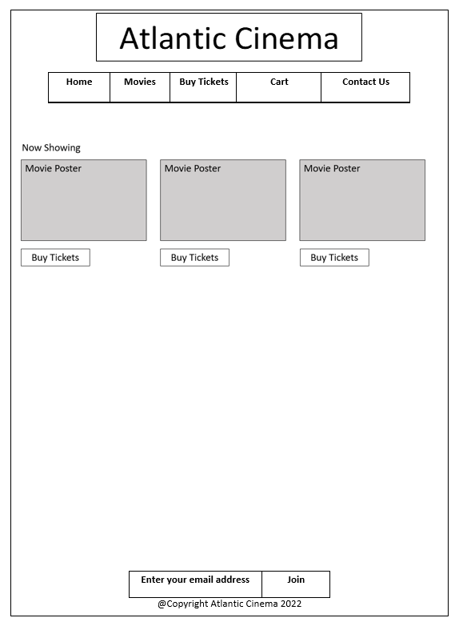

Slide 12
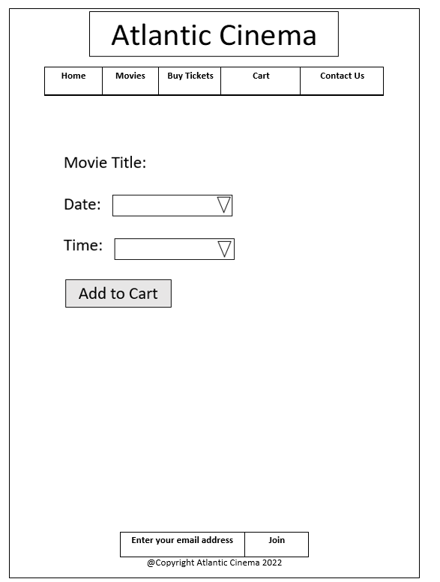

Slide 13
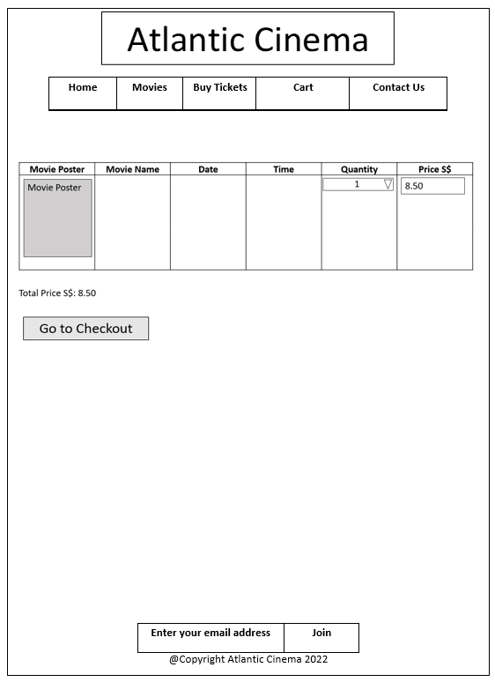
When user click add to cart,
when user click cart nav
The data will be entered.

Slide 15
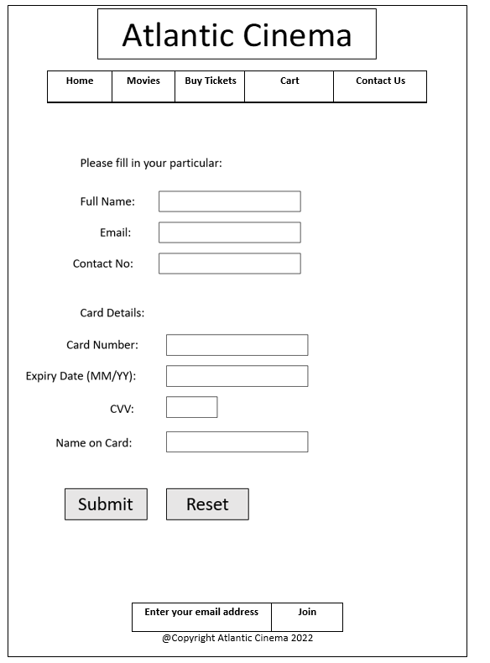

Slide 16
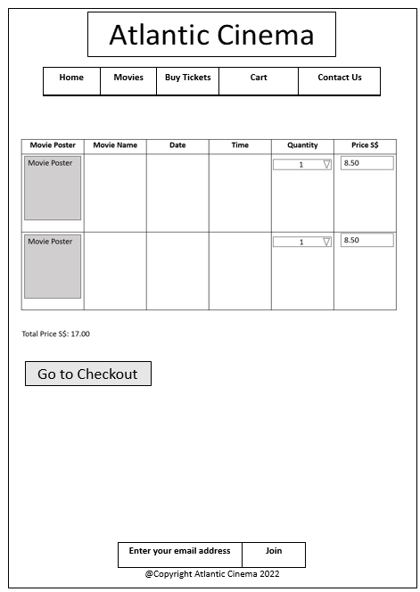

Slide 17
When the user click submit button

Slide 18
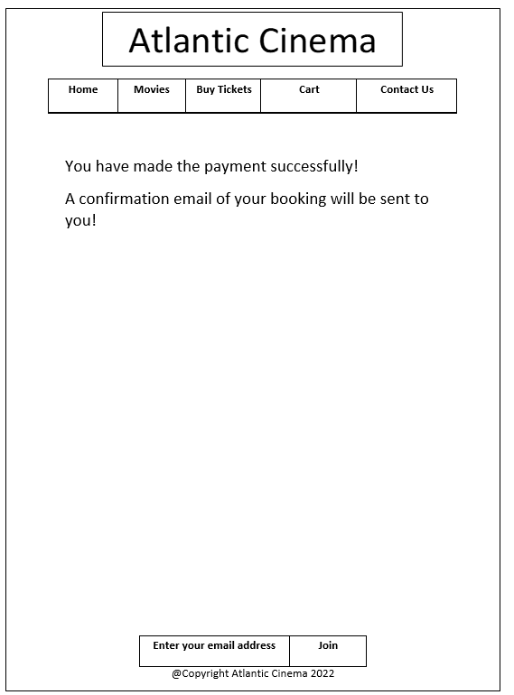
Payment_successful Page

Slide 19
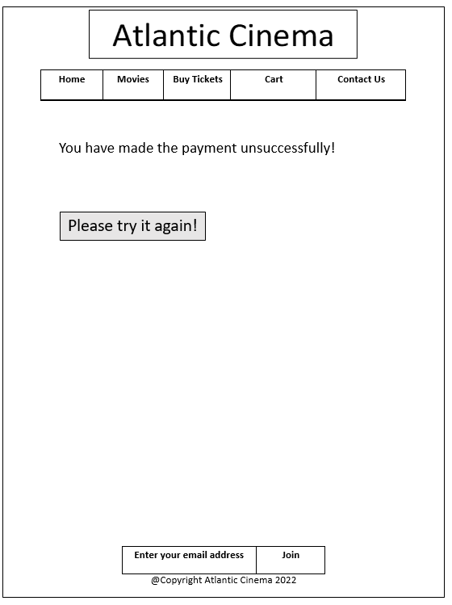
Payment_unsuccessful Page

Slide 20
Payment_unsuccessful Page link to

Slide 21
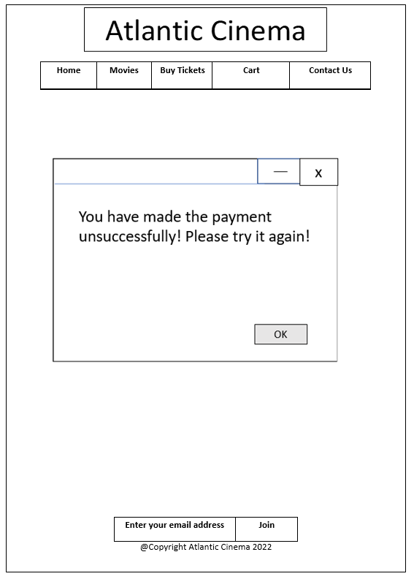
Payment_unsuccessful Page v2

Slide 22
Payment_unsuccessful Page link to

Slide 23
