Slide 2
Web pages for wireframes
Logo
Home page
Contact page
Movie page
Promotion page ver1 or
Promotion page ver2
Login page (optional)
Register page (optional)
Payment page
Payment successful
Payment unsuccessful
Location page (cinema)
BuyTicket Page
Member page (optional)
Seating page

Slide 3
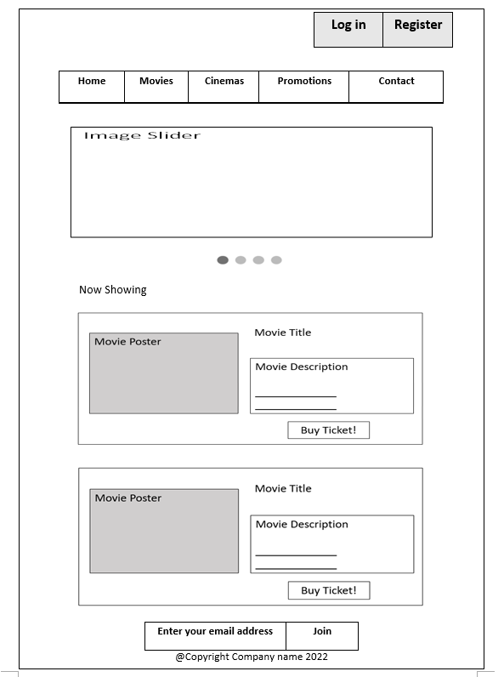

Slide 5
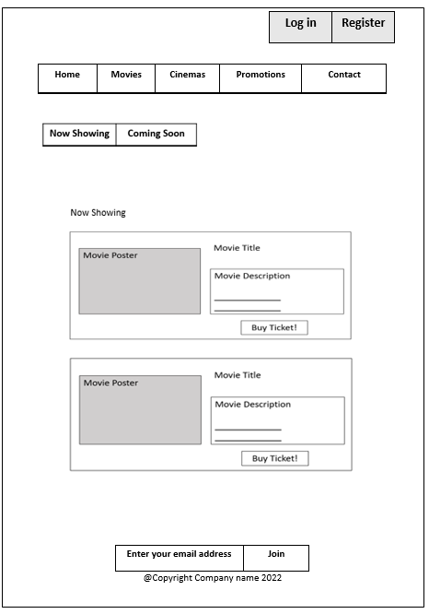
When click now showing

Slide 6
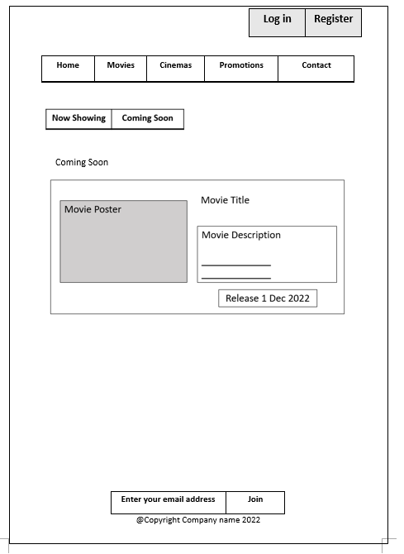
When click coming soon

Slide 8
https://www.sourcecodeexamples.net/2020/12/movie-seat-booking-project-with.html

Slide 9
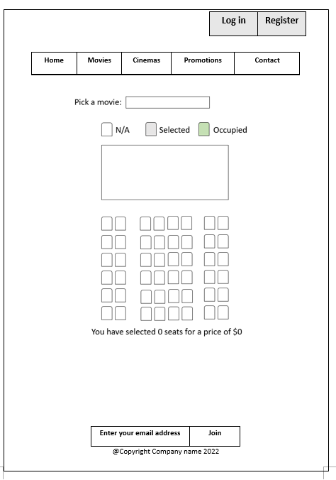

Slide 10
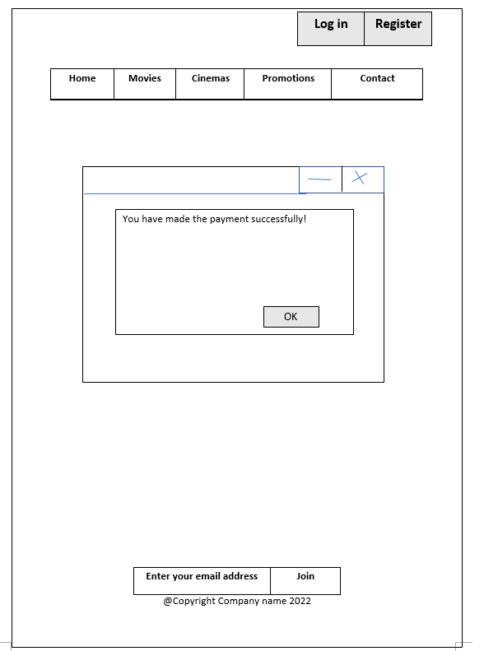

Slide 11
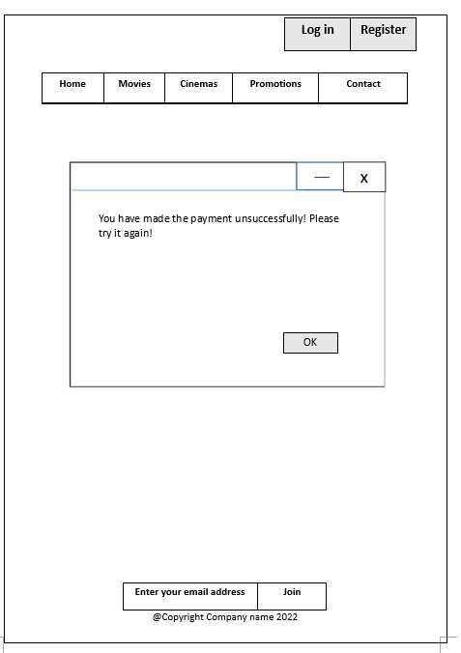

Slide 12
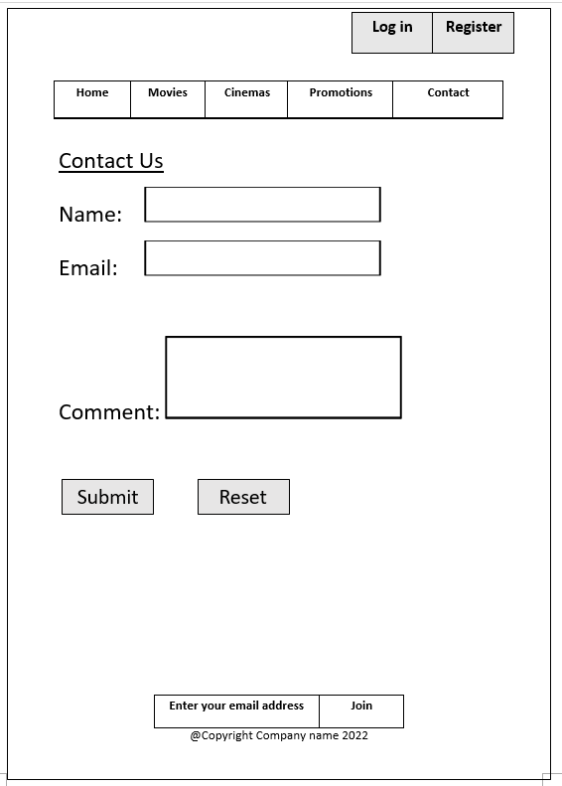

Slide 14
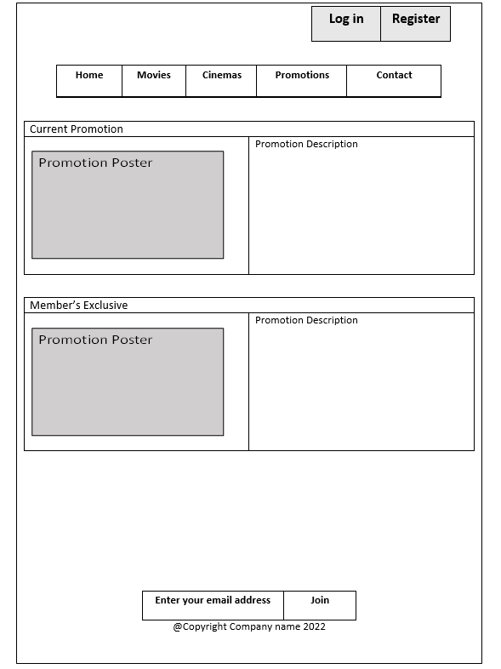

Slide 15
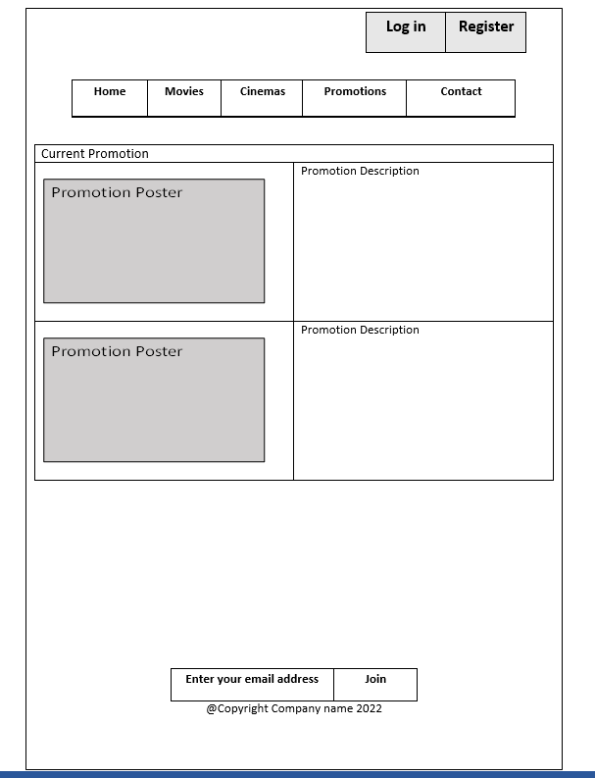

Slide 16
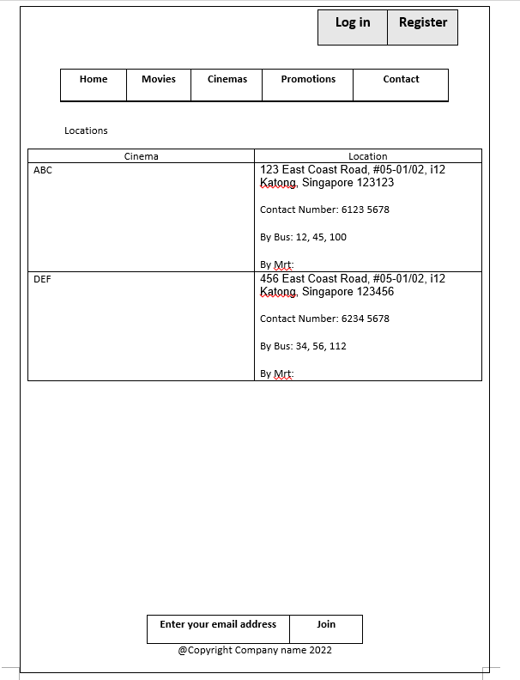

Slide 17
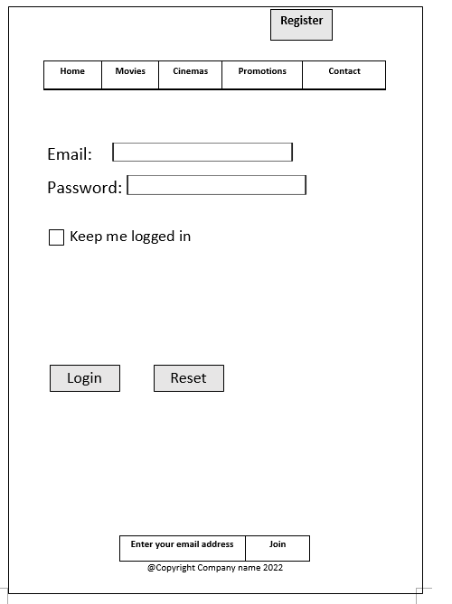

Slide 18
After login

Slide 19
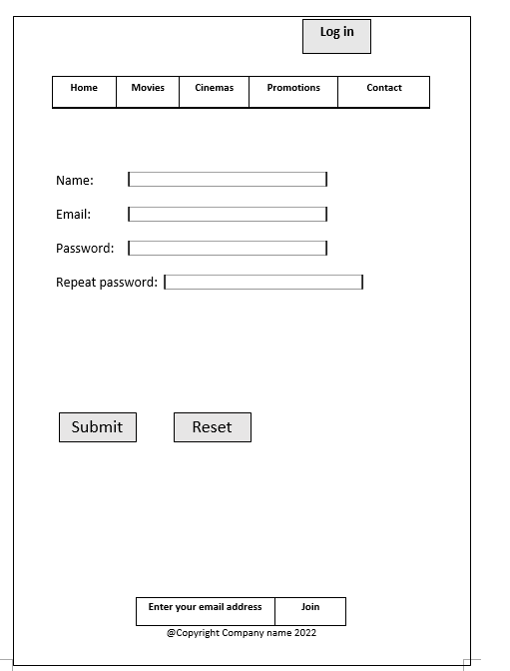

Slide 20
After register

