Slide 2
Web pages for wireframes
Home page
Contact page
Movie page
Promotion page ver1 or
Promotion page ver2
Login page (optional)
Register page (optional)
Payment page
Payment successful
Payment unsuccessful
Location page (cinema)
BuyTicket Page
Member page
Seating page

Slide 3
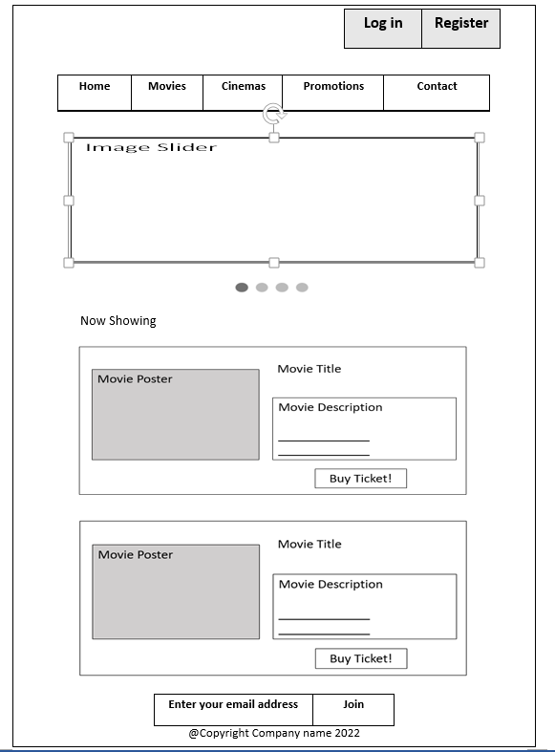

Slide 8
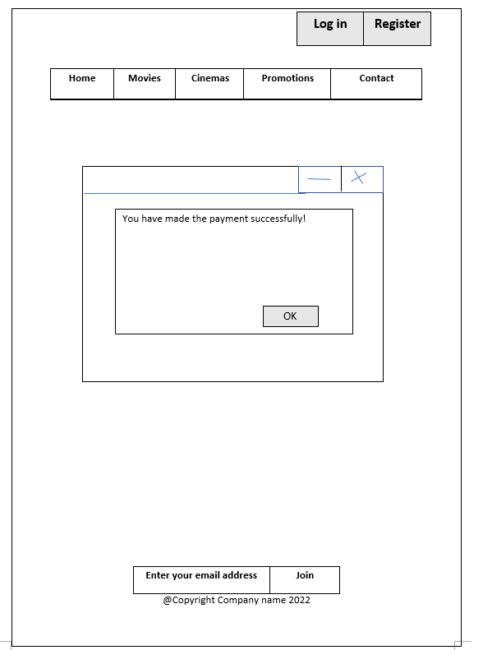

Slide 9
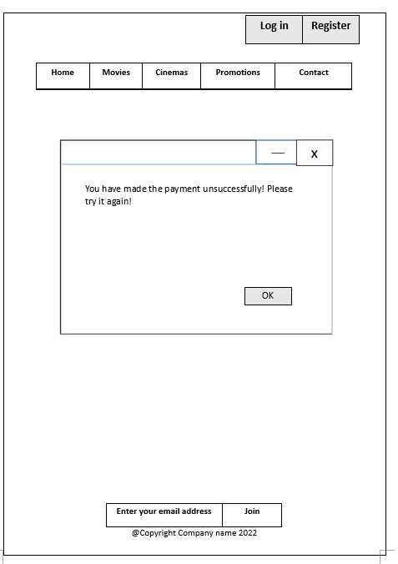

Slide 10
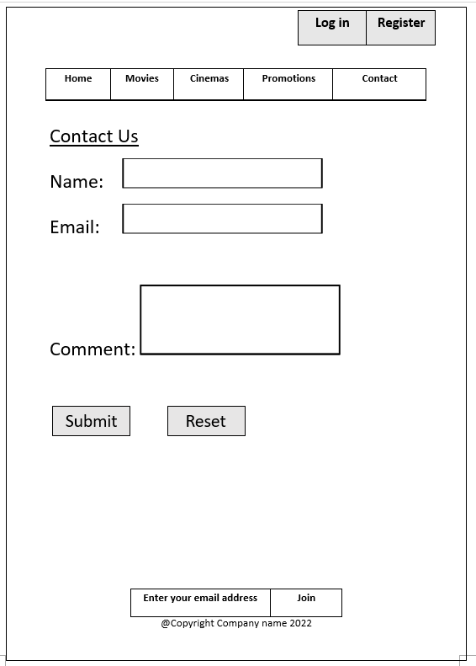

Slide 12
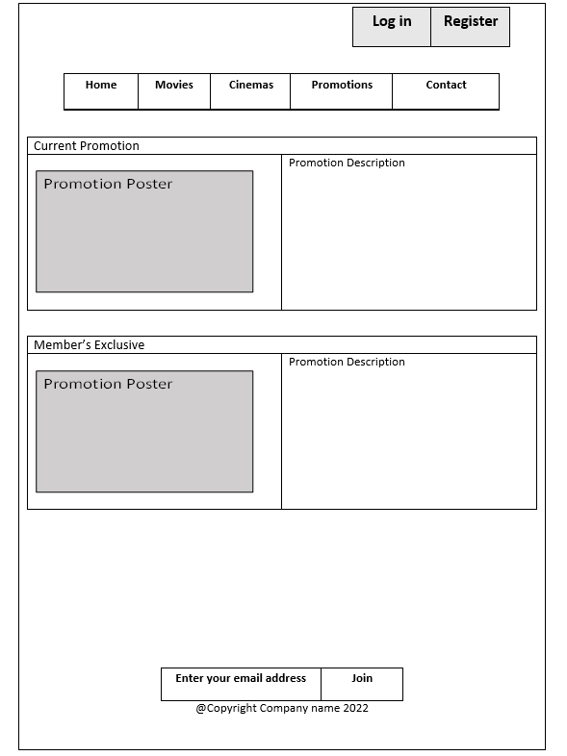

Slide 13
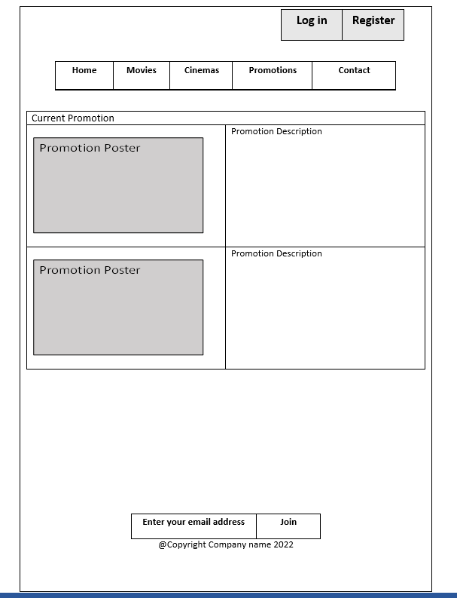

Slide 14
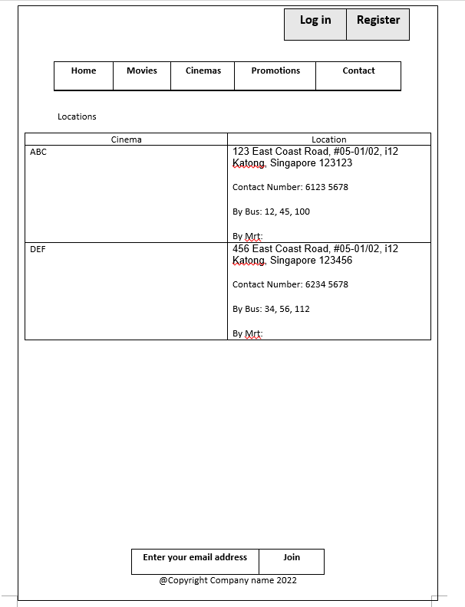

Slide 15
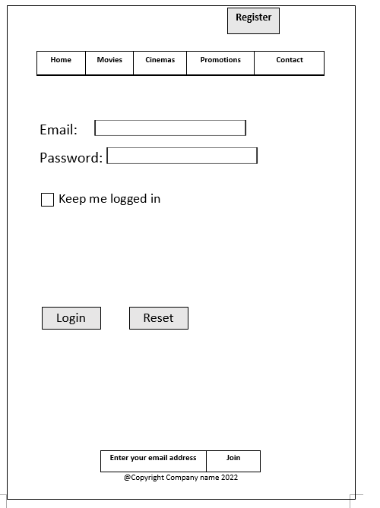

Slide 16
After login

