Slide 1


ACCUBET AI
THE FUTURE OF SPORTS BETTING
BY: ALBERT SARPONG & SHANE D’SOUZA

Slide 2
PROJECT OBJECTIVES
OBTAIN HIGH QUALITY DATA DIRECTLY FROM NBA
PREDICT NBA GAMES WITH SUFFICIENT ACCURACY
CREATE USER FRIENDLY INTERFACE WHERE USERS CAN CHOOSE WHICH GAME THEY WANT PREDICTED
STORE EACH PREDICTION ON THE BLOCKCHAIN

Slide 3
DIFFERENCES FROM LAST PROJECT
DATA WAS MANUALLY SCRAPED FROM NBA.COM, NOT DOWNLOADED FROM KAGGLE
DIFFERENT ML TECHNIQUES AND TOOLS WERE USED
HIGHER ACCURACIES WERE ACHIEVED
STREAMLIT PROVIDED A MUCH EASIER USER INTERFACE TO DEAL WITH
BLOCKCHAIN WAS UTILISED WHICH PROVIDES TRANSPARENCY TO THOSE WHO WOULD LIKE TO REFERENCE OUR ACCURACY FOR PAST PICKS

Slide 4
DATA SCRAPING AND CLEANING
WE WILL GO THROUGH OUR JUPYTER NOTEBOOK TO DEMONSTRATE SCRAPING AND CLEANING TECHNIQUES DEPLOYED

Slide 5
Gradient boosting & logistic regression ml models
We will go through our gradient boosting and logistic regression jupyter notebooks to demonstrate accuracy acheived

Slide 6
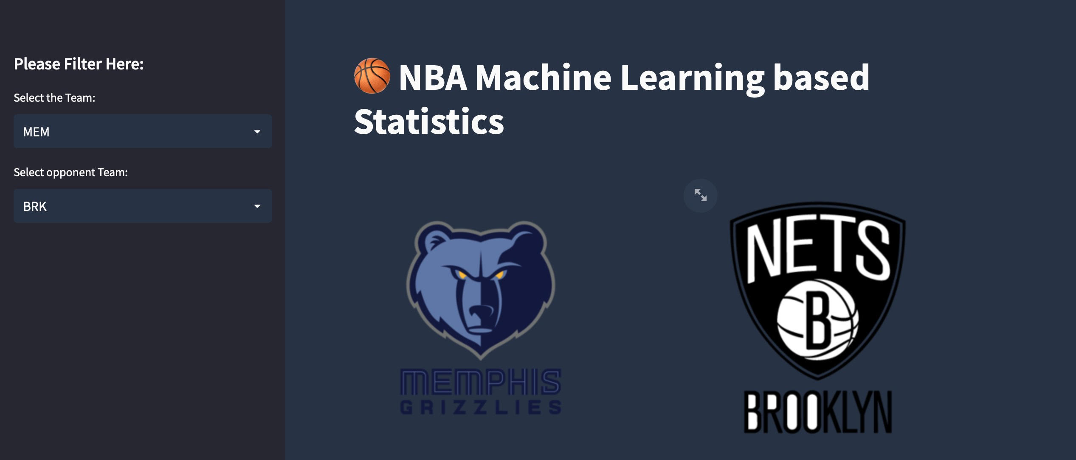
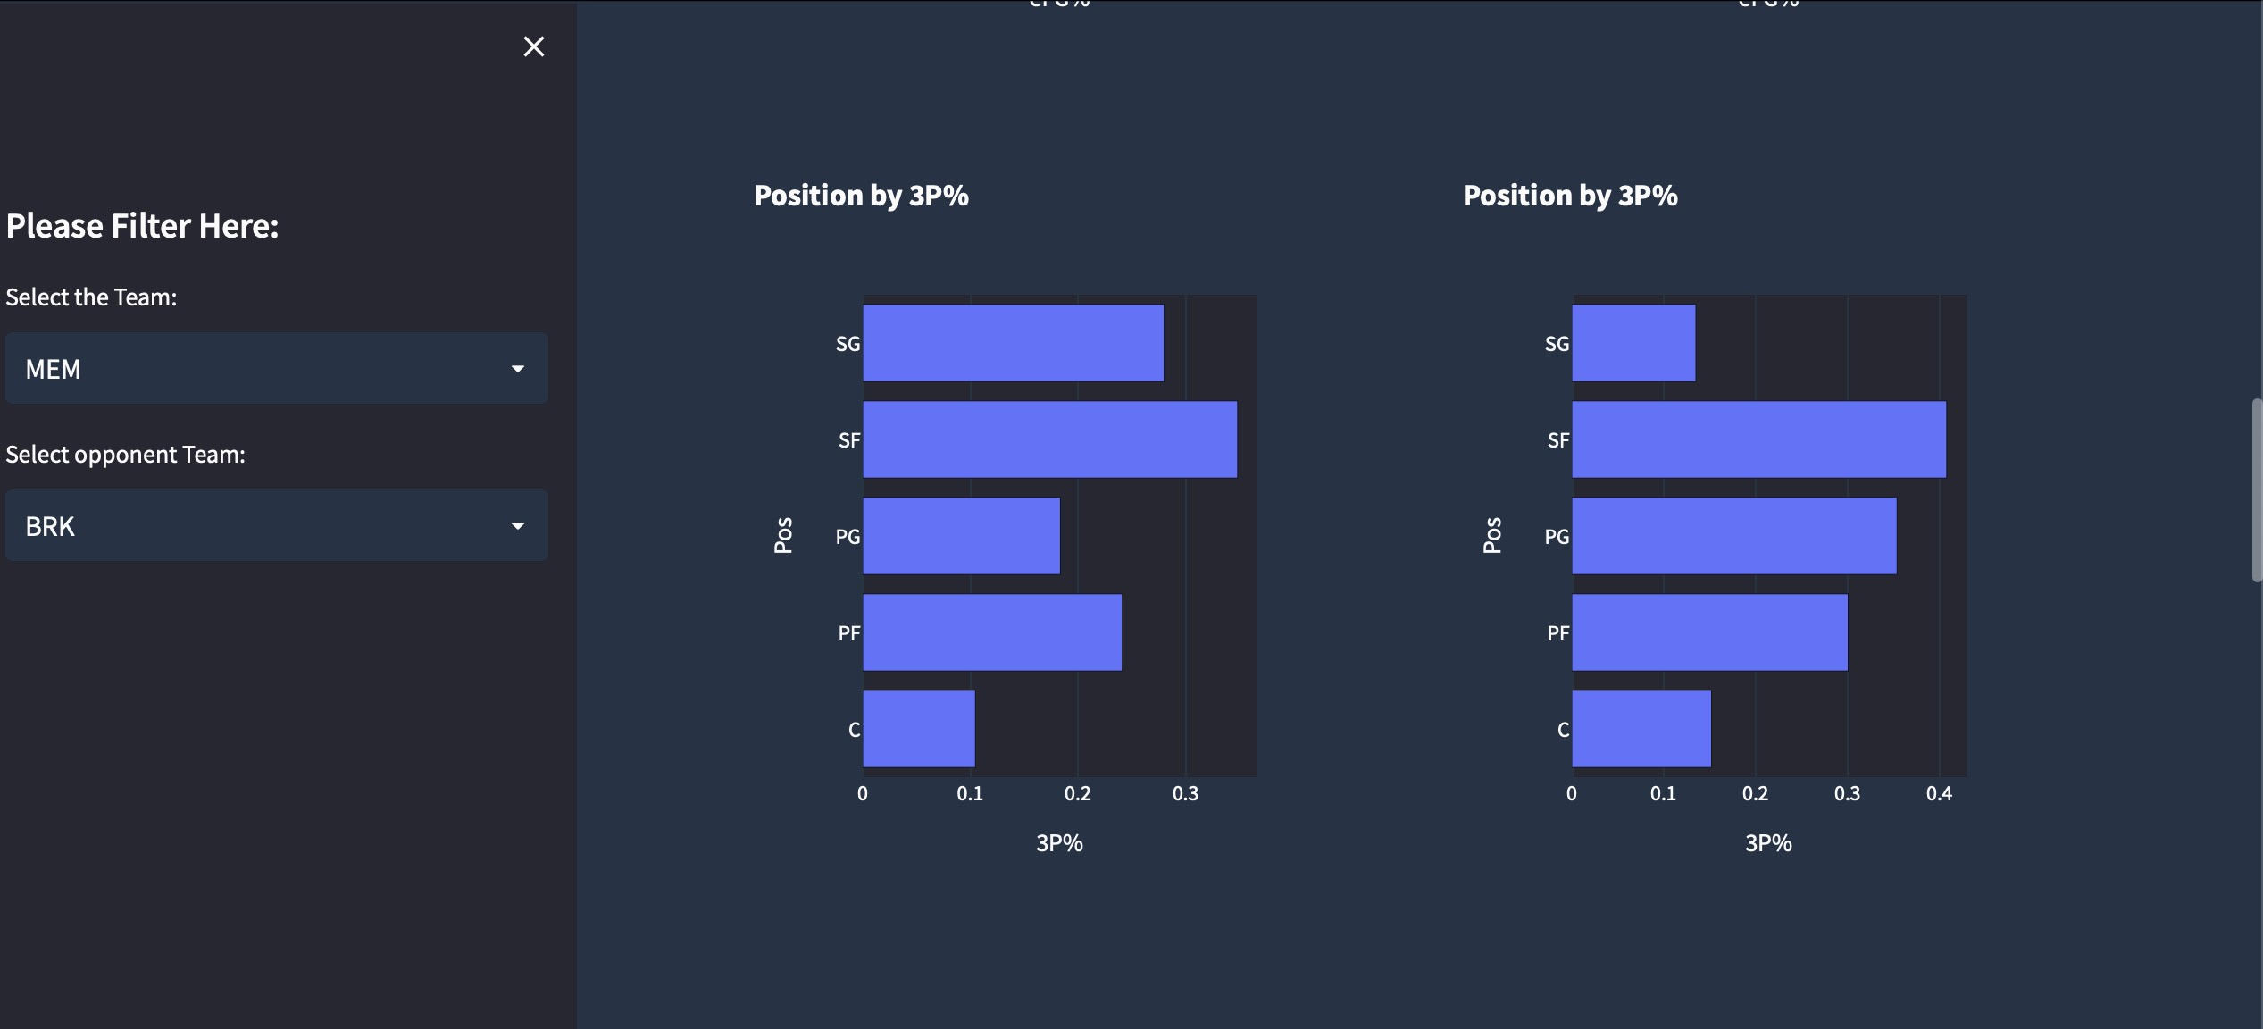

Slide 7
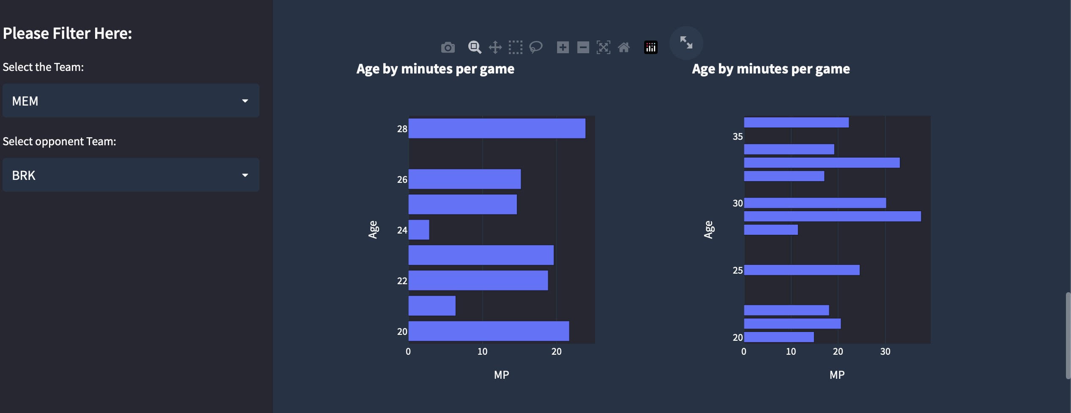
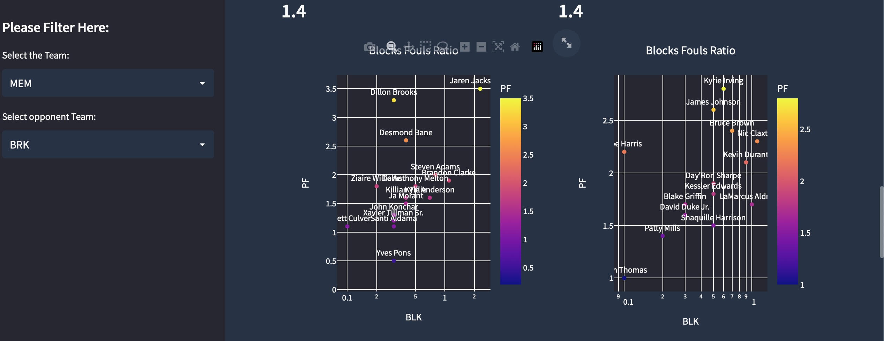

Slide 8
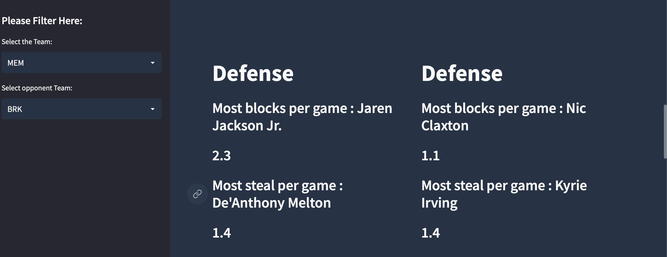
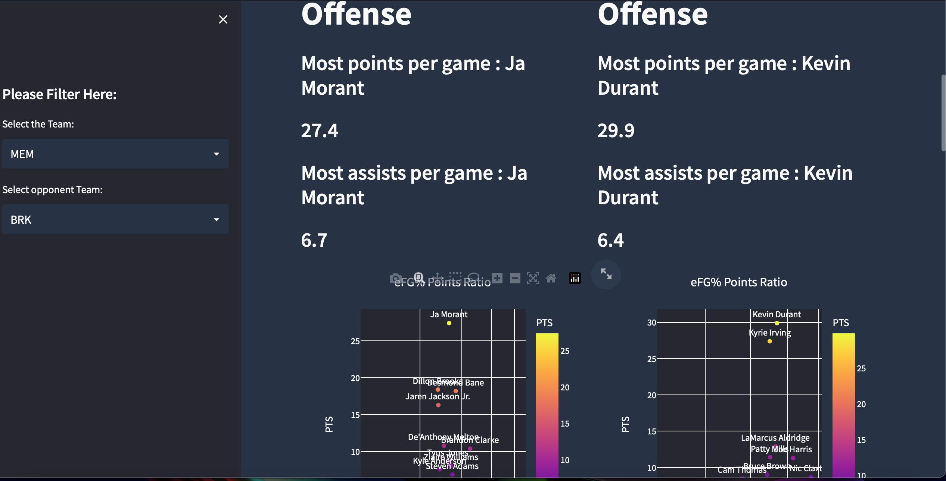

Slide 9
