Slide 1
FaceLock
Project Members: Shane Vance, Bardia Borhani, and Alex Puga
Faculty Coach: Bill Iverson

Slide 2
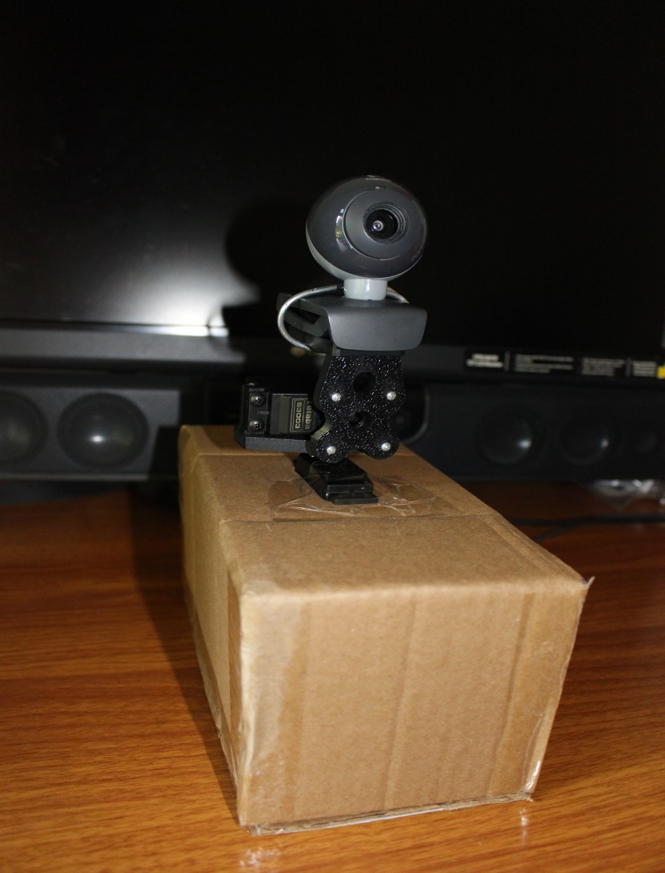
Introduction and Background
What is it?
Facial detection and tracking program
Inspiration
First saw project on Instructables
Why this project?
Interesting,
Improve security,
Improve coding abilities,
Build real world application,
Work as a team
Project Objective
Improve live streaming applications and security systems -- used by many

Slide 3
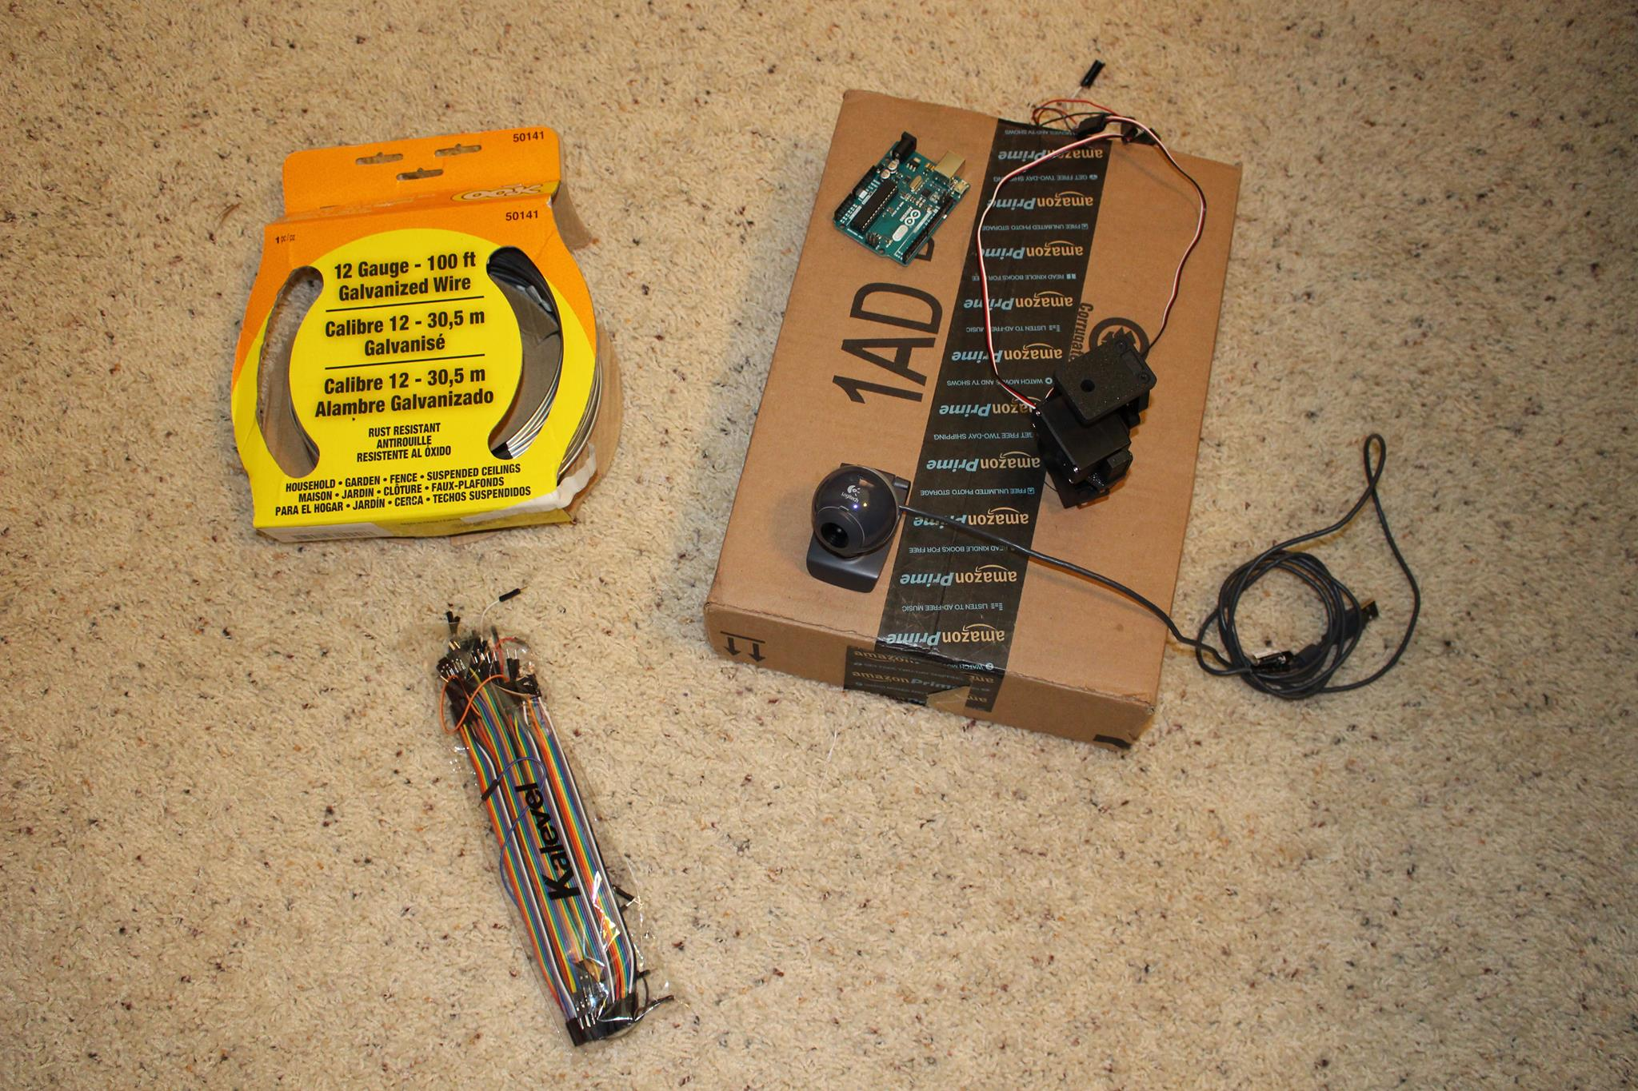
Project Description
Buying parts -- Amazon (via Michael), Instructables, and Shane
Parts:
Webcam
Arduino UNO
Power source
Jumper wires
Hobby wire
Pan/Tilt servos
Cardboard box
3
2
5
6
1
4

Slide 4
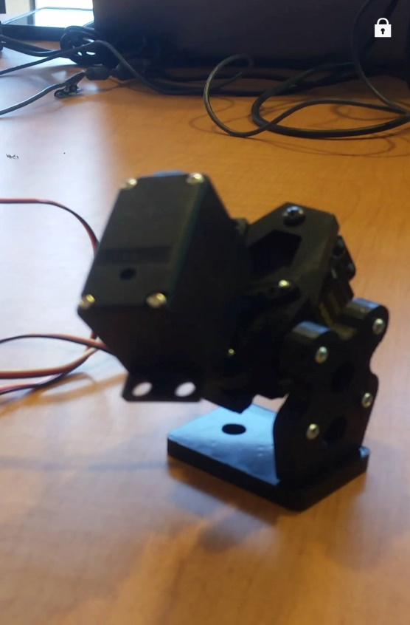
Putting the parts together:
Pan/Tilt servos
Two servos linked together
Connected servos to Arduino via jumper wires
Hobby wire used to hold webcam to servos

Slide 5
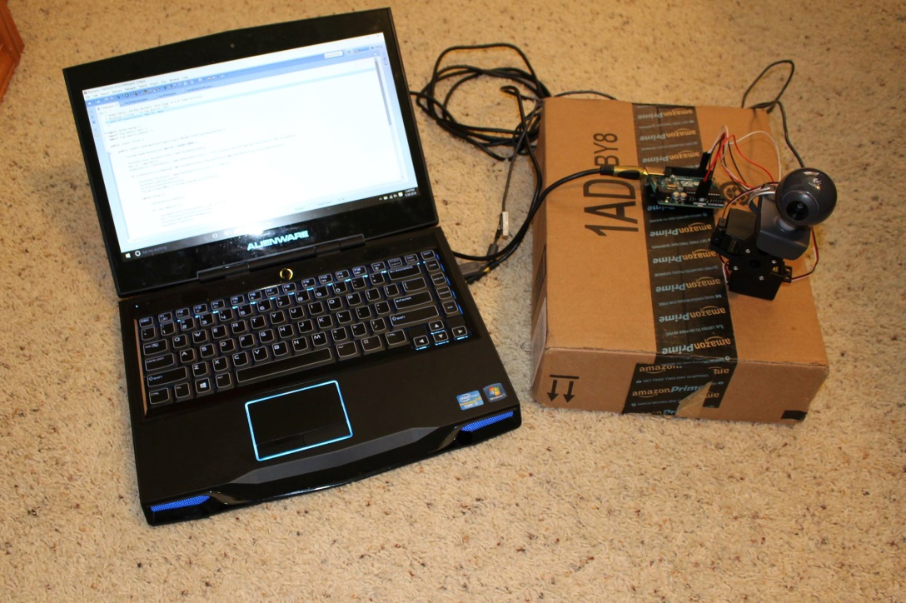
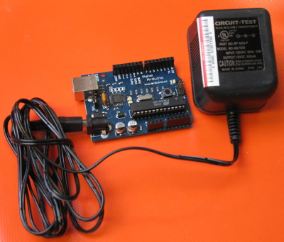
Putting the parts together:
Arduino UNO with power source

Slide 6

Programming
Planned to use C++, however, opted to use Java
Constructed 4 classes
GUI, face detection, and processing webcam image
One for sending coordinates to the Arduino
OpenCV (Open Source Computer Vision)
Library containing code for facial detection
Provided by Intel®
Issues
Program sometimes freezes and/or lags

Slide 7
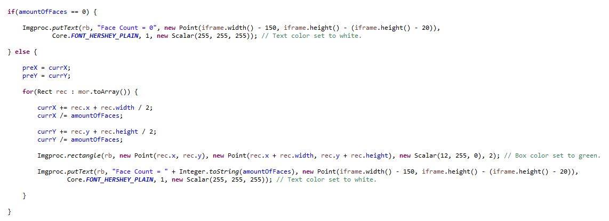
Let’s show you FaceLock!

Slide 8
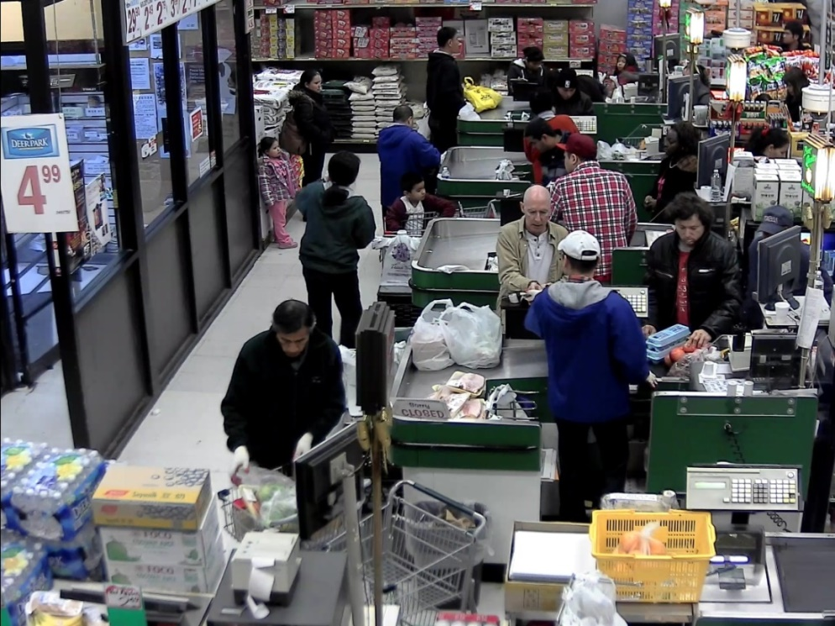
Impact/Significance
This project is the next step to improvement in national security and monitoring
Expand use of face detection and eventually recognition
Cameras are already used to monitor our home, stores, and buildings around the world
Imagine, these motion cameras could identify thieves and/or criminals

