Slide 1
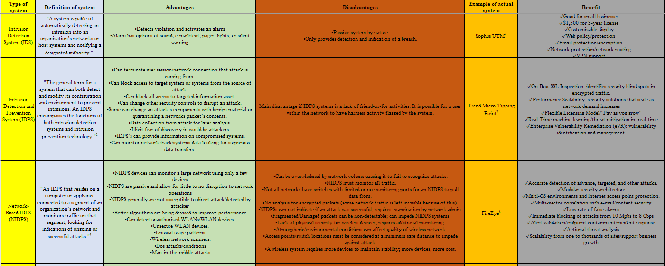
Intel Corporation and IDS’s
¹ (Whitman & Mattord, 2018, Chapter 7) ⁶ (Sophos, 2019)
² (Whitman & Mattord, 2018, Chapter 7) ⁷ (Trend Micro., 2019)
³ (Whitman & Mattord, 2018, Chapter 7) ⁸ (FireEye, 2019)
⁴ (Techopedia. 2019) ⁹⁽(Flowmon, 2019)
⁵ (Whitman & Mattord, 2018, Chapter 7) ¹⁰(Alien Vault an AT&T company, 2019)

Slide 2
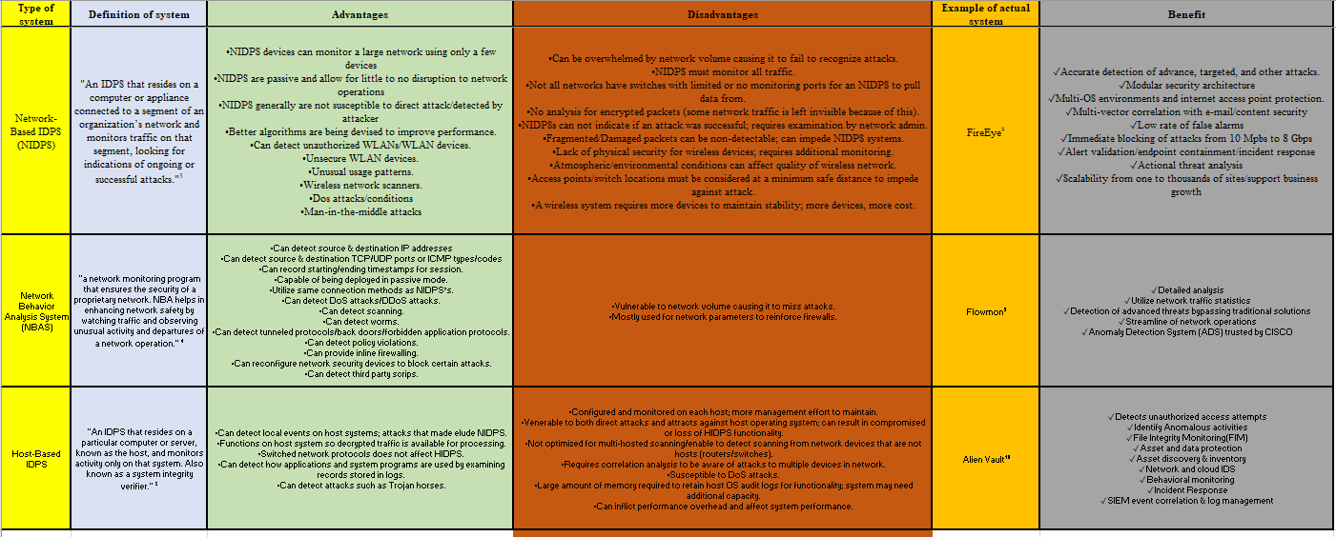
Intel Corporation and IDS (continued)
¹ (Whitman & Mattord, 2018, Chapter 7) ⁶ (Sophos, 2019)
² (Whitman & Mattord, 2018, Chapter 7) ⁷ (Trend Micro., 2019)
³ (Whitman & Mattord, 2018, Chapter 7) ⁸ (FireEye, 2019)
⁴ (Techopedia. 2019) ⁹⁽(Flowmon, 2019)
⁵ (Whitman & Mattord, 2018, Chapter 7) ¹⁰(Alien Vault an AT&T company, 2019)

Slide 3
Why not use Firewalls and Antiviruses?
Firewalls being a combination of hardware and software that filters or prevents specific information from moving between an outside network and an inside network. Firewalls merely provide a barrier to protect information assets.
Anti-viruses are exactly as their name implies, they are designed to combat and destroy known computer viruses. While some can have active scan functions, they will only deal with viruses attempting to infect a system, not an actual attacker.
References
Techopedia. (2019). Network Behavior Analysis (NBA). Retrieved from https://www.techopedia.com/definition/16118/network-behavior-analysis-nba
Whitman, M. E., & Mattord, H. J. (2018). Principles of Information Security (6th ed.). Retrieved from https://ng.cengage.com/static/nb/ui/evo/index.html?deploymentId=5741082248543125029303882&eISBN=9781337281638&id=446244221&snapshotId=1098432&dockAppUid=16&nbId=1098432&.
Trend Micro. (2019). TIPPINGPOINT® THREAT PROTECTION . Retrieved from https://www.trendmicro.com/en_us/business/products/network/intrusion-prevention/tipping-point-threat-protection-system.html
Sophos. (2019). Sophos UTM Feature List. Retrieved from https://www.sophos.com/en-us/medialibrary/PDFs/factsheets/sophos-utm-feature-list-dsna.ashx
FireEye. (2019). FireEye Network Security. Retrieved from https://www.fireeye.com/content/dam/fireeye-www/products/pdfs/pf/web/fireeye-network-threat-prevention-platform.pdf
Flowmon. (2019). Nbad Delivers Advanced Technology. Retrieved from https://www.flowmon.com/en/solutions/use-case/network-behavior-analysis-anomaly-detection
Alien Vault an AT&T company. (2019). Monitor and Protect Your Critical Systems with Host-based IDS. Retrieved from https://www.alienvault.com/solutions/host-intrusion-detection-system

