Slide 1
Language Identification and the textcat Package
INFO 523
Shane Freeborn, Robert Gray

Slide 2
Purpose
Allows for quick language detection of a large body of text by analyzing strings of text and comparing them to the texts stored in its database
Useful for optimized translation applications that take a string of text and give a direct translation back to the user
Can also be used to identify languages within texts that may be unknown to the reader

Slide 3
Early methods
Human effort (someone who knows the language)
Lists of unique characters or combinations thereof

Slide 4
Contemporary methods
Neural nets (Batchelder, 1992)
Markov chain model (Dunning, 1994)
Mutual cross entropy (Sibun et al., 1996)
Cumulative frequency addition (Ahmed et al., 2004)
Hidden Markov models (Murray, 2002)

Slide 5
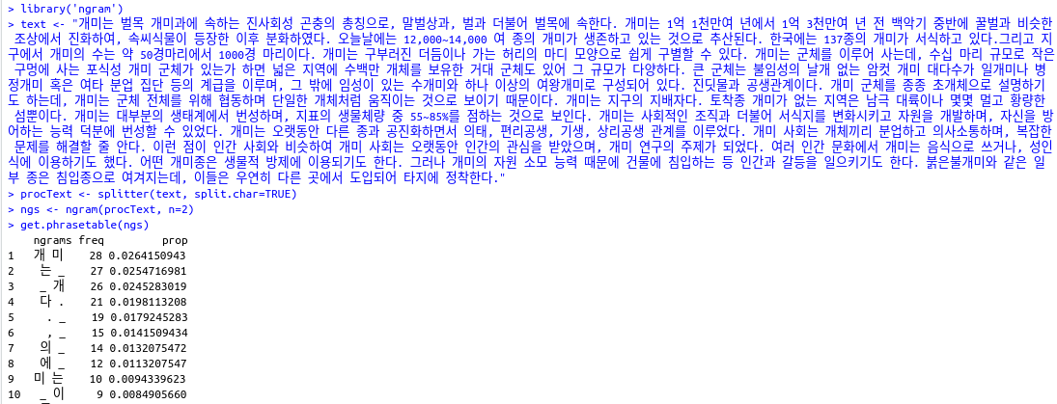
N-grams from scratch
The “ngram” package:

Slide 6
N-gram-based approaches
Cavnar and Trenkle (1994)
Reduced version of the above (Hornik et al., 2013)
textcat package

Slide 7
textcat: Latin alphabet languages
Most (93.2%) languages using the Latin alphabet were correctly identified.
Even very similar languages were identified (most of the time).
Suitable texts could not be found for Middle Frisian or Mingo
Problems with Vietnamese and Quechua

Slide 8
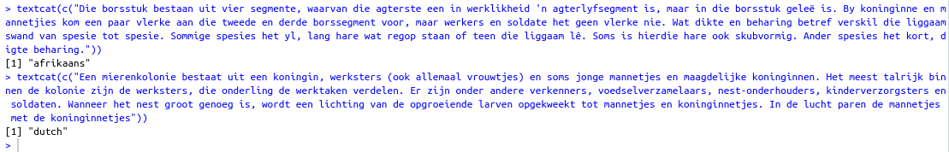
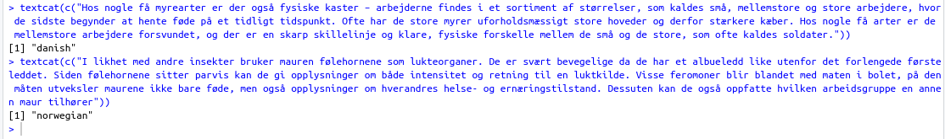
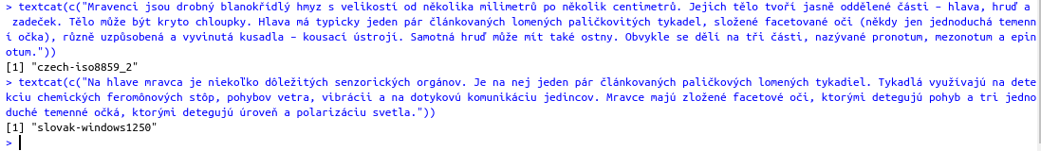
Disambiguation of similar languages

Slide 9
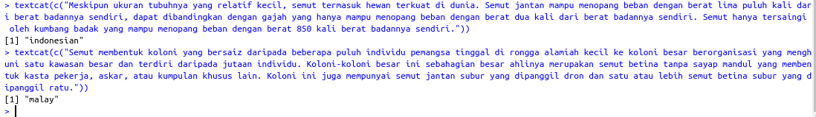
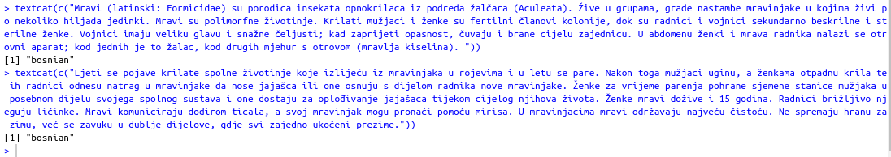
Disambiguation of similar languages
This should be Croatian

Slide 10
Vietnamese and Quechua
Identification was possible only by manipulating the function parameter “p”:
p=textcat::TC_byte_profiles
Otherwise, Vietnamese was identified as Scots, and Quechua as Tagalog

Slide 11
textcat: Cyrillic alphabet languages
4 out of 5 languages using the Cyrillic alphabet were correctly identified.
Serbian was identified either as Bulgarian or Russian (surprising)
Modifying the “p” parameter did not help either: it simply identified Serbian as Chinese
This should be Serbian

Slide 12
textcat: Greek and Hebrew
Greek was correctly identified
Hebrew was correctly identified
Yiddish (which uses the Hebrew alphabet) texts were classified as Hebrew
There are unique glyphs/glyph combinations used in Yiddish which make this surprising

Slide 13
textcat: All other languages
None of the other languages supposedly supported were identified:
Devanagari languages (Hindi, Marathi, Nepali, Sanskrit)
Languages using Arabic script (Arabic, Persian)
Chinese and Japanese
Others (Amharic, Armenian, Georgian, Korean, Tamil, Thai)

Slide 14
Unique character algorithm

Slide 15
Conclusions and recommendations
Downloading textcat requires:
In Terminal (if using Linux):
sudo apt-get install liblapack-dev libblas-dev gfortran
R packages (dependencies):
“devtools”, “slam”
The textcat package in R is best suited for languages using the Latin, Cyrillic, and Greek alphabets.
Other languages might be better identified through a unique-character counting algorithm.

