Slide 1
The Gang steals the script
An eSports Data Analysis
Shane Fuller

Slide 2
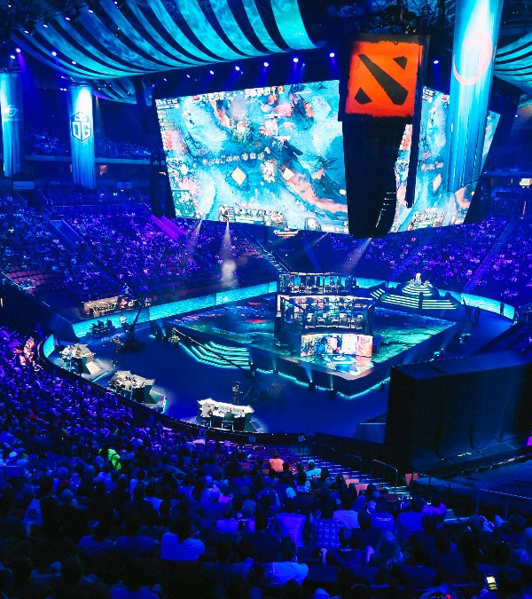
Esports introduction
An esport is a muiltiplayer video game played competitively for spectators
In its annual report, the marketing researcher is predicting 2018 revenues to hit $905 million, a staggering 38% increase from 2017’s $655 million
Twitch, the primary streaming website for competitive esports, receives about 15 million daily active users, and shows hundreds of different games for people to spectate

Slide 3
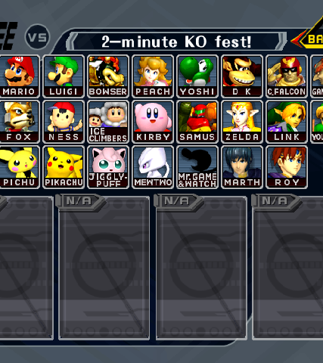
Competitive melee
Personally, my game of interest in the esports community, is competitive Super Smash Brothers Melee
Established in in 2001 for the Gamecube, the game is a Nintendo product in which the goal is to knock the opponents off of the stage
The competitive community established in the early 2000’s, and there have been about 2.8 million dollars in earnings from 2,431 major tournaments
https://www.youtube.com/watch?v=QlZfapuj9Kg&list=PLjqjFqIMEtWeXI7UinpWNdjKlB7MXsJ73&index=21

Slide 4

Project slippi
Project Slippi at its core is a Melee Data Framework
Announced in early 2015, the project has been primarily developed in and implemented this year
Provides analysis, visualizations, and replays for every game played at a tournament
https://slippi.gg/

Slide 5
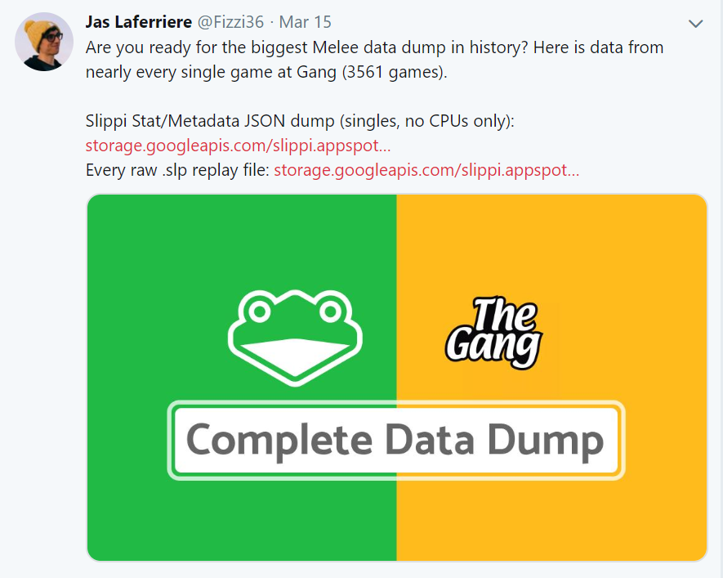
Data Collection
The data was collected from Project Slippi at the tournament The Gang Steals the Script
Collected from a network of 25 consoles throughout the venue
Matches are both tournament and friendlies, and range in skill

Slide 6
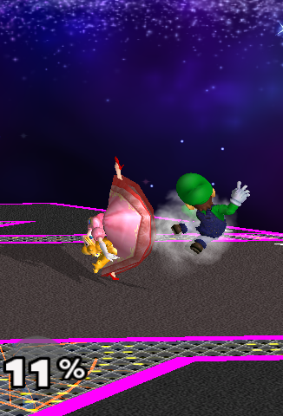
Data Understanding
First step was to review the format of a .slp file, which is a replay of all the inputs completed by both players in a game
Understand the different documents within the JSON document, and what each subheading information held
Headings included Root, Stocks, Conversions, Moves, ActionCounts, Overall, SuccessfulConversions, InputsPerMinute, etc.
After understanding each feature in the file, the next step was to find the variables that I felt impacted the players win condition most heavily

Slide 7
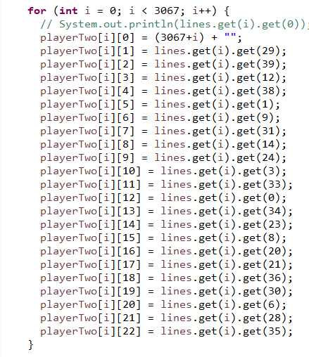
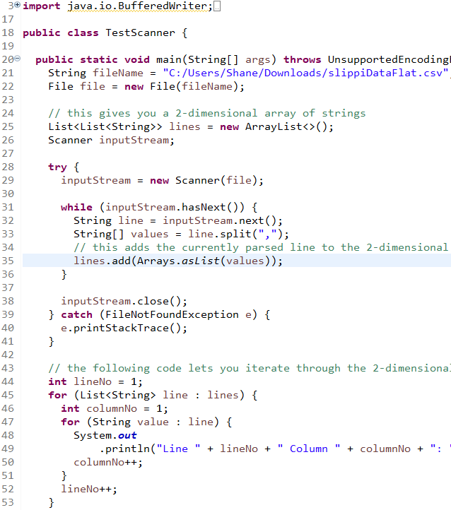
Data Preparation
Converted the JSON data dump into flat CSV files, extracting selected features
Wrote Java script to distinguish the stats for each individual player
Renamed the column headings and added columns to maintain data after reformatting
Imported into R for cleaning step, included deleting rows with only N/A values, deleting unhelpful or confusing columns, and converting the values to numeric types from character types
This led to the final Analytics Base Table, gangScriptData.csv

Slide 8
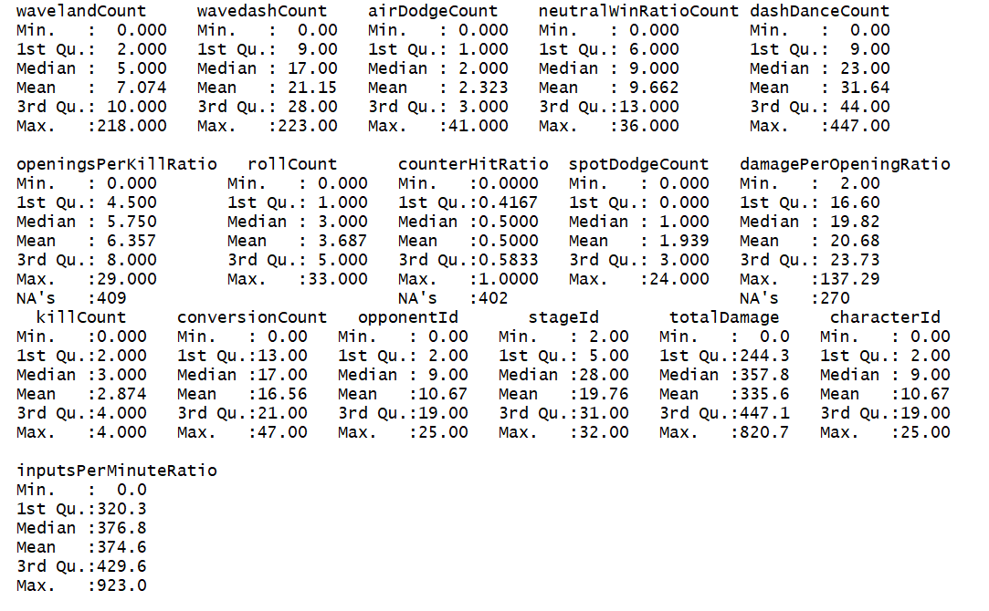
Analytics base table
17 columns wide
6,131 rows deep
14 numeric values
4 ratios
10 integer counts
3 Identifiers
Stage Id
Character Id
Opponent Id

Slide 9
modeling
Linear Model
OneR Model
Naïve Bayes Model
Rules Model
Decision Tree Model

Slide 10
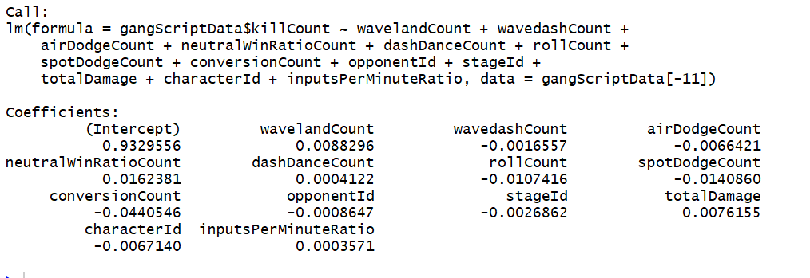
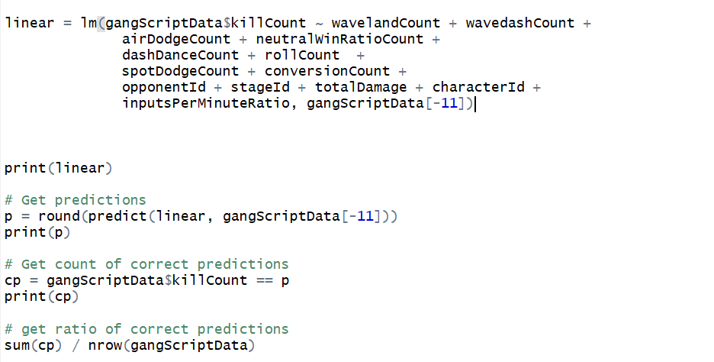
Linear model
The linear model was the first model that was run
Surprisingly not a bad success rate, as the model had an accuracy of about 43.1%
One reason for success is that 45% of the data has a target killCount of 4, so the model was more prone to guess 4
Intercept suggests that without these movement features, the player is expected to get about 1 kill a game (0.933)

Slide 11
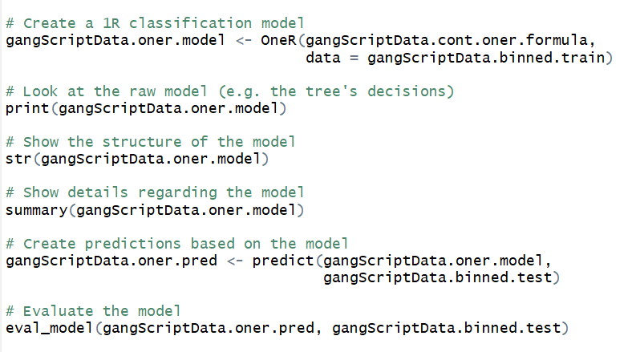
Oner model
Supervised binning was performed to reduce the risk of overfitting
Due to nature of OneR Model, severe overfitting still occurred
The model memorized the training set, and set on the feature totalDamage to predict the overall killCount
The accuracy resulted in 0%, which was expected with this model

Slide 12
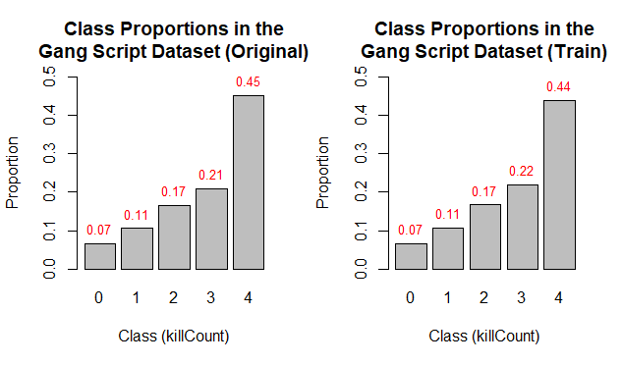
Naïve Bayes model
Supervised binning was performed to reduce the risk of overfitting
Problems in the model came with unproper binning, however the data presented would not be successful with a Naïve Bayes model anyways
Accuracy resulted in 0%

Slide 13
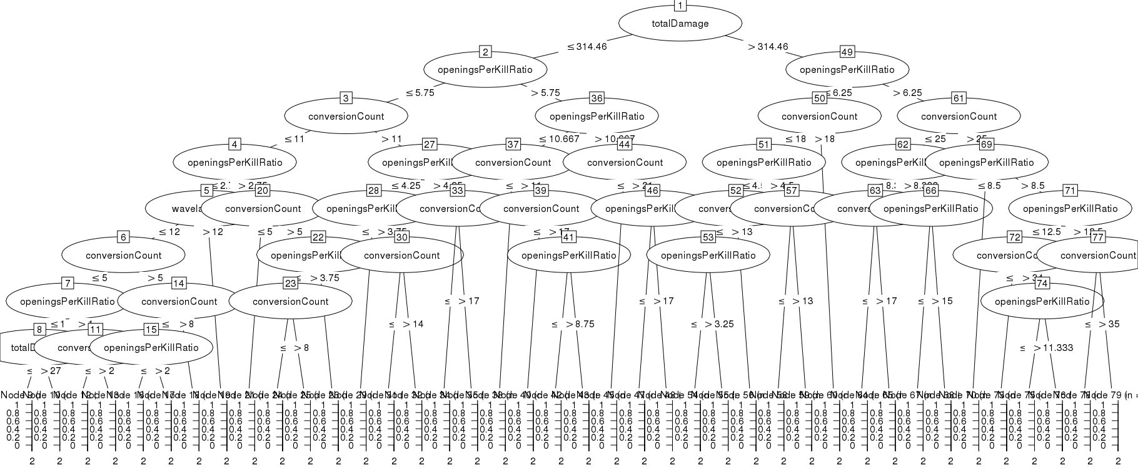
Decision tree model
The decision tree also relied heavily on the totalDamage, openingsPerKillRatio, and conversionCount
After calculating the performance of nominal values, this model had an accuracy of 90.38%.
Kappa Statistic: .8638

Slide 14
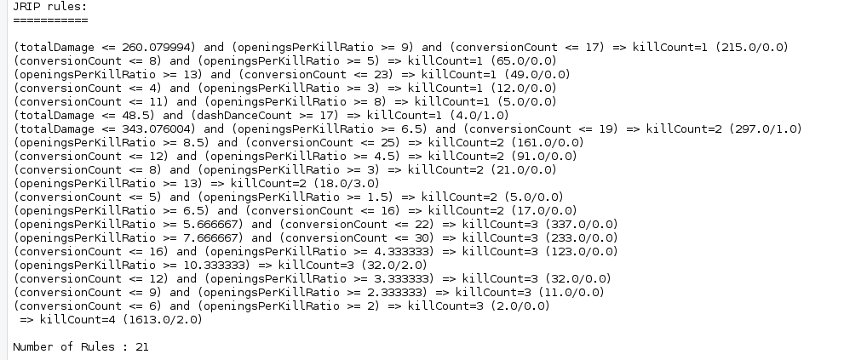
Rule set model
The rules set model ended up creating 21 unique rules for the data set
After calculating the performance of nominal values, this model had an accuracy of 10.63%.
Kappa Statistic: -0.175

Slide 15
evaluation
Linear Model: 43.1% Accuracy
OneR Model: 0% Accuracy
Naïve Bayes Model: 0% Accuracy
Rules Model: 10.63% Accuracy
Decision Tree: 90.38% Accuracy

Slide 16
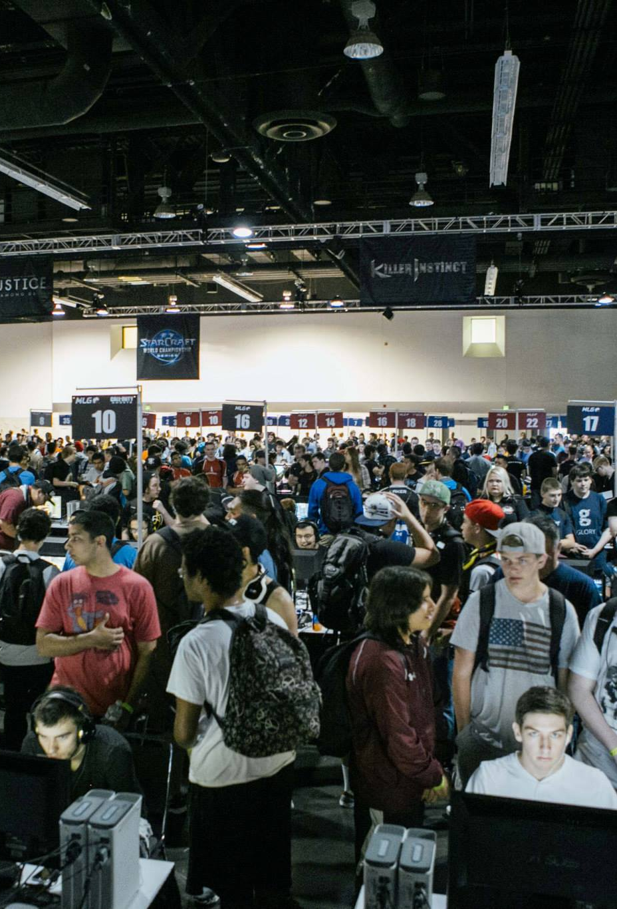
Issues with the data
The models were not very successful, simply because the data provided is incredibly complicated and hard to truly evaluate properly. When playing a game against another individual, there are so many extraneous features that go into the match. Especially in Melee, with each minute played, there are thousands of decisions that need to be processed, small precise movements that need to be made, and all an extremely small frame of time. The moves a player makes in each circumstance is unique to that player alone, and when so many play styles leads to varying levels of success, it is very difficult to truly understand what allows one player to win and one player to lose. For something like this to be successful, many more features need to be collected, and analyzed on a much smaller scale, specially paying close attention to individual performances rather than generalizing by character.

Slide 17
Future Work
Expand the number of hooks in the Project Slippi software to collect more in game features
Specialize the features to be how individual characters interact with one another, and how they interact on specific stages
Take into account the different ranges of character skill, continue to see trends by skill tier to find how players can focus and develop
Work on finding out of game features to see how players interact in high pressure situations (etc. record heart rate, interview players on mental game)

Slide 18
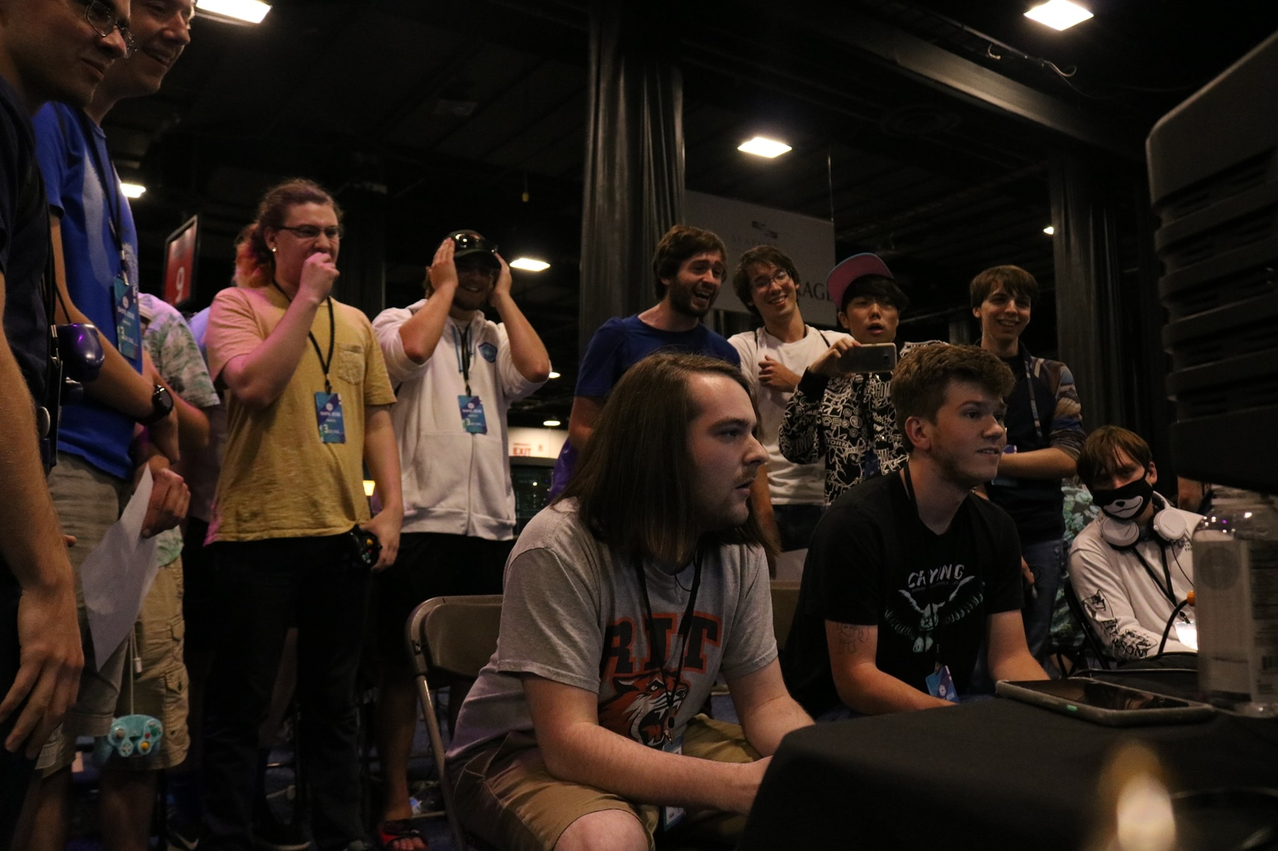
Conclusion
Issues with complexity of data to get working, proper models
The most successful of the models was the Decision Tree model, with an accuracy of 90.38%
Moving forward, the effort to add to the data framework of Competitive Melee will be to look to character/player specific features, and metal game features
Special thanks to the Project Slippi team, especially Fizzi36 for the creation of the product, as well as answering any questions I had about the .slp files he provided
Shameless Plug: If this seems interesting to you, we operate tournaments every Friday here at Skidmore. Also planning to implement this software before the end of the year!

Slide 19
Questions/comments
Thank You!

