Slide 1
WEB 340 Node.js
Week 5 – Layouts

Slide 2
Objectives
During this week, you will learn:
EJS layouts and partial views
Express template engines
CSS layouts
Website navigation

Slide 3
EJS templates and syntax
Express’s default content type is HTML, so if you do not do anything special, res.render will return your response and send them to the client as HTML (Hahn, 2016)
Express has the ability to return content in many different formats (XML, JSON, HTML)
Changing the response objects content type will tell Express what format to use
res.type([type])

Slide 4
EJS templates and syntax contd.
EJS can do templating for simple strings, HTML, plain text, JSON, you name it (Hahn, 2016)
EJS follows many of the same conventions in standard programming languages
Control flow: <% // control statement here %>
Escaping output: <%= // escaped output goes here (variables passed from Node.js %>
Include partial views: <%- include(‘EJS FILE NAME’) %>

Slide 5
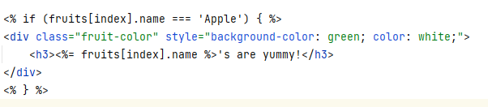
EJS templates and syntax contd.
if…else statement

Slide 6

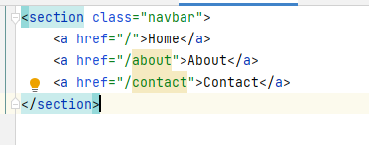

EJS templates and syntax contd.
Escaping output:
Partial views (use the include statement in the file you want the partial view displayed in):

