Slide 1
WEB 340 Node.js
Week 4 - Express

Slide 2
Objectives
During this week, you will learn:
What Express is
How to write middleware functions
Writing and using error handling in middleware
How to use open source middleware npm packages
How to setup a new application using Express, HTML, CSS, and EJS

Slide 3
Objectives
During this week, you will learn:
Simple and pattern-matching routing
Using middleware routing
Service static files with express.static
Using Express with Node’s built-in HTTPS module

Slide 4
Introduction to Express
Without a framework like Express, Node gives you a pretty simple API (Hahn, 2016)
Express is a helpful third-party module, which is not bundled with Node.js, but is intended to simplify web development
Express is an abstraction layer that sits on top of Node’s built-in HTTP server (Hahn, 2016)
Node handles request flows through a single beginning and end point
Express has the ability to handle many requests

Slide 5
Introduction to Express contd.
Middleware is written with request handler functions
These functions take a minimum of two arguments: Request Object and Response Object
A third optional argument is the Next Object
Express error-handling middleware does not handle errors that are thrown with the throw keyword, only when you call the next with an argument
Supports routing

Slide 6
EJS View Engine
Name all EJS views with a .ejs file extension
Place all EJS files in a folder named views
We do this to keep code base organized
You may write standard HTML code in an EJS file
All rules governing CSS, HTML and JavaScript work in EJS files
Effectively, the only difference between an EJS and HTML file is the file extension
Adds EJS specific features: for loops, if statements, variables, while loops, etc.,

Slide 7
Project setup
Create a new folder:
CLI command: mkdir hello-world
Initialize the folder using NPM:
CLI command: npm init
Answer the prompts (leave default for everything except for author and license)
All licenses in this course should be set to MIT
Remove the “test” script from the package.json file and add one for “start” with a value of “node index.js”
Install express, pino (the textbook uses morgan, which you can use instead of pino), and ejs

Slide 8
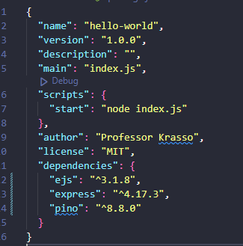
Project setup contd.
Example package.json:

Slide 9
Project setup contd.
Create a new file named index.js
Add imports for express, path, and pino/morgan
Create an Express application and put it inside a variable named app
Set the view engine to ejs
Tell express that the views (ejs pages) are in a folder named views
Create a variable for PORT and give it the value process.env.PORT || 3000
Create a route for the root of the application and return the index.ejs view

Slide 10
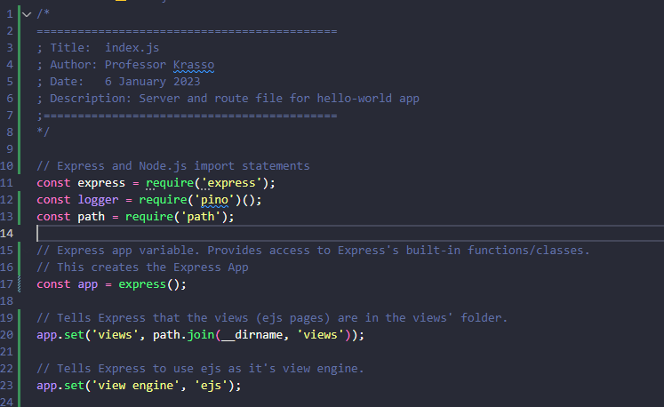
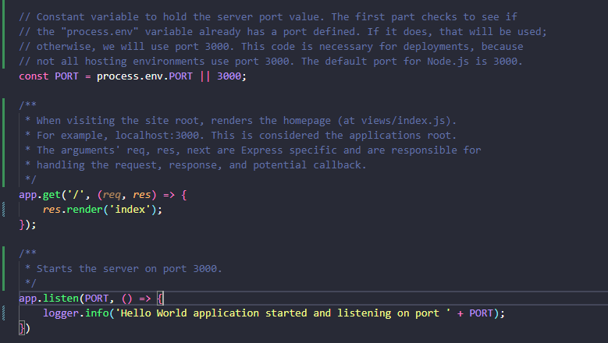
Project setup contd.
Example: index.js

Slide 11
Project setup contd.
Add a folder named views to the root of your project
Add a file named index.ejs inside the views folder
Add an h2 tag with a value of “You are now in <Your Last Names> world!”

Slide 12
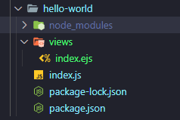
Project setup contd.
Example: folder structure:

Slide 13

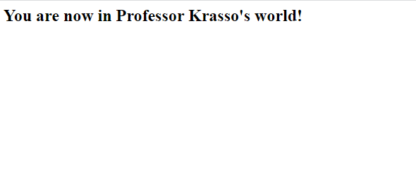
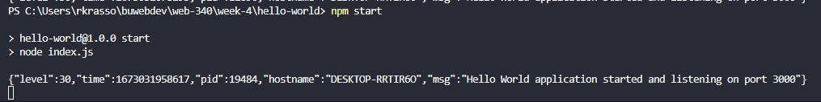
Project setup contd.
Example: index.ejs

Slide 14
Additional Resources
hello-world (full solution from the project setup slides): https://github.com/buwebdev/web-340/tree/master/week-4/hello-world
hello-views: https://github.com/buwebdev/web-340/tree/master/week-4/hello-views
hello-routes: https://github.com/buwebdev/web-340/tree/master/week-4/hello-routes

Slide 15
Additional Resources contd.
To test the projects in the courses GitHub repository:
Clone or download the repo
Open a new terminal window and CD into the directory where the projects are saved
Run the npm install command
Run the npm start command
You can view each of the projects code base by opening them in VS Code

Slide 16
Pets-R-Us Project
Assignment 4.2 includes a link to the solution I built for the Pets-R-Us project
Your solution will look different, but the features and functionality will be the same
This is a “final solution”
I am providing a link to the final solution so you can have an idea of what you will be building throughout the remaining weeks in this course

