Slide 1
WEB 340 Node.js
Week 8 – Advanced Forms

Slide 2
Objectives
During this week, you will learn:
How to create advanced forms in Express
JSON data type
Reading data from a JSON file

Slide 3
JSON
Stands for JavaScript Object Notation
Lightweight format for storing and transporting data
Often used in websites to send data between a server and web page
Used heavily in JavaScript full-stack applications
Easy to understand and follows a key/value pair format

Slide 4
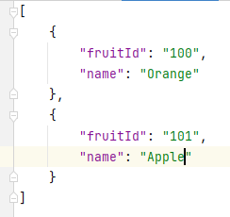
Reading data from a JSON file
To read data from a JSON file, use the Node.js built-in fs.readFileSync function:
First read the file and store it in a variable: let jsonFile = fs.readFileSync(‘./public/data/services.json’);
Next, parse the file into an array: let services = JSON.parse(jsonFile);
To create a JSON file use the following format:

