Slide 1
WEB 340 Node.js
Week 6 – Data Persistence

Slide 2
Objectives
During this week, you will learn:
What databases are
What Relational Databases are
What NoSQL is
How work with Mongoose in an Express application

Slide 3
Databases
Popular database that’s wiggled its way into the arms of many Node.js developers (Hahn, 2016)
In general, web applications store their data in one of two kinds of databases: relational or non-relational (Hahn, 2016)
Relational databases store data in table structures that resemble spreadsheets
Tables are constructed with rows and columns

Slide 4
Databases contd.
Columns represent the field type (i.e., first name, last name, or address)
Rows represent the row data
Non-relational databases are called NoSQL databases because they typically do not use traditional SQL (Structured Query Language) queries

Slide 5
NoSQL
In general, most NoSQL databases are a lot like JavaScript because they are less ridged and more flexible
Most applications have one database, like MongoDB and these databases are hosted on servers (Hahn, 2016)
Servers are located in a companies server farm or hosted by third-party cloud providers
Examples of third-party cloud providers are: MongoDB Atlas, Digital Ocean, and AWS
A MongoDB server can have many databases on it

Slide 6
NoSQL contd.
Best practices suggest, one database should be used per application
Most organizations follow one of two strategies: many MongoDB instances on one server or one MongoDB instance per server
Cost plays an important role in either implementation
MongoDB databases should be clustered across multiple servers
To access a MongoDB database, the server sends requests to it through an API and database connection string

Slide 7
MongoDB
Client libraries, referred to as database drivers, are the APIs developers use to manipulate data in a database
MongoDB is structured by documents and collections
Each collection is comprised of documents
Documents represent the data structure and identify the fields in the object (i.e., first name, last name, address, etc.,)

Slide 8
MongoDB contd.
Documents are similar to JSON in structure, but are actually called BSON data structures
If it is valid JSON, it is typically valid BSON
Think of MongoDB collections as an Excel workbook and documents as the Excel spreadsheets in the workbook
Or, better yet, think of MongoDB collections as a filing cabinet and files in the cabinet as documents

Slide 9
MongoDB contd.
Web 340 introduces MongoDB to save data in the Pets-R-Us application
This is not a database course; Web 335 is
This course does not cover database features or advanced topics
This course assumes you have limited to no experience with database technologies

Slide 10
How to get your database connection string?
Sign in to MongoDB Atlas -> Open the “Overview tab”
Select the “Connect” button
Choose the “Connect your application” option
Copy the string value under bullet point 2
Make sure you read the comments under the string value
It explains what you will need to replace in the connection string
Skipping past this part will cause errors in your project

Slide 11
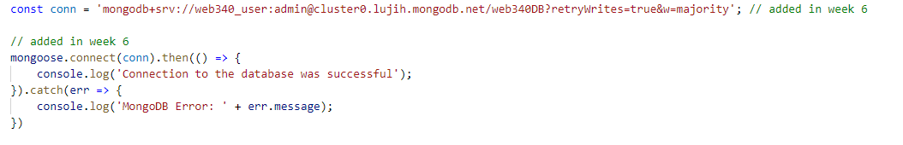
How to get your database connection string?
For the username and password, use the credentials you created following the MongoDB Atlas guide
Example:
Special note. Your application will generate errors if you did not follow the instructions under the pop-window when you copied the connections string from MongoDB Atlas

Slide 12
Mongoose
Object Data Modeling library for MongoDB
NPM Package
Manages the relationships between MongoDB and Node.js
You write code in Node.js and Mongoose translates the code to MongoDB queries
Abstracts developers from MongoDB (as long as you know JavaScript you are fine)

Slide 13
Mongoose contd.
Provides a straight-forward, schema-based solution to modelling your applications data and includes built-in type casting, validation, query building, business logic, and more, out of the box (Hahn, 2016)
Easy to learn
Great for Node.js developers

Slide 14
Mongoose setup
Step 1: install mongoose
Step 2: define a mongoose model
Step 3: export the model
Step 4: import the model using a require statement

Slide 15

Mongoose setup contd.
Every mongoose model needs a Schema, which is essentially the structure of the data you are creating (i.e., fields: first name, last name, address):
Every mongoose model needs to be exported as a mongoose model

Slide 16
Mongoose setup contd.
Most used data types and constraint:
Data types: String, Number, Date, Boolean
Constraints: unique, required, default
Default can be used as follows:
createdAt: {type: Date, default: Date.now }
Unique sets the property to only accept unique values
Required sets the property to a required field

Slide 17
Mongoose queries
find
findOne
Create
findByIdAndDelete
findByIdAndUpdate

Slide 18
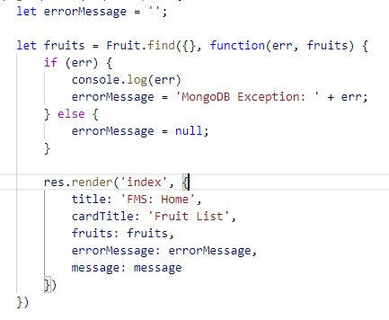
Mongoose queries contd.
Example: find()

Slide 19
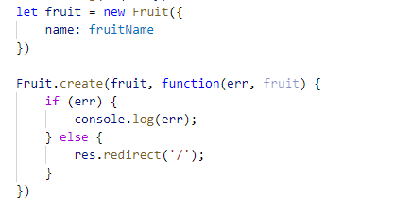
Mongoose queries contd.
Example: create()

Slide 20
Mongoose queries contd.
The find function returns an collection of documents
Called off of the model you import (i.e., const Fruit = require(‘./models/fruit’);
Returns a callback function, which includes a MongoDB specific error object or a collection object
Fruit.find({}, function(err, fruits) {})
The first argument is for filtering
The second argument is the callback function
The first argument in the callback function is the MongoDB error object
The second argument in the callback function is the collection object

Slide 21
Mongoose queries contd.
The create function returns the inserted document
Called off of the model you import
Returns a callback function, which includes a MongoDB specific error object or the collection object
Requires an object literal
Fruit.create(newFruit, function(err, fruit) {})
The first argument is a new fruit object (object literal), second argument is the callback function
The first argument in the callback function is the MongoDB error object
The second argument in the callback function is the inserted fruit object

Slide 22

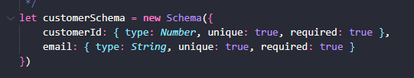

Account registration (pets-r-us)
Import mongoose and create a variable to hold the mongoose schema object
Define the customer schema with fields for customerId and email
Export the schema as a mongoose model

Slide 23
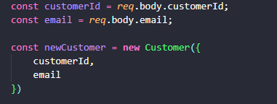
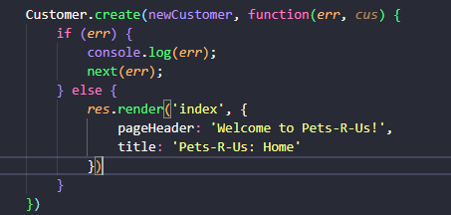
Account registration contd.
To add a new customer to MongoDB, you will first need to create a new customer object literal
Next, call the create() function on the mongoose model

