Slide 1
WEB 340 Node.js
Week 3 – Modules

Slide 2
Objectives
During this week, you will learn:
How to work with modules in Node.js
JavaScript script mode
Asynchronous programming and callbacks
Promises
Async/await

Slide 3
JavaScript classes
To create a class in JavaScript, you use the keyword class followed by opening and closing curly braces
class Person {}
Methods are the functions inside of a class
getFirstName() {}
getLastName() {}
Properties are the fields inside of a class
firstName
lastName

Slide 4
JavaScript classes contd.
Constructor is a special method assigned to all classes and is used to initialize an object created with the class keyword
let me = new Person();
It is common practice to initialize a new class with class properties through the constructor
For example, lets say we had a Person class with properties for firstName and lastName
To initialize the class with its properties we would add arguments to the constructor for firstName and lastName and in the body of the constructor we would set them to the properties firstName and lastName

Slide 5
JavaScript classes contd.
The purpose of initializing a classes properties in its constructor is to restrict access to the properties
Properties defined in the classes constructor must be supplied as arguments when initializing the class
Constructor arguments behave identical to function/method arguments
They are placeholders for data and can be named whatever you like
Names should be easy to remember and descriptive: firstName, lastName, address
Do not use names like param1, param2, param3

Slide 6
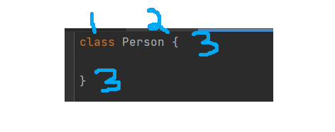
JavaScript classes contd.
Below is an example of a Person class:
1. Defines the class using JavaScript’s built-in keyword “class”
2. Name of the class being created
3. Everything inside of the opening and closing curly braces are referred to as the “body of the class”

Slide 7
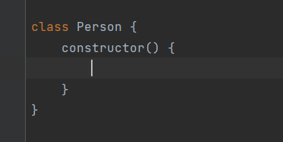
JavaScript classes contd.
Below is an example of a Person class a default constructor

Slide 8
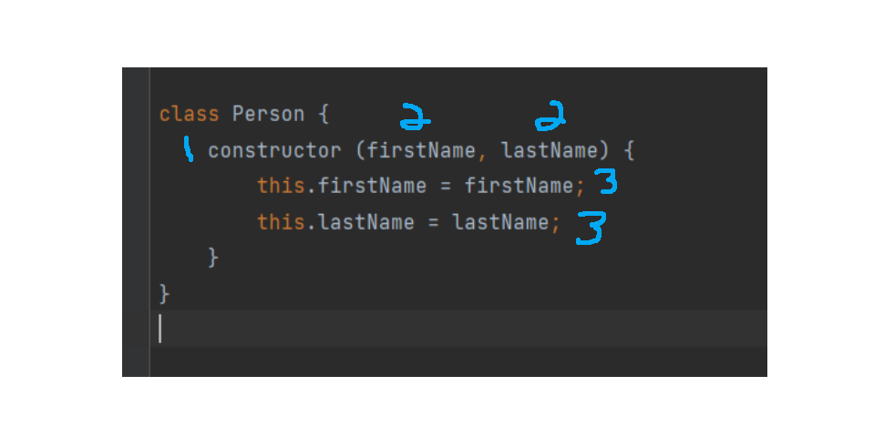
JavaScript classes contd.
Below is an example of a Person class with two properties: firstName and lastName
Properties are initialized through the constructor

Slide 9
JavaScript classes contd.
The following explanation references the previous slide
1. JavaScript keyword is used to identify the method as a constructor
2. Parameters for the constructor method
Parameter names can be named whatever you like; make sure they are descriptive and easy to remember
3. Class properties
As with parameters, class properties can be named whatever you like

Slide 10
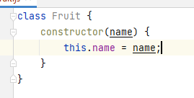


JavaScript classes contd.
Defined with the JavaScript keyword “class”
All classes include a default constructor
Fields can be initialized in the classes constructor
To create an instance of a class, use the “new” keyword

Slide 11
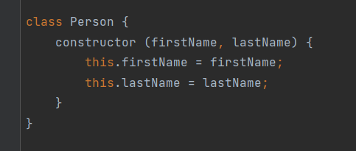
JavaScript classes contd.
The term “initialize the classes properties/fields in the classes constructor” is demonstrate in the following code snippet

Slide 12
JavaScript functions
Block of code designed to perform a task
Different than class methods
Functions inside of a class are called methods
Functions built outside of a class are called functions
Executed when invoked (sometimes referred to as “called”)
The parentheses may include zero or more parameters, separated by commas
Code is executed in the body of the function (inside the curly braces)

Slide 13
JavaScript functions contd.
Function arguments are the values received by the function when they are invoked
let myName = name(‘Professor Krasso’)
“Professor Krasso” is an argument passed to a function named “name”

Slide 14
JavaScript arrays
Below is an example of how to create a String array

Slide 15

JavaScript arrays contd.
Below is an example of how to create a number array

Slide 16
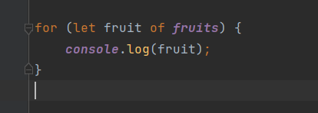
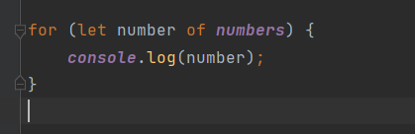
JavaScript arrays contd.
Below are examples of how to use a for…of loop to display the contents of the arrays created in the previous two slides

Slide 17
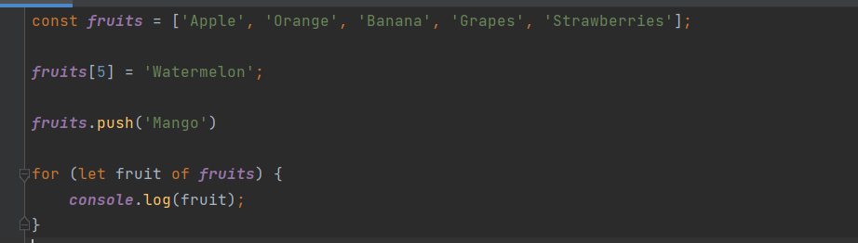
JavaScript arrays contd.
Below is an example of how to add values to an string array

Slide 18
JavaScript arrays contd.
In the previous slide, the second line of code adds a new fruit item to the fruits array by index
In Web 231 you learned that arrays are 0 indexed objects
Meaning the first element in the array starts at index 0
Of the two options illustrated in the previous slide, JavaScript's built-in .push() function is the preferred approach for adding items to an array

Slide 19
JavaScript arrays contd.
The preceding slides are intended to demonstrate how to work with objects in an array
As you review the next couple slides pay close attention to how objects are added to each array
To get the most out of this presentation you are encouraged to write the code in a program and test it

Slide 20
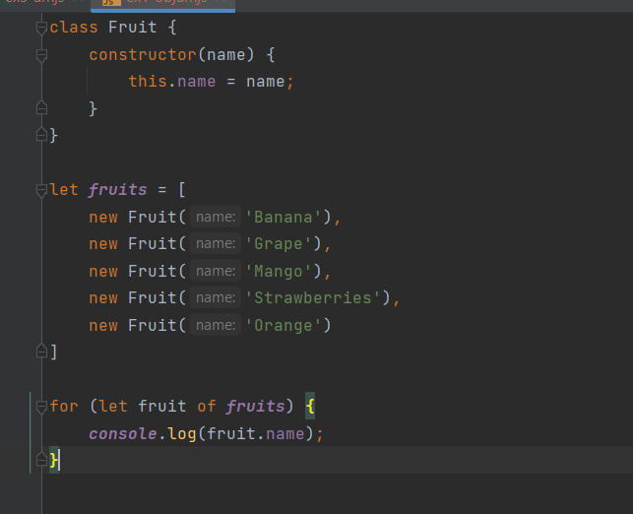
JavaScript object array

Slide 21
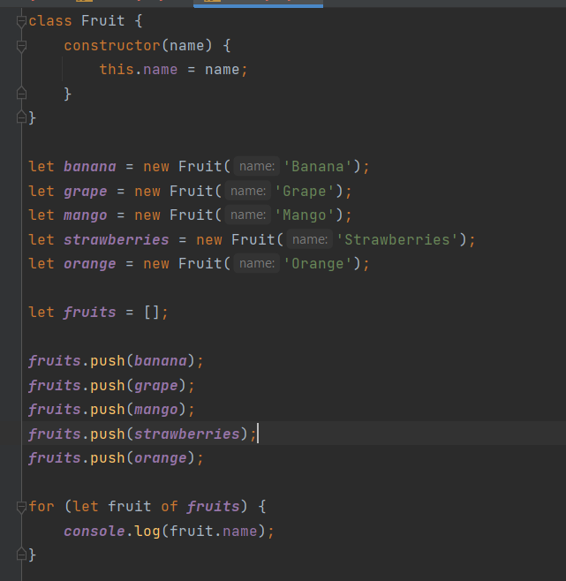
JavaScript object array contd.

Slide 22
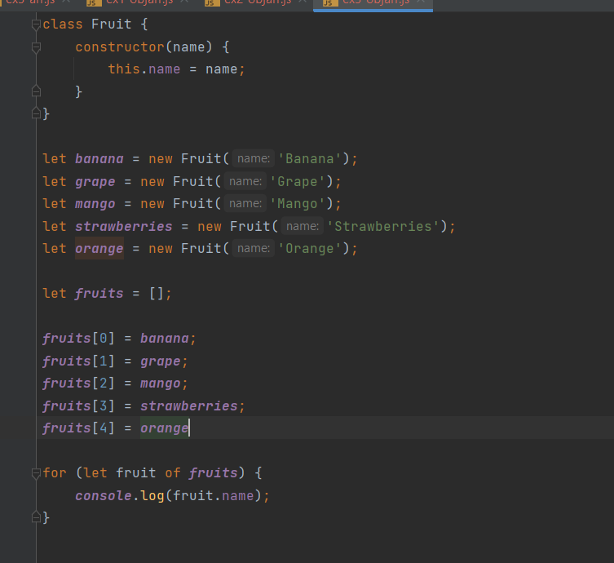
JavaScript object array contd.

Slide 23
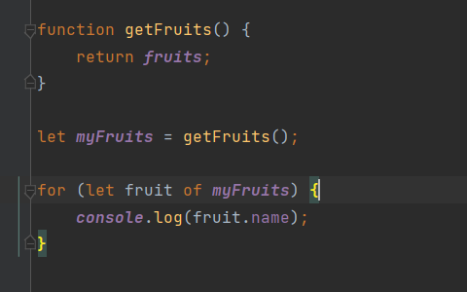
JavaScript object array contd.
The following example illustrates how to create a function that returns an array of objects

Slide 24
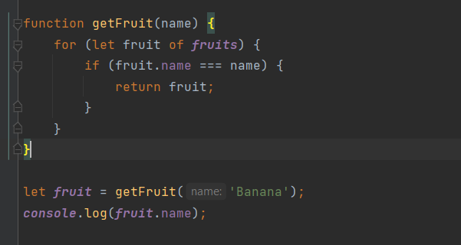
JavaScript object arrays contd.
The following example illustrates how to return a single object from an array of objects by argument

Slide 25
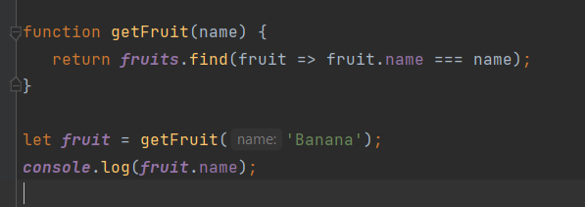
JavaScript object arrays contd.
The following example illustrates how return a single object from an array of objects by argument using JavaScript’s built-in find() function

Slide 26
Node modules
Designed to allow the reuse of objects, classes, and functions
Most programming languages have a way of sharing code between multiple files
Referred to as code splitting
Implements a standard module called CommonJS, which allows you to include code form one file to another (Hahn, 2016)
Do not confuse Node modules (CommonJS) with ES Modules (what you are learning in Web 231 and Web 330)

Slide 27
Node modules contd.
Multiple components to this file system: built-in modules, third-party modules, and custom modules (Hahn, 2016)
Two options for exporting classes, objects, and functions
module.exports and exports
Recommended approach is to use module.exports
exports points to module.exports
It is a variable derived from the modules object

Slide 28
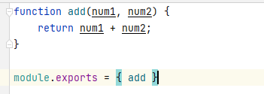
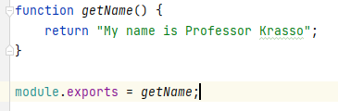
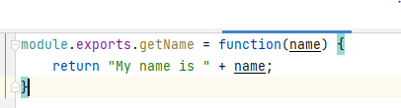
Node modules contd.
Exporting a module example:

Slide 29
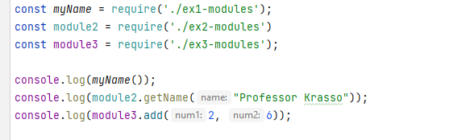
Node modules contd.
Importing an exported module example:

Slide 30
Guestbook (chp. 3.5)
Add the NPM packages: nodemon, morgan, express, and ejs
Rename the app.js file to index.js
Update the scripts in the package.json file:
“start”: “node index.js”
“dev”: “nodemon index.js”
In the index.js file: add imports for express, path, and logger to the index.js file
In the index.js file: replace app.set(“views”, path.resolve(__dirname, “views”)) with app.set(‘views’, path.join(__dirname, ‘views’));
Replace all references to var with const and let (all files)

Slide 31
Guestbook (chp. 3.5) contd.
In the index.js file: replace app.use(bodyParser.urlencoded({extended: false})); with app.use(express.urlencoded({extended: false}));
In the index.js file: create a const variable named PORT and assign it the following value
process.env.PORT || 3000
In the index.js file: replace the property “content” from the entries.push() call in the app.post(‘/new-entry’) route with “body”
In the index.js file: replace http.createServer(app).listen(3000, function() {} with app.listen(PORT, () => { console.log(‘Guestbook app started on port: ‘ + PORT) })

Slide 32
Guestbook (chp. 3.5) contd.
Replace references to <% include header %> and <% include footer %> with <%- include(‘header.ejs’) %> and <%- include(‘footer.ejs’) %>
References are in the index.ejs, 404.ejs, and new-entry.ejs files
In the new-entry.ejs file where the <form> is defined add an attribute for action and give it a value of /new-entry
action=“/new-entry”

Slide 33
Guestbook (chp. 3.5) contd.
In the new-entry.ejs file look for the label for the “Entry Text” input field and replace the for=“content” attribute with for=“body”
If you have extra time, try updating the Bootstrap version to 5 and updating the HTML classes to reference the latest CSS classes in Bootstrap 5
This is not a requirement, but it could be a fun exercise and it will teach you how to update CSS versions in a web application

