Slide 1
Presentation 1.2 The Technology Value Stream
Shane Hingtgen
5/24/23
Bellevue University

Slide 2
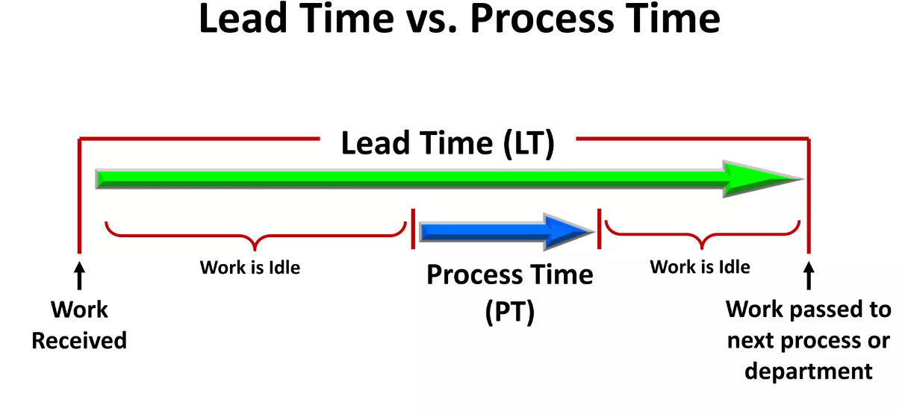
Lead Time Vs Process Time
Part of the LEAN process
Two measures for value streams
Lead Time
Processing time
Lead time starts once work is received
Process time starts when work actually begins
(TKMG INC, 2016)

Slide 3



Lead Time Vs Process Time
Lead Time:
Defined as the time it takes from the start of the job until the job is finished
Is calculated by the amount of days needed for materials, other goods then the delivery of the final commodity
Errors in the process/manufacturing, lack of raw goods or not enough workers or accidents can impact time
Can be improved with Just In Time strategies (Kenton, 2022)

Slide 4

Lead Time Vs Process Time
Process Time:
Is about the time needed to create the product
Is able to judge the rate of completion of product

Slide 5
Lead Time Vs Process Time
It is a way to measure the efficiency of a job
To get faster with a shorter lead we would need to lower the amount of time jobs are in queue (Kim et al., 2016)

Slide 6

The Common Scenario: Deployment Lead Timers Requiring Months
Often times teams of developers can experience a lengthy lead time
Long lead times are very common if the organization is large
Or needs lots of manual testing and stages of approval (Kim et al., 2016) Can also be slowed by a manual deployment of software (Levy, 2019)

Slide 7
The Common Scenario: Deployment Lead Timers Requiring Months
Common items that increase lead times:
The amount of testing that is manual
Deploying software releases manually
A lengthy handoff process
Overly cumbersome approval processing

Slide 8
The Common Scenario: Deployment Lead Timers Requiring Months
Improving Lead Time:
Lowering the amount of handoffs
Consider automating the handoff work
Since manual software testing is slow, begin automating all or most of the testing (Levy, 2019)
Consider an automatic deployment of software
For organizations that automate deployment “It is not uncommon for organizations to see deployment lead times reduced by over 90%.” (Levy, 2019)

Slide 9
Our DevOps Ideal: Deployment Lead Times of Minutes
Its important for developers to quickly receive feedback (Kim et al., 2016)
The feedback is helpful for “them to quickly and independently implement, integrate, and validate their code” (Kim et al., 2016)
Always check the smaller changes of code (Kim et al., 2016)
And do an automatic code check to test it

Slide 10
Our DevOps Ideal: Deployment Lead Times of Minutes
Another thing to do is create things that are modular
This allows it to easily to be tested automatically (Kim et al., 2016)
Allows the bugs to be contained easier
Will not make the entire software fail causing disruptions to clients productions (Kim et al., 2016)

Slide 11
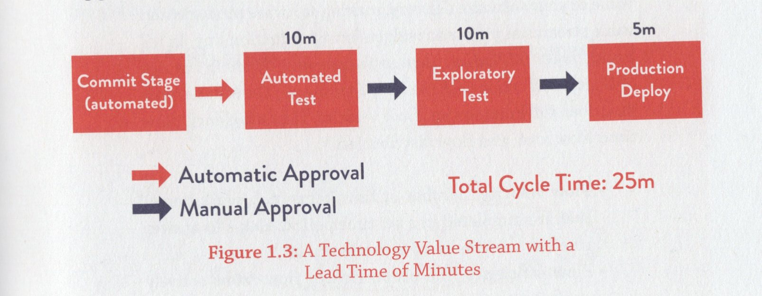
Value Stream Map
(Kim et al., 2016)
A Value Stream Map is a tool for LEAN
It’s a flowchart that has time measurements
Allows you to test the process time
Maps out different steps of approvals/auto tests etc

Slide 12
References:
TKMG INC. (2016, October 27). Lean Leadership - Part 3 of 3. SlideShare. https://www.slideshare.net/KarenMartinGroup/lean-leadership-part-3-of-3-67838100#30
Kim, G., Debois, P., Willis, J. O., & Humble, J. (2016). The DevOps Handbook: How to Create World-Class Agility, Reliability, and Security in Technology Organizations. https://dl.acm.org/citation.cfm?id=3044729
Verma, E. (2023, May 24). Understanding TAKT Time and Cycle Time vs. Lead Time. Simplilearn.com. Retrieved May 24, 2023, from https://www.simplilearn.com/time-confusion-cycle-time-takt-time-lead-time-part-1-article
Kenton, W. (2022, September 8). Lead Time: Definition, How it Works, and Example. Investopedia. Retrieved May 24, 2023, from https://www.investopedia.com/terms/l/leadtime.asp
Levy, M. (2019, September 24). 5 Causes of Long Lead Times in Software Delivery. dzone.com. Retrieved May 24, 2023, from https://dzone.com/articles/the-5-longest-lead-times-in-software-delivery

