Slide 1


Cybersecurity Group
1/20/2026
Android Debug Bridge

Slide 2
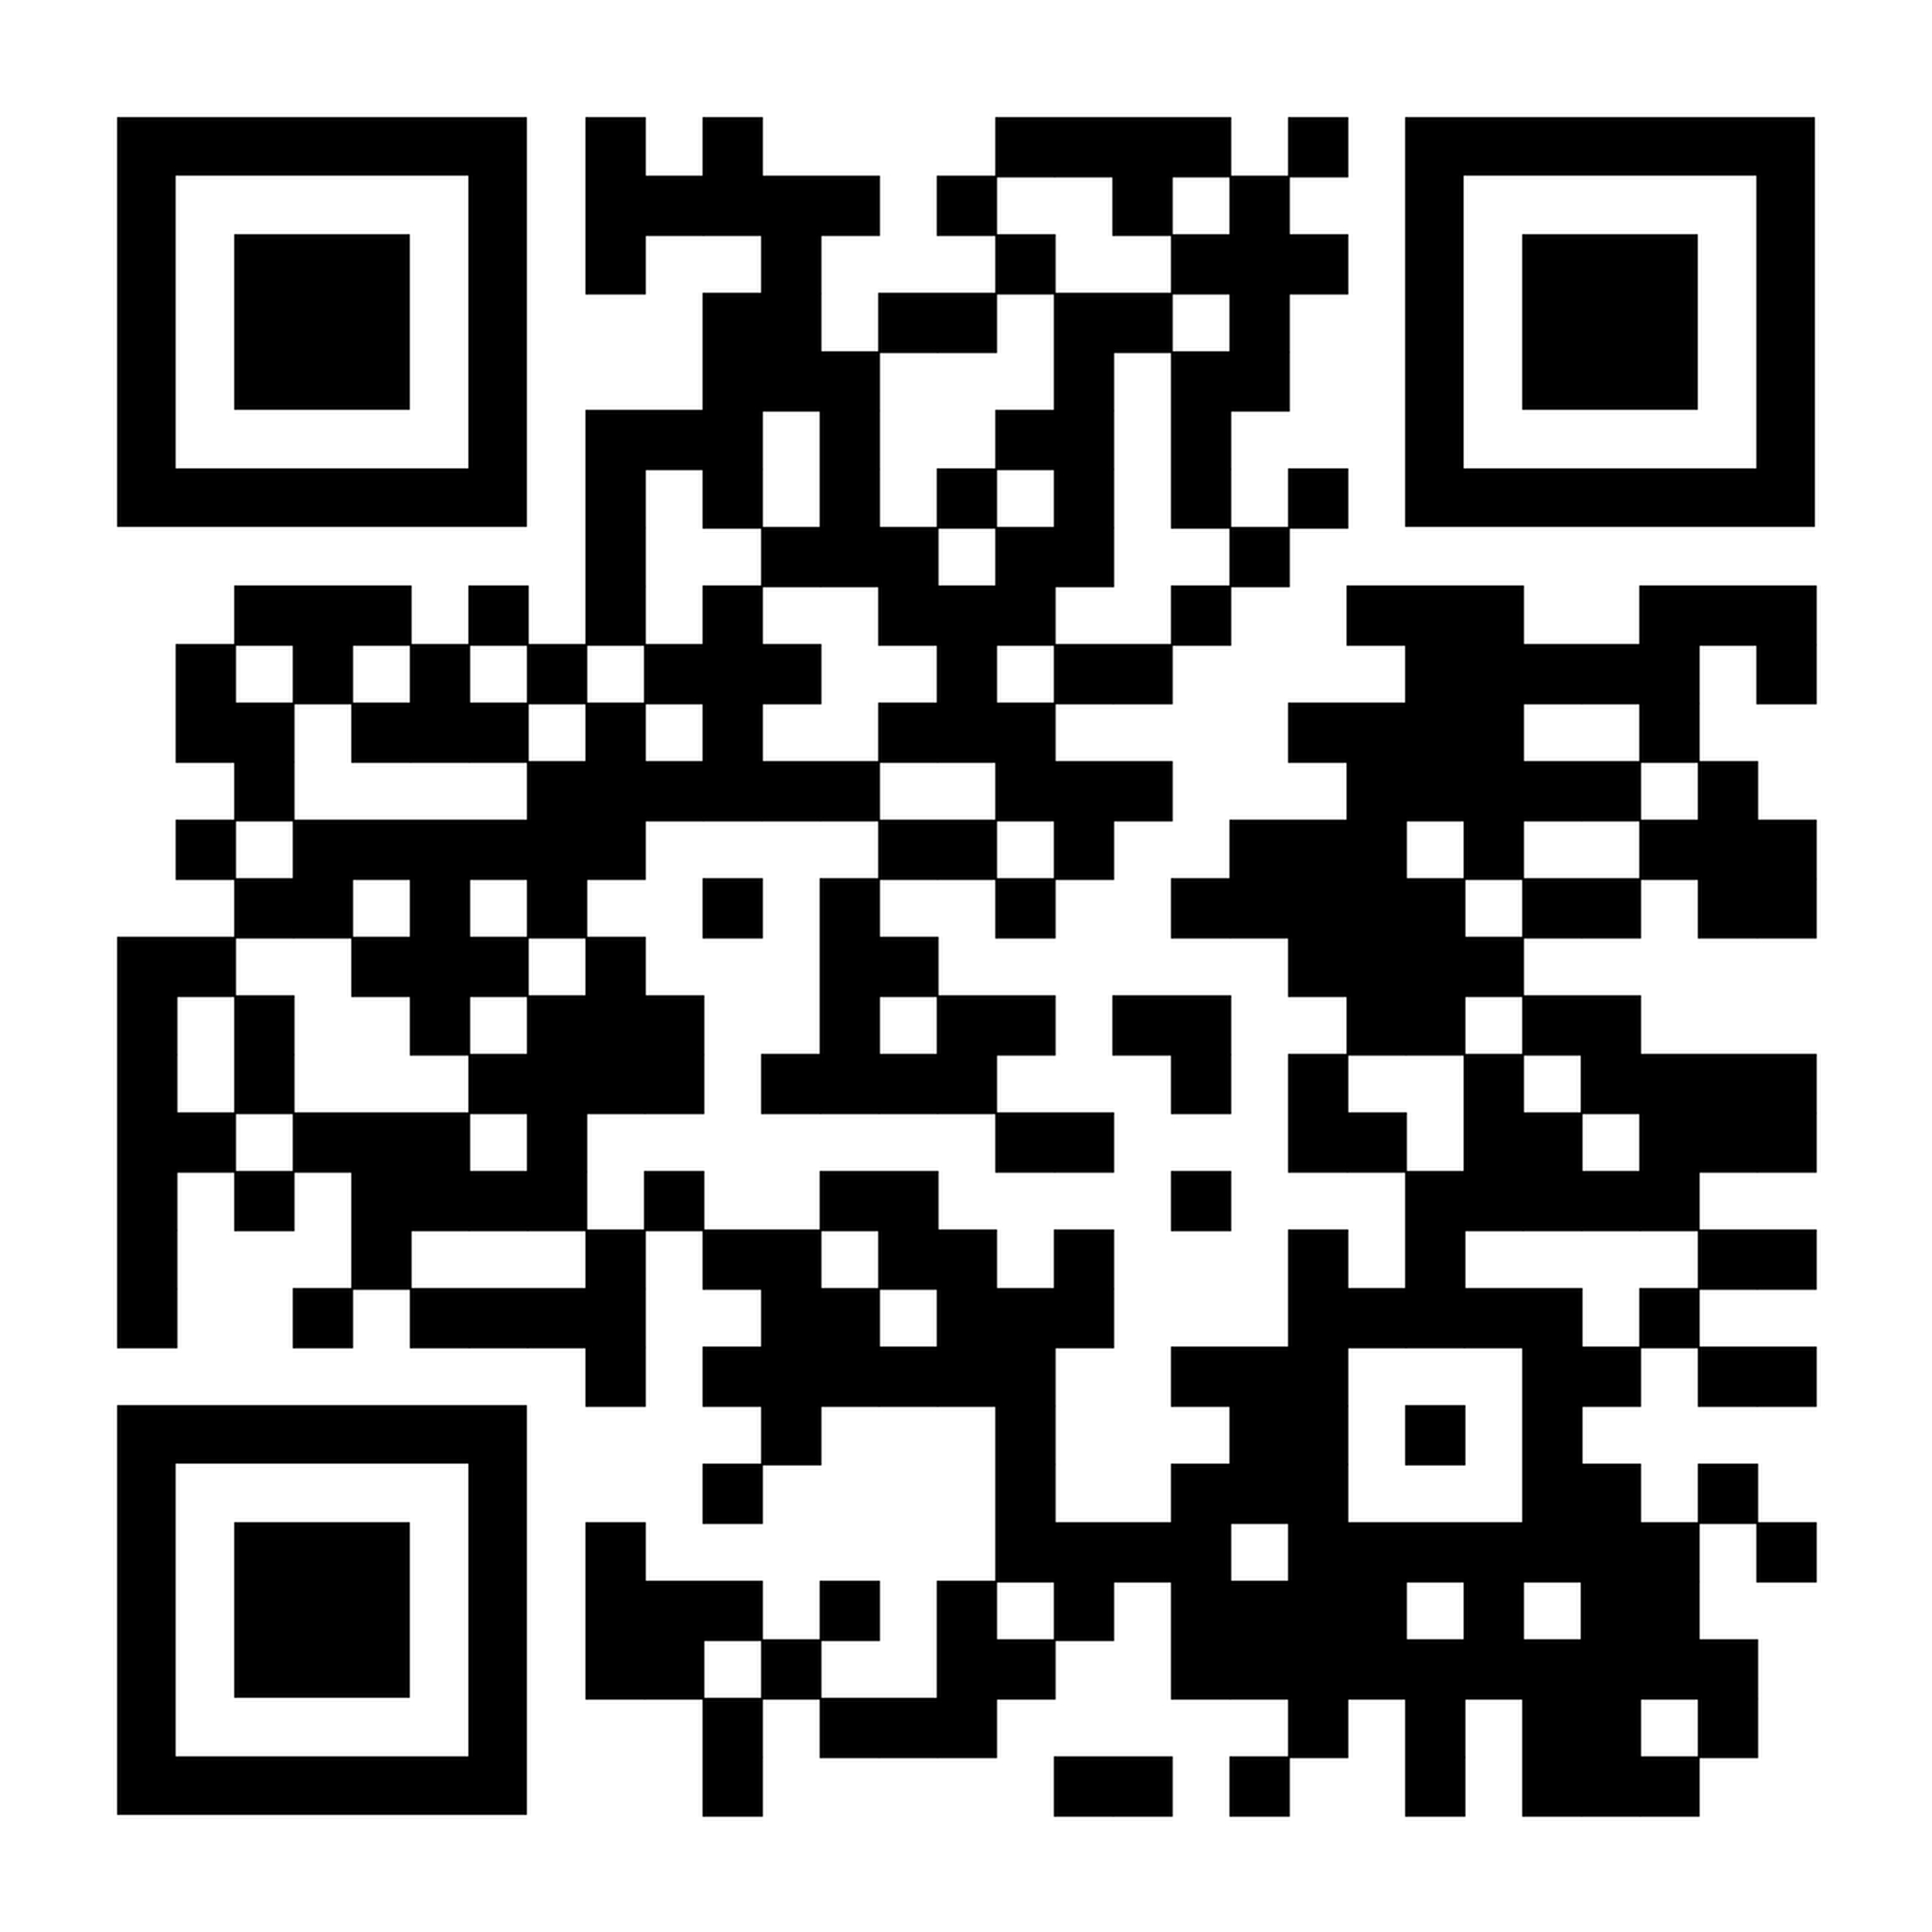
Attendance Form
Please fill out this form each time you attend a CSG meeting.
This helps us get attendance numbers for funding and other RSO purposes.
For those in CySER, this tracks your club attendance requirement.

Slide 3
!! DISCLAIMER !!
The information presented in this lecture is for educational purposes only.
CSG is not responsible for your use of the material introduced in this lesson. Misuse of these skills can lead to severe legal consequences, and viewers are responsible for ensuring their own compliance with the law.
But we are all here to here to learn! If you are unsure how to use something, ask for help before proceeding!

Slide 4
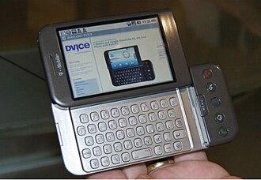
What is Android?
An operating system for mobile devices based on the Linux kernel
Despite using a modified Linux kernel, it debatably shouldn’t be considered truly Linux. There’s no default root access, it doesn’t really use GNU software, and most retail Android has proprietary code
The world’s most widely used operating system
D

Slide 5
Who created Android?
Android Inc. was created by a group of experienced Californian mobile developers in 2003.
They failed to secure investment for their digital camera operating system, so pivoted to creating a smartphone operating system to compete with Symbian and Windows Mobile (Which are both now defunct)
By 2005, the company had been acquired by Google for $50M in what their VP later called their "best deal ever."
In 2007 the “Open Handset Alliance” (Google, Motorola, Samsung, Sprint, T-Mobile, Qualcom) announced they were going to standardize an open source mobile OS
The “Android Open Source Project” was launched: the OS would be developed by Google, but be open source. They also defined compatibility guidelines to work in this new ecosystem (compatibility test suite)
Google used to literally have two branches for their Android source code, but that caused issues when merging private to public. Now they only release it at launches

Slide 6
Android Debug Bridge
Wired ADB
Paired Wireless ADB
Part of the Android Software Development Kit
Copy files to and from host computer, view logs, open a shell, etc.
Runs as daemon (background process)
Host (PC) starts ADB server listening on TCP port 5037
Upon ADB client request, scans USB and establishes connection with adbd
Prompts device user for authorization
On first connect, if device agrees, the client’s public key is stored. Otherwise signature checked (RSA)
ADB connection established
When prompted by user, device opens random pairing port for ADB and generates pairing code
Host on same network (or SSH, or VPN) runs pairing command and enters code
RSA and user authorization
Pairing port is closed and connection is established on a port automatically chosen by the device (TCP)

Slide 7
Historical Problems With ADB
Android <4.1: No authentication system, sometimes on by default, fixed wireless ADB port of 5555. Very vulnerable to scanning
Android 4.2 - 10: RSA and user authentication required, wireless port can be changed (still defaults to 5555). But no transport encryption, and ports would stay listening once opened. Vulnerable to TOFU MITM
Android 11+: Encrypted traffic, random pairing port and authentication code each time prevents impersonation. But, TCP ports can still be manually exposed

Slide 8
Examples of Exploitation
RageAgainstTheCage(1.6-2.2): By reaching max process limit, ADB will fail to drop privileges and run as root
Modem Takeover(2017): PC malware and ADB-enabled phone allow attackers to use PC ADB to boot phone into modem diagnostics
Botnets: Too many to name. Often fixed port and known CNXN packet made it easy to scan for open ADB connections. Android cloud emulation often ran as root. IoT Android forks often don’t have the same protections or are misconfigured

Slide 9
ADB ”””Evil Maid Attack””” Demo
ADB vulnerabilities on properly configured modern smartphones are basically gone, mainly IoT is vulnerable nowadays
But here’s a contrived way you could maliciously use ADB (if the stars aligned)
Moral of the story: don’t enable dev options on Android

Slide 10


Thank you!
Discord Server
Instagram
Questions?

