Slide 1
Intro to Windows Communication Foundation
Tim Rayburn, Principal Consultant
Microsoft MVP

Slide 2
WCF Design Goals
Service Orientation
Thinking Long-Term
Adapting to Change
Interoperability
Heterogeneity
Existing Applications
Unification
Programming Model
Developer Experience
Increase Reuse
Loose Coupling
Protocols, Formats and Standards
Simplifying Landscape
Choice vs Complexity

Slide 3
Service Orientation: Tenets
Boundaries are explicit.
Services are autonomous.
Share schema and contract, not implementation or type.
Policy-based compatibility.

Slide 4
Interoperability
No one company decides how everyone will interact.
Technologies will continue to evolve, and standards will change.
Today we care about:
XML
XSD
WSDL
SOAP
Increasingly we also care about REST

Slide 5
Unification
ASMX & WSE
.NET Remoting
Enterprise Services
System.Messaging
WCF

Slide 6
Why do we care?
Analyze
Design
Develop
Implement
Maintain
CHANGE

Slide 7
WCF is not an SOA…
SOA requires a change in:
Analyzing the companies competencies so that business and IT can agree on what is core.
Designing in such a way that they fit into the company processes.
Developing with tools that enable interoperability.
Implementations that can be reconfigured easily to accommodate explosive growth.
Maintaining the agreements made, and breaking them only when absolutely necessary.

Slide 8
How Departments Interact
Sales
Pick Request
Fufillment
Tracking Receipt

Slide 9
How Systems Interact
ERP
Message
Inventory
Message

Slide 10
The ABCs of WCF
Address
Binding
Contract

Slide 11
The ABCs of WCF
Where
How
What

Slide 12
Types of Bindings
TCP
Basic HTTP
SOAP 1.2
Duplex SOAP 1.2
Named Pipes
MSMQ
REST
POX
Extensibility is the Key!

Slide 13
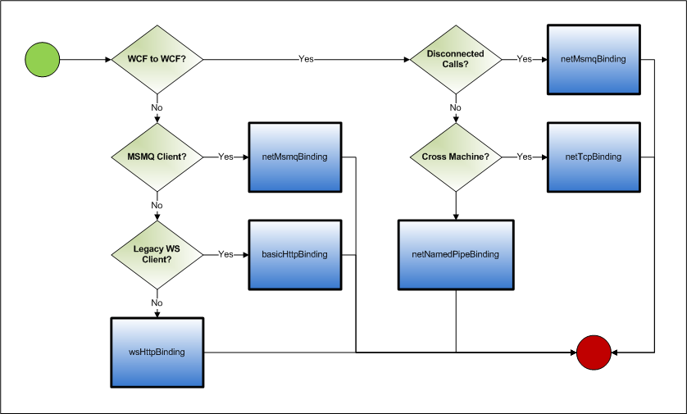
Choosing the Right Binding

Slide 14
DEMO – Creating a Service

Slide 15
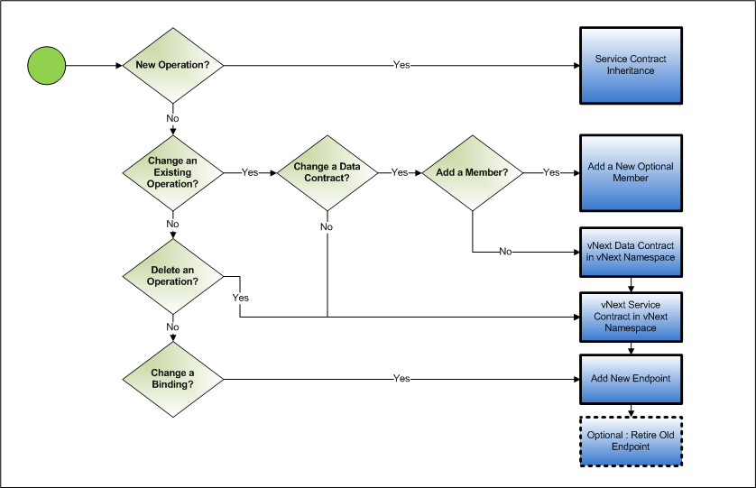
Versioning

Slide 16
DEMO – Versioning a Service
http://TimRayburn.net

