Slide 1
CCOPilot.ai
AI-Native Customer Success Platform for the Mid-Market
Seed Round • Confidential
Shane James
Founder & CEO | 25 years C-suite CS | 2 Fortune 500 exits (IBM, ServiceNow)
Author: "Your Customers Are Lying to You"
Notes:
Keep this to 10 seconds. 'I'm Shane James, 25 years running CS at companies that exited to IBM and ServiceNow. I wrote the book on why CS is broken. Now I've built the software to fix it.'

Slide 2
The Problem
$1.6T
CSMs manage 30-50 accounts with spreadsheets
No AI, no prioritization, no signals
Health scores built on lagging indicators
They report churn, they don't predict it
Annual cost of customer
churn in the U.S.
Expansion revenue dies in Slack threads
No pipeline, no SLA, no attribution
5-6 disconnected tools per CS team
$80-150K/year in fragmented spend
The mid-market is underserved. Gainsight prices out Seed–Series C companies ($50-150K/yr). ChurnZero lacks AI depth. There is no AI-native CS platform built for this segment.
Notes:
Spend 60 seconds here. The key insight: the mid-market CS tooling gap is a $1B+ opportunity that incumbents can't serve because they're architected for enterprise.

Slide 3
Market Opportunity
Why Now
TAM
$4.5B
SAM
AI matured enough to automate CS workflows (GPT-4 class models)
Post-ZIRP era: efficiency > growth at all costs — CFOs demand CS ROI
Gainsight's enterprise focus left a $1.8B mid-market gap
CS teams growing 30% YoY but tooling hasn't kept pace
$1.8B
SOM
Global CS software market
(Gainsight, Totango, ChurnZero, Vitally, etc.)
$180M
SaaS companies Seed–Series C
with 5+ CSMs, $1M-$50M ARR
U.S. mid-market SaaS
Year 1-3 addressable
Notes:
VCs care about timing. The 'Why Now' is: AI capabilities hit the threshold needed for CS automation in 2024, and post-ZIRP economics make efficiency tools mandatory. This is a market timing play.

Slide 4
The Solution
One AI-native platform that replaces 5-6 tools and gives every CSM a team of 20 AI agents
20 AI Agents
Customer 360
Churn prediction, sentiment analysis,
expansion detection, renewal prep —
all running 24/7
AI-generated customer briefs, health
scores, risk signals, and recommended
actions in one view
CSQL Pipeline
Portfolio Intelligence
CS-sourced expansion revenue with
qualification criteria, 48-hr SLA,
and conversion tracking
Three views: CSM, Manager, Executive.
Dimension analysis, coaching flags,
board-ready dashboards
Notes:
60 seconds. Don't demo — just land the four pillars. The demo comes later if they're interested. Key message: 'This isn't a dashboard. It's an autonomous CS operating system.'

Slide 5
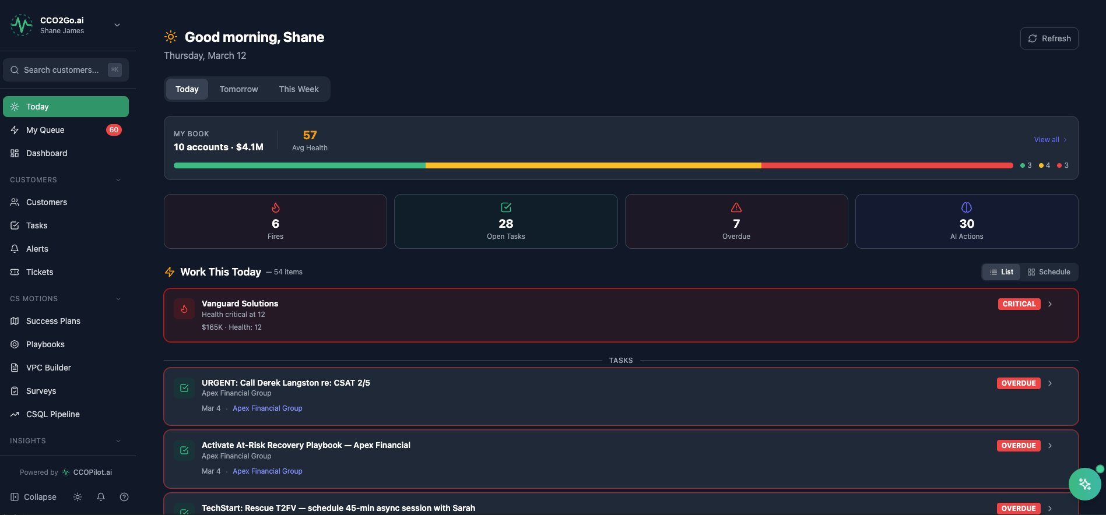
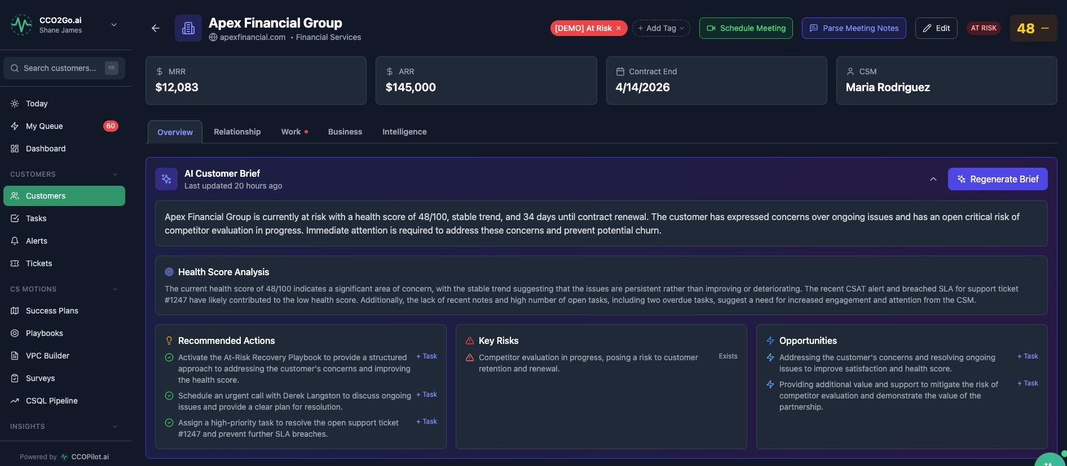
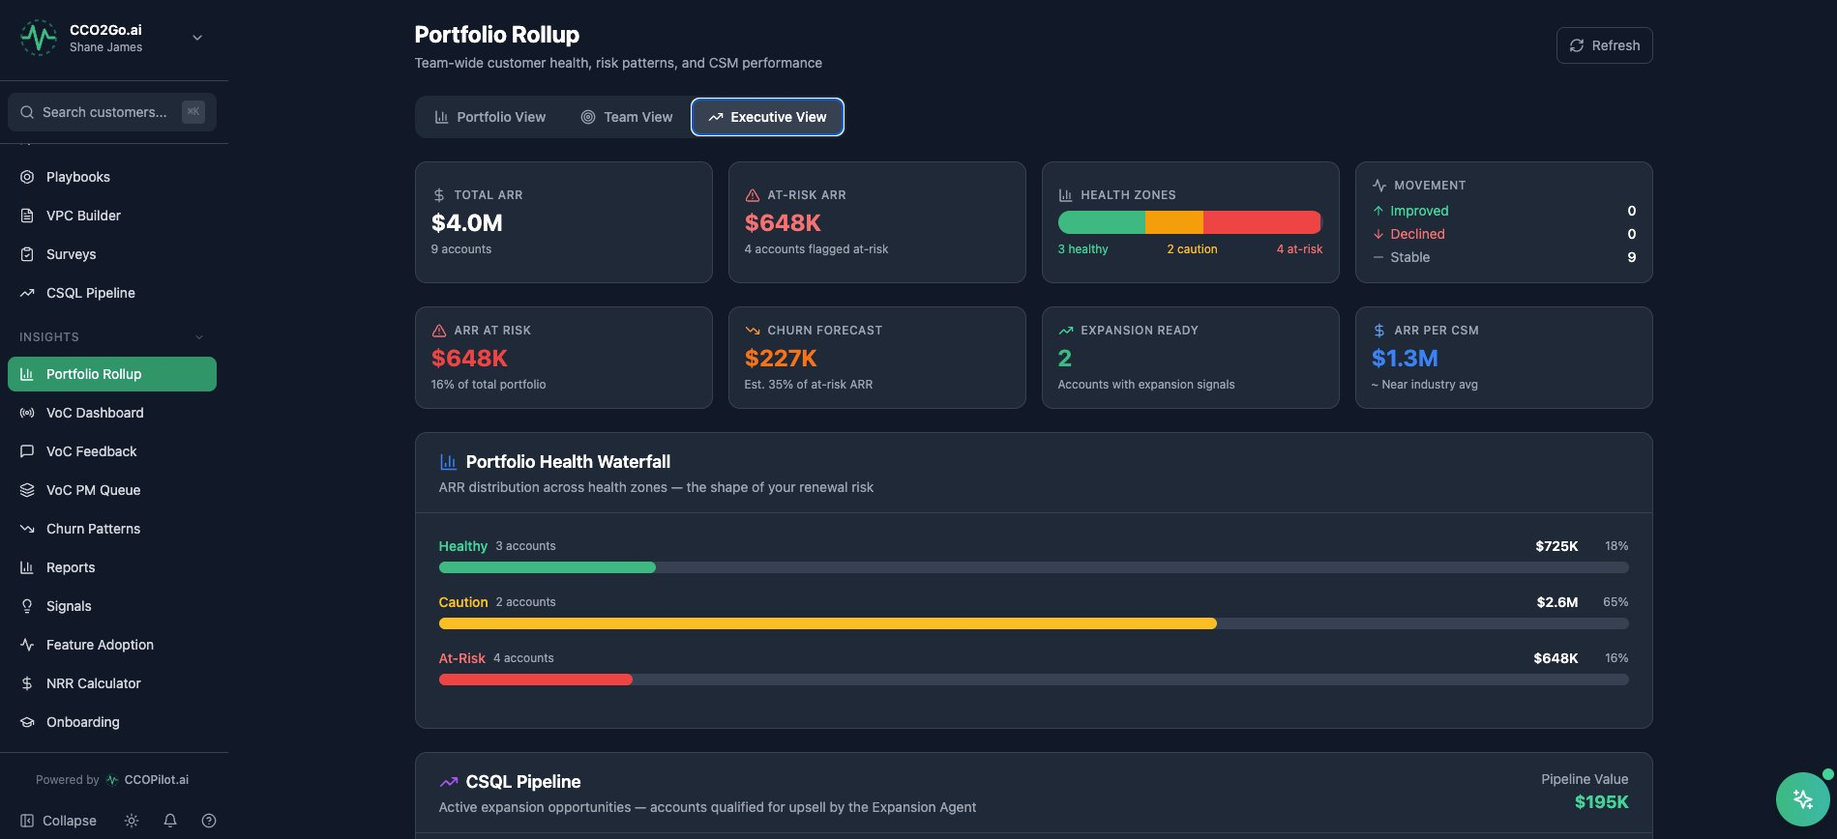
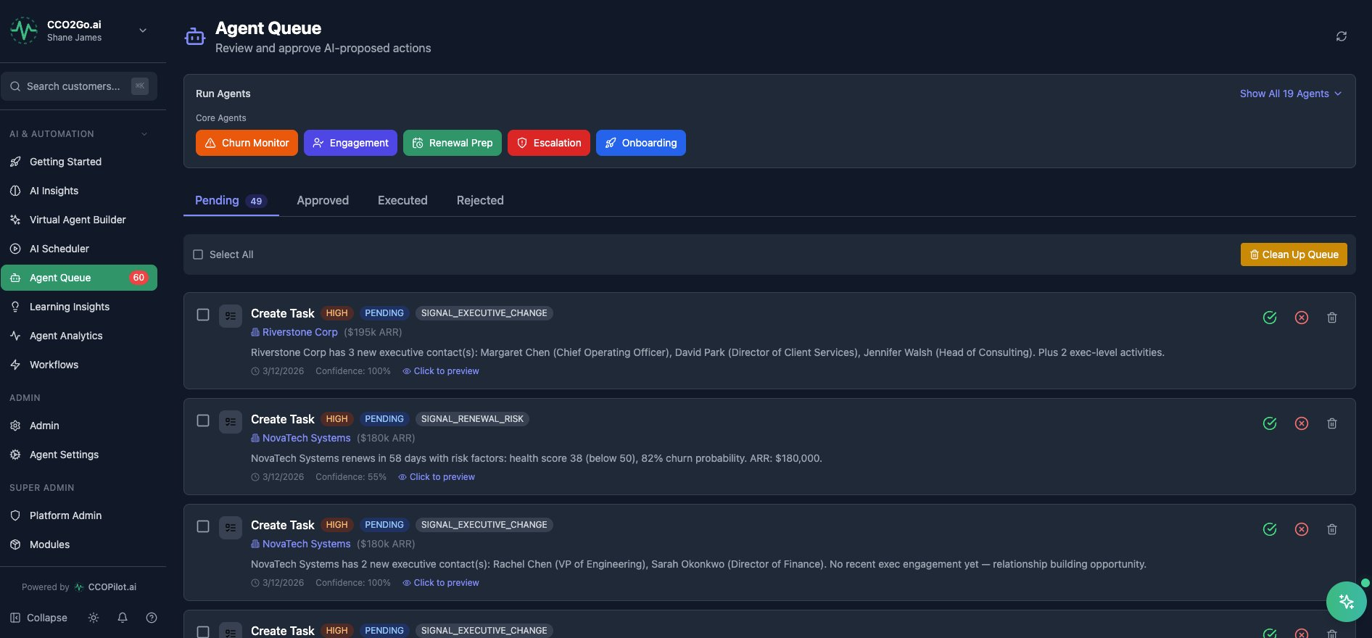
The Product — Built and Live
Not a prototype. Full multi-tenant platform in production at ccopilot.ai
CSM Daily Queue
AI Customer Brief
Executive Dashboard
AI Agent Queue
Notes:
Don't narrate each screenshot. Say: 'The product is live. Here's the CSM daily queue, AI customer briefs, executive dashboards, and the agent queue where AI proposes actions and humans approve. I'm happy to do a full demo after.'

Slide 6
Competitive Landscape
 | CCOPilot | Gainsight | ChurnZero | Vitally
AI Agents (20+) | ✓ | — | — | —
CSQL Expansion Pipeline | ✓ | — | — | —
Churn Pattern Matching | ✓ | Basic | Basic | —
AI Customer Briefs | ✓ | — | — | —
Built-in Ticketing | ✓ | — | — | —
VoC → PM Routing | ✓ | — | — | —
Manager 1:1 AI Prep | ✓ | — | — | —
Mid-Market Pricing | ✓ | — | ✓ | ✓
Annual Contract | $18-36K | $50-150K | $20-60K | $15-40K
CCOPilot is the only AI-native CS platform. Competitors bolt AI onto legacy architectures.
Notes:
Don't trash competitors. Say: 'Gainsight built the category. We respect that. But they were built for Fortune 500 in 2013. We built for AI-first mid-market in 2025. Different architecture, different market, different economics.'

Slide 7
Defensibility
01
Agent Architecture
20 specialized AI agents that compound in value as they process more customer data. Each agent is a product feature a competitor would need to build from scratch.
02
Proprietary IP
The Churn Cascade framework, CSQL qualification model, and health score algorithm are codified from 25 years of CS leadership and a published methodology.
03
Data Flywheel
Every churned account feeds the churn pattern engine. Every expansion deal trains the CSQL model. The platform gets smarter with every customer interaction.
04
Switching Costs
Health scores, playbooks, success plans, agent configurations, and customer history create deep switching costs after 90 days of use.
Notes:
VCs will push on moat. Lead with the agent architecture — '20 agents that get smarter with more data is a 2-3 year head start that compounds.' The book and framework are credibility moats, not just technical ones.

Slide 8
Go-to-Market Strategy
40%
Consulting → Software
CCO2Go.ai fractional CCO clients become CCOPilot customers. Built-in pipeline from existing relationships. Near-zero CAC.
25%
Book-Driven Inbound
"Your Customers Are Lying to You" creates thought leadership credibility. LinkedIn distribution to 50K+ CS professionals.
20%
VC Portfolio Deals
Partner with VC firms to offer CCOPilot to portfolio companies at 20-30% discount. Land 5-10 customers per VC partnership.
15%
PLG + Content
Free health score calculator, CS assessment tool, and gated content for demand generation. LinkedIn ads targeting VP CS.
Notes:
The consulting-to-software pipeline is the key differentiator. Most SaaS founders build product then figure out distribution. Shane already has the distribution through CCO2Go consulting clients. That's the unfair advantage.

Slide 9
Traction & Milestones
COMPLETED
NEXT 12 MONTHS
Full platform built and deployed (React/TypeScript/Node.js/PostgreSQL)
20 AI agents operational with configurable thresholds
11 integrations live (Gmail, HubSpot, Jira, Zoom, Stripe, etc.)
Multi-tenant architecture with role-based access controls
Book published — establishes thought leadership and methodology
CCO2Go consulting practice generating revenue
Demo environment with realistic customer data
Q1
5 design partners (free → paid conversion)
Q2
First 10 paying customers, $100K ARR
Q3
Hire: 1 engineer, 1 sales rep
Q3
20 customers, $300K ARR
Q4
VC portfolio partnerships (2-3 firms)
Q4
30 customers, $500K ARR
Y2
Series A readiness: $1.5M+ ARR
Notes:
Be honest about traction stage. The strength is: the product is BUILT. You're not asking for money to build — you're asking for money to sell. That's a fundamentally different risk profile than most seed deals.

Slide 10
Founder
Shane James
Founder & CEO
25+ years C-suite Customer Success leadership
Led CS through 2 Fortune 500 acquisitions: Manta → IBM, data.world → ServiceNow
Reduced client churn from 22% to 7%, improved NRR from 85% to 115%
Author: "Your Customers Are Lying to You" — methodology codified into CCOPilot
Built full-stack platform solo (React, TypeScript, Node.js, PostgreSQL, AI integration)
Operating CCO2Go.ai fractional CCO practice (Seed–Series C startups)
Key Hires with Seed Funding
Senior Full-Stack Engineer
Head of Sales / GTM
Customer Success Lead
Scale platform, API robustness, enterprise features
Outbound sales, VC partnerships, pipeline management
Own onboarding, retention, and expansion for first 20 customers
Month 1
Month 2
Month 4
Notes:
VCs will ask about the solo founder risk. Counter: 'I built the entire product myself — that proves technical capability. The seed funding is to build the team around it. The first hire is engineering to scale what's already working.'

Slide 11
The Ask
Use of Funds
$1.5M
Engineering (1 senior + 1 mid)
40% ($600K)
Seed Round
Sales & GTM
25% ($375K)
18-month runway to $500K+ ARR
and Series A readiness
Marketing & Content
15% ($225K)
Infrastructure & AI Costs
10% ($150K)
Operations & Legal
10% ($150K)
Milestones This Funding Enables
30+ paying customers
$500K+ ARR • 3 VC portfolio partnerships • Series A metrics (>100% NRR, <12mo payback) • SOC 2 Type II certification
Notes:
Be specific. '$1.5M gets us to 30 customers, $500K ARR, and Series A readiness in 18 months. The majority goes to engineering and sales — the two things that accelerate from product-built to product-sold.' If they push on valuation, say 'We're flexible on structure — SAFE or priced round — but the product being built changes the risk calculus versus a typical pre-product seed.'

Slide 12
The AI-native Gainsight for the mid-market.
Built by the domain expert who wrote the book.
Product is live. Market is ready. Team is hiring.
Shane James
shane.james@cco2go.ai | (813) 666-8427 | www.ccopilot.ai
Notes:
End strong. Three sentences: 'CCOPilot is the AI-native Gainsight for the mid-market. I wrote the book on why CS is broken, then I built the software to fix it. The product is live — I'm looking for the right partner to help me scale it.' Then stop talking.

