Slide 1
CCOPilot.ai
The AI-Powered Customer Success Platform
20 AI Agents • One Platform • Zero Churn Surprises
Shane James | Founder & CEO | shane.james@cco2go.ai | (813) 666-8427
Notes:
Title slide. For CFO: lead with 'this platform pays for itself in 90 days.' For VC: lead with 'this is the AI-native Gainsight killer for SMB/mid-market.'

Slide 2
The $1.6 Trillion Problem
Customer churn costs U.S. companies $1.6T per year. Most CS teams are fighting it with spreadsheets and gut instinct.
✕
CSMs manage 30-50 accounts manually
No prioritization, no signals, no automation
✕
Health scores that don't predict anything
Built on lagging indicators, not AI-weighted signals
✕
Churn surprises blindside leadership
Risk is invisible until the customer cancels
✕
Expansion revenue left on the table
No CSQL pipeline, no formal expansion motion
✕
5-6 disconnected tools per CS team
CRM, ticketing, surveys, docs, spreadsheets, Slack
Notes:
CFO angle: 'This is what you're paying for today — fragmented tools, reactive teams, surprise churn.' VC angle: 'This is the market gap. Every company with 50+ customers has this problem.'

Slide 3
CCOPilot Replaces the Entire CS Tech Stack
20
1
22%→7%
115%
AI Agents
Platform
Churn Reduction
NRR Achieved
Working 24/7 across
your portfolio
Replaces 5-6 tools
your team uses today
Proven results from
25+ years in CS leadership
From 85% — expansion
revenue unlocked by AI
CCOPilot.ai
Notes:
CFO: 'One platform, one budget line, replaces Gainsight + Zendesk + SurveyMonkey + spreadsheets.' VC: '20 AI agents is the moat — no competitor has this depth of automation.'

Slide 4
CCOPilot across the post-sales lifecycle
Every stage. Every signal. One platform.
Sales handoff
Onboarding
Adoption
Steady state
Renewal prep
Expansion
At-risk / recovery
Churn autopsy
Customer DNA
Stakeholder mapping
Contact Intelligence
Success plans
CRM data sync
T2FV tracking
Onboarding playbooks
Milestone tracking
Adoption baseline
Onboarding agents
Feature adoption intel
Nudge engine
Usage monitoring
Review triggers
FAR scoring
AI daily queue
20 AI agents 24/7
Sentiment analysis
Engagement velocity
VPC surveys
Support monitoring
Renewal watcher
EBR/QBR creator
Churn prediction
Risk escalation
AI meeting prep
CSQL pipeline
Expansion signals
Champion ID
Multi-threading
Growth tracking
Churn patterns
Churn Cascade
Rescue playbooks
Escalation workflows
Save plans
Post-churn analysis
Pattern library
Could-have-saved
Feeds prediction
CCOPilot.ai

Slide 5
A Day in the Life of a CSM
From morning login to end of day — how CCOPilot transforms every workflow

Slide 6
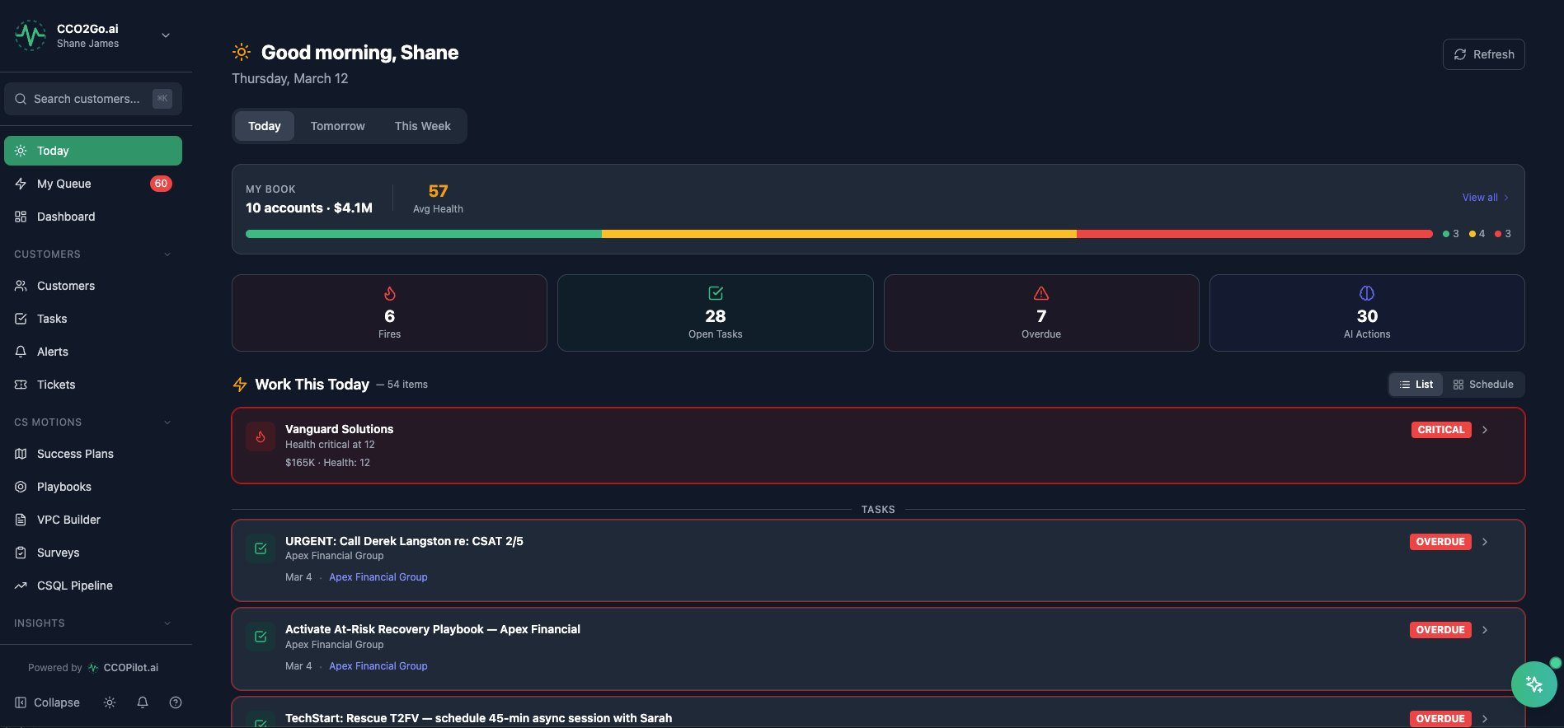
8:00 AM — The CSM Opens Their Day
OUTCOME: ZERO WASTED TIME
AI-prioritized daily queue — fires first, then tasks, then follow-ups
Portfolio health bar shows 10 accounts at a glance with color zones
30 AI actions queued overnight — the system worked while you slept
No digging through CRM, email, or Slack to figure out what to do today
Result: CSMs start working in 30 seconds, not 30 minutes
CCOPilot.ai
Notes:
CFO: 'This eliminates 45 min/day of CSM ramp-up time. That's 187 hours/year per CSM recovered.' VC: 'This is the Superhuman for CS — the first screen that makes CSMs love the tool.'

Slide 7
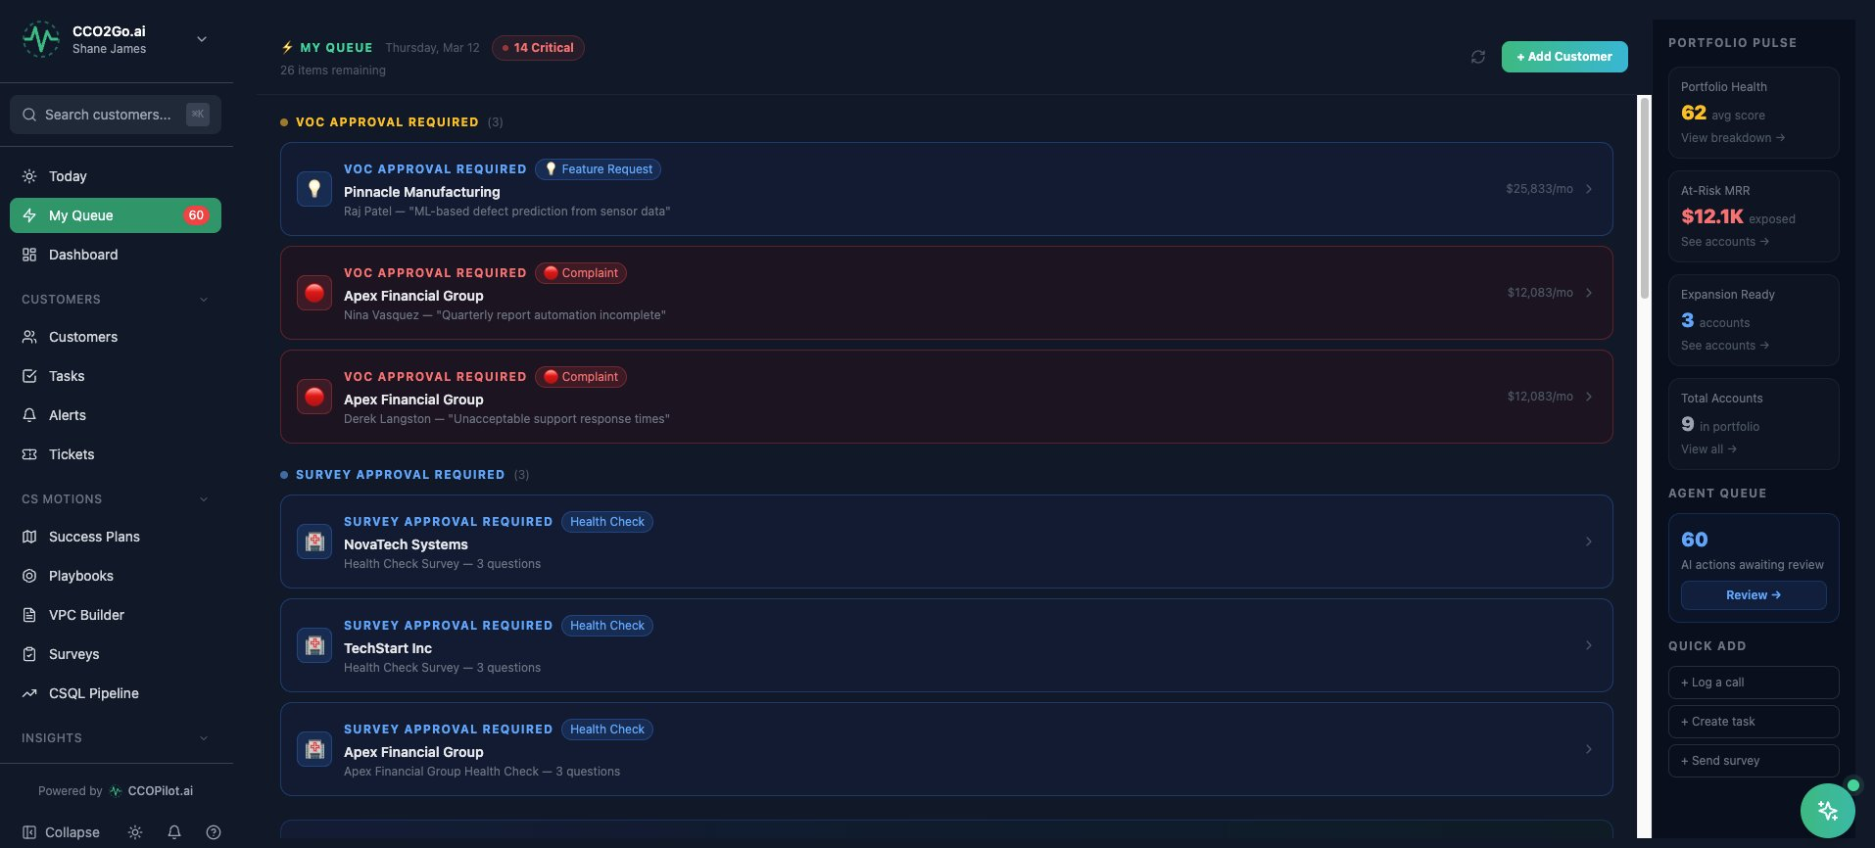
8:15 AM — The AI Queue: Approvals & Prioritization
OUTCOME: AI DOES THE TRIAGE
VOC approvals surface customer complaints with revenue context ($12K/mo exposed)
Survey approvals queue health check surveys for CSM review before sending
Portfolio Pulse sidebar — health score, at-risk MRR, expansion ready count
Agent Queue shows 60 AI-proposed actions awaiting human review
Result: CSM reviews and acts on AI recommendations, not raw data
CCOPilot.ai
Notes:
CFO: 'The AI does the analysis — the human approves and personalizes. That's 3x throughput per CSM.' VC: 'Human-in-the-loop AI is the right architecture for CS. Full autonomy scares buyers.'

Slide 8
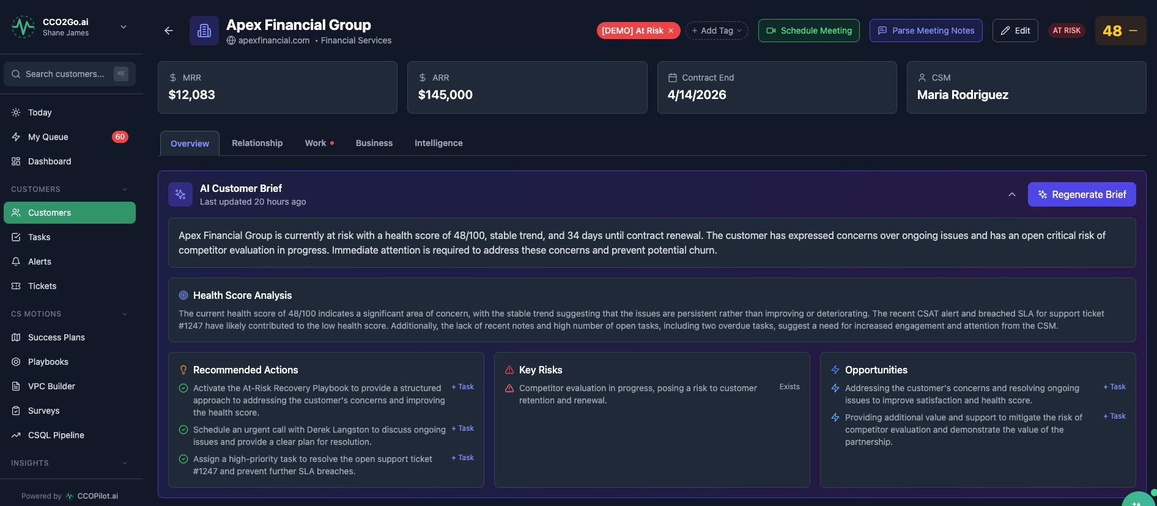
8:30 AM — Customer 360: AI Brief in 10 Seconds
OUTCOME: KNOW EVERYTHING INSTANTLY
AI Customer Brief auto-generates: health analysis, recommended actions, key risks, opportunities
One-click task creation from any AI recommendation ('+Task' buttons)
Health score 48/100, renewal in 34 days, competitor evaluation in progress
5 tabs: Overview, Relationship, Work, Business, Intelligence
Result: CSMs walk into every meeting fully prepared, every time
CCOPilot.ai
Notes:
CFO: 'This eliminates 3-5 hours/week of meeting prep per CSM.' VC: 'The AI brief is the wedge feature — once you use it, you can't go back to manual prep.'

Slide 9
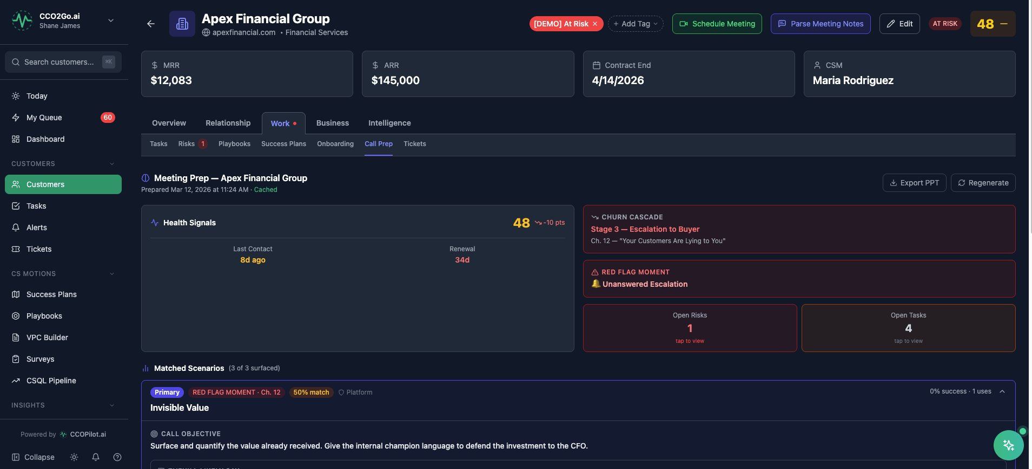
9:00 AM — AI Meeting Prep with Churn Cascade
OUTCOME: NEVER WALK IN BLIND
Auto-generated meeting briefing with health signals, churn stage, and red flags
Churn Cascade maps to book chapters — 'Stage 3: Escalation to Buyer'
Matched Scenarios from proven playbooks with success rates
Call Objective written by AI: 'Surface value received, defend the investment to CFO'
Export to PowerPoint for exec-level customer meetings
CCOPilot.ai
Notes:
CFO: 'Every customer conversation is now strategic, not reactive.' VC: 'The Churn Cascade is IP — it's from Shane's book and codified into the platform.'

Slide 10
Portfolio Intelligence
Three views for three roles — CSM, Manager, Executive

Slide 11
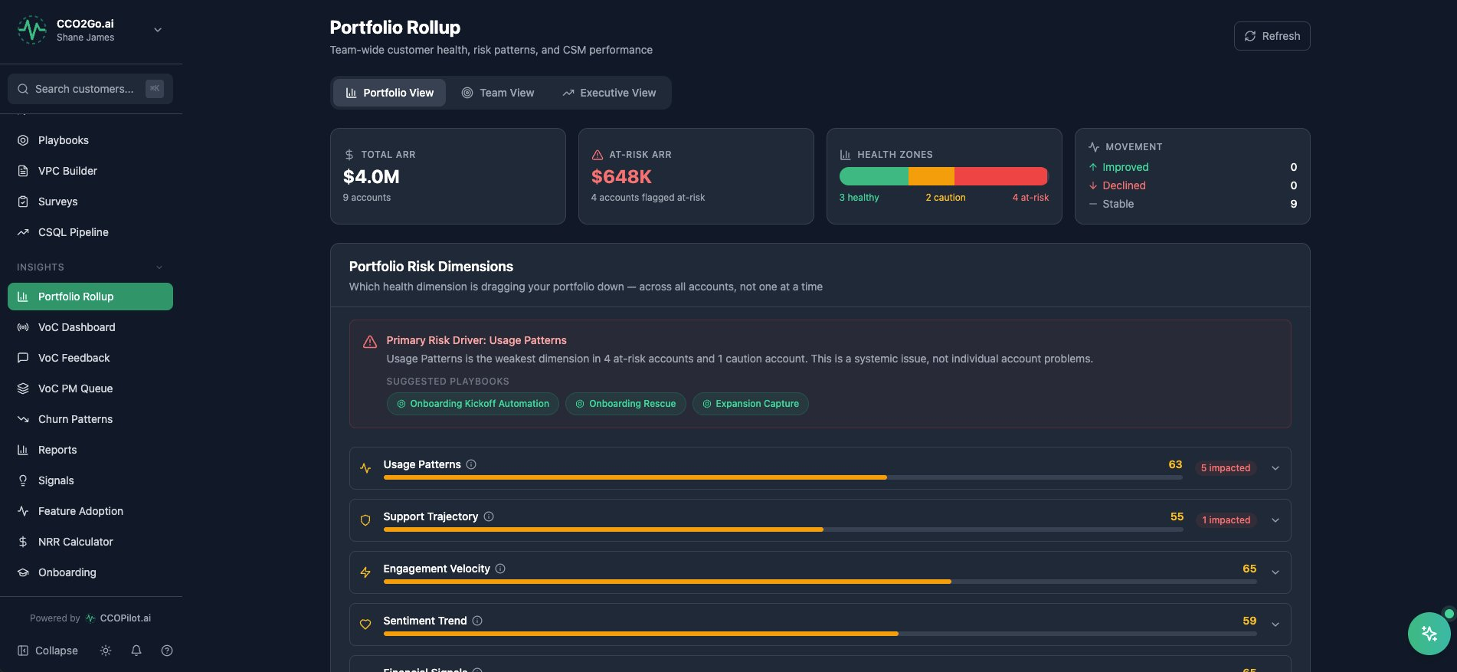
Portfolio View — Risk Dimensions at a Glance
OUTCOME: SEE THE FOREST, NOT JUST TREES
$4M ARR across 9 accounts with 6 health dimensions scored and ranked
Primary Risk Driver identified automatically — 'Usage Patterns' dragging portfolio down
AI suggests matching playbooks: Onboarding Kickoff, Rescue, Expansion Capture
Every dimension is clickable — drill into which accounts are affected
Result: Managers fix systemic problems, not individual fires
CCOPilot.ai
Notes:
CFO: 'This is the difference between fighting fires and preventing them.' VC: 'No competitor shows portfolio-level dimension analysis with auto-playbook matching.'

Slide 12
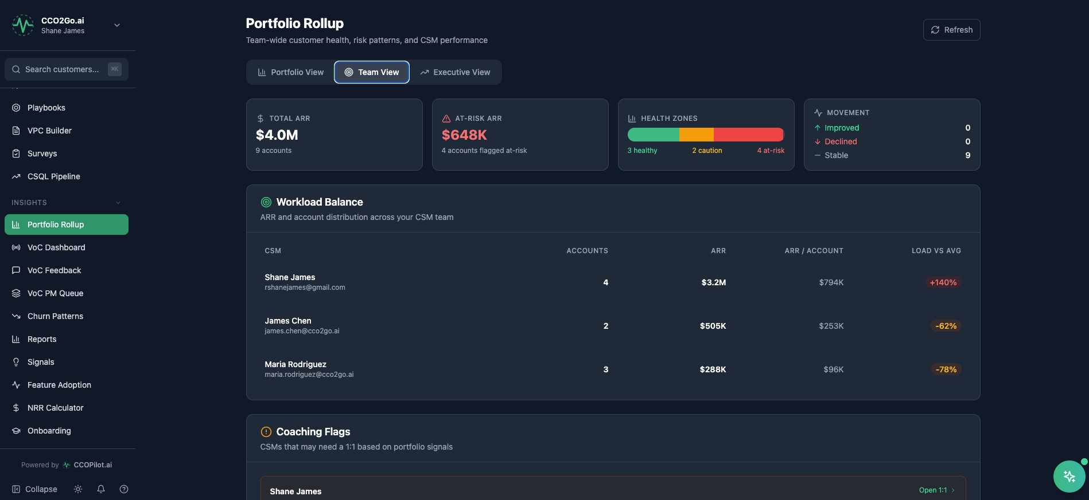
Team View — CSM Workload & Coaching Signals
OUTCOME: MANAGE THE TEAM, NOT JUST THE ACCOUNTS
ARR per CSM with load-vs-average comparison (+140%, -62%, -78%)
Coaching Flags auto-detected — which CSMs need a 1:1 this week
Click any CSM row to open their account list with health breakdown
AI-generated 1:1 agenda with coaching priorities and driving questions
Result: VP of CS knows exactly where to spend their time
CCOPilot.ai
Notes:
CFO: 'This prevents the #1 CS failure mode — overloaded CSMs silently drowning.' VC: 'Manager-level tooling is what gets the VP of CS to buy. CSM tools get adoption. Manager tools get the PO.'

Slide 13
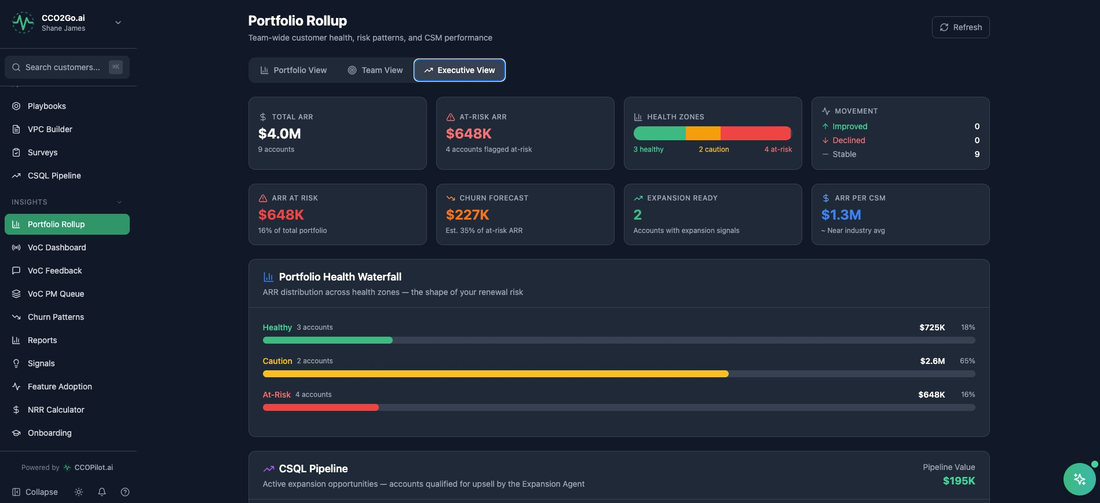
Executive View — CFO-Ready Portfolio Dashboard
OUTCOME: BOARD-READY NUMBERS IN ONE CLICK
ARR at Risk ($648K), Churn Forecast ($227K), Expansion Ready (2 accounts)
Portfolio Health Waterfall — ARR distribution across zones: 18% healthy, 65% caution, 16% at-risk
CSQL Pipeline with $195K in active expansion opportunities
Every stat card is clickable — drill into the accounts behind the number
Result: Board decks built from real data, not fabricated optimism
CCOPilot.ai
Notes:
CFO: 'This is the dashboard I've been asking CS to build for 3 years.' VC: 'Executive dashboards drive enterprise adoption and upsell to larger deals.'

Slide 14
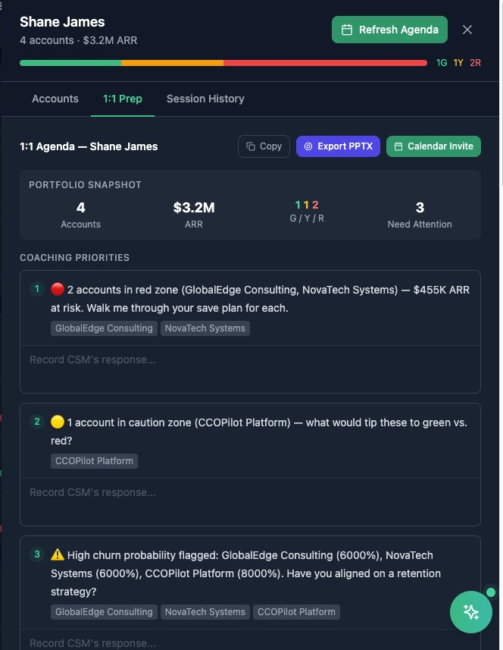
AI-Powered 1:1 Prep — Manager ↔ CSM
OUTCOME: COACHING THAT ACTUALLY IMPROVES PERFORMANCE
Portfolio Snapshot: 4 accounts, $3.2M ARR, 1G/1Y/2R health distribution
AI-generated coaching priorities: 'Walk me through your save plan for $455K at risk'
Session History tracks answers over time — did the CSM follow through?
Export to PPTX or send calendar invite directly from the platform
Result: Manager 1:1s become data-driven coaching sessions, not status updates
CCOPilot.ai
Notes:
CFO: 'This turns your CS managers from firefighters into coaches.' VC: 'Session history + answer comparison over time is a retention feature for the platform itself.'

Slide 15
20 AI Agents — Your Always-On CS Team
Working 24/7: monitoring health, detecting churn, scoring sentiment, qualifying expansion

Slide 16
AI That Works While Your Team Sleeps
20
24/7
60+
Human
Active Agents
Monitoring
Actions/Day
In the Loop
Churn, renewal, sentiment,
onboarding, expansion...
Every account scored
every day, not monthly
AI-proposed tasks, alerts,
and escalations
AI proposes, human
approves and personalizes
CCOPilot.ai
Notes:
CFO: '20 agents running daily means your 3-person CS team operates like a 10-person team.' VC: 'The agent architecture is the technical moat — each agent is a product feature competitors would need to build from scratch.'

Slide 17
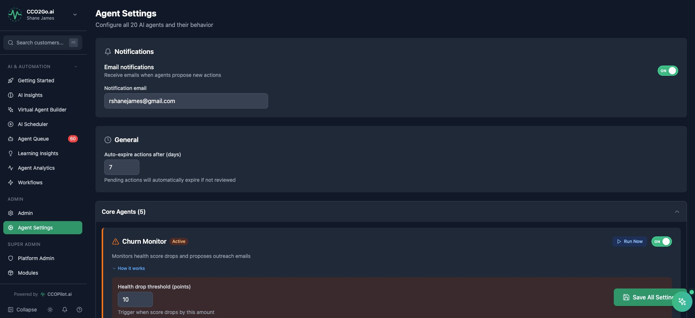
Agent Settings — Configure & Control Every Agent
OUTCOME: AI YOU CAN TUNE, NOT A BLACK BOX
20 agents organized by category: Core, Detection, Relationship, Expansion
Each agent has configurable thresholds (e.g., health drop = 10 points)
'Run Now' buttons for on-demand execution — don't wait for the schedule
'How it works' expandable section explains every agent's logic
Result: CS leaders control the AI — it doesn't control them
CCOPilot.ai
Notes:
CFO: 'Configurable thresholds mean you tune to your business, not a vendor's assumptions.' VC: 'Configurability is what makes this enterprise-ready vs. a toy.'

Slide 18
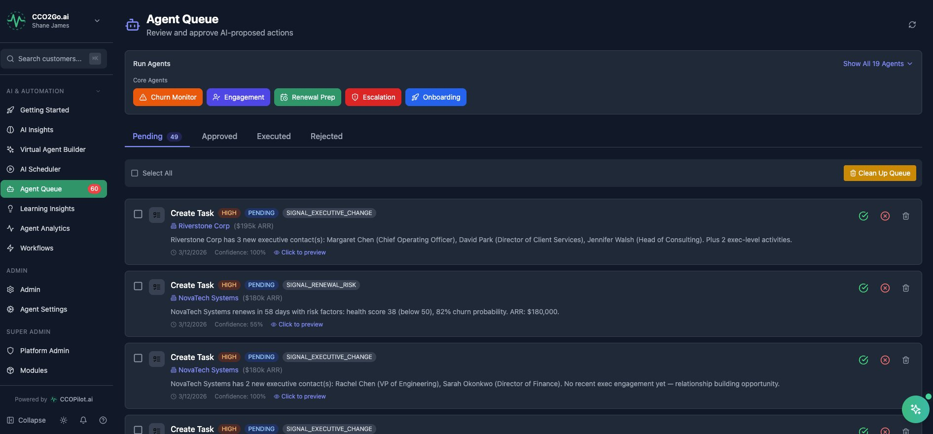
Agent Queue — Review & Approve AI Actions
OUTCOME: TRUST BUT VERIFY
49 pending AI-proposed actions with confidence scores (55%-100%)
Filter by agent type: Churn Monitor, Engagement, Renewal Prep, Escalation, Onboarding
Each action shows: customer, ARR, signal type, and recommended task
Approve, reject, or modify before execution — full human control
Result: AI scales the team without sacrificing judgment
CCOPilot.ai
Notes:
CFO: 'Your team reviews AI recommendations instead of building them from scratch — 3x throughput.' VC: 'This is the agent orchestration layer. It's Zapier for CS with AI brains.'

Slide 19
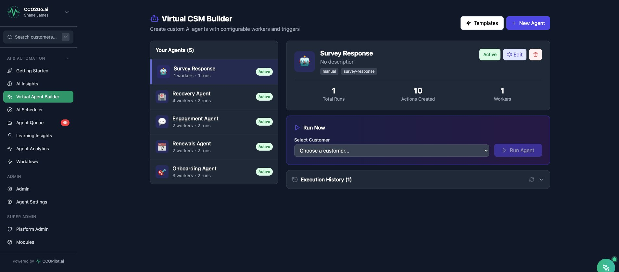
Virtual CSM Builder — Create Custom AI Agents
OUTCOME: BUILD YOUR OWN AI WORKFORCE
5 active custom agents: Survey Response, Recovery, Engagement, Renewals, Onboarding
Each agent has configurable workers and triggers
'Run Now' with customer selection for on-demand agent execution
Execution History tracks every action taken by each agent
Result: CS leaders build automation without engineering resources
CCOPilot.ai
Notes:
CFO: 'No-code agent creation means CS can automate without IT tickets.' VC: 'User-created agents = compounding platform value. More agents = higher switching costs.'

Slide 20
Voice of Customer Intelligence
From raw feedback to product decisions — with AI doing the analysis

Slide 21
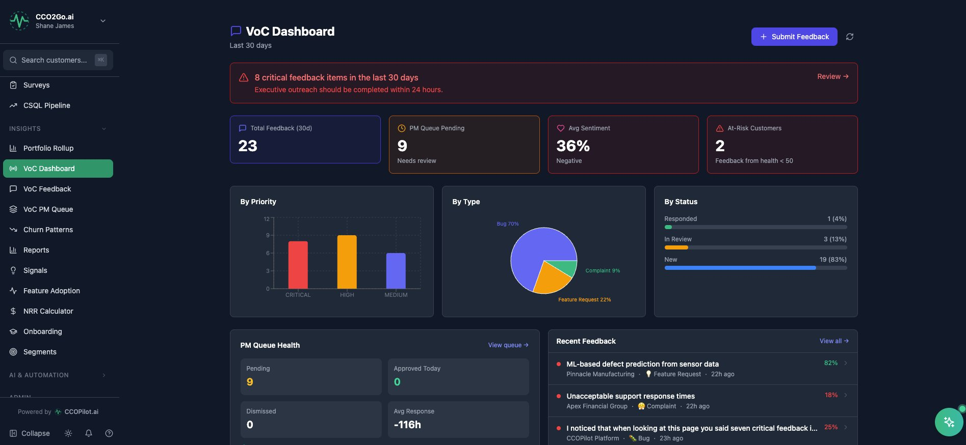
VoC Dashboard — Feedback Intelligence at Scale
OUTCOME: HEAR EVERY CUSTOMER, NOT JUST THE LOUDEST
23 feedback items in 30 days, broken down by priority (Critical/High/Medium)
Sentiment scoring: 36% negative — automatic alert threshold
PM Queue Health: 9 pending items for product team review
Feedback by Type: 70% bugs, 22% feature requests, 9% complaints
Result: Product team gets structured, prioritized customer voice — not raw Slack noise
CCOPilot.ai
Notes:
CFO: 'This replaces the broken telephone between CS and Product. Decisions are data-driven.' VC: 'VoC routing to PM is a unique differentiator — competitors stop at the CS dashboard.'

Slide 22
Proactive CS Motions
Success Plans, Playbooks, CSQL Pipeline, and Churn Pattern Detection

Slide 23
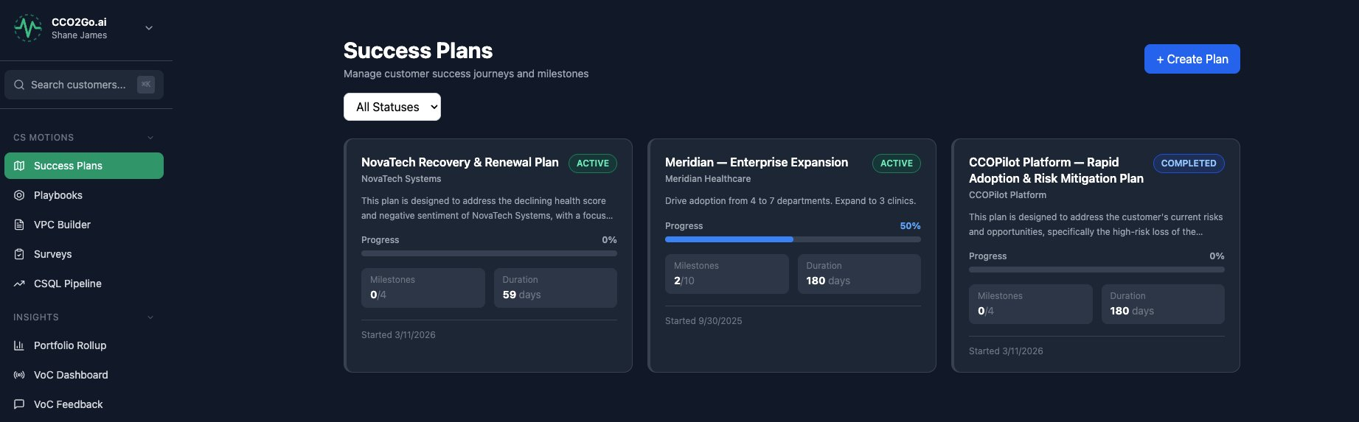
Success Plans — Structured Customer Journeys
OUTCOME: EVERY CUSTOMER HAS A PLAN, NOT JUST THE TOP 10
Active plans with milestone tracking (0/4, 2/10 completed)
Duration tracking: 59 days, 180 days — tailored to customer segment
Three plan types visible: Recovery, Enterprise Expansion, Rapid Adoption
Status tracking: Active, Completed — with start dates and progress bars
Result: No customer falls through the cracks — every account has a documented path to value
CCOPilot.ai
Notes:
CFO: 'Success plans are how you prove CS is executing, not just existing.' VC: 'Plan templates + milestone tracking = scalable CS operations for Series A-C companies.'

Slide 24
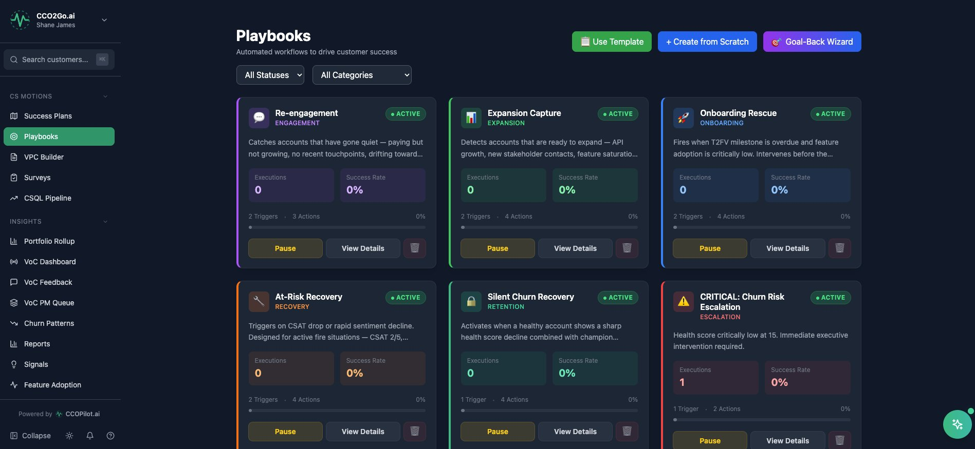
Playbooks — Automated Workflows for Every Scenario
OUTCOME: BEST PRACTICES THAT EXECUTE THEMSELVES
6 active playbooks: Re-engagement, Expansion Capture, Onboarding Rescue, At-Risk Recovery, Silent Churn, Critical Escalation
Each playbook has triggers, actions, execution count, and success rate
Goal-Back Wizard: start with the outcome, AI builds the playbook
Template library + create from scratch options
Result: Your best CSM's playbook runs for every CSM, automatically
CCOPilot.ai
Notes:
CFO: 'Playbooks encode institutional knowledge — when your best CSM leaves, the playbook stays.' VC: 'Template marketplace is a future monetization vector.'

Slide 25
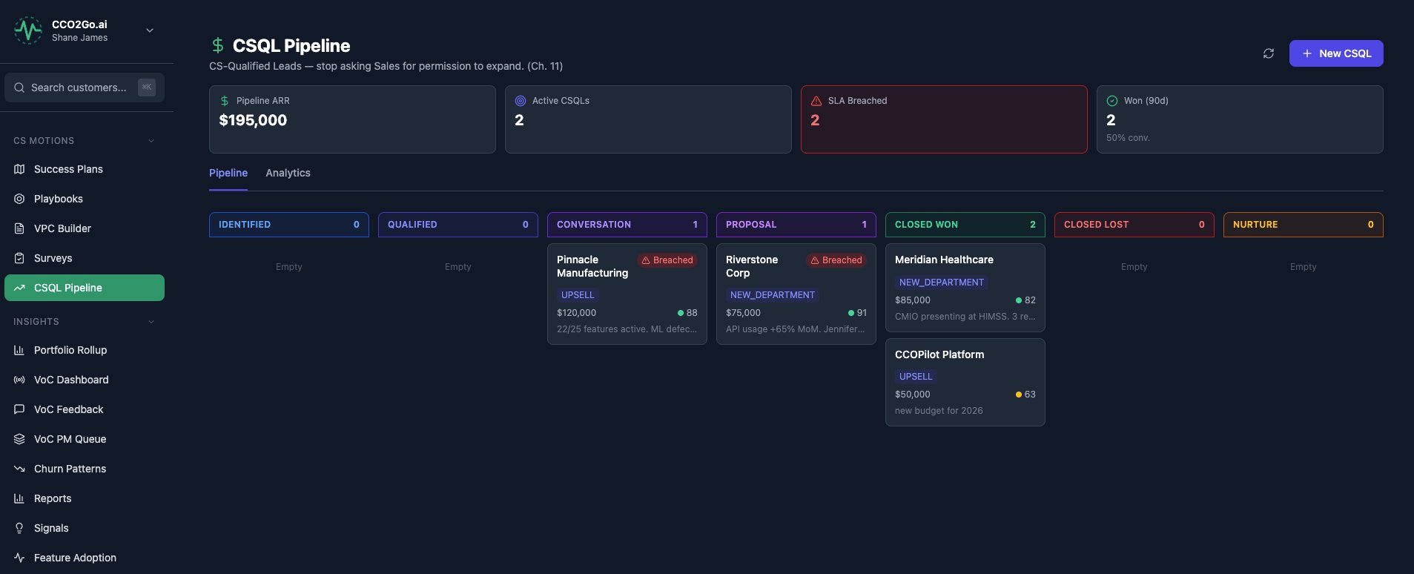
CSQL Pipeline — CS-Sourced Expansion Revenue
OUTCOME: CS BECOMES A REVENUE ENGINE
$195K in active pipeline ARR with 50% conversion rate on closed deals
Kanban board: Identified → Qualified → Conversation → Proposal → Won/Lost
48-hour SLA enforcement — breached opportunities are flagged in red
Qualification criteria: health above threshold + usage growth + triggering event
Result: CS sources expansion revenue with the same rigor as Sales sources new logos
CCOPilot.ai
Notes:
CFO: 'This is the pipeline that doesn't exist in most CS orgs. It's found revenue.' VC: 'CSQL pipeline is the wedge into RevOps — it makes CS indispensable to the revenue motion.'

Slide 26
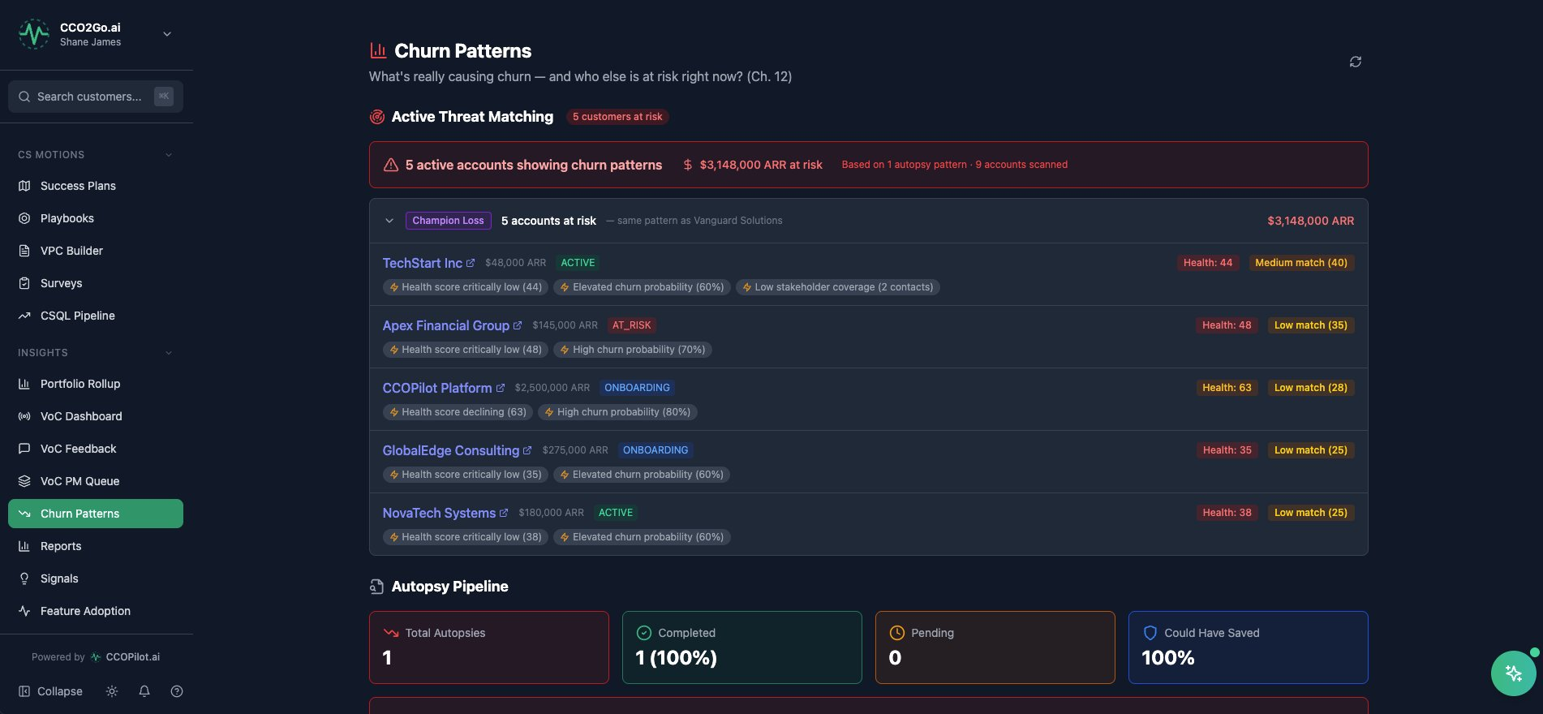
Churn Pattern Detection — Predict Before It Happens
OUTCOME: SAVE ACCOUNTS BEFORE THEY LEAVE
Active Threat Matching: 5 accounts showing churn patterns, $3.1M ARR at risk
Champion Loss pattern detected across 5 accounts with health and match scores
Autopsy Pipeline: completed churn analysis feeds back into pattern detection
'Could Have Saved: 100%' — the system learns from every churned account
Result: Churn prediction based on real patterns, not guesswork
CCOPilot.ai
Notes:
CFO: '$3.1M at risk identified proactively — even saving 30% of that pays for the platform 10x over.' VC: 'Churn autopsy feedback loop is a data flywheel — gets smarter with every customer.'

Slide 27
Onboarding & Adoption Intelligence
Time to First Value tracking, feature adoption monitoring, and early warning detection

Slide 28
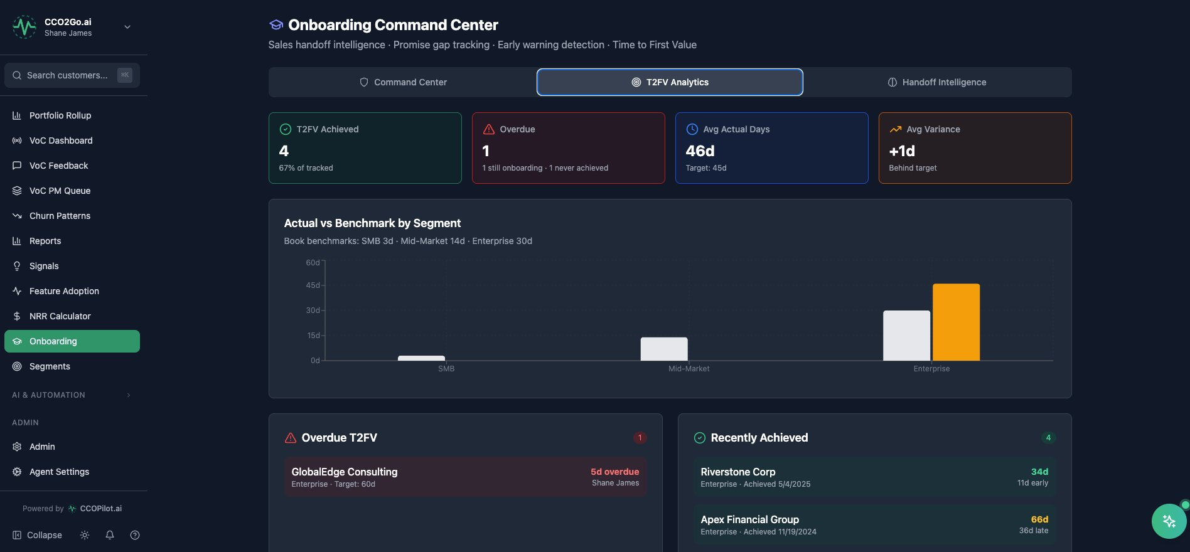
Onboarding Command Center — T2FV Tracking
OUTCOME: CUSTOMERS HIT VALUE FASTER
T2FV Analytics: 4 achieved, 1 overdue, avg 46 days (target: 45d)
Segment benchmarking: SMB 3d, Mid-Market 14d, Enterprise 30d
Overdue T2FV alerts with variance tracking (+1d behind, 5d overdue)
Recently Achieved list with early/late indicators (11d early, 36d late)
Result: Onboarding failures caught at day 5, not day 90
CCOPilot.ai
Notes:
CFO: 'Fast T2FV = lower churn at renewal. Every day saved in onboarding compounds into retention.' VC: 'T2FV is the metric investors care about most — it predicts everything downstream.'

Slide 29
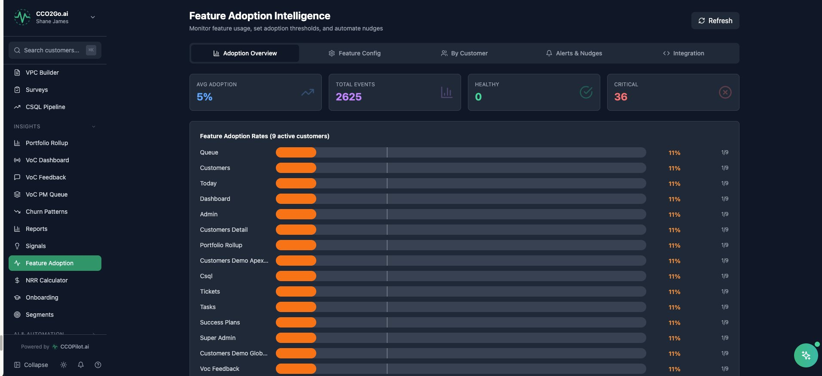
Feature Adoption Intelligence
OUTCOME: KNOW WHAT CUSTOMERS ACTUALLY USE
2,625 total feature events tracked across 9 active customers
Per-feature adoption rates with visual bars — instantly see what's sticky
Healthy vs. Critical segmentation: 0 healthy, 36 critical adoption gaps
Alerts & Nudges tab: auto-nudge customers toward underused features
Result: Product and CS align on what drives retention vs. what's shelfware
CCOPilot.ai
Notes:
CFO: 'Feature adoption directly correlates with renewal probability. This is leading indicator data.' VC: 'Product-led growth meets CS — adoption data is the bridge.'

Slide 30
Support Ticketing & Integrations
Built-in ticketing system plus deep integrations with your existing stack

Slide 31
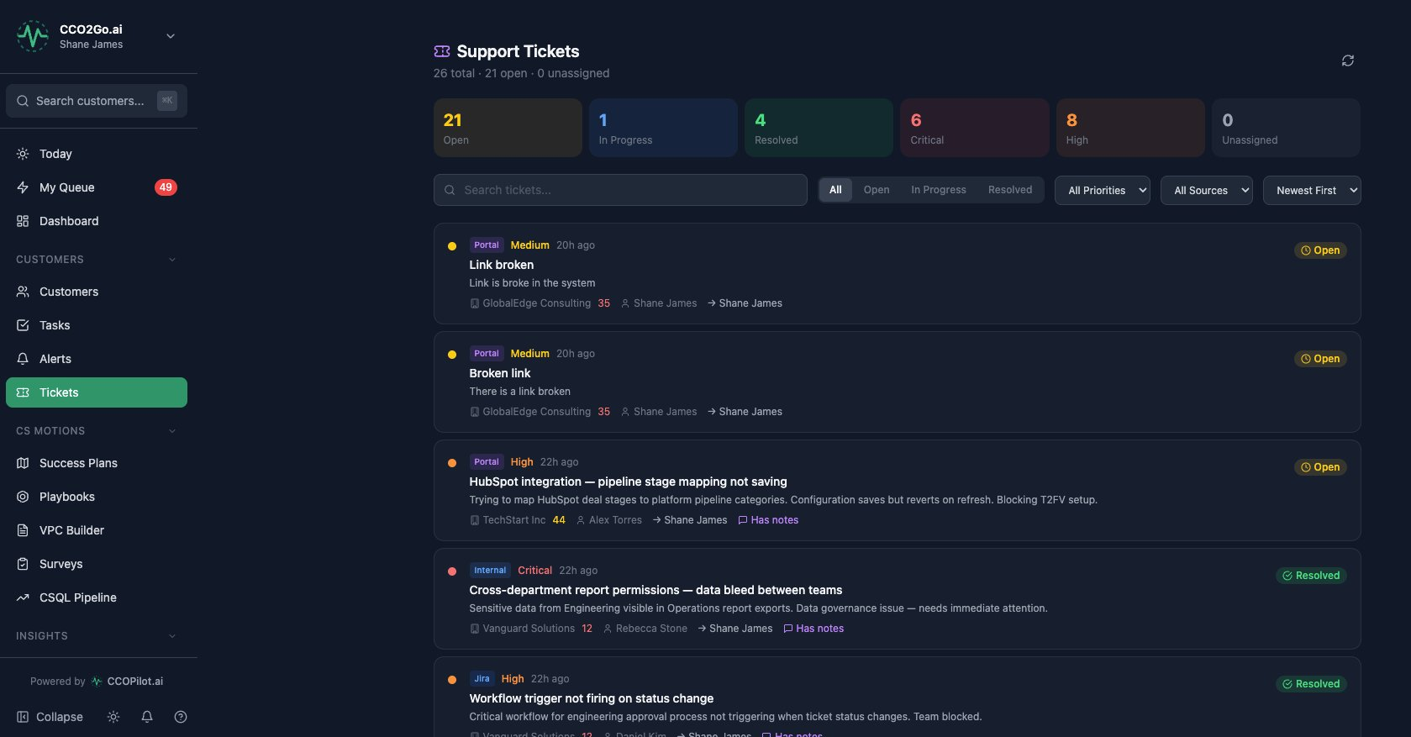
Support Tickets — Unified in the CS Platform
OUTCOME: SUPPORT DATA FEEDS CS INTELLIGENCE
26 total tickets with priority, source (Portal/Internal/Jira), and status tracking
6 critical tickets flagged — AI escalation agent monitors these automatically
Each ticket links to customer health score (35, 44, 12 visible)
Multi-source: Portal submissions, internal reports, Jira sync
Result: Support isn't a silo — ticket patterns feed health scores and churn prediction
CCOPilot.ai
Notes:
CFO: 'This eliminates the Zendesk license and connects support data to revenue risk.' VC: 'Unified ticketing is table stakes but necessary — it completes the data picture for AI agents.'

Slide 32
Integrations — Connect Your Entire Stack
CCOPilot connects to the tools your team already uses
Gmail
Email sync + AI sentiment analysis on every customer email
Slack
Notifications and alerts delivered where your team works
Google Calendar
Meeting sync for call prep and activity tracking
Stripe
Revenue data for ARR tracking and expansion signals
Zoom
Auto-match meetings to customers with 85% confidence threshold
Zendesk
Support ticket ingestion for health score calculation
HubSpot
CRM sync — contacts, deals, and activity bidirectional
QuickBooks / FreshBooks
Financial data for SMB customer segments
Salesforce
Enterprise CRM integration for larger deployments
Microsoft 365
Calendar and email for Microsoft-shop customers
Jira
Issue sync — ticket patterns feed churn prediction
CCOPilot.ai
Notes:
CFO: 'One platform replaces 5-6 tools. Net cost reduction even before productivity gains.' VC: 'Integration breadth is the land-and-expand strategy — each integration deepens lock-in.'

Slide 33
The Business Case — ROI in 90 Days
3-5x
40%
$195K
5→1
CSM Productivity
Churn Reduction
Pipeline Created
Tool Consolidation
AI handles triage,
prep, and monitoring
From 22% to 7%
proven track record
CS-sourced expansion
revenue in 90 days
One platform replaces
Gainsight, Zendesk, etc.
CCOPilot.ai
Notes:
CFO: 'At $500/user/month with 5 CSMs, you're at $30K/year. If you save ONE $145K account, ROI is 4.8x.' VC: '$500/user is the sweet spot — cheaper than Gainsight, more AI than ChurnZero, built for the SMB/mid-market gap.'

Slide 34
Ready to See It Live?
Book a personalized demo with your actual customer data
Shane James
Founder & CEO — CCOPilot.ai
shane.james@cco2go.ai | (813) 666-8427
www.ccopilot.ai
25+ years C-suite CS leadership • 2 Fortune 500 acquisitions (IBM, ServiceNow) • Author: 'Your Customers Are Lying to You'

