Slide 1
Slides 1
James Adams

Slide 2
Test 1
Text here

Slide 3
Section

Slide 4
Columns
Put your contents in column code blocks
To make them show up in two columns

Slide 5
Types of fruit

Slide 6
Types of fruit
Apples
Pears

Slide 7
Apples
Are green
Taste nice

Slide 8
Comparison
Title one
Text
Title two
Text

Slide 9
Statistical test
Decision
An opinion or conclusion about a population parameter formed on the basis of incomplete information
Sample data

Slide 10
Probability is a numerical measure that describes the likelihood that an event will occur

Slide 11
Sampling Distribution
A sampling distribution is the distribution of sample statistics of different samples of the same size from the same population
A sampling distribution of the mean shows us how the sample mean varies from sample to sample

Slide 12
Statistic vs. Parameter (1)
We use a statistic from a sample as a point estimate for a population parameter
We use the sample mean (a statistic) to estimate the population mean (a parameter)
One parameter
Potentially many sample statistics
Notes:
Point estimates will not match population parameters exactly, but they are our best guess, given the data
Using a single number (sample mean) to estimate another single number (population mean)

Slide 13
Statistical hypotheses
Two competing explanations
Just chance
Alternative explanation
Null
Hypothesis H₀
Alternative
Hypothesis H_{a}

Slide 14
p-values and supporting hypotheses
p > .05
p < .05
Null
Hypothesis H₀
Alternative
Hypothesis H_{a}
not significant
significant
do not reject
accept

Slide 15
true
n = 50
TRUE
TRUE
FALSE
n = 10
TRUE

Slide 16
Confidence interval
- +
Margin of error
Margin of error
Confidence interval

Slide 17
Estimation
Interval estimation.3
Point estimation
Interval estimation .5

Slide 18
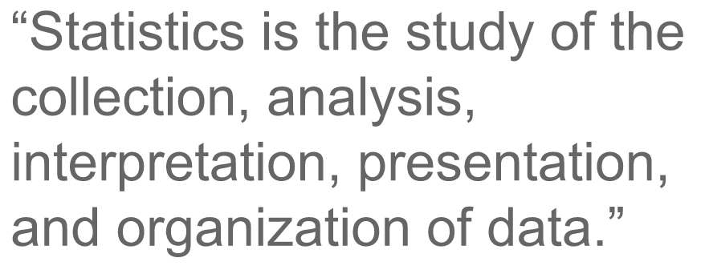


Slide 19
Q: Margin of Error
Q: Margin of error
A margin of error is half the width of confidence interval?
TRUE
FALSE
Notes:
The higher the variability in the statistic from sample to sample, the higher the uncertainty

Slide 20
Q: SE and uncertainty
Q: The SE and uncertainty
As the standard error of a point estimate increases, there will be:
a) Higher uncertainty
b) Lower uncertainty
Notes:
The standard error measures variability of the statistic from sample to sample. The more the statistic varies from sample to sample, the higher the uncertainty.

Slide 21
Q: Hypothesis testing
Q: Hypothesis testing
A p-value is the chance of getting a statistic as extreme as that observed, if the null hypothesis is ___
The smaller the p-value, the greater the evidence ______ null hypothesis
Results are statistically significant if the p-value is less than the _________ level
If the p-value < . ___ , then the alternative hypothesis is supported, otherwise you should _____ null hypothesis
You can/can’t prove the null hypothesis

Slide 22
Your task
Discuss with person next to you some ideas
Decide which is the best one
Do for several cases

Slide 23
Plan
Types of fruit
Basket makers

Slide 24
Section transition

Slide 25
Basket makers
Weavers
Strawmen

Slide 26
Plan
Types of fruit
Basket makers

Slide 27


Slide 28
See you next week

Slide 29
Example

Slide 30
Interesting quote
Author of quote

Slide 31
Two in the bush are worth three in the hand
TRUE
FALSE

Slide 32




http://www.flaticon.com/

